Slide 1
MEDA :
Your Medicine Assistant
By - 0502 UMDinos

Slide 2
Table of Contents
MEDA Logo
Introduction
Objectives
Business Case
Dataset Description
Methodology
Our Fine-tuned model VS ChatGPT3.5
Market Opportunities
Future Scope
Conclusion

Slide 3

Logo (Created by GenAI)

Slide 4

What is MedA?
AI symptoms checker
Leveraging a LLM
Input: symptoms as a message
Output: medications that align to the specific conditions of a patient
Image created by GenAI
Notes:
The "MedAI" tool serves as a sophisticated symptom checker that leverages a large language model (LLM) designed specifically for medical assistance. By inputting symptoms, users can access tailored recommendations for medications that align with their specific health conditions. This capability aids individuals in determining the urgency of their medical needs—whether to seek immediate healthcare intervention or manage their condition at home with the appropriate medications. This approach not only streamlines the process of identifying suitable treatments but also enhances patient autonomy in managing their health effectively.

Slide 5
Objectives
1. Enhance Clinical Decision Support:
Provide AI-driven support to medical professionals by recommending specific drugs based on detailed descriptions of medical conditions, thereby aiding in clinical decision-making.
2. Streamline Professional Workflows: Develop a conversational interface that allows medical professionals to quickly and efficiently obtain drug recommendations, facilitating better patient management and treatment planning.
3. Train with Realistic Medical Scenarios:
Utilize a structured dataset to simulate real-world medical consultations, ensuring the AI accurately interprets complex medical descriptions and responds appropriately.
4. Ensure Accuracy and Reliability:
Fine-tune the conversational model to deliver accurate and reliable medication suggestions, increasing trust among medical professionals and enhancing patient care outcomes.
Notes:
Objective 1: Enhance Clinical Decision Support
Our first goal is to enhance clinical decision-making by using AI to provide precise medications recommendations based on detailed medical analyses.
Objective 2: Streamline Professional Workflows
We also aim to streamline healthcare workflows, enabling professionals to access vital information quickly through a conversational AI interface.
Objective 3: Train with Realistic Medical Scenarios
MEDA is trained with realistic medical scenarios to understand and respond accurately to complex medical conditions.
Objective 4: Ensure Accuracy and Reliability
Finally, we continuously refine MEDA to ensure it remains a reliable and accurate resource in clinical settings.

Slide 6
Business Case
Cost Efficiency
Accuracy and Patient Safety
Improved Patient Outcomes
Competitive Differentiation
Enhanced Data Utilization
Regulatory Compliance
The business case outlines the tangible benefits and strategic advantages that support the implementation and scaling of MEDA in the healthcare industry.

Slide 7
Dataset Description
Content Overview:
Contains data on drugs, the medical conditions they treat, condition descriptions, and side effects.
Data Structure:
Organized into key columns such as drug_name, medical_condition, medical_condition_description, and side_effects.
Application:
Utilized to train a conversational AI to simulate a pharmaceutical assistant, providing drug recommendations based on user inquiries.
Format and Processing:
Initially in CSV format, processed into JSONL format for efficient line by line handling in AI model training.

Slide 8

Methodology: Four Steps to Fine-Tune Chat Models
Setting up the dataset
Data Preparation
Fine-Tuning
Inference

Slide 9

Setup
Installing the latest version of OpenAI Python package
Importing the libraries (json, openai, os, pandas, pprint)
Establishing the client API key
Importing the data to the notebook
Notes:
We begin by installing the latest version of the OpenAI Python package. This library is essential as it provides us with the tools to interact with OpenAI’s API.
Next, we import necessary libraries like JSON for data handling, OpenAI for API interactions, OS for operating system operations, Pandas for data analysis, and pprint for making the output more readable.
We establish a connection to OpenAI's services by setting up the client API key. This key is crucial as it authenticates our requests to the API, ensuring secure and private access.

Slide 10
2. Data Preparation
Each training example is a simple list of messages with final entry being the completion that the model will produce
4096 token limit for each example
Train, validate, and test the data
Validation is optional to make sure the model does not overfit the training model
Importing the data to the notebook
Notes:
Each training example is a user-inputted symptom description followed by the AI’s recommended medication. This format teaches the model realistic conversational exchanges.
We limit each example to 4096 tokens to balance detail with processing efficiency, ensuring the model remains responsive and accurate without getting overwhelmed.
We follow a three-phase approach: training the model on known data, optionally validating to prevent overfitting, and testing to assess performance on new data.
Data is imported using standard Python libraries, ensuring it’s ready for training while maintaining its integrity.

Slide 11
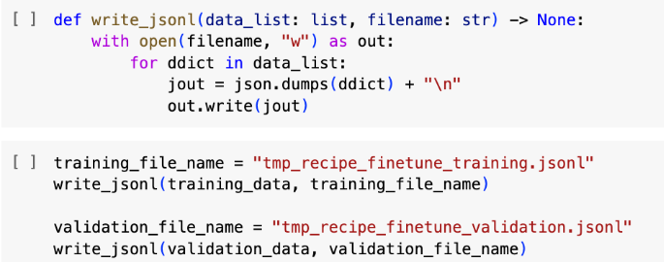
Code Example
Saving the data as .jsonl files, where each line is one training example conversation
Notes:
This code shows how we save our training data. We use a format called JSONL, which means each line in the file represents one training example.
The function write_jsonl takes a list of data and a filename. It opens the file, writes each piece of data as a separate line, and ensures it’s properly formatted in JSON, which is a common data format that's easy to read and use.
We use this function to create two files: one for training our model and another for validation. This helps us organize our data neatly and makes it easier to manage during training and testing phases.
By keeping our data organized and easy to access, we streamline the process of training and validating our model, ensuring reliability and efficiency.

Slide 12
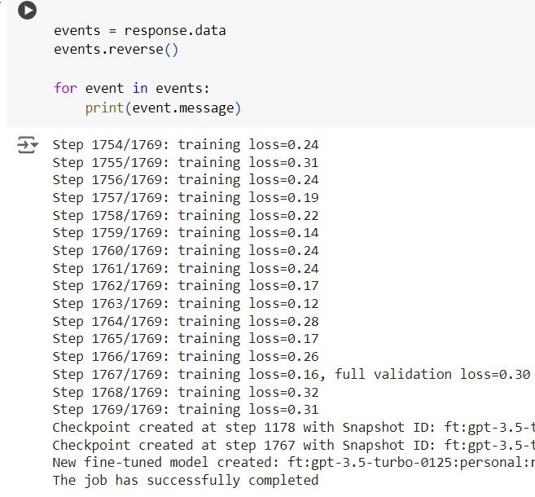
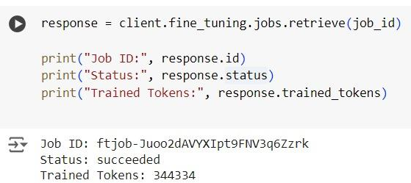
3. Fine-Tuning
Check job status
Status: succeeded
Fine-tuned model id from the job: ft:gpt-3.5-turbo-0125:personal:recipe-ner:9K4Whg5B
Notes:
We monitor the training process through a status check to ensure everything is running smoothly. A successful status means our model is learning without any issues.
This part of the code retrieves the job's details like the Job ID and how many tokens the model has been trained on. These tokens represent the data pieces the model has learned from.
The log shows the training progress, including the training loss at each step. Lower training loss indicates better learning by the model. We also ensure there are checkpoints where we can save the model’s state, which is crucial for long training processes.
At the end of the fine-tuning, we have a new model ID, which is a version of our AI specifically tailored to our needs. This model ID is used whenever we need the AI to generate responses.

Slide 13
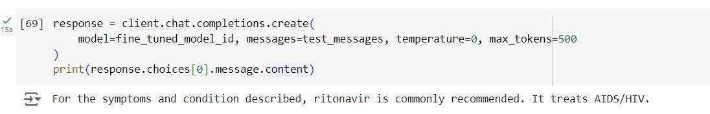
4. Inference
Call Chat.Completions with fine-tuned model
Notes:
Inference is the stage where our model puts what it has learned into practice. It uses the fine-tuned model to predict outcomes based on new data.
Here, we use the Chat.Completions function with our model to generate a response. We provide a set of test messages as input, and the model returns what it thinks is the best response based on the training it received.
In this example, for symptoms described in the test messages, the model recommends a medication. It shows the model not only understands the query but also provides medically relevant advice, like suggesting ritonavir for treating AIDS/HIV.

Slide 14
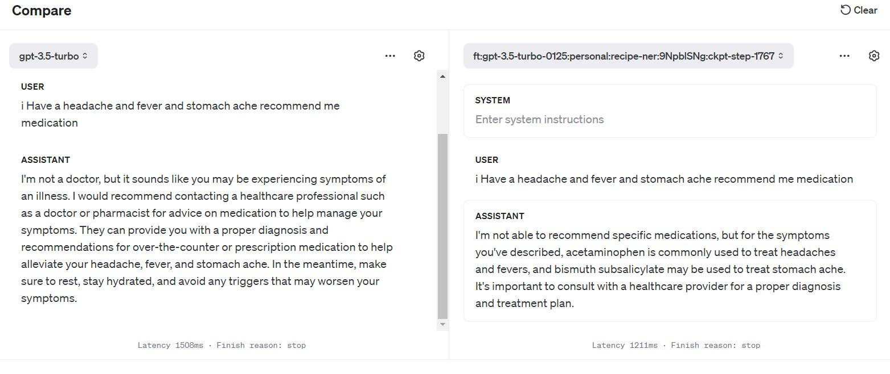
Our Fine-tuned model VS ChatGPT3.5

Slide 15
Market Opportunities
Support for Regulatory Compliance and Standardization
Integration with Healthcare
AI Growth
Scalability Across Healthcare Systems and Regions
Operational Efficiency in Clinical Settings
Educational Tool for Continuous Medical Learning
Enabling Remote Diagnoses in Telemedicine
Notes:
Rising Demand for AI in Healthcare: The increasing integration of artificial intelligence in healthcare presents a significant opportunity for tools that enhance diagnostic accuracy and treatment efficacy, driving demand for advanced AI solutions.
Efficiency in Clinical Settings: Medical professionals seek tools that reduce time spent on administrative tasks and improve clinical workflows. An AI tool that provides quick and accurate drug recommendations can greatly enhance operational efficiency.
Support for Telemedicine: With the growth of telemedicine, there's a growing need for tools that support remote diagnosis and treatment recommendations. This AI tool can be a vital component in telehealth platforms, providing critical support in virtual care environments.
Continued Professional Education: The tool can also serve as an educational platform for medical professionals, keeping them updated on the latest medications and treatment protocols, thus fostering continuous learning and professional development.
Expansion into New Markets: Initially targeted at individual clinics and hospitals, the tool has the potential to expand into larger healthcare systems and different geographic regions, further increasing its market reach.
Compliance and Standardization: As regulatory bodies push for higher standards in patient care and data handling, tools that help medical professionals stay compliant and standardize care protocols will be increasingly valuable.

Slide 16

Future Scope
Expansion to Additional Specialties
Integration with Electronic Health Records
Multi-Language Support
Advanced Predictive Analytics
Mobile and Wearable Integration
AI Training with Real-time Data
Image created by GenAI
Notes:
Symptom Checker: Users could enter their symptoms into the app, and it would provide a list of possible conditions that match those symptoms. This could help patients decide whether they need to seek medical care immediately or monitor their symptoms at home.
Medication Management: The tool could remind patients when to take their medications, provide information on potential side effects, and advise on drug interactions. This is especially useful for patients with chronic conditions who take multiple medications.
Virtual Consultation: Integration with telemedicine platforms could allow users to consult with healthcare providers directly through the app. Providers could review the symptoms and information provided by MedAI to prepare for and guide the consultation.
Health Education: The app could provide educational content tailored to the user’s symptoms or conditions. This could include advice on home care, when to seek professional help, and how to prevent related health issues.
Triage and Urgency Assessment: By assessing symptoms, the tool could help triage patients, suggesting whether they need emergency care, can wait for a regular doctor's appointment, or can manage their symptoms at home.
Integration with Healthcare Systems: The tool could be integrated with electronic health records (EHR), allowing it to access a patient’s medical history and make more accurate recommendations based on past health issues and treatments.
Research and Data Collection: With user consent, the app could collect data on common symptoms and their outcomes, helping healthcare researchers identify trends, potential outbreaks, and effectiveness of treatments.
Support for Healthcare Providers: Clinicians could use the tool to quickly check potential diagnoses and treatments, helping them make decisions or reminding them of less common conditions they might not immediately consider.

Slide 17
Conclusion
"MedA" app integrates medical expertise with AI for precise medicine recommendations based on symptoms
Enhances patient autonomy and supports healthcare providers with efficient, targeted care
Promises more personalized, accessible, and effective healthcare solutions (future goal)
Crucial for improving health outcomes and optimizing medical practices globally (future goal)

Slide 18

Thank You for Listening!
Image created by GenAI

