Slide 1
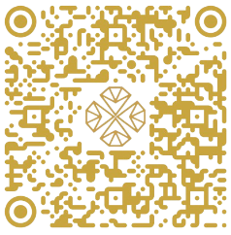
जय भिक्षु
श्री महावीराय नमः
जय महाश्रमण
TAX INVOICE
RISHAB GEMS
Invoice Details
Exquisite Diamond Jewellery
RG-2025
Address: Holding-221, 123A, SANGAM COMPLEX, C18, SOUTH DUMDUM, N - 24 PGS
_ /_ _ /_ _ _ _
Phone: +91 9231877565
_ _ /_ _ /_ _ _ _
Email ID: manishdugar48@gmail.com / rishabgemsandjewellery@gmail.com
Manish Dugar
Trade License No.: 0917P1236622411294
Client Information
Payment Method
Rishab Dugar
CASH
₹
rishabdugar@dugargemsanddiamonds.com
NEFT / IMPS
₹
UPI
9330549405
₹
CHEQUE
123 A Sarat Chatterjee Road Sangam Complex Lake Town Block C Flat 18
₹
No. | Item Description | Weight | Rate (₹) | Amount (₹)
Billing Summary
Banking & Payment Info
Particulars | Amount (₹)
Subtotal
Rounding (±)
NET PAYABLE | ₹
RISHAB GEMS
Bank Account: 6450811814
IFSC Code: KKBK0006605
Phone Number: +91 9231877565
UPI ID: rishabgems@kotak
Eighty Seven Crores Sixty Five Lakhs Forty Three Thousand Two Hundred Ten only
Terms & Conditions
All transactions are governed under Kolkata jurisdiction.
Interest @ 18% per annum will be charged if payment is delayed beyond 30 days.
Goods once sold will not be returned or exchanged.
Client Signature
For RISHAB GEMS
Trade License - 0917P123662241129
(Authorized Signatory)
___________________
___________________
Scan to Verify

