Slide 1
Final Project: Climate Anomalies and Wildfires in the Western U.S.
by Ashmita Duggal

Slide 2
Climate Anomalies and Wildfire Activity (2000–2023)
Focus: CA, AZ, OR wildfires and climate trends
Goal: Do hotter, drier years = more wildfires?

Slide 3
Data Sources
NOAA: Temperature and precipitation anomalies
NIFC: Total US wildfire counts (2000–2023)
Merged by year for analysis

Slide 4
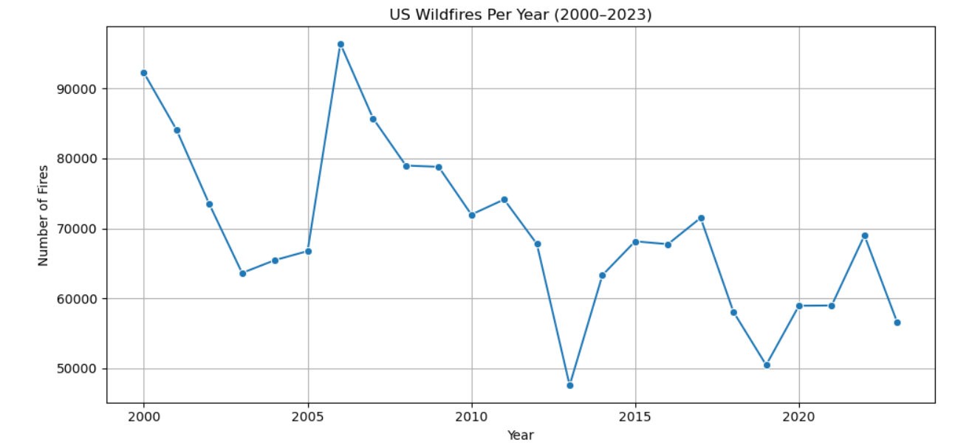
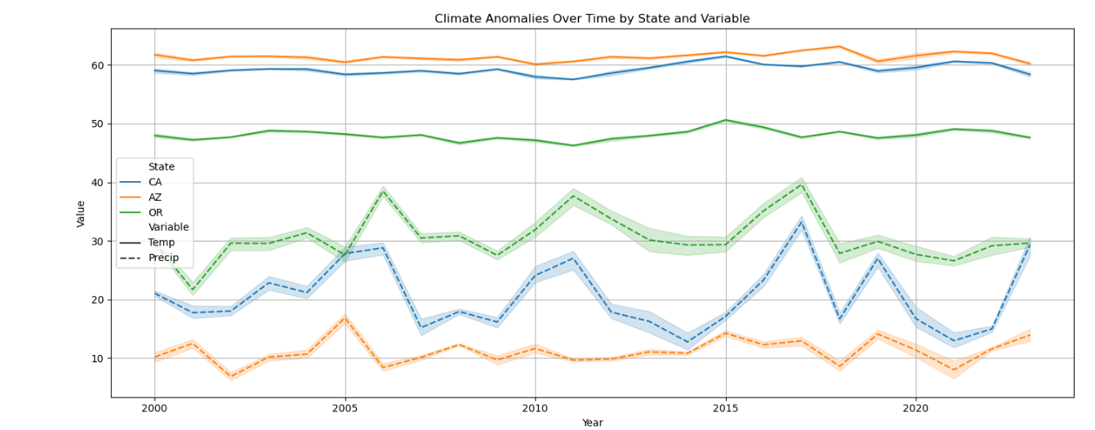
Wildfire & Climate Trends
Wildfire counts slightly decreased since ~2006
Temperatures increasing across all 3 states
Precipitation anomalies more variable

Slide 5
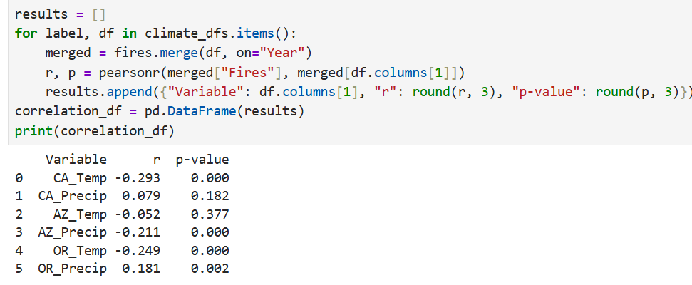
Correlation Results
Weak negative correlation: temperature vs fire count
AZ_Precip shows weak negative correlation (r ≈ -0.21)
Some results significant, but effect sizes are small

Slide 6
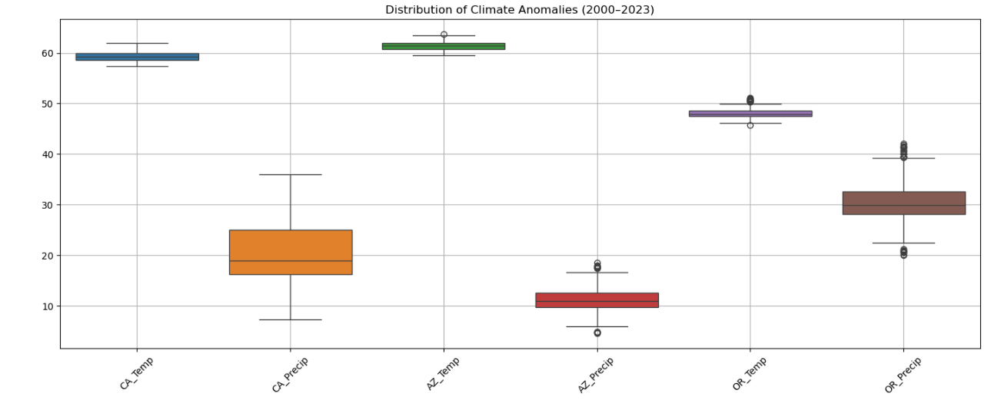
Climate Variability
CA shows widest variation in temp & precip anomalies
More extremes may explain fire risk
Boxplots visualize climate stress by state

Slide 7
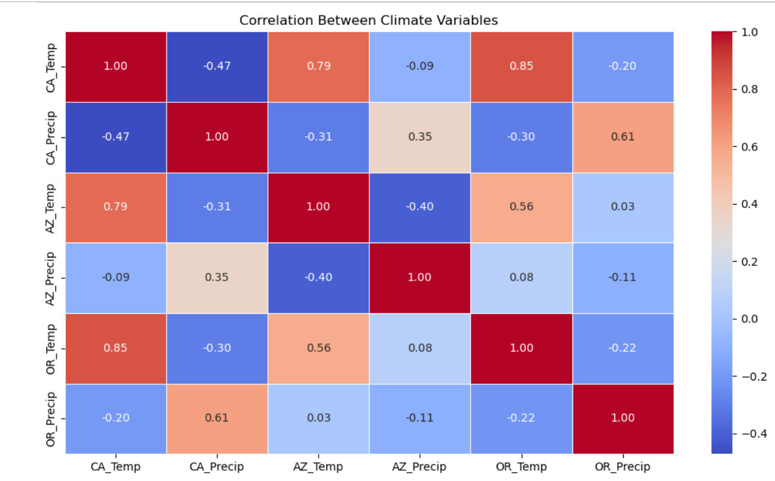
Climate Relationships
Temp and precip negatively correlated in most states
Hotter years also tend to be drier
Compound stress may impact wildfire behavior

Slide 8
Interpretation
Wildfire count not solely driven by climate
Fire suppression, policy, and land use also matter
Severity vs count: more fires doesn’t mean worse fires

Slide 9
Conclusion
Climate plays a role, but it’s not the full story
Weak correlations suggest more complex drivers
Policy and ecological context are key

Slide 10
Next Steps
Use acres burned or fire intensity next
Incorporate monthly/regional climate data
Study human ignition and suppression effects

Slide 11
Thanks for listening! Questions?

