Slide 1
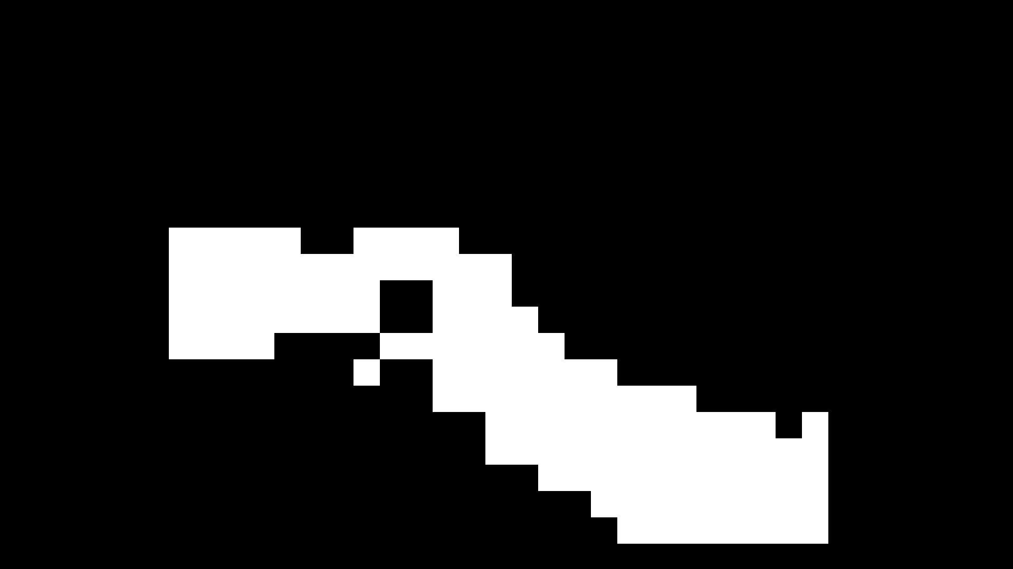
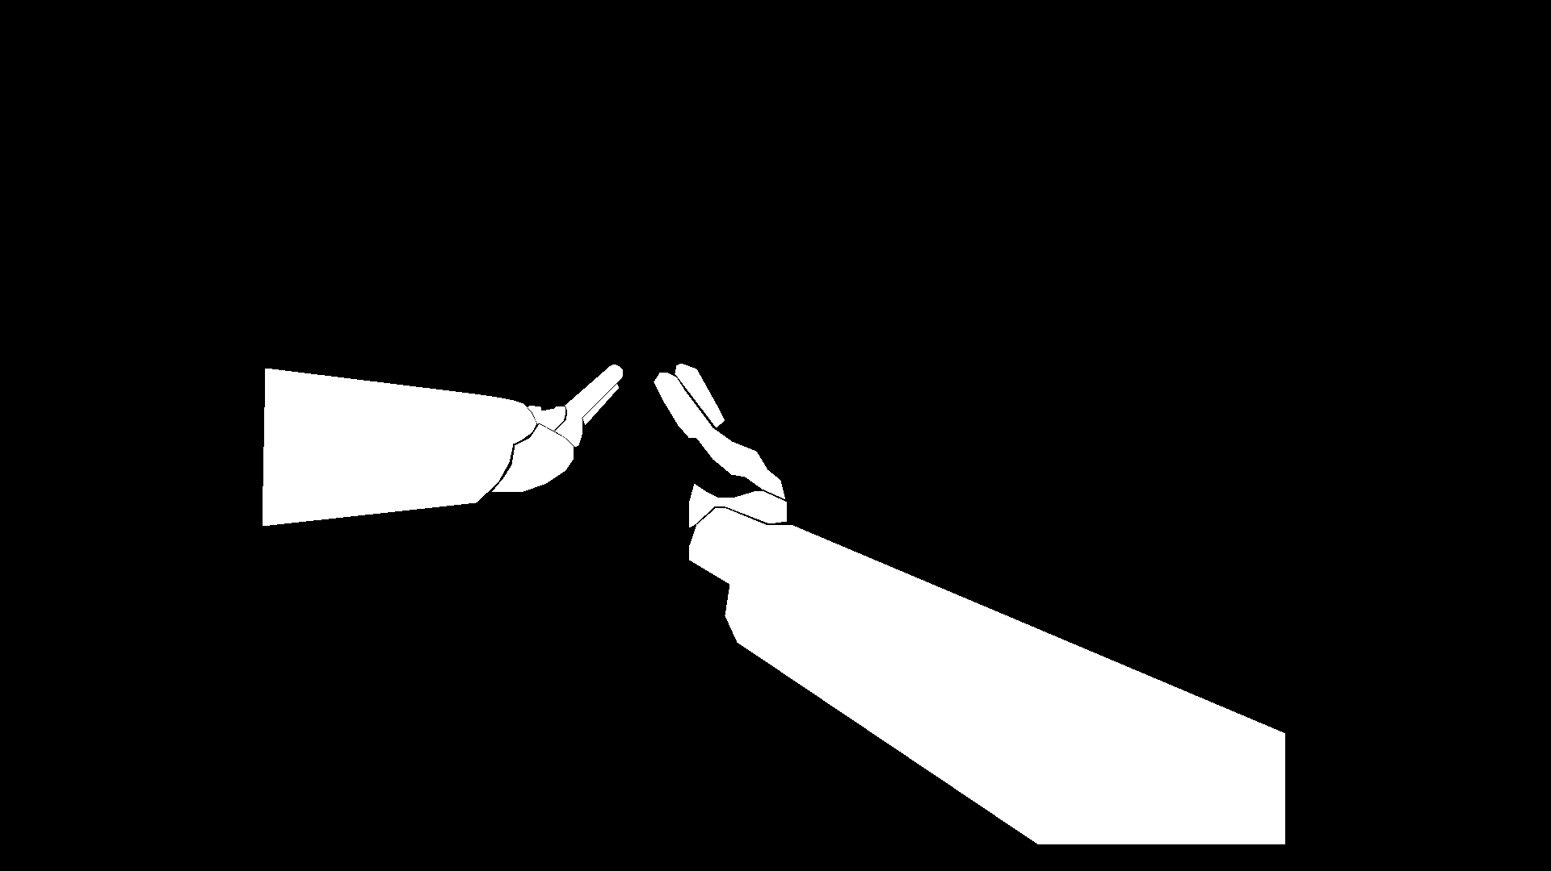
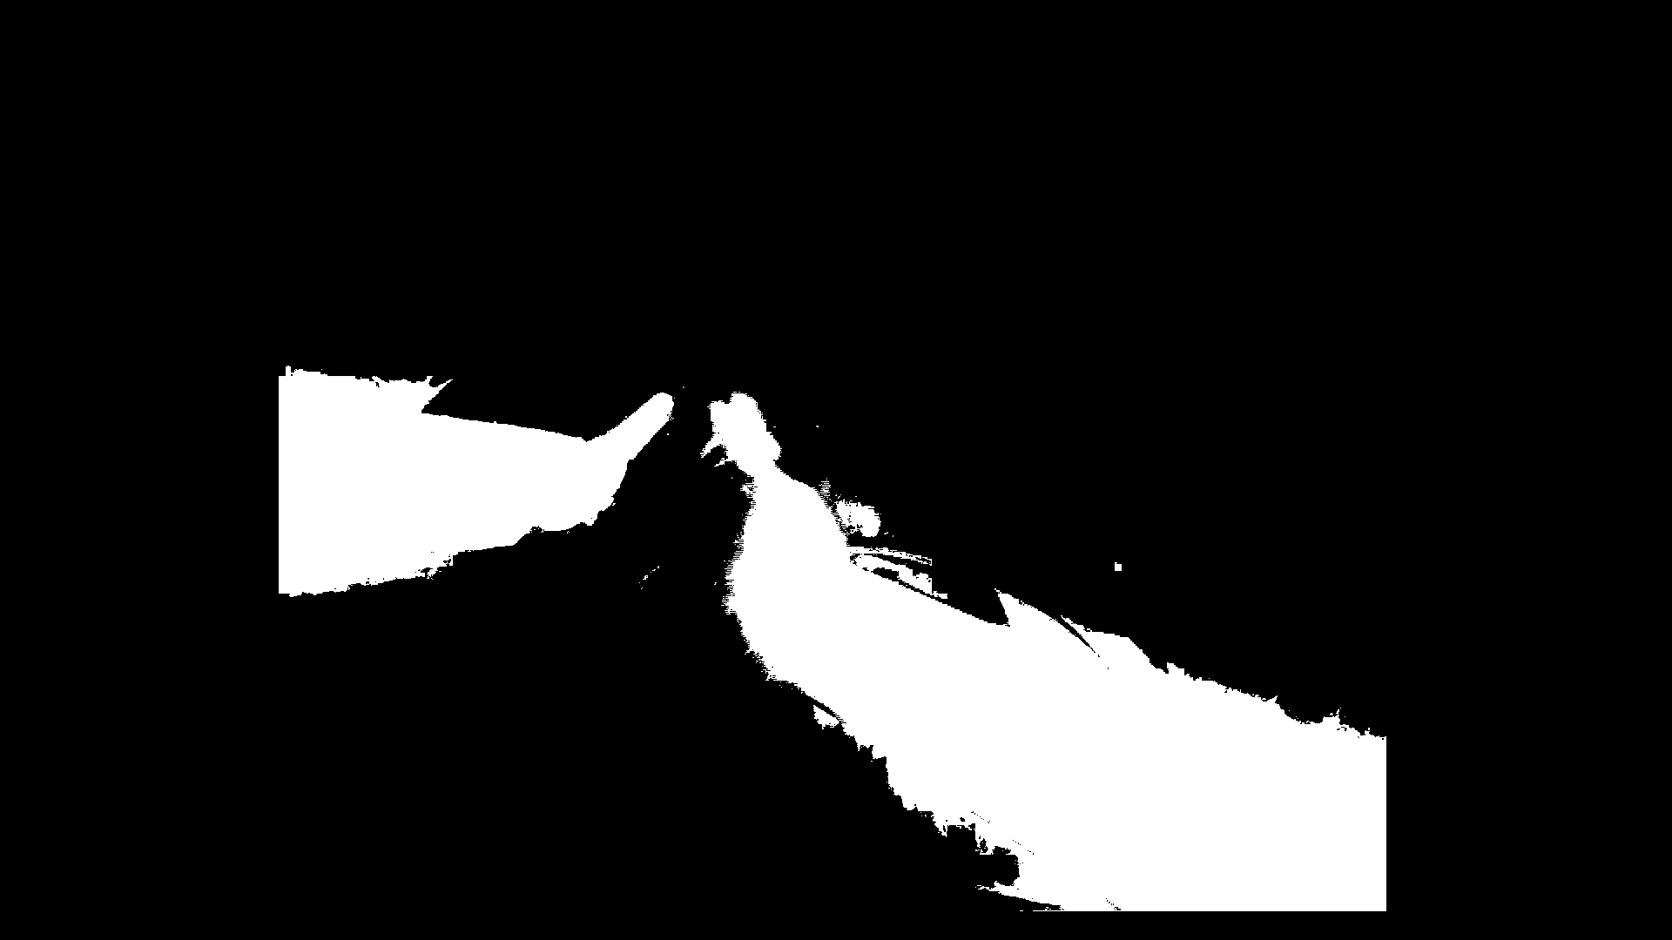
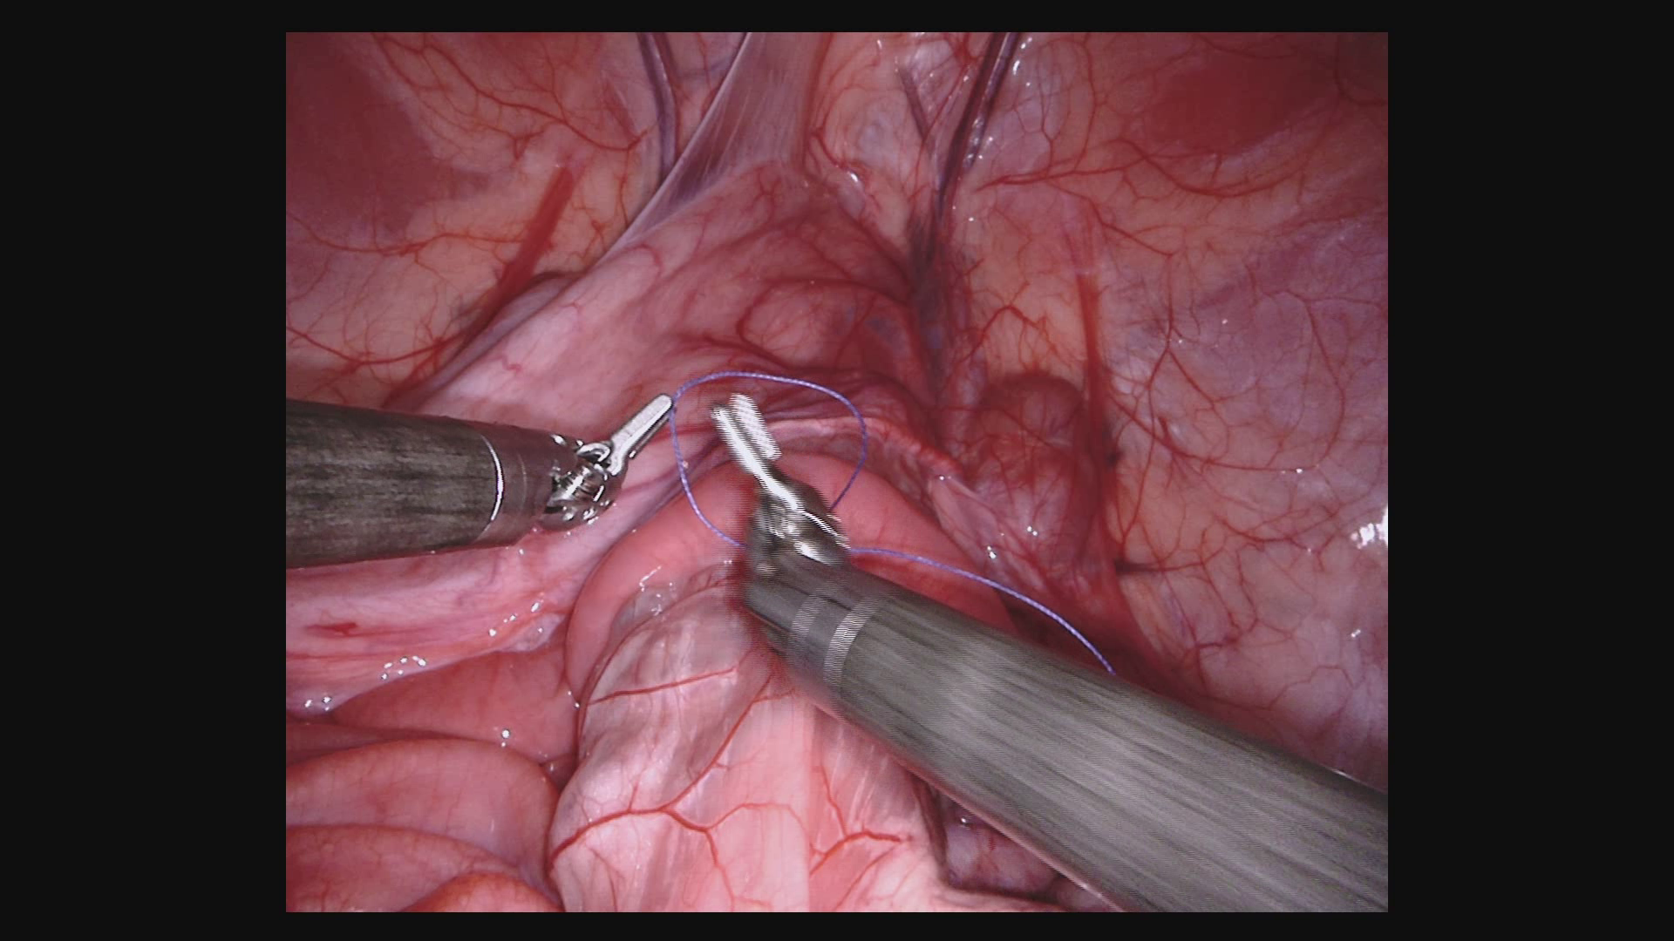
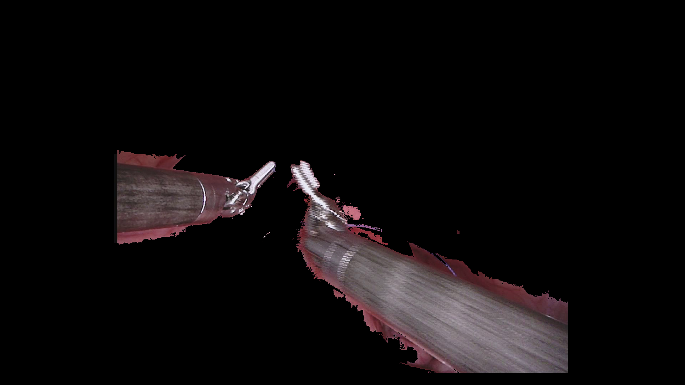
Patch and stitch CNN output
CRF based
post processing
Ground Truth
Output Mask
Foreground
v/s
background?
VGG-19
Segmented Output
Rahul Duggal (Indraprastha Institute of Information technology - Delhi, India)
www.rahulduggal.com

