Slide 1
Reservoir behaviour
cho2015

Slide 2
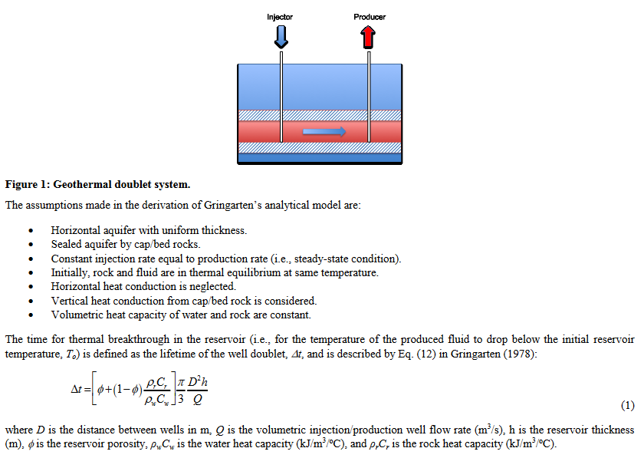
Gringarten (1978) model
Cho, J., Augustine, C., & Zerpa, L. E. (2015). Validation of a Numerical Reservoir Model of Sedimentary Geothermal Systems Using Analytical Models. Proceedings, Fortieth Workshop on Geothermal Reservoir Engineering, 1–13. https://pangea.stanford.edu/ERE/pdf/IGAstandard/SGW/2015/Cho.pdf
Notes:
Eq. (1) also shows that reservoir lifetime is independent of the reservoir permeability. Instead, reservoir permeability only impacts the pressure difference across the reservoir.

Slide 3
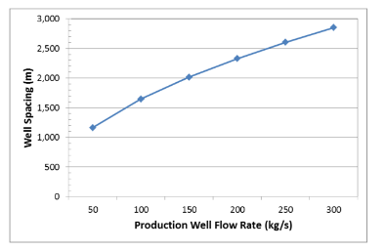
Thermal breakthrough in 30 yrs

Slide 4
Plot for 50 by 50 grid

Slide 5
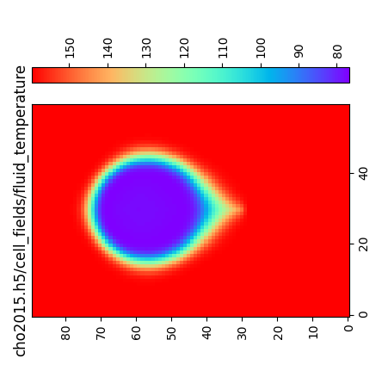
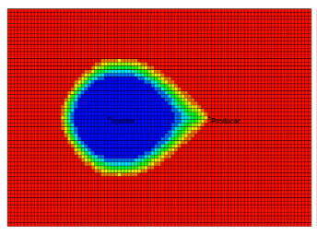
Temperature plots
cho2015
waiwera

