Slide 1

BSEYD and Log PE Measures
Efficacy as a TRADING SIGNAL

Slide 2
BSEYD and LOG PE: Future Crashes Warning Signals
Introduction:
Proposed by Ziemba et al. first in 2002-04 and its current form in 2016*, inspired by Gordon Growth formula and Shiller PE
We are using an old version, the current which says 500 days rolling period
Future Crashes are defined as >10% Draw-Down from a date Starting within 6 months from the first signal day.
We will use a cutoff of sqrt(3) which is equivalent to which a 25% one sided tail in Cantelli’s inequality
Later while deriving trading signal we use a little variation of this cutoff because the measure can remain above or below the cutoff level, We take a trade only when it cross the cutoff and then crosses below/above the cutoff as we do for normal technical indicators like RSI
We will discuss more about the assumptions and rationale as we navigate through the sections
Also that first form of this indicator was published in 2002-2004 and the current papers are from 2016, so will be interesting to see the efficacy post publications
Statistical Characteristics:
We use a 500 days rolling z statistics:
BSEYD Measure = 10 Year CMT Yields - Earning Yield(EY) of Broader Stock Market(SPX 500)
Log PE Measure = LN(PE), where PE=1/EY
Both are then standardized based on 500 days historical lookback
Raw Signals:
We will check for raw signals efficacy, we will calc the peak date and max DD date after each signal (for a lookahead period of 252 Days from signal)
To critically asses the claims we will also look at the run up and number of days from the signal date to the peak date, this will be pain if short on the signal date and it will also force us forego any upside in case of a false signal
Different period of Good – Bad Signals will be assessed and we will try to find reasons for their performance
But the strategy will be formed in a way so that these biases do not creep in while formulating
*Ref:
https://www.tandfonline.com/doi/full/10.1080/21649502.2015.1165893
https://www.tandfonline.com/doi/full/10.1080/21649502.2015.1165905?src=recsy

Slide 3
Raw Signals: BSEYD
signal_date | peak_date | trough_date | DrawDown | RunUp | SigToPeakDays | PeakToTroughDays
27-12-1999 | 24-03-2000 | 20-12-2000 | -17.2 | 4.83 | 63 | 188
07-03-2002 | 19-03-2002 | 09-10-2002 | -33.63 | 1.1 | 9 | 142
22-05-2007 | 09-10-2007 | 10-03-2008 | -18.64 | 2.69 | 98 | 104
20-09-2007 | 09-10-2007 | 17-09-2008 | -26.12 | 3.06 | 14 | 237
21-12-2007 | 26-12-2007 | 20-11-2008 | -49.76 | 0.89 | 3 | 229
24-04-2008 | 19-05-2008 | 09-03-2009 | -52.58 | 2.72 | 18 | 202
24-07-2008 | 11-08-2008 | 09-03-2009 | -48.17 | 4.21 | 13 | 144
31-10-2008 | 04-11-2008 | 09-03-2009 | -32.73 | 3.82 | 3 | 84
03-02-2009 | 09-02-2009 | 09-03-2009 | -22.23 | 3.74 | 5 | 19
05-05-2009 | 19-01-2010 | 08-02-2010 | -8.13 | 27.27 | 179 | 14
04-08-2009 | 23-04-2010 | 02-07-2010 | -15.99 | 21.04 | 182 | 49
22-05-2013 | 15-01-2014 | 03-02-2014 | -5.76 | 11.66 | 165 | 12
21-08-2013 | 15-01-2014 | 03-02-2014 | -5.76 | 12.51 | 102 | 12
20-11-2013 | 18-09-2014 | 15-10-2014 | -7.4 | 12.91 | 208 | 19
01-05-2015 | 21-05-2015 | 11-02-2016 | -14.16 | 1.07 | 15 | 183
31-07-2015 | 03-11-2015 | 11-02-2016 | -13.31 | 0.28 | 67 | 68
29-10-2015 | 03-11-2015 | 11-02-2016 | -13.31 | 0.98 | 4 | 68
17-11-2016 | 01-03-2017 | 13-04-2017 | -2.8 | 9.55 | 70 | 31
21-02-2017 | 26-01-2018 | 08-02-2018 | -10.16 | 21.45 | 236 | 9
20-12-2017 | 20-09-2018 | 20-12-2018 | -15.81 | 9.39 | 189 | 63
17-05-2018 | 20-09-2018 | 24-12-2018 | -19.78 | 7.74 | 88 | 65
09-11-2020 | 12-02-2021 | 04-03-2021 | -4.23 | 10.82 | 66 | 13
25-02-2021 | 07-05-2021 | 12-05-2021 | -4.01 | 10.53 | 51 | 3
Hit Ratio: 69.57%
* Hit ratio is defined as DD more than 10 percent starting within a year

Slide 4
Raw Signals: Log PE
signal_date | peak_date | trough_date | DrawDown | RunUp | SigToPeakDays | PeakToTroughDays
16-05-2001 | 21-05-2001 | 21-09-2001 | -26.43 | 2.17 | 4 | 82
15-08-2001 | 24-08-2001 | 23-07-2002 | -32.68 | 0.59 | 8 | 224
19-11-2001 | 04-01-2002 | 09-10-2002 | -33.75 | 1.86 | 32 | 192
25-02-2002 | 19-03-2002 | 09-10-2002 | -33.63 | 5.49 | 17 | 142
13-07-2007 | 09-10-2007 | 11-07-2008 | -20.81 | 0.81 | 62 | 190
11-10-2007 | 12-10-2007 | 09-10-2008 | -41.74 | 0.48 | 2 | 250
11-01-2008 | 19-05-2008 | 20-11-2008 | -47.26 | 1.83 | 89 | 130
14-04-2008 | 19-05-2008 | 09-03-2009 | -52.58 | 7.4 | 26 | 202
16-07-2008 | 11-08-2008 | 09-03-2009 | -48.17 | 4.81 | 19 | 144
14-10-2008 | 04-11-2008 | 09-03-2009 | -32.73 | 0.78 | 16 | 84
14-01-2009 | 28-01-2009 | 09-03-2009 | -22.6 | 3.73 | 10 | 27
16-04-2009 | 19-01-2010 | 08-02-2010 | -8.13 | 32.93 | 192 | 14
29-01-2013 | 21-05-2013 | 24-06-2013 | -5.76 | 10.7 | 79 | 23
30-04-2013 | 21-05-2013 | 24-06-2013 | -5.76 | 4.48 | 16 | 23
03-11-2014 | 21-05-2015 | 25-08-2015 | -12.35 | 5.6 | 138 | 66
04-02-2015 | 21-05-2015 | 20-01-2016 | -12.74 | 4.37 | 75 | 167
06-05-2015 | 21-05-2015 | 11-02-2016 | -14.16 | 2.44 | 12 | 183
05-08-2015 | 03-11-2015 | 11-02-2016 | -13.31 | 0.47 | 64 | 68
03-11-2015 | 03-11-2015 | 11-02-2016 | -13.31 | 0 | 1 | 68
11-01-2018 | 20-09-2018 | 24-12-2018 | -19.78 | 5.9 | 175 | 65
02-01-2020 | 19-02-2020 | 23-03-2020 | -33.92 | 3.94 | 33 | 23
09-04-2020 | 02-09-2020 | 23-09-2020 | -9.6 | 28.35 | 102 | 14
10-07-2020 | 02-09-2020 | 23-09-2020 | -9.6 | 12.43 | 39 | 14
08-10-2020 | 12-10-2020 | 30-10-2020 | -7.48 | 2.54 | 3 | 14
Hit Ratio: 75 %
* Hit ratio is defined as DD more than 10 percent starting within a year

Slide 5
Raw Signals to Trading Strategy
Commentary on Raw Signals:
LogPE measure are better than BSEYD signals and more consistent
There are certain successful signals but with a big run-up before drawdown, this can be painful
The signals fake-out during aggressive QE upto 2016 and Taper tantrum (2012-13) and more recent after the covid rally (so they are sensitive to Fed actions and Puts)
Since we have seen the Raw signals we should be wary of formulating a strat to avoid any hindsight bias
Raw signals are one thing, we will try to use these signals to trade a strategy profitably
Raw signal esp. the log PE are good , and would have averted most crashes in last 2 decades
I have to admit that a test should also be done on the cases (>10%DD) when the system didn’t give any warnings
A longer period should have been checked but for data constraints
Trading Signals:
The original raw signals were meant to be early warning signals, we do not have access to data (options market) and VIX ETNs to formulate any sophisticated strategy to express our view
I have fetched data for 5% Put Protected SPX (^PPUT) and TLT ETF (Treas 20+ year) from cboe website and yahoo resp.
So we use a Naïve strategy to re-allocate our assets completely (de-lever Risky Asset) to Hedge(PPUT/TLT) on first signal, to be conservative after deleveraging we will remain invested in the hedge for 252 Bdays, and then again do risk-on given we do not have any risk-off signal on that day
It can be argued that will be unfair, but lets assume it as a compensation for any hindsight bias because of our knowledge
TXN cost 10 bps for both SPX and Hedge
Target weight rebalancing is not done during any intervening period and weights are allocated back and forth only on the turn of Buy-Sell signal days
Ideally I should have used SPY (and Adj Close which would have been TR) but the PPUTs are based of SPX so if have used close of SPY, while using TLT I am using adj. close i.e. TR values
Long only portfolio, No Leverage
The runups can be painful if we take the signal as a short signal, and that is expected because the signals are meant to be an early warning system

Slide 6
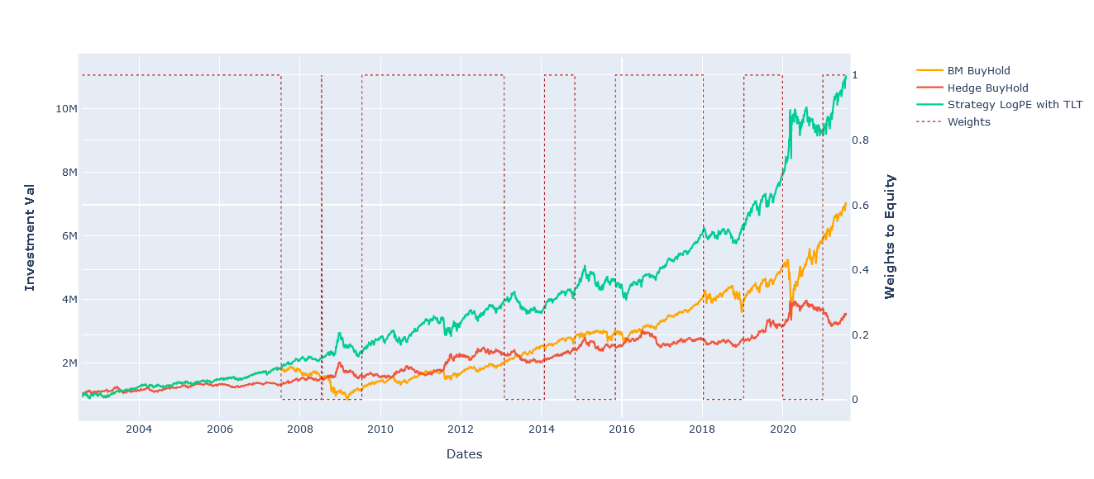
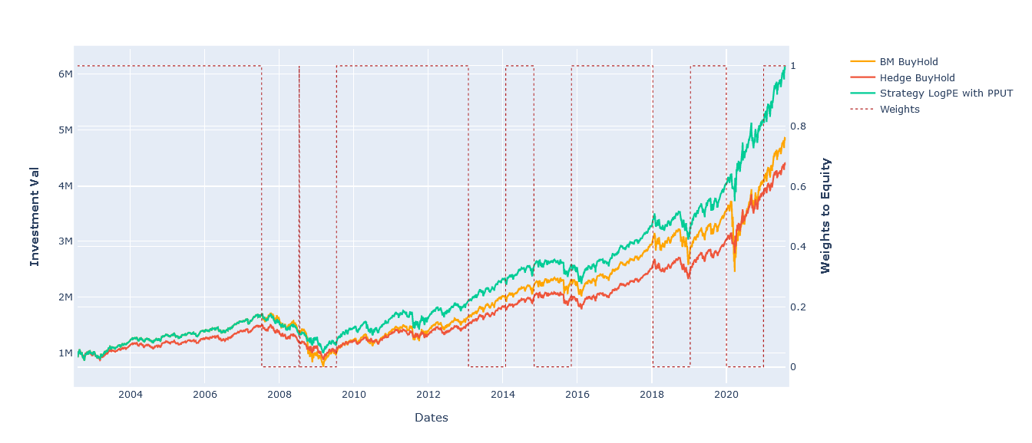
Trading Strategy: Performance: Log PE Measure
Comments:
One would expect that PPUT will perform better given its is protected at 5% but it was able to save dd during GFC and also during ‘19 correction- Static Hedges are not so good for portfolio protection
TLT performs good but as the strategy is Naïve around timing it tends to hold TLT beyond its utility
Significantly reduces the drawdowns
Has good timing of risk on risk off red dotted lines
Init Cap = USD 1 Mio
BM = SPY Close For PPUT and SPY Adj Close(TR) for TLT
Hedge BuyHold is the eqt curve if we would have been always been in Risk off asset instead (TLT or PPUTs)
Hit Ratio: 64.71 %
* Hit ratio is defined as DD more than 10 percent starting in 6 months to year period

Slide 7
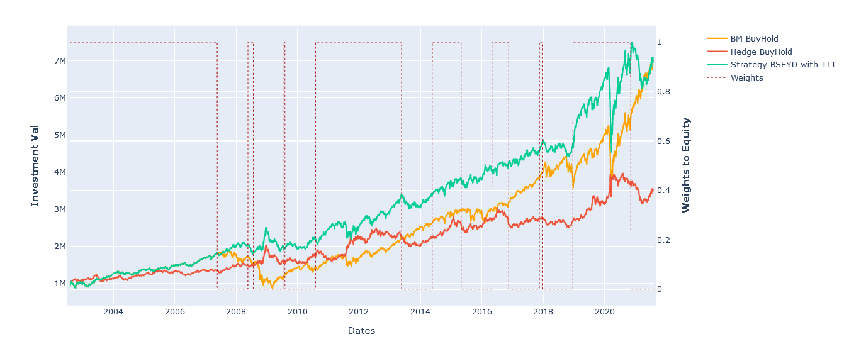
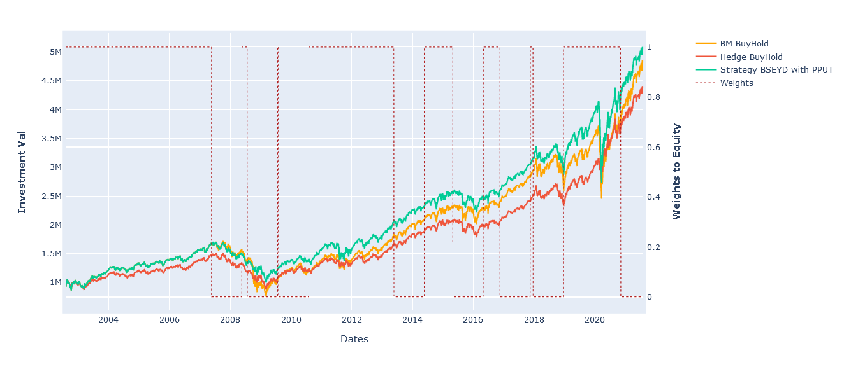
Trading Strategy: Performance: BSEYD Measure
Comments:
BSEYD signals have been good in the past and it leveraged and deleveraged at the right moments
But it has floundered in the most recent past : Pre and Post Covid
It is very sensitive to central Bank intervention
Init Cap = USD 1 Mio
BM = SPY For PPUT and SPY Adj Close(TR) for TLT
Hedge BuyHold is the eqt curve if we would have been always been in Risk off asset instead
Hit Ratio: 64.71 %
* Hit ratio is defined as DD more than 10 percent starting in 6 months to year period

Slide 8
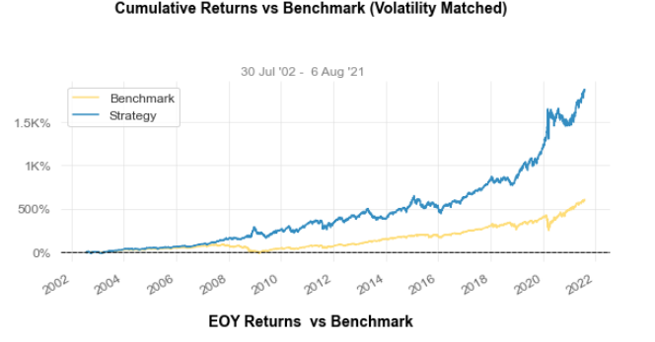
Trading Strategy: Performance Metrics
Strategy with TLT(SPY) | Log PE | BSEYD | Buy&Hold
Start | 30-Jul-02 | 30-Jul-02 | 30-Jul-02
End | 06-Aug-21 | 06-Aug-21 | 06-Aug-21
Cuml. Ret | 1005.50% | 594.75% | 604.64%
CAGR% | 13.46% | 10.72% | 10.80%
Sharpe | 0.91 | 0.72 | 0.63
Sortino | 1.32 | 1.02 | 0.89
Max DD | -26.59% | -33.72% | -55.19%
Longest DD days | 723 | 744 | 1,772
Strategy with PPUT(SPX) | Log PE | BSEYD | Buy&Hold
Start | 30-Jul-02 | 30-Jul-02 | 30-Jul-02
End | 06-Aug-21 | 06-Aug-21 | 06-Aug-21
Cuml. Ret | 514.57% | 408.52% | 386.57%
CAGR% | 10.01% | 8.92% | 8.67%
Sharpe | 0.7 | 0.61 | 0.53
Sortino | 1 | 0.86 | 0.74
Max DD | -41.53% | -41.42% | -56.47%
Longest DD days | 1299 | 1680 | 1982
Comments:
As mentioned PPUT are not a good index by construction as they give little benefit over the unhedged SPY other than lowering the vol slightly (static hedges are painful mostly)
TLT log PE strat Significantly reduces the drawdowns and increases the Sharpe by good amount
Even BSEYD with TLT has low drawdowns and most of the bad performance can be attributed to post covid era (sensitive to Fed Actions)
Right side is a graph of a Log PE vol matched strategy(using leverage), we can have outsized returns for the same level of risk
Point 1 and 4 also answers questions put forward by Chris during our discussion :
Dynamic puts like CPPIs are mostly better than Static Puts as they can not realize profits properly esp. if puts bought are short term (yes, they control the volatility a little but there are better ways).Also CPPIs have vol cost on realized vols rather than Implied vol
Vol/DD reducing strats can be used for maximizing return, normally without leverage those strategies are meant to control vol/drawdown, but they can leveraged (like we move up the slope on a CML line) to Vol match hence Higher return for equal risk (at least in expectations)

Slide 9
Conclusion:
Conclusion:
Our Raw Signals show good hit ratio for both the measures, we further check their timing by formulating a naïve trading rule
LogPE Strategy outperforms B&H SPY (with both risk-off assets)
BSEYD strategy has lost its sheen since lately and also is very sensitive central bank intervention (FED Puts belief/QE)
Sharpe ratio and Drawdown are Attractive for Log-PE + TLT
PPUTs are decent but do not protect drawdowns and are not good hedge, I must have chosen something that is not corr. with equities mkt in the notebook have checked for GLD
Vol matched portfolio looks an even better option but Vol Matching will deploy leverage(See previous slide)
LogPE strategy was lagging behind the BM during low vol market of 2016 and also during taper tantrum, but has picked up post 2016
On a long scale it is decisively better evading 2008 crash and covid crash more recently
The 100% deleverage can be seen as a compensation for selecting any parameter that might have induced selection and hindsight bias
Improvements:
Since the strategy is based on rather conservative approach and instantaneous risk off we can do better by using more sophisticated techniques like Deriv overlays, portfolio insurance, momentum to value rotations(and with knowledge of Momentum Crashes) , VIX exposure or using the weight in port construction such as black-litterman etc
Can be Esp. useful to combine BSEYD and LogPE values as they are not always co-incident and use it as a forward looking factor/weights in a more comprehensive factor blending method (through the statistical techniques like ridge regression decision trees, which are also decently tractable) such as Low Implied Volatility, High Dispersion** among assets, flattish yield, tight corp spreads etc. kind of regime factors
We have just used one tail of the measure we can further make a strategy based on other tail, infact many of Ziemba’s paper (2002) give such rules and I in my past work have found it to be useful (did not try it for US mkts, avoided here because those results were already back tested, any parameter tuning here would have inflated the stats)
Any further strat should be carefully analyzed for Sharpe (will prefer to use Probabilistic Sharpe for a good significance testing of Sharpe) if we choose to use the same framework of trading signals
The strategy signals(for both measure) are different than a typical trend-following signal , trend following signals are late to respond to sudden sell off and this factor can complement such strats
Forward PE measure can also be a good factor, have backtested that at work and it gives slightly better results
Bottom Line: use it as a regime factor with other higher frequency factors
All calcs in jupyter notebook attached with details on data sources etc
I have also attached a notebook that calcs Market Dispersion factor

Slide 10
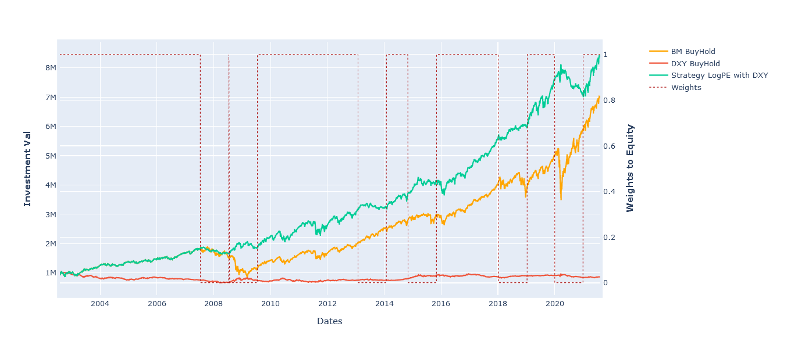
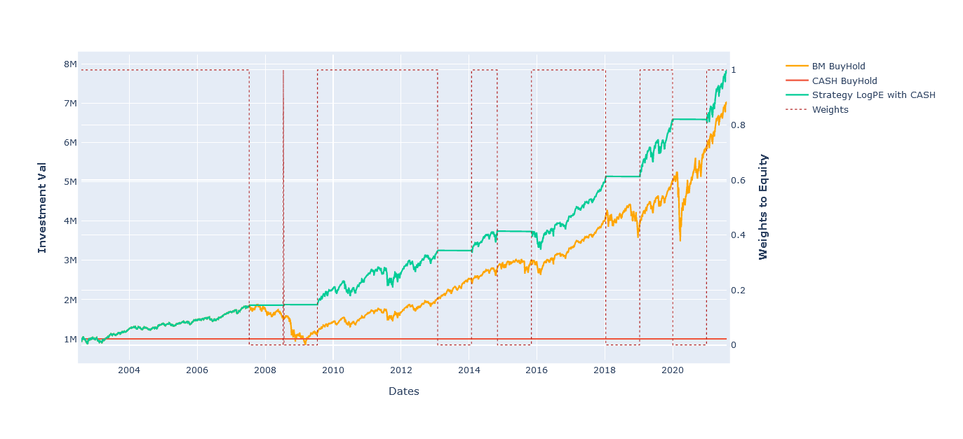
Trading Strategy: Performance Metrics: Addendum:- CASH or DXY
Comments:
I tried to test for CSH and DXY as riskoff and in fact the strategy has best sharpe with them, did not include as I didn’t know for the data downloaded for DXY from yahoo is good and investible (I guess it is not and we need dxy futures or basket futures have worked)
The strategy with DXY index and cash has best sharpe, better than TLT: .93 and .96 resp
The cash strat work decently well with BSEYD measure as well
*pls ignore the formatting on this page

Slide 11
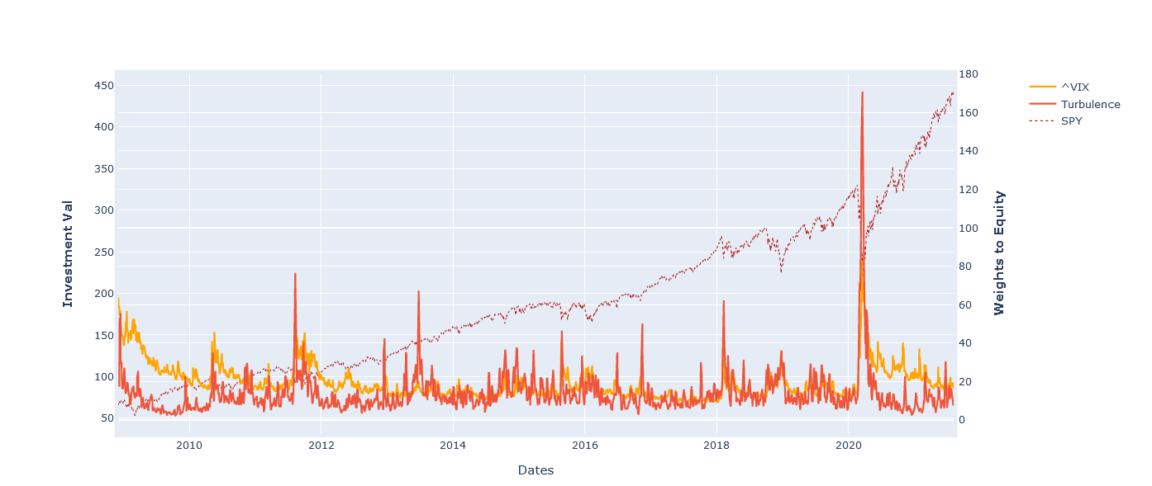
Addendum:- Turbulence Index
Comments:
More details in the jupyter notebook
Utility:
A better measure of dispersion
A proxy for VIX where VIX is not available or only signifies a small portion of mkt like currencies and EuroStoxx/NIFTY

Slide 12
Thanks

