Slide 1
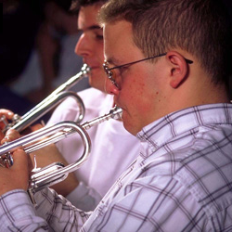
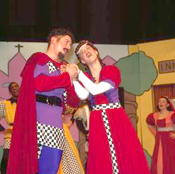


Discovery
CAMPS
Igniting and Nurturing the Passions of Young People
Business Summary
April, 2001

Slide 2
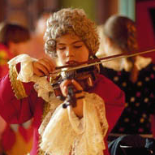
Discovery
CAMPS
VISION
Corporate Structure Nurtures Growth
Corporate
Hire directors
Advertising
Strategic sponsorships
“After my son returned from Discovery Camp, it was obvious that his skills and interest has gone sky-high.”
- Lewis Hart
Satisfied Parent
Directors
Maintain camp
Grass roots marketing
Hire camp staff
Directors are highly motivated by equity stake in parent corporation.
Camps
Variable cost structure
Affiliate with universities
Clean, safe, and educational
Staff
Salaried employees
Seasonal - yearly turnaround

Slide 3
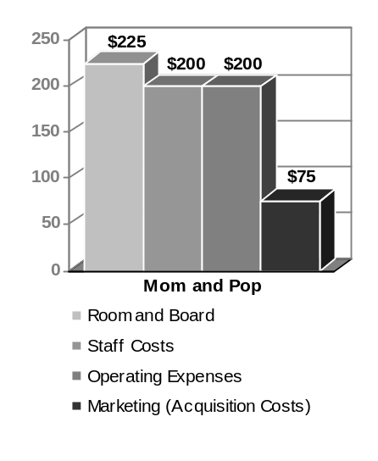
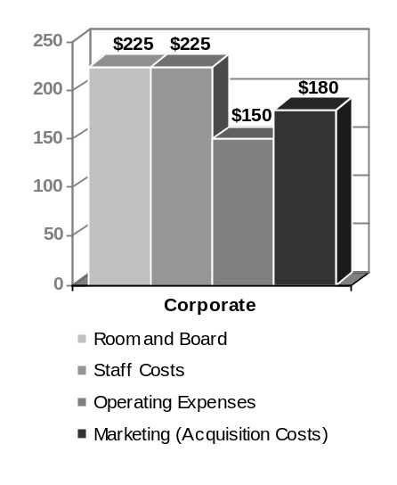
Discovery
CAMPS
VISION
Corporate profit is consistently higher and scales more attractively
Mom and Pop
Corporate
“After my son returned from Discovery Camp, it was obvious that his skills and interest has gone sky-high.”
- Lewis Hart
Satisfied Parent
Revenue Per Camper
$ 750
$ 825
Cost Per Camper
$ 645
$ 645
Contribution per Camper
10%
22%

