Slide 1
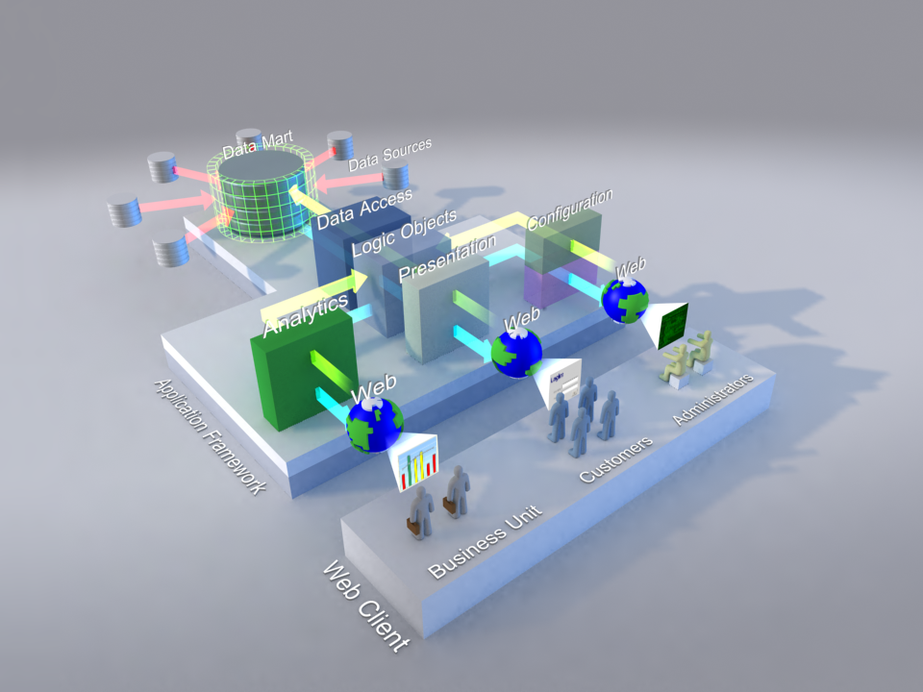
Web Application Architecture
N-Tiered Application Framework
Our n-tiered framework allows for rapid deployment and buildout of reliable, safe, and field-proven applications tailored for your business needs.
Configured Web Application Architecture
Designed for maximum flexibility in the user layers, our architecture supports web-enabled configuration that allows business and other non-technical users to control the output of the application to fit their particular business unit goals.
Bottom Line: Your Customers Win
It all boils down to making an impact where it matters the most: your customers. With analytics and ease of configuration, you will be able to adjust and quickly react to changing customer landscapes to ensure satisfaction.

