Slide 1

Connect
Contact Manager
Team 17

Slide 2
ROLES
DATABASE | PHONG “TOMMY” NGUYEN
API | DAREN HIRSCH
 | MITCH LEHMAN
FRONT END | LAUREN BRAVINE
 | PHONG NGUYEN
MANAGER | PATRICK SWAFFORD

Slide 3
Requirements
  Remote Database/Server
  Lamp stack
  Login
  Logout
  Delete user
  c.r.u.d.
    (create, read, update, delete)
  search

Slide 4
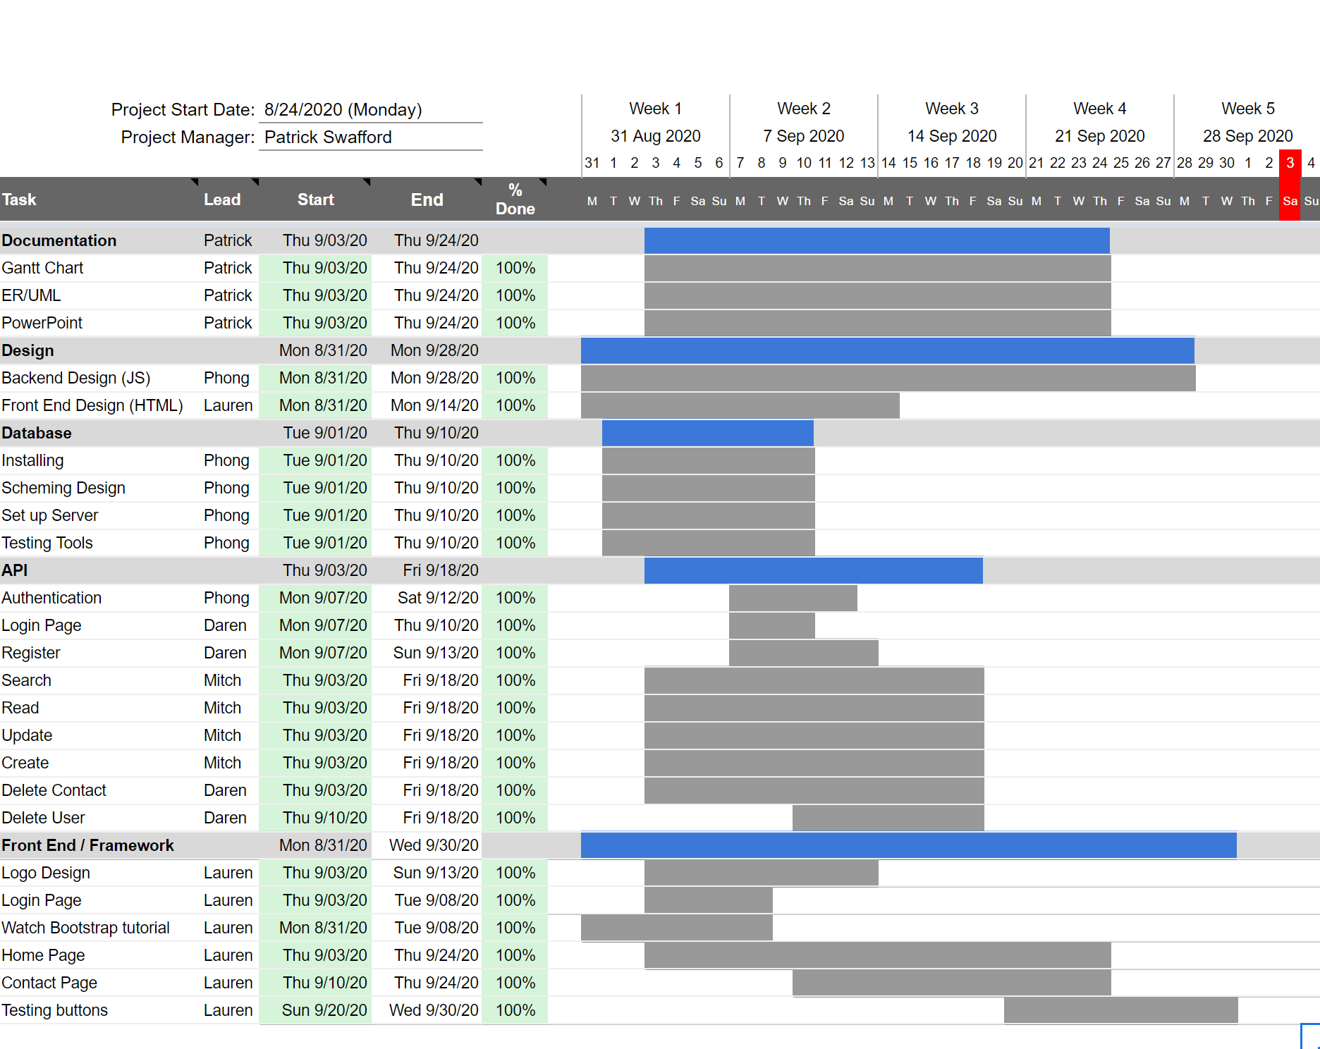

GANTT CHART

Slide 5
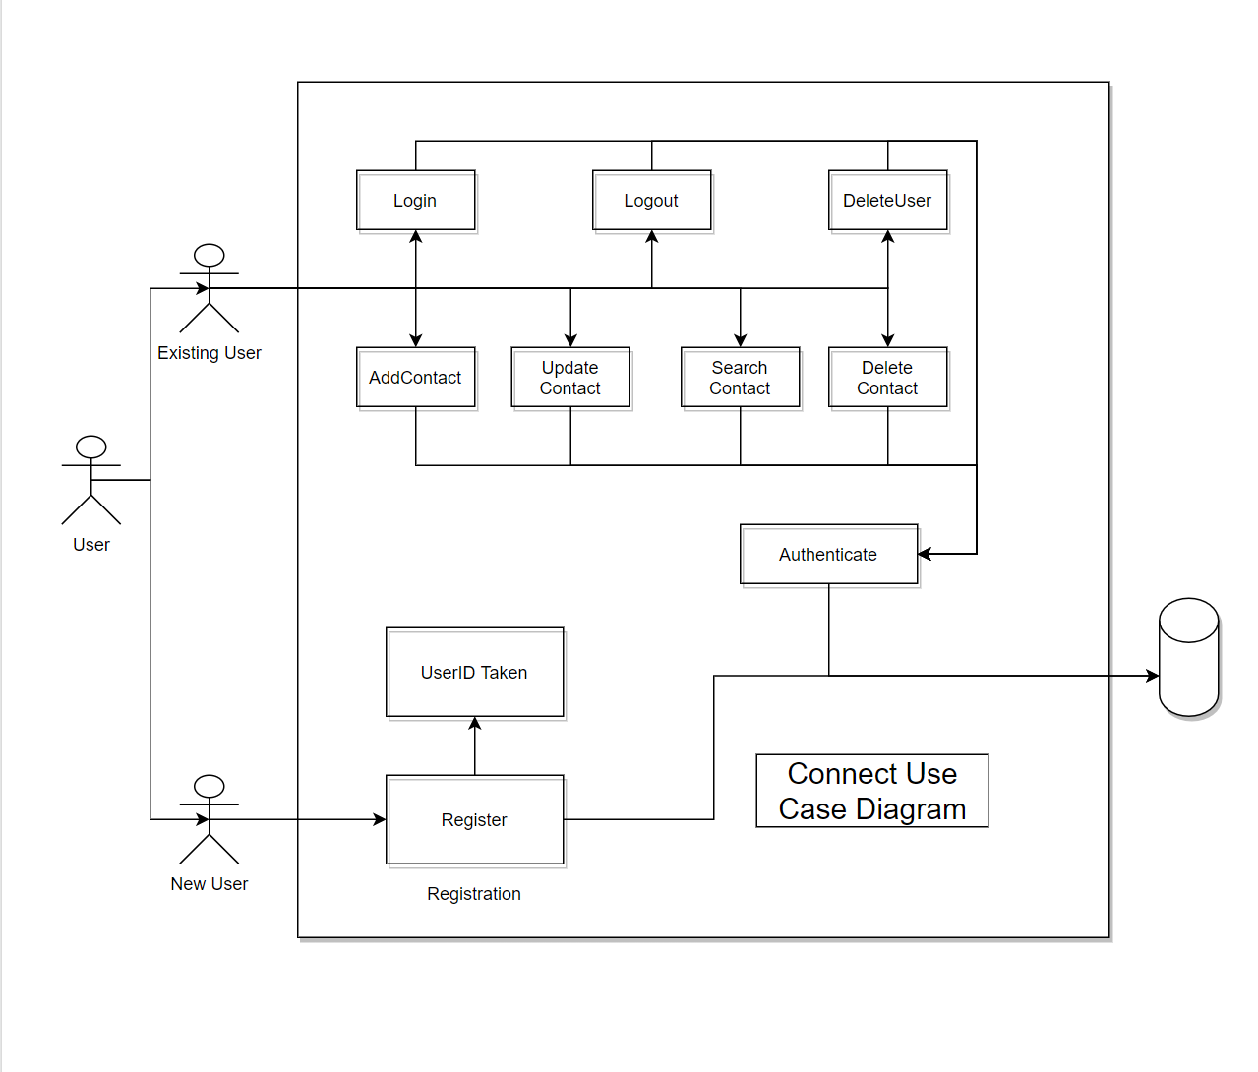
USE CASE DIAGRAM

Slide 6
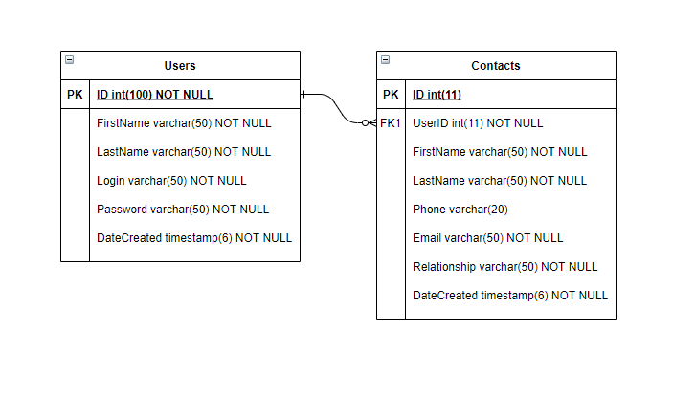
ERD

Slide 7
Lamp stack
LINUX
APACHE
MYSQL
PHP

Slide 8









Technologies Used
Discord
Zoom
Github
Swaggerhub
Sonarcloud
godaddy
cpanel
Draw.io
youtube

Slide 9






FRONT END
Bootstrap
HTML
CSS
JavaScript
  Dark Mode Theme
  CSS Keyframes to
  make a moving background

Slide 10
Retrospective
What went well?
Great team
2nd week of presentations
Formatting the home contact table was difficult initially, but we were able to make it look nice
What went wrong?
Git version control deployment on cpanel
GoDaddy server went under maintenance multiple times, hindering ability to test site

Slide 11
API ENDPOINT
WITH SWAGGERHUB
DEMO

Slide 12
Demo
Application
DEMO

Slide 13
Questions?

