Slide 1
Android内存相关系列
深圳框架组
2022.4
杜国伟
duguowei@xiaomi.com

Slide 2
内存
andorid
kernel

Slide 3
内存
kernel
modem
smaps
oom_adj
lmk
am_compact
Reclaim
watermark
heap
native heap
java heap

Slide 4
内存 smaps
pidof system_server
1493
cat /proc/1493/smaps | grep 'Pss' | awk '{total += $2};END {print total}'
cat /proc/1493/smaps | grep 'Rss' | awk '{total += $2};END {print total}'
dumpsys meminfo 1493

Slide 5
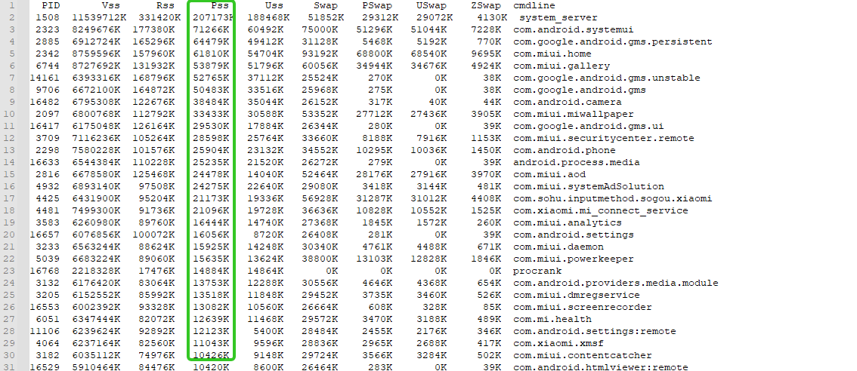
内存 procrank
procrank -v/r/p/u/s

Slide 6
dump
dumpsys meminfo
dumpsys meminfo $pid/package_name
dumpsys activity lru

Slide 7
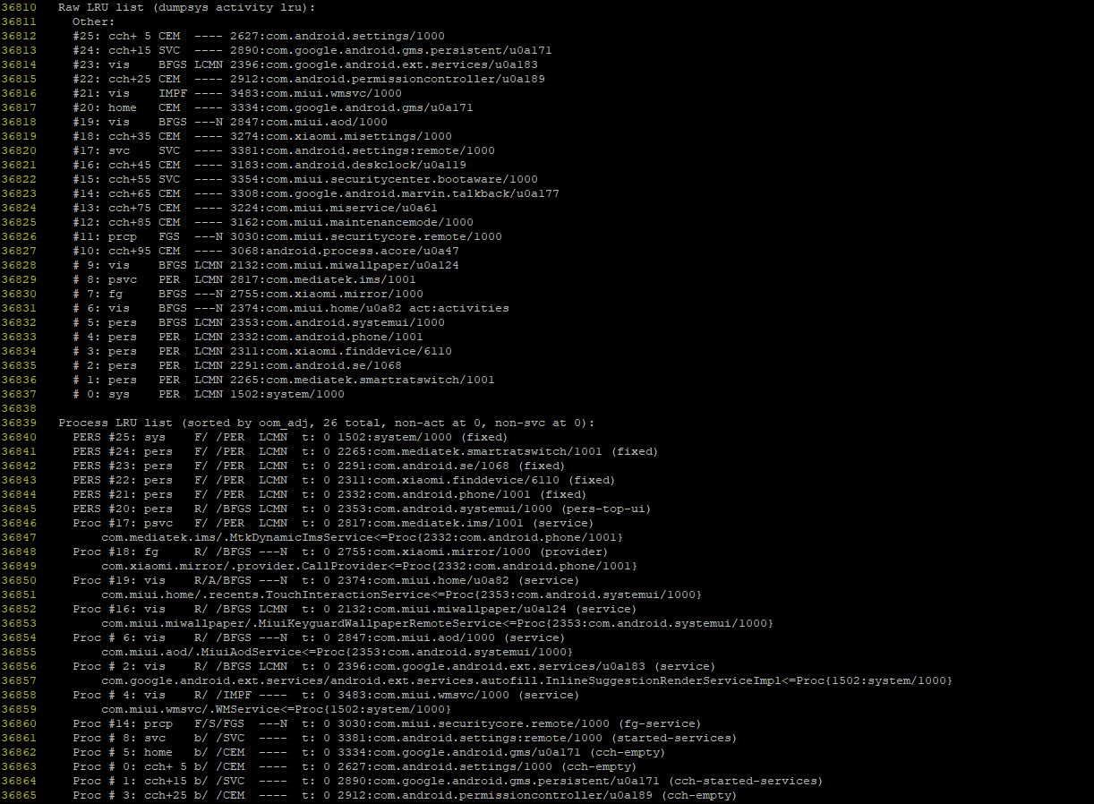
oom_score_adj
dumpsys activity lru

Slide 8
oom_score_adj
framework/base/services/core/java/com/android/server/am/
ProcessList.java
定义oom_score_adj值
LmkdConnection.java
lmkd
socket
ams. updateOomAdjLocked
->OomAdjuster.applyOomAdjLSP
->ProcessList.setOomAdj
->lmkd

Slide 9
oom_score_adj
CACHED_APP_MAX_ADJ | 999~900 | only hosting activities that are not visible
SERVICE_B_ADJ | 800 | aren't as shiny and interesting as the ones in the A list
PREVIOUS_APP_ADJ | 700 | the previous application that the user was in
HOME_APP_ADJ | 600 | holding the home application
SERVICE_ADJ | 500 | holding an application service
PERCEPTIBLE_APP_ADJ | 200 | hosting components that are perceptible to the user
VISIBLE_APP_ADJ | 100 | hosting activities that are visible to the user
FOREGROUND_APP_ADJ | 0 | running the current foreground app
PERSISTENT_SERVICE_ADJ | -700 | the system or a persistent process has bound to
PERSISTENT_PROC_ADJ | -800 | a system persistent process, such as telephony
SYSTEM_ADJ | -900 | The system process
NATIVE_ADJ | -1000 | Special code for native processes

Slide 10
内存 memtrack
memtrack
egl
gl

Slide 11
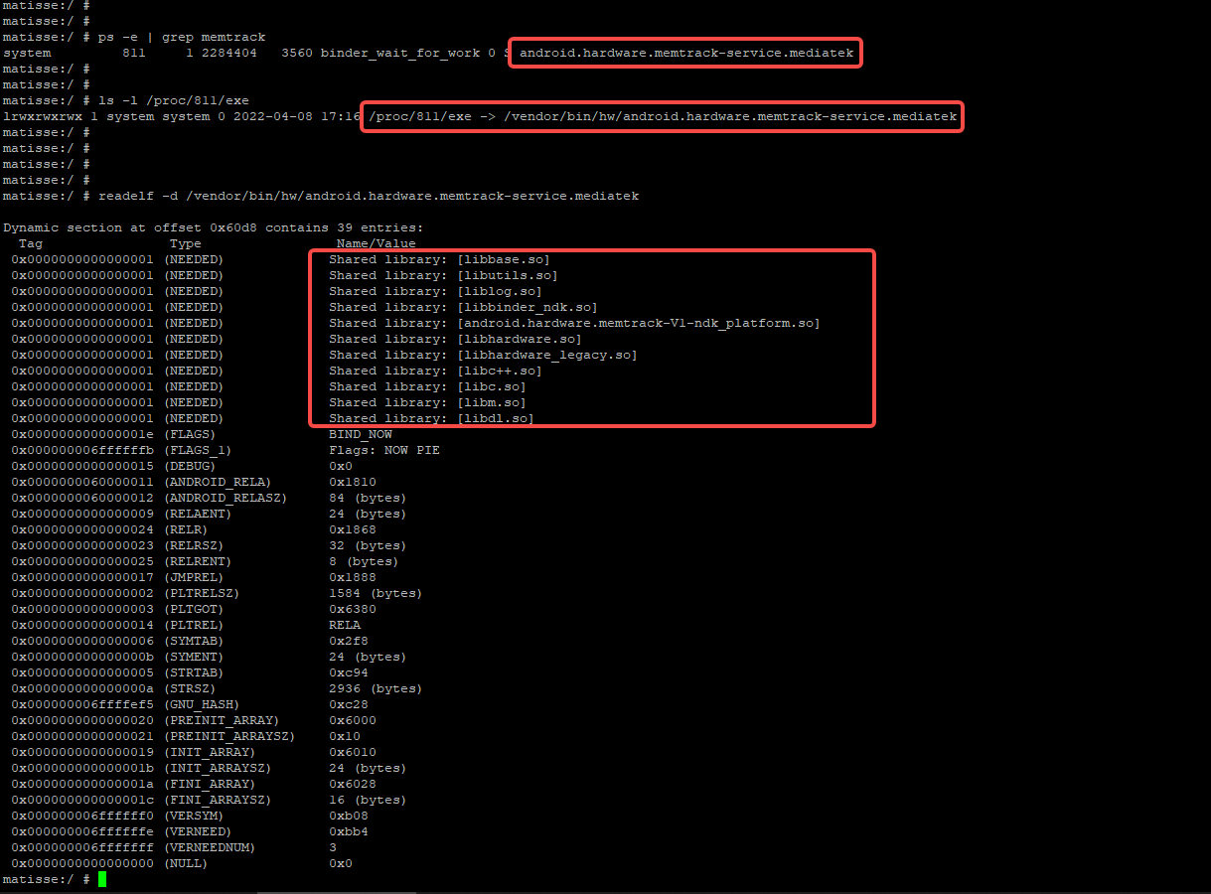
内存 memtrack
mtk

Slide 12
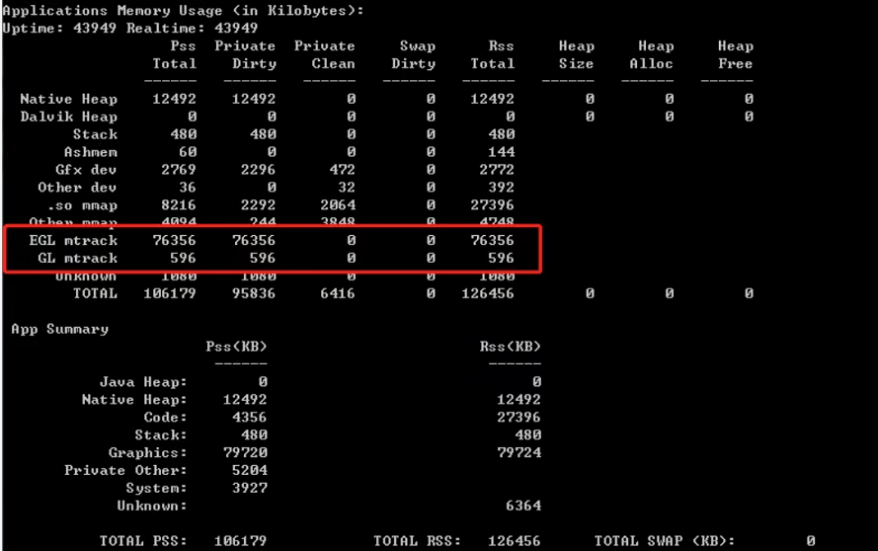
内存 memtrack
qcom

Slide 13
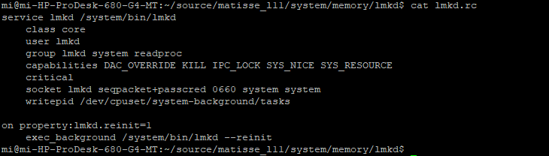
lmkd
system/memory/lmkd

Slide 14
reclaim
kernel
app

Slide 15
reclaim kernel
kernel
echo 0/1/2 > /proc/sys/vm/drop_caches
0:pagecache
1:slab objects(includes dentries and inodes)
2:slab objects and pagecache
process_madvise
compactProcess
CONFIG_PROCESS_RECLAIM
/proc/$pid/reclaim

Slide 16
reclaim app
CachedAppOptimizer.java
com_android_server_am_CachedAppOptimizer.cpp
“”、“file” 、“anon”、“all”
COMPACT_PROCESS_MSG
COMPACT_SYSTEM_MSG
compactAppSome(DEFAULT_COMPACT_ACTION_1=“file”)
compactAppFull(DEFAULT_COMPACT_ACTION_2=“all”)
compactAppPersistent
compactAppBfgs
compactAllSystem

Slide 17
reclaim app
EventLog.writeEvent(EventLogTags.AM_COMPACT, pid, name, action,
rssBefore[0], rssBefore[1], rssBefore[2], rssBefore[3],
rssAfter[0] - rssBefore[0], rssAfter[1] - rssBefore[1],
rssAfter[2] - rssBefore[2], rssAfter[3] - rssBefore[3], time,
lastCompactAction, lastCompactTime, lastOomAdj, procState,
zramFreeKbBefore, zramFreeKbAfter - zramFreeKbBefore);

Slide 18
Kernel
NODE
ZONE
PAGE

Slide 19
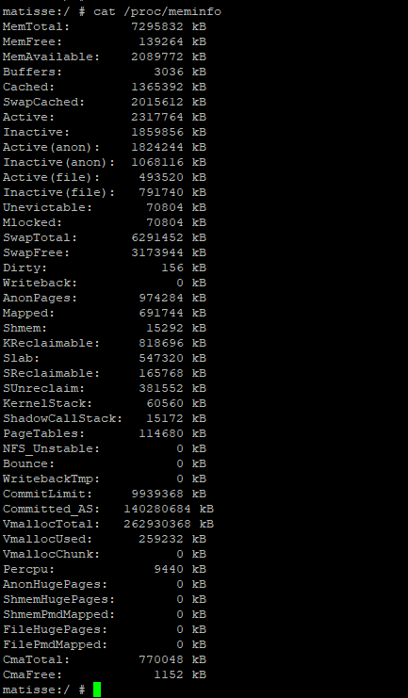
meminfo
cat /proc/meminfo(proc.5)

Slide 20

free
free -h

Slide 21

vmstat
vmstat
sudo vmstat -m

Slide 22
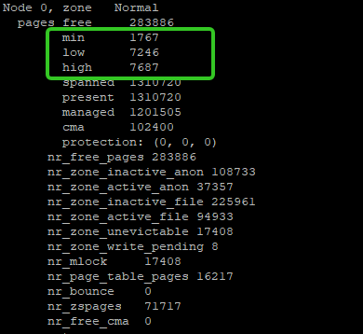
zoneinfo
cat /proc/zoneinfo
Node 0, zone DMA32
Node 0, zone Normal
Node 0, zone Movable

Slide 23
buddyinfo
cat /proc/buddyinfo
order:0~10
CONFIG_FORCE_MAX_ZONEORDER=11

Slide 24
buddyinfo
alloc_page
struct page * //page metadata struct
alloca_pages
page_address
//kernel virtual memory(%px---%pK)

Slide 25
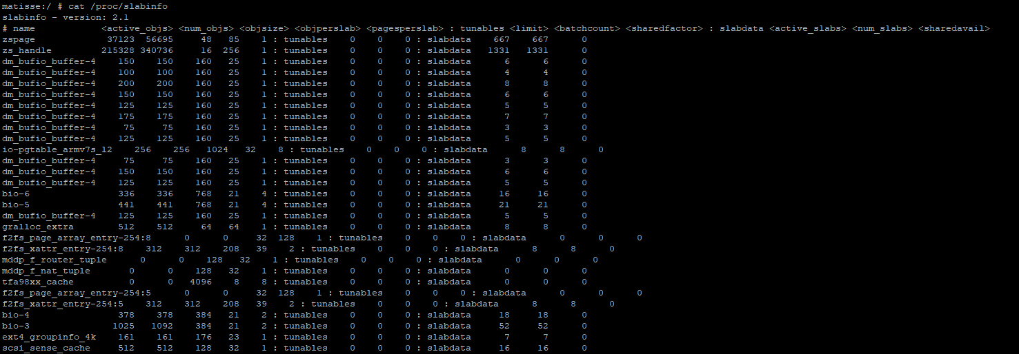
slabinfo
cat /proc/slabinfo(man slabinfo.5)

Slide 26
slab cache allocator
#include <linux/slab.h>
void *kmalloc(size_t size, gfp_t flags);//1~8192bytes
void *kzalloc(size_t size, gfp_t flags);
malloc --x-- k[m|z]alloc
physically contiguous
cacheline-aligned
void kfree(const void *);
//if(kptr) kfree(kptr);
UAF/DF //return;

Slide 27
slab cache allocator
#include <linux/slab.h>
static struct kmem_cache *;
KMEM_CACHE
kmem_cache_create
kmem_cache_destroy

Slide 28
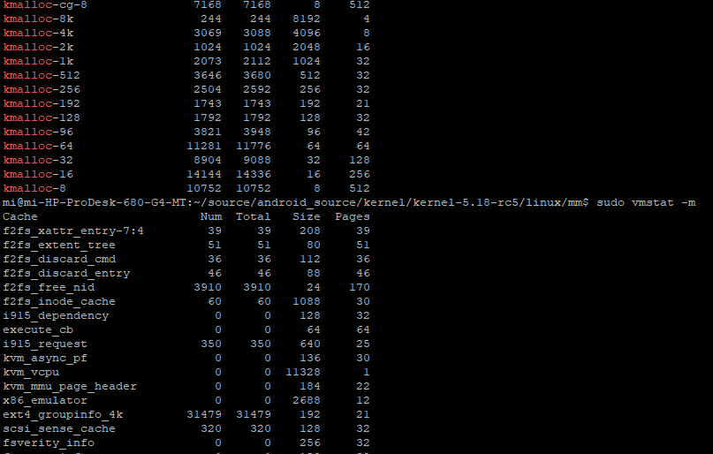
slab cache allocator
sudo vmstat -m
ls -l /sys/kernel/slab/...
kmalloc
kmem_cache
KMALLOC_MAX_SIZE
MAX_ORDER 11
PAGE_SIZE 12
1 << 11 - 1 + 12=4M

Slide 29
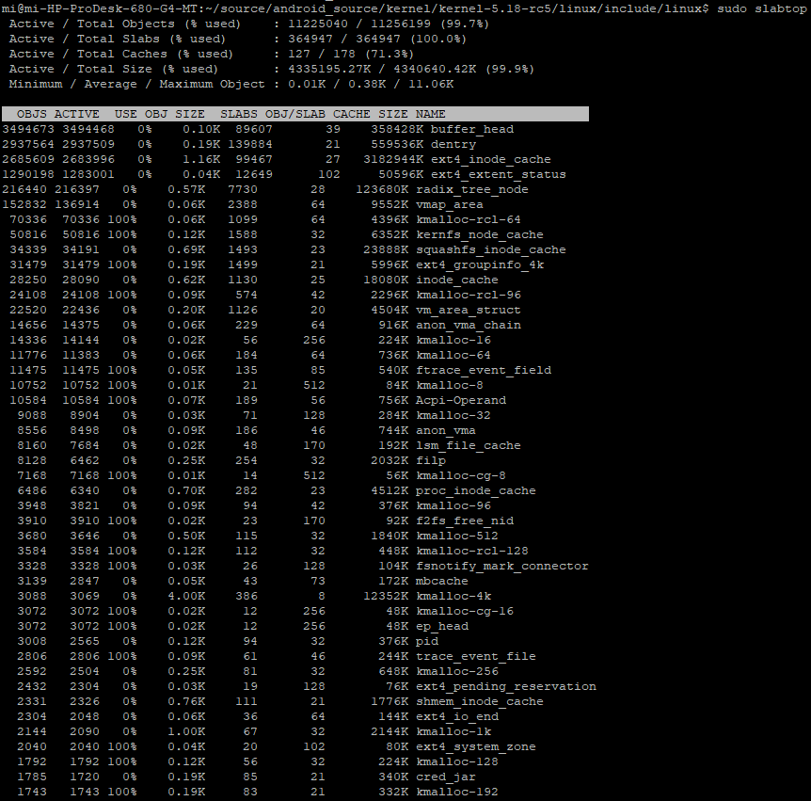
slab cache allocator
sudo slabtop

Slide 30

Q&A

