Slide 1
Improving Android
Bootup Time
Tim Bird
Sony Network Entertainment, Inc.
<tim.bird (at) am.sony.com>

Slide 2
Overview
Android boot sequence
Measuring bootup time
Problem areas
  Including some gory details
Ideas for improvements
Conclusions
Resources

Slide 3
Android Boot Sequence
Bootloader
Kernel
Init
  Loads several daemons and services, including zygote
  See /init.rc and /init.<platform>.rc
Zygote
  Preloads classes
  Starts package manager
Service manager
  Starts services

Slide 4
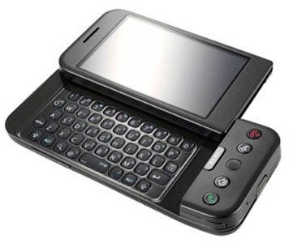
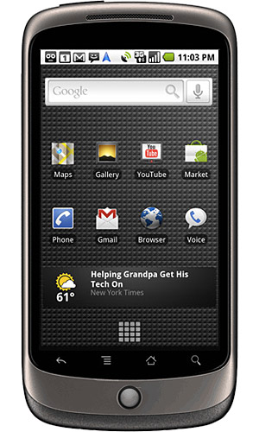
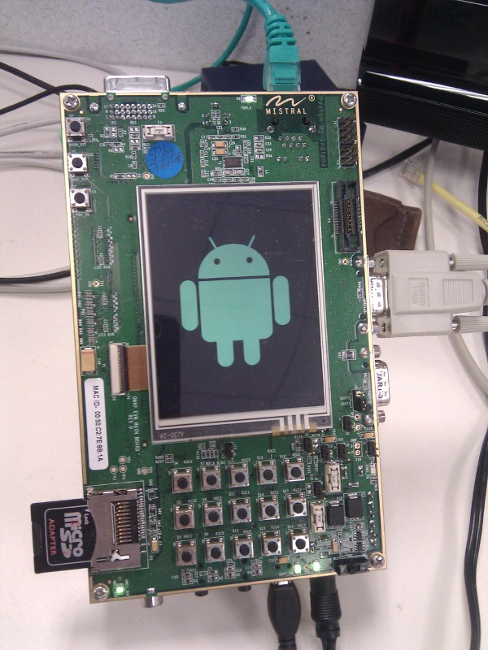
Measuring boot time
Systems Measured
  Android Developer Phone (ADP1)
    Qualcomm MSM7201 at 528 MHz with 192M RAM
    Running Donut (1.6)
  Nexus 1
    Qualcomm 8250 at 1 GHz with 512 RAM
    Running Eclair (2.1)
  OMAP Evaluation Module
    TI OMAP 3530 at 600 MHz with 128M RAM
    Running Eclair

Slide 5
Tools used
Stopwatch
  It's kind of sad that it takes so long that you can use a stopwatch
Message loggers
  Grabserial
  Printk times
  Android system log
Bootchart
Strace
Dalvik method tracer*
Ftrace*

Slide 6
Grabserial
Tool for measuring time of printouts on a serial port, from a host machine
  Only useful with EVM board, which has serial console
Shows timestamp for each line received over serial console
See http://elinux.org/Grabserial

Slide 7
Printk-times
Kernel option for adding time stamp to each printk
  Set CONFIG_PRINTK_TIME=y
  Option is on "Kernel hacking" menu, "Show timing information on printks"
Can save view on serial console, or after boot with ‘dmesg’
Can turn on 'initcall_debug' on kernel command line
See http://elinux.org/Printk_Times
Init program also outputs to /dev/kmsg
  Can adjust loglevel of 'init' program
    Change “loglevel 3” to “loglevel 7” in /init.rc

Slide 8
Bootchart
'init' gathers data on startup
  Must re-compile 'init' with support for bootchart data collection
A tool on the host produces a nice graphic
See http://elinux.org/Bootchart and http://elinux.org/Using_Bootchart_on_Android

Slide 9
Strace
Shows system calls for a process (or set of processes)
Is part of AOSP since Eclair
Can add to init.rc to trace initialization.
  For example, to trace zygote startup, in /init.rc change:
to
service zygote /system/bin/app_process -Xzygote /system/bin --zygote --start-system-server
service zygote /system/xbin/strace -tt -o/data/boot.strace /system/bin/app_process -Xzygote
/system/bin --zygote --start-system-server

Slide 10
Android system log
Android has built-in logging system
Use ‘logcat’ command to view messages
I added extra instrumentation for class preloading and package scanning
I also set PARSE_CHATTY flag for package scanning
I built my own tool (logdelta) to scan log and produce 'delta' times

Slide 11
Logcat specifics
Interesting info is emitted into both the “main” log and the “event” log
To get main log info, use:
  adb logcat –v time –d *:V >test.log
  grep preloaded and grep “Time to scan”
  E.g. logdelta test.log | grep Contacts.apk
To get events info, use:
  adb logcat –b events –v time –d | grep boot

Slide 12
Dalvik method tracer
Method tracer is built into Dalvik
Can be activated with ddms or using calls inside source
Unfortunately, it didn’t work on the EVM platform, due to a problem with the clock
Would be problematical for boot anyway, since thread of execution goes outside of Java (into C++ and kernel) for lots of important operations

Slide 13
Ftrace
I could have really used ftrace for some things
  Like to see page faults intermingled with system calls
Kernel version for EVM (2.6.29) didn’t support it
Should be usable in future version of Android (Froyo is at 2.6.32)
NOTE: ARM is missing function graph tracing
  But there’s a fix
  See http://elinux.org/Ftrace_Function_Graph_ARM

Slide 14
Measurement results
Stopwatch
Grabserial
Printk times
Strace
Bootchart
Logcat

Slide 15
Stopwatch results
Platform | Time to static splash screen | To animated splash | To home screen | Number of apps
ADP1 | 4 | 32 | 57 | 39
Nexus 1 | 3.5 | 20 | 36 | 79
EVM | 17* | 37 | 62 | 45
NOTES: All times in seconds.
*EMV used a development bootloader, with high overhead and delays

Slide 16
Printk-times results
ADP1 kernel boot time
  6.2 second kernel boot
EVM kernel boot time
  Clock not re-initialized at bootup
  Have to diff end time with first reported time
  6.2 second kernel boot
[ 6.276367] Freeing init memory: 116K
[44935.943115] OMAP DMA hardware revision 4.0
….
[44942.164093] VFS: Mounted root (nfs filesystem) on device 0:12.
[44942.170196] Freeing init memory: 164K

Slide 17
Initcall_debug results
77515 usecs - initcall omap_kp_init+0x0/0x1c returned 0
99152 usecs - initcall ehci_hcd_init+0x0/0xa4 returned 0
106334 usecs - initcall omap3evm_soc_init+0x0/0x9c returned 0
107079 usecs - initcall inet_init+0x0/0x1dc returned 0
115603 usecs - initcall omap_mmc_init+0x0/0x1c returned 0
148236 usecs - initcall omapfb_init+0x0/0x34 returned 0
154584 usecs - initcall omap_nand_init+0x0/0x30 returned 0
269770 usecs - initcall clk_disable_unused+0x0/0x8c returned 0
1514553 usecs - initcall ip_auto_config+0x0/0xdbc returned 0
Interesting init_calls:
  ip_auto_config = 1.51 seconds
  ehci_hcd_init = .1 seconds
    Usually more on real hardware
  Various omap init routines = .86 seconds

Slide 18
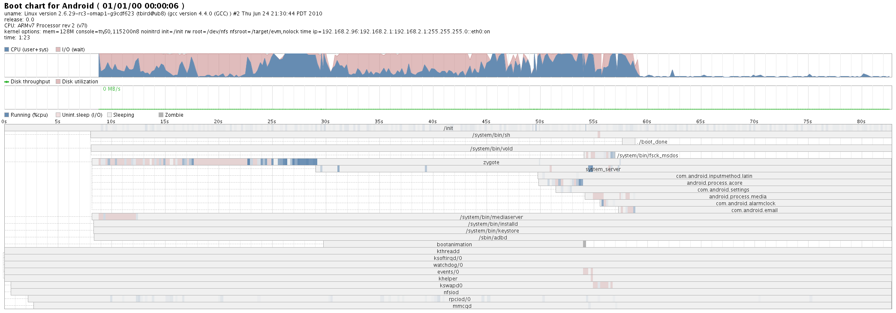
Bootchart results

Slide 19
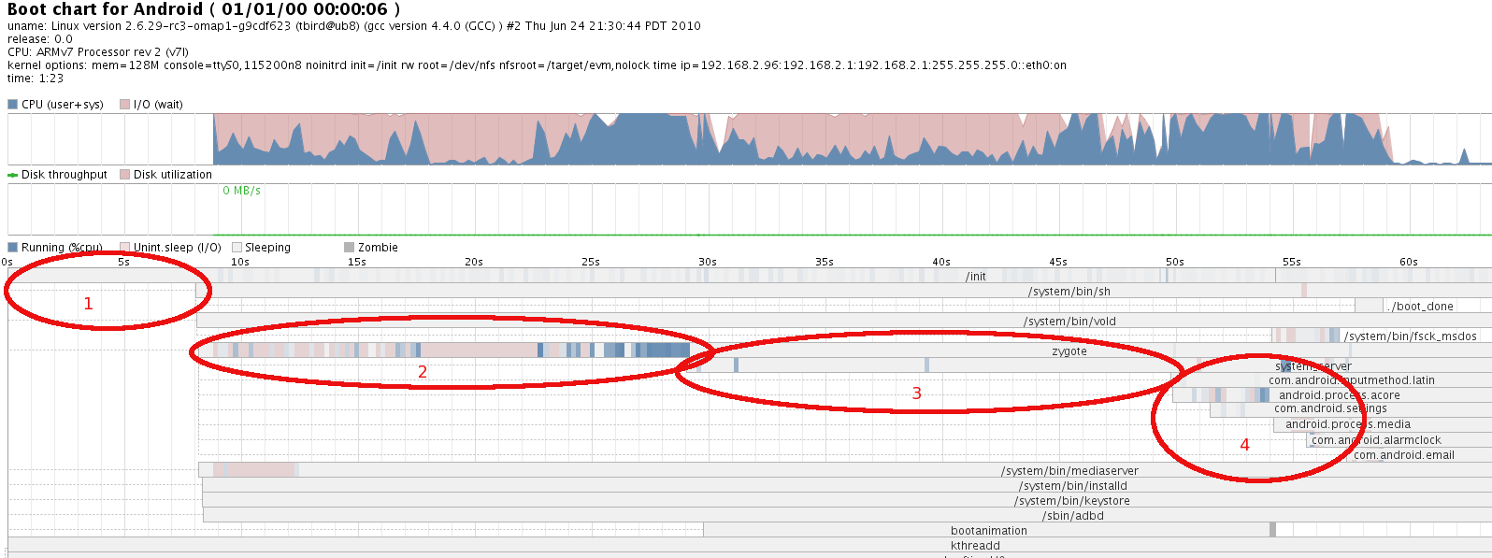
Bootchart closeup

Slide 20
Regions of interest
Area 1 = kernel init
  Approx. 8 seconds in this chart
Area 2 = zygote class preloading
  From approx. 8 to 29 seconds into boot
    21 seconds
Area 3 = PackageManager package scanning
  From approx 29 to 50 seconds into boot
    21 seconds
Area 4 = System Services starting
  From approx. 50 to 59 seconds into boot
  9 seconds

Slide 21
Logcat results (main)
ADP1:
  preloaded 1514 classes in 11530ms
  Time to scan packages: 10.064 seconds
N1:
  preloaded 1942 classes in 5360ms
  Time to scan packages: 8.975 seconds
EVM:
  preloaded 1942 classes in 13619ms
  Time to scan packages: 19.731 seconds

Slide 22
Logcat results (events)
I/boot_progress_start( 754): 12559
I/boot_progress_preload_start( 754): 17879
I/boot_progress_preload_end( 754): 28546
I/boot_progress_system_run( 768): 29230
I/boot_progress_pms_start( 768): 29697
I/boot_progress_pms_system_scan_start( 768): 30117
I/boot_progress_pms_data_scan_start( 768): 44171
I/boot_progress_pms_scan_end( 768): 50006
I/boot_progress_pms_ready( 768): 50505
I/boot_progress_ams_ready( 768): 53166
I/boot_progress_enable_screen( 768): 56793

Slide 23
Problem Areas
Bootloader init
Kernel init
Zygote class preloading
Package scanning
Service initialization

Slide 24
Bootloader init
Outside scope of this talk
Didn't measure commercial bootloader, only development one (U-boot)
Is contained within first 4 seconds on phones (I think)

Slide 25
Kernel Init
Is mostly the usual suspects
  ip_auto_config
  USB (ehci, ohci) init
  OMAP flash and driver initialization
See initcall_debug results
Just follow standard instructions for optimizing initcalls in the kernel
  See http://elinux.org/Boot_Time
Some of this is board-specific
  Depends on your flash controller
  Is outside scope of this talk

Slide 26
Zygote class preloading
Zygote pre-loads just under 2000 classes, and instantiates them in its heap
Controlled by resource: preloaded-classes
Which comes from source:
  frameworks/base/preloaded-classes
Google developers say you can adjust this as much as you like
  Android can boot without preloading any classes
  Can add or remove individual classes
    I found that AutoText took 4 seconds to load
  HOWERVER – it can result in bad application load times and memory usage later

Slide 27
Package manager package scan
EVERY package is scanned at boot time
Very deep nesting, with abstraction
Not sure of exact set of purposes
  But I see validation of certificates, permissions, capabilities and dependencies, etc.
Very difficult to trace
  It bounces between java, c++ and kernel
  And uses mmaped files (meaning accesses cause page faults)!!
    So it's not even using syscalls for reading the data

Slide 28
Package scan call tree
callstatic("com/android/server/SystemServer","init2")
init2()
main(context, factoryTest)
PackageManagerService(context, factoryTest)
scanDirLI(dir, flags, mode)
scanPackageLI(file, file resfile, flags, mode)
parsePackage(file, dest filename, metrics, flags)
parsePackage(file, dest, metrics, flags)
openXmlResourceParser(cookie, filename) (“AndroidManifest.xml“)
openXmlBlockAsset(cookie, filename)
openXmlAssetNative(cookie, filename)
android_content_AssetManager_openXmlAssetNative
openNonAsset(cookie, filename, flag)
openNonAssetInPathLocked(filename, mode, asset_path)
getZipFileLocked(asset_path)
getZip(ap.path)
get(path)
getZip()
SharedZip(path, modWhen)
ZipFileRO::open(path)
parseZipArchive(void)
get4LE(ptr)
(memory access)

Slide 29
parseZipArchive()
Evil routine that builds an in-memory data structure for accessing a package file
Scans the entire package, checking the content headers
  Caused read of almost entire package
  Touches every page in mmaped file, even if a sub-file in the archive won't be read later
  i.e. Entire package file is read, when only the AndroidManifest.xml file is requested

Slide 30
Ideas for Improvements
First, a side note on toothpaste..
Kernel speedups
Optimize package scan
Optimize class preloading
Miscellaneous optimizations
Readahead??

Slide 31
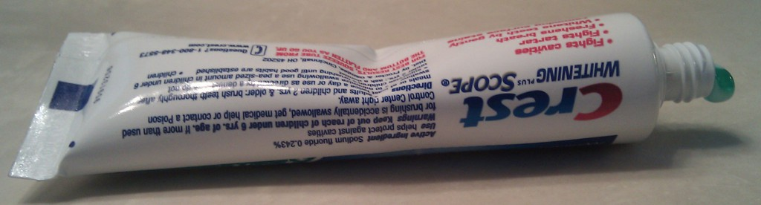
Toothpaste
When you squeeze a tube of toothpaste, sometimes it just moves the toothpaste somewhere else in the tube, and nothing actually comes out.
Same with optimizations:
  Reduction in one area causes problem (speed or size) in some other area

Slide 32
Toothpaste (cont.)
“Toothpaste effect” is demonstrated with class preloading and page cache effects
I tried to improve things
  But the I/O delays just moved somewhere else in the system
  Sometimes making things worse
  AutoText class preload example:
      Eliminated preload of AutoText class and gained 4 seconds during class preloading, but /system/frameworks/frameworks-res.apk was just loaded later in the boot, costing 4 seconds there
  Contacts.apk package scan example:
      Moved AndroidManifest.xml to its own package, to avoid reading the entire (1.6M) package to build the package index, but next reference of Contacts.apk contents caused the index rebuild again (costing the entire page cache load)

Slide 33
Kernel speedups
Outside the scope of this presentation
See http://elinux.org/Boot_Time
Should really be able to get kernel up in 1 second
  Modulo network delays

Slide 34
Optimize Class Preloading
Preload less, and let apps pay penalty for shared class and resource use
  Move some classes to services, and have preloaded class be an accessor stub
  Figure out how to share heap back with zygote
  This needs a lot of analysis - Google Android devs know that the whole process of selecting what classes to preload is a black art
Thread the heap construction
  There is some evidence that class preloading has I/O waits, and would benefit from threading
  Don't know if this is possible
  NOTE: all threads need to terminate before spawning Android apps

Slide 35
Use pre-constructed dalvik heap
Basic operation:
  Snapshot the heap at end of preloading
  Check for modifications to any class in preload list, and do regular preload
  Otherwise, load pre-constructed heap
Issues:
  Don't know if this is possible
    Need to find parts of heap that are identical on each boot
    Probably need separate "always-the-same" and "may-change" classes
  Need careful analysis, and might need knowledge of each class

Slide 36
Optimize Package Scan
Most definitely! This should be first thing attacked
I tried first order optimization
  Removed per-file signature check in parseZipArchive()
  This reduced duration of this routine (cumulative for 138 calls) by several seconds
  But… total boot time was not reduced (!!)
    Toothpaste effect strikes again!
Need to continue analysis
  May need to switch to a compressed flash file system, instead of managing indexing and compression in user space.

Slide 37
Miscellaneous
zoneinfo inefficiences
  Discovered with strace
  Routine that does read syscall for 40 bytes, then 8 bytes, then another 8 bytes (hundreds of times)
    No buffering at user level
    Sloppy loop coding
  Linear scan of timezone file
    For a file not present!!
  Probably only a few hundred milliseconds, but worth changing

Slide 38
readahead
I got interesting results from pre-filling the page cache
  Just added following to /init.rc
Results:
  Use of cat delayed start of class preloading by ~2 seconds
  Reduces package scan time by ~10 seconds
  Reduced total boot time by ~5 seconds
service preload /system/bin/cat /system/framework/framework-res.apk /system/app/Music.apk /system/app/Gallery.apk /system/app/Camera.apk /system/app/Settings.apk /system/app/Launcer.apk /system/app/Contacts.apk /data/app/ApiDemos.apk >/dev/null
oneshot

Slide 39
Readahead notes
Could use [s|u]readahead to pre-fill page cache
Note: Bionic is missing readahead syscall definition and libc call
However…
  Using readahead masks bad behavior
  Contacts.apk (half of 1.6M) is read 4 times! during boot
  Filling page cache makes reads after first one fast, but it would be better to avoid (most of) the reads altogether
    Would be good to just optimize or eliminate parseZipArchive()
sreadahead should be used as last optimization (after all other enhancements)

Slide 40
Conclusions
Only about 5 seconds reduction in boot time
  From pre-filling page cache with ‘cat’
  Warning: On dev board with NFS rootfs
But, have a good foundation and set of tools for improving things going forward
  Good idea of where time is spent

Slide 41
Observations
“Premature optimization is the root of all evil”
  Be very careful of optimizing wasteful operations
  Better to improve or eliminate the operations, than hide the wasteful operations with caching
Beware of systemic or architectural problems
  Package management basically builds a persistent container and compression architecture in user space
  Except, it does it poorly. (It rebuilds the in-memory data structure for indexing an archive over and over.)
  Just use a file system, for heaven's sake!

Slide 42
Resources
Wiki page for this talk: http://elinux.org/Improving_Android_Boot_Time
Use android-porting, android-platform, and android-kernel mailing lists, depending on where your issue is
  See
  http://elinux.org/Android_Web_Resources#Mailing_Lists
My e-mail: tim.bird (at) am.sony.com

Slide 43
Thanks for your time
Questions and Answers

