Slide 1

Git and GitHub An Introduction
Duhai Alshukaili
http://chapter10.wordpress.com
Jan 30-31, 2024

Slide 2
Git Basics

Slide 3
What is Git?
Distributed Version Control System.
A time machine for your code.
Efficiently manages multiple copies of your code.
Enables collaboration and history management.
Essential for modern software development.¹
One of need to have skills by programmers (https://bit.ly/3tkr7xd)

Slide 4
What is a Version Control System?
A software tool that helps track and manage changes to files, code, or any other set of digital assets over time.

Slide 5

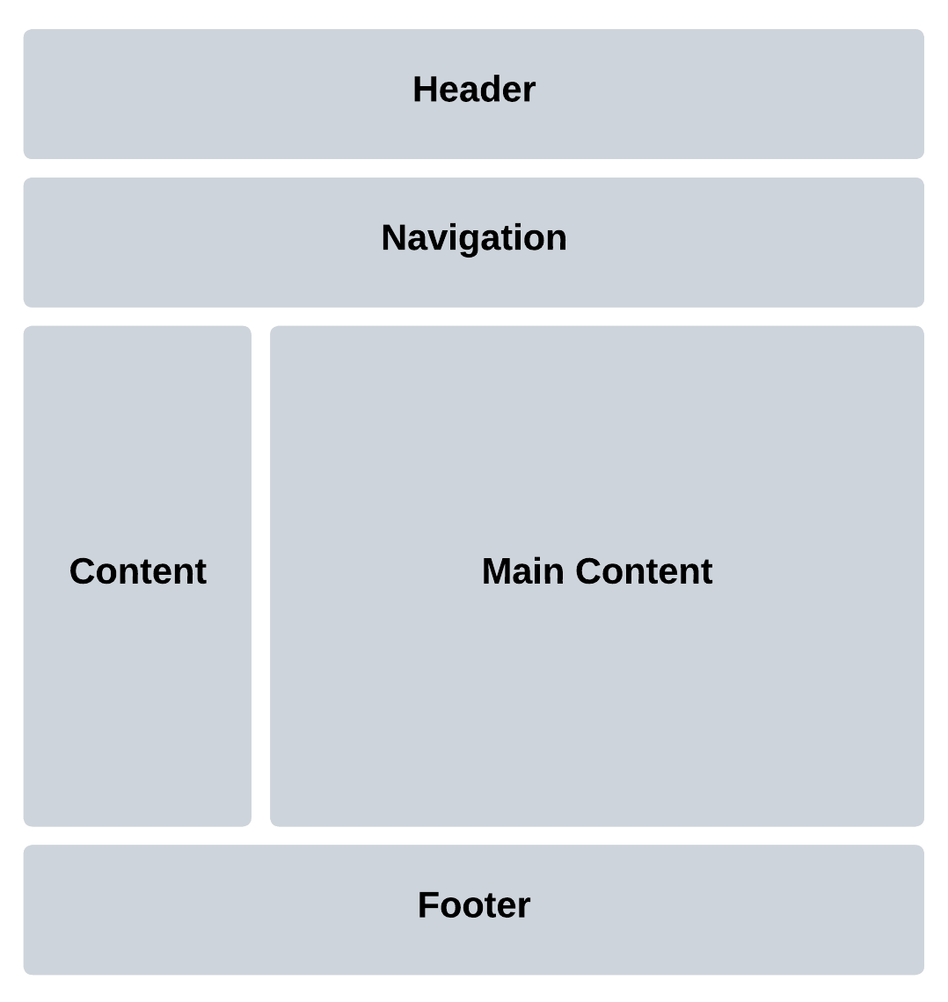
What is a Version Control System?
Project v0.1
Project v0.2
Project v0.3
Project v0.4

Slide 6
What is a Version Control System?
Project v0.1/v0.2/v0.3

Slide 7





Version Control Systems

Slide 8
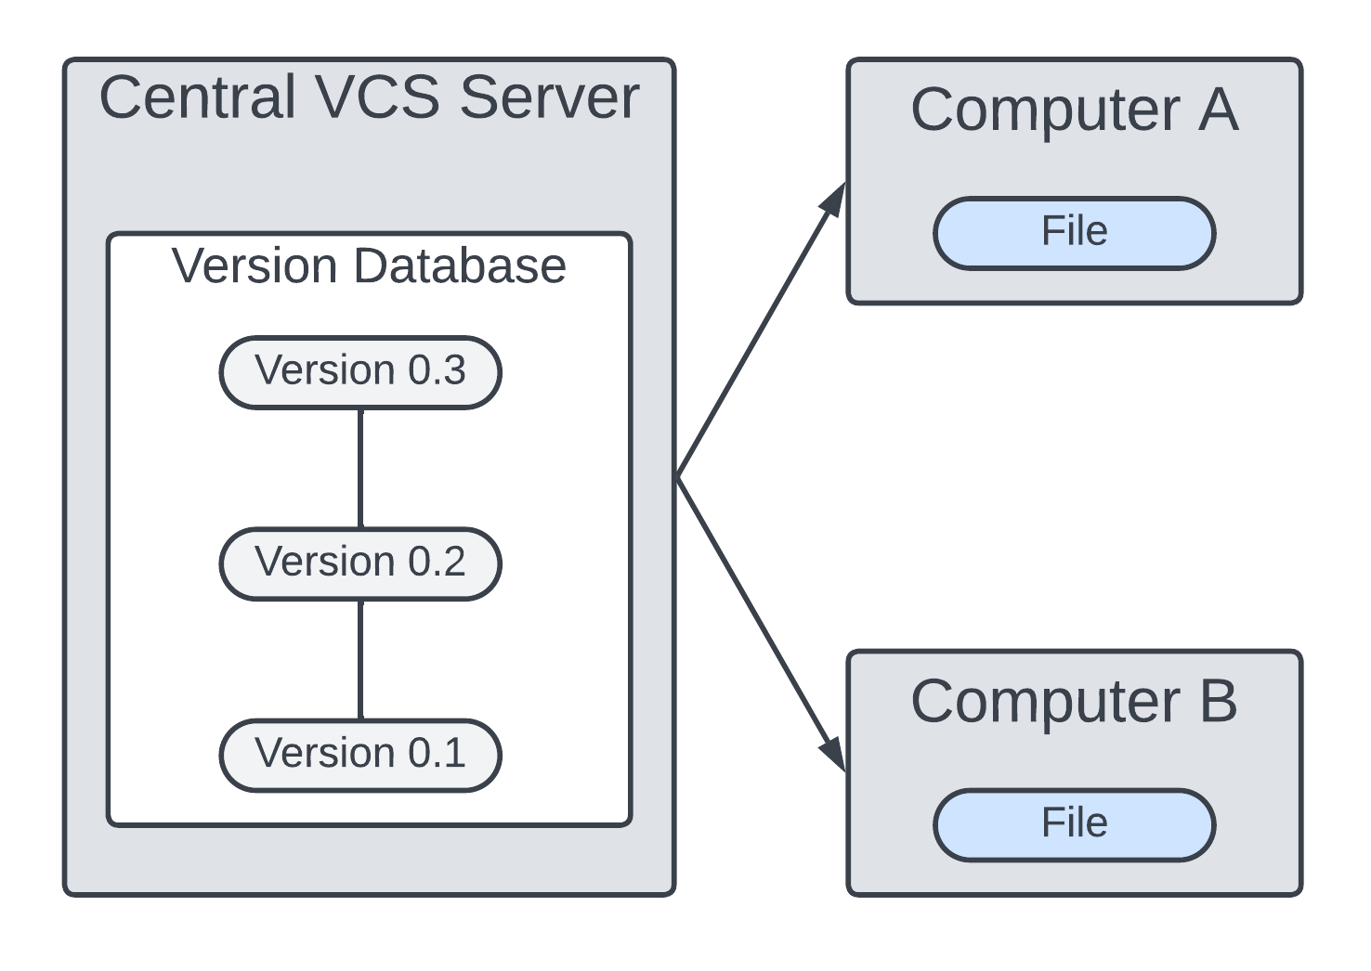
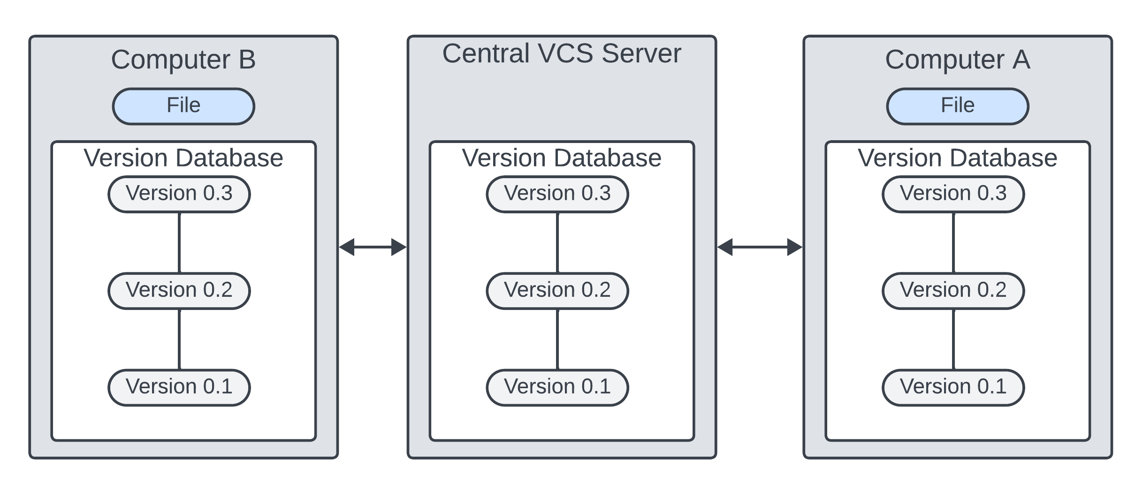
Centralized VCS
Distributed VCS

Slide 9
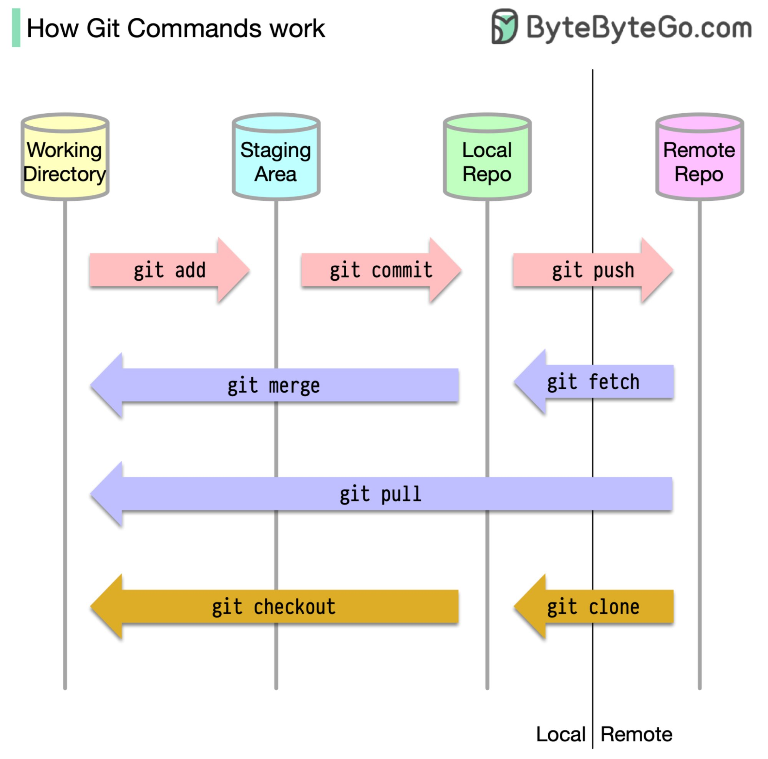
git init

Slide 10

Tooling Up
We will need the following:
A code editor: VS Code
Git
Terminal
In Windows OS: Git Bash (comes with Git)

Slide 11
Essential Terminal Commands
Check current working directory: pwd
Navigate to a specific directory: cd folderPath
Making a new directory: mkdir folderName
Go up one directory: cd ..
To create a new file: touch fileName
To rename the file: mv oldName newName
List the content of a directory: ls folderName
Copy a file to another directory: cp filePath destination
To remove a file: rm fileName
To remove a folder: rm –rf folderName

Slide 12
Create Our First Repository (Repo)
Let us say you have an existing code that is placed in some directory.
To create a new repo use the command git init
After initialization all the files in the directory will be untracked.
You can get a status of your repo using git status command
To get help about a specific git command use --help switch
Ex: git init --help

Slide 13
Tracked vs Untracked Files
Tracked Files:
Files which were in the last snapshot
Untracked Files
Files which were not in the last snapshot

Slide 14
Untracked Files
Modified Files
Staged Files
Committed Files
index.html
index.html
index.html
index.html
style.css
$ git add index.html
$ git commit –m “First Commit”
$ git add index.html
History
First Commit

Slide 15
Checking the History of Commits
To see the history of your commits use the command:
$git log
To get a more concise history use the command:
$git log –oneline
You can create a shortcut command of the above by using:
$git config --global alias.hist "log --oneline"
With that you can view the history using: $git hist

Slide 16
COMMIT_EDITMSG File
If you commit a file without a “-m” flag, an editor window will open a file named COMMIT_EDITMSG.
Note the file will be opened using the default editor we set during the installation.
In this file you can type you commit message, similar to the message given to the –m flag.
Useful for long message.

Slide 17
Your Turn: Activity 1
Set Up Your Environment
Install Git on your computer.
Configure Git to use VS Code as your default text editor.
Open your terminal or Git Bash.

Slide 18
Your Turn: Activity 2
Basic Git Commands
Check your current working directory using the pwd command.
Create a new directory using mkdir.
Navigate to the directory you just created using cd.
Create a new file using touch.
Use ls to list the contents of your directory.
Rename a file using mv.
Remove a file and a directory using rm.

Slide 19
Your Turn: Activity 3
Initialize a Git Repository
Initialize a new Git repository in your directory using git init.
Check the status of your repository with git status.

Slide 20
Undoing Your Work

Slide 21
The HEAD Pointer
You can use the $git show <commit> command to see the details of particular commit.
For the current commit, Git uses the term HEAD as reference to the current commit.
Thus: You can see the current commit by typing $git show HEAD

Slide 22
Using checkout Command
The checkout command is versatile. For now we can use it to:
Undo changes in modified files:
$git checkout <file-name> # file should be in (M) state.
Move the HEAD pointer to a previous commit.
$git checkout <commit>
Checkout is considered as a safe option to go back in time as you can delete or modify previous commits.

Slide 23
Using revert Command
The revert command allows you to revert the changes made by specific commit.
$git revert <commit>
The changes of the made in the specified <commit> are undone and the modification because of revert is committed.
Note, revert does not touches and other changes made by other commits.

Slide 24
Using reset Command
The $git reset command is used to move the HEAD pointer to a spesfic commit.
Unlike checkout, reset allows you to make perment changes to the repo.
Unline revert, reset undo all the changes that were made after the commit we are reseting to.

Slide 25
Mixed Reset (Unstages Changes)
Use: $git reset –-mixed <commit>
Moves the HEAD pointer to <commit>
Unstages the changes.
To discard the changes permently, we need to use:
$git checkout <file-name>
The default flag for reset

Slide 26
Soft Reset (Preserve Changes)
Use: $git reset –-soft <commit>
Moves HEAD pointer to <commit>
Keeps the changes staged.
To unstage the files use: $git reset <file-name>

Slide 27
Hard Reset (Discard Changes)
Use: $git reset –-hard <commit>
Moves HEAD branch to <commit> and discards all changes.
A hard reset will remove the commit and make the changes in one single setp.
Be careful when using this command. You can esily shoot your self in the foot with it.

Slide 28
Ignoring Files by Git
To keep certain files, like auto generated ones, from being tracked, use the .gitignore file.
Ideally, this file should be created once you create the repo.
You need several steps to ignore files that have been committed (see next slide).

Slide 29
Example .gitignore file
# Ignore log files
*.log
# Ignore build directories
/build/
# Ignore a specific file
config.ini

Slide 30
Ignoreing Committed Files
To remove previouly committed files you need to do the following.
Add the files to the .gitignore
Use $git rm –r –-cached <file-name> to delete them from the index
Use $git reset . To unstage the files.
Last, use $git checkout . to discard the files.

Slide 31
Should I Commit .gitignore
It depends on the project.
See the following Stack Overflow discussion: https://bit.ly/3ZS280e

Slide 32
Your Turn: Activity 4
Staging and Committing
Add a file to the staging area using git add.
Commit your changes using git commit.
Create a commit without the -m flag and provide a commit message using an editor.
Use git log to view the commit history.

Slide 33
Your Turn: Activity 5
Undoing Changes
Explore the HEAD pointer using git show HEAD.
Use git checkout to undo changes in an unmodified file.
Undo changes and move the HEAD pointer to a previous commit using git checkout.
Demonstrate the revert command to undo a specific commit.
Explain the reset command for moving the HEAD pointer to a specific commit.

Slide 34
Your Turn: Activity 6
Ignoring Files
Create a .gitignore file to ignore specific files.
Explain how to ignore files that were previously committed.
Discuss whether you should commit the .gitignore file.

Slide 35
GitHub Basics

Slide 36



What is GitHub
GitHub is a web-based platform and service that is primarily used for version control and collaborative software development.

Slide 37
Git vs. GitHub
Git is a version control system that runs locally, while GitHub is a web-based platform for hosting Git repositories and enabling collaboration.
Git is used for local version control, whereas GitHub is used for remote collaboration and project management.
Git operates offline, GitHub relies on the internet for collaboration.
Git is software you install on your machine, GitHub is a service accessible via a web browser.

Slide 38
Pushing Our Code to GitHub Repo
$git remote add origin <URL>
# Add remote repo named “origin” with the specifed URL
$git branch –M main
# Rename the default branch from “master” to “main”
$git push –u origin main
# push the “main” branch from the local repo to remote repo
# named “origin”
Notes:
git remote add origin https://github.com/duhai-alshukaili/gitProject.git:
This command is used to add a remote repository named "origin" with the specified URL. It establishes a connection between your local repository and the remote repository on GitHub.
git branch -M main:
This command renames the default branch from its previous name (often "master") to "main." This change is in response to a broader industry effort to use more inclusive terminology.
git push -u origin main:
This command pushes the "main" branch from your local repository to the "main" branch of the remote repository named "origin" on GitHub. The -u flag is used to set up a tracking relationship between the local and remote branches. This means that in future pushes and pulls, you can simply use git push and git pull without specifying the branch and remote, as it remembers the relationship.

Slide 39
Making Commits on GitHub
You can use the Web browser to create and edit files.
In such a case all commits will be made via the browser.
Let us create a readme file using this method.

Slide 40
Pulling from GitHub to Local Repo
When you make commits in GitHub, the new commits are not reflected in the local repo
The same applied when someone else makes commits in remote repo.
The local repo need to pull the new commits using the $git pull command as follows:
$git pull origin main
Git connects to the remote repo “origin” and fetches the latest changes from the “main” branch.
After that, the changes are merged on the local checked-out branch (i.e., current branch).
Notes:
The command `git pull origin main` is used to update your local Git repository with changes from a remote repository, specifically from the branch named "main" in the remote repository named "origin." Here's a breakdown of the command:
- `git pull`: This command combines two primary Git operations, `git fetch` and `git merge`. It first fetches the changes from the remote repository and then merges them into your current local branch.
- `origin`: This is the name of the remote repository. In Git, "origin" is a default name often given to the remote repository from which you initially cloned or to which you've set up a connection.
- `main`: This is the name of the branch in the remote repository from which you want to pull changes. It's common to use "main" or "master" as the default branch name, but it can be named differently in some repositories.
Here's how `git pull origin main` works:
1. Git connects to the remote repository named "origin" and fetches the latest changes from the "main" branch in that repository.
2. Once the changes are downloaded to your local machine, Git automatically merges those changes into your currently checked-out branch (the branch you're currently working on).
The `git pull` command is especially useful when you want to update your local branch with the latest changes from a shared or central branch in a collaborative project. It ensures your local copy of the code is synchronized with the remote repository, allowing you to work on the most up-to-date codebase. If there are any conflicts between your changes and the changes in the remote branch, Git will prompt you to resolve them.

Slide 41
Simplifying git pull
If you don’t like to type the name of the remote repo and the branch you can use the following command to shorten your git pull:
$git branch –-set-upstream-to=origin/main main
Once that is done, now you can get any updates using the command:
$git pull

Slide 42
Your Turn: Activity 7
GitHub Setup
Create a GitHub account if you don't have one.
Log in to your GitHub account.
Explore the GitHub interface.

Slide 43
Your Turn: Activity 8
Create Your First GitHub Repo
Create a new repository on GitHub.
Name it and provide a description.
Take note of the repository URL.

Slide 44
Your Turn: Activity 9
Make Commits on GitHub
Use the GitHub web interface to create or edit files in your repository.
Make changes and create commits using the web browser.

Slide 45
Your Turn: Activity 10
Link Local Git to GitHub
Add a remote repository using git remote add origin <URL>.
Rename the default branch from "master" to "main" using git branch -M main.
Push your local main branch to the remote repository using git push -u origin main.

Slide 46
Your Turn: Activity 11
Make Commits on GitHub
Reflect on the fact that changes made on GitHub are not automatically reflected in the local repository.
Demonstrate how to pull changes from GitHub using git pull origin main.
Show how to simplify the git pull command using git branch --set-upstream-to=origin/main main.

Slide 47
Working with Branches

Slide 48
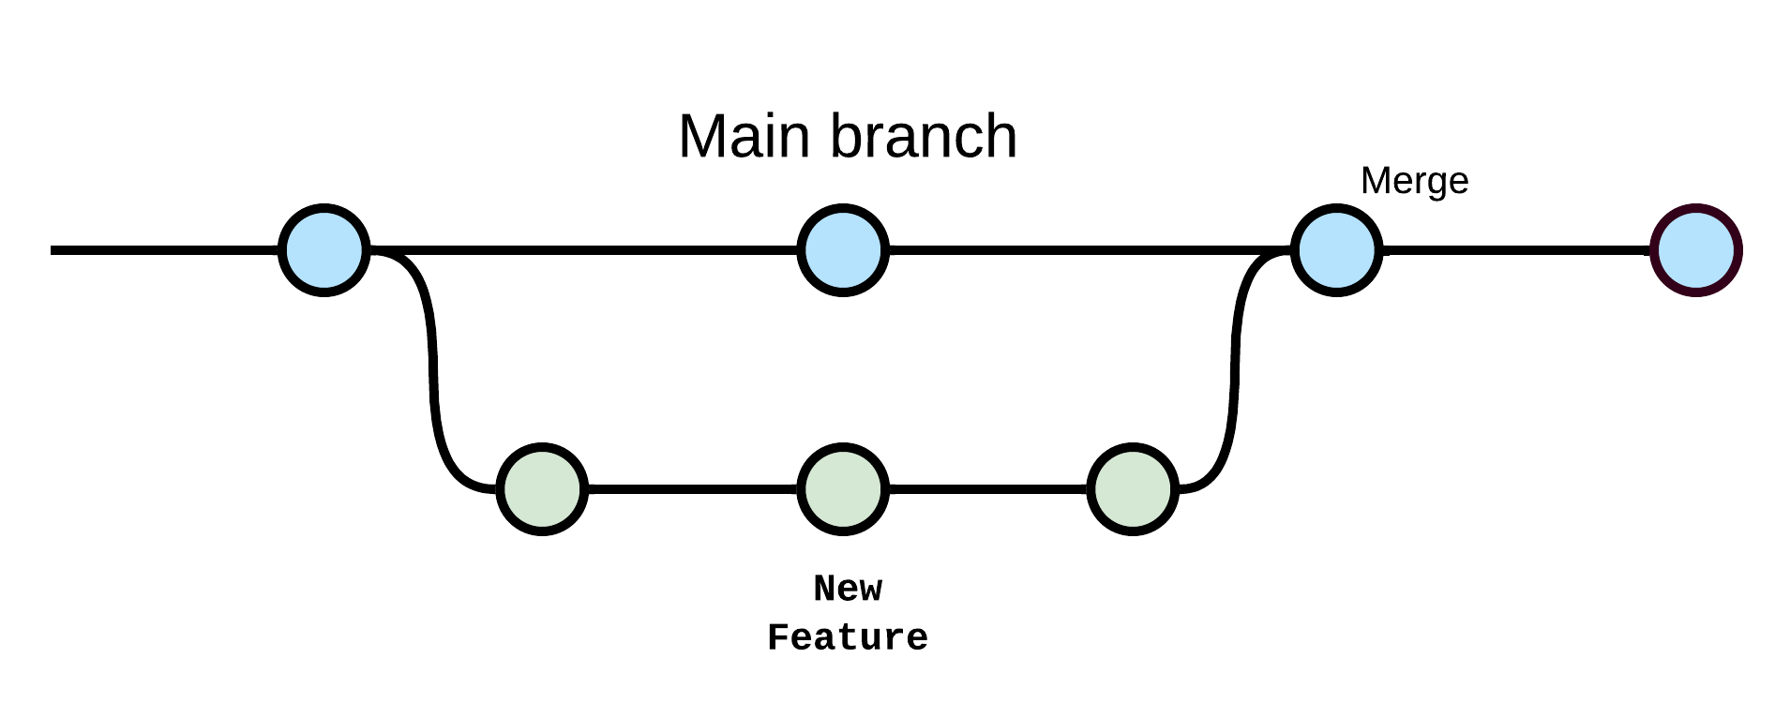
Git Branches
Branches are independent lines of work within a Git repo. They allow you to work on different features, bug fixes and experiments in isolation from the main branch.

Slide 49
Best Practices
Create a branch for each new feature or bug fix.
Regularly merge or rebase your branch to stay up to date with the main branch.
Keep branch names descriptive and meaningful.

Slide 50
Using git branch Command
To create a new branch use the command:
$git branch <branch-name>
To see the current branches use the command $git branch
The active branch will have an asterisk (*) next to its name.
To switch to a branch use the command:
$git checkout <branch-name>

Slide 51
Commits on A New Branch
Any commits that you will make in the in the new branch will not be available in the main branch.
At some point in time you will need to merge the changes you make to the main branch.
We will see that in a later slide.

Slide 52
More on Adding and Deleting Branches
You can create a branch and check it out in a single command using:
$git checkout –b <branch-name>
To delete a branch you need to use the command:
$git branch –D <branch-to-delete>
Note, that you can’t delete a branch that you are currently working on.

Slide 53
Pushing a Branch to GitHub
To push a branch we created in a local repo to a remote repo use the command:
# origin is remote repo name
$git push origin <branch-name>

Slide 54
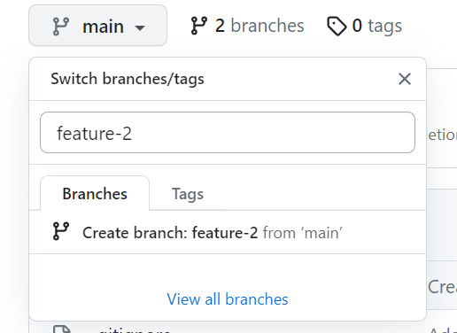
Creating Branches in GitHub
To pull a branch created in a remote repo use:
$git pull origin <remote-branch>
To switch to that branch use:
$git checkout --track origin/branch
--track means that the local branch will track the changes in the remote branch
To create a branch use the branch button
Notes:
The command git checkout --track origin/feature-1 is used to create and switch to a new local branch that is set to track the remote branch named "feature-1" on the remote repository named "origin." Here's a breakdown of the command:
git checkout: This Git command is used to switch between branches or navigate to a specific commit. In this context, it's being used to create and switch to a new branch.
--track: This option indicates that the new local branch should be set to track the specified remote branch. Tracking means that your local branch will automatically stay in sync with the remote branch when you perform Git pull and Git push operations.
origin/feature-1: This specifies the remote branch you want to track. It's in the format remote/branch. In this case, it's "feature-1" on the remote named "origin."
Here's what happens when you run git checkout --track origin/feature-1:
Git creates a new local branch named "feature-1" based on the remote branch "origin/feature-1."
The new local branch "feature-1" is set to track the remote branch "origin/feature-1."
Git automatically switches your working directory to the new "feature-1" branch, so you can start working on it immediately.
This command is often used when you want to start working on a feature or bug fix that already exists as a remote branch on a shared or remote repository. It's a quick way to set up a local branch that is connected to the corresponding remote branch, allowing you to collaborate with others and easily keep your local branch up to date with remote changes.

Slide 55

Deleting a Branch on GitHub
Note that you need to delete the branches locally as well using:
$git branch –D <branch-name>
From GitHub
Using the command line
$git push origin --delete <branch-name>

Slide 56
Your Turn: Activity 12
Create and Switch Branches
Explain the concept of branches in Git.
Create a new branch using git branch.
List branches using git branch and identify the active branch.
Switch to a different branch using git checkout.
Try the command git branch –b <branch-name>.

Slide 57
Your Turn: Activity 13
Make Commits on a New Branch
Create a new branch and make several commits.
Explain that commits made on this branch won't affect the main branch.
Push the new branch from your local repo to GitHub using git push origin <branch-name>

Slide 58
Merging Branches

Slide 59
Merging Branches
In Git, merging is the process of combing changes from one branch into the other.
It allows multiple lines of development to come together.
Git provides two primary methods for merging:
Fast-forward; and,
3-Way merge

Slide 60
Fast-Forward Merge
A fast-forward merge occurs when there are no new commits in the target merge (i.e., main).
Here, Git simply move the target branch pointer to the latest commit of the source branch.
How it works:
$git checkout <target-branch>
$git merge <source-branch>

Slide 61
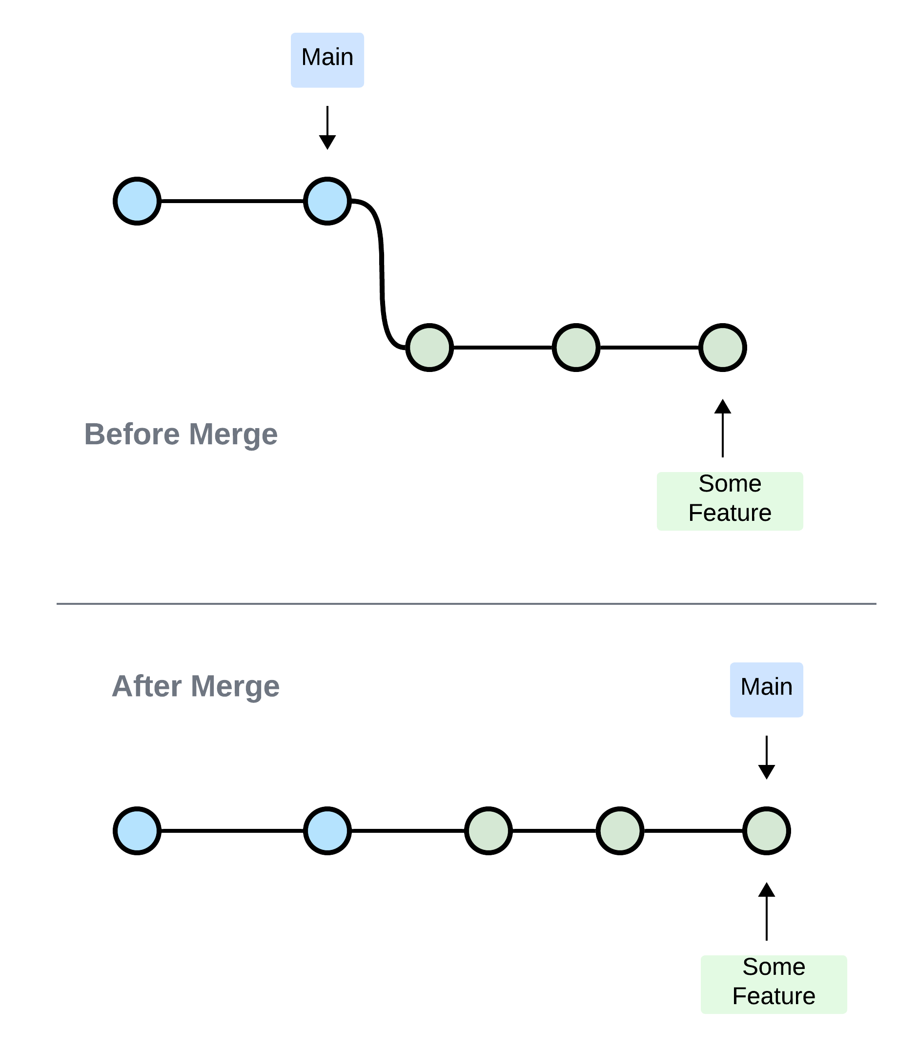
Fast-Forward Merge

Slide 62
3-Way Merge
A 3-Way merge occurs when there are new commits in both the sources and target branches to be merged.
It happens when both branches progress independently.
It works pretty much the same way as in Fast-Forward merge:
$git checkout <target-branch>
$git merge <source-branch>

Slide 63
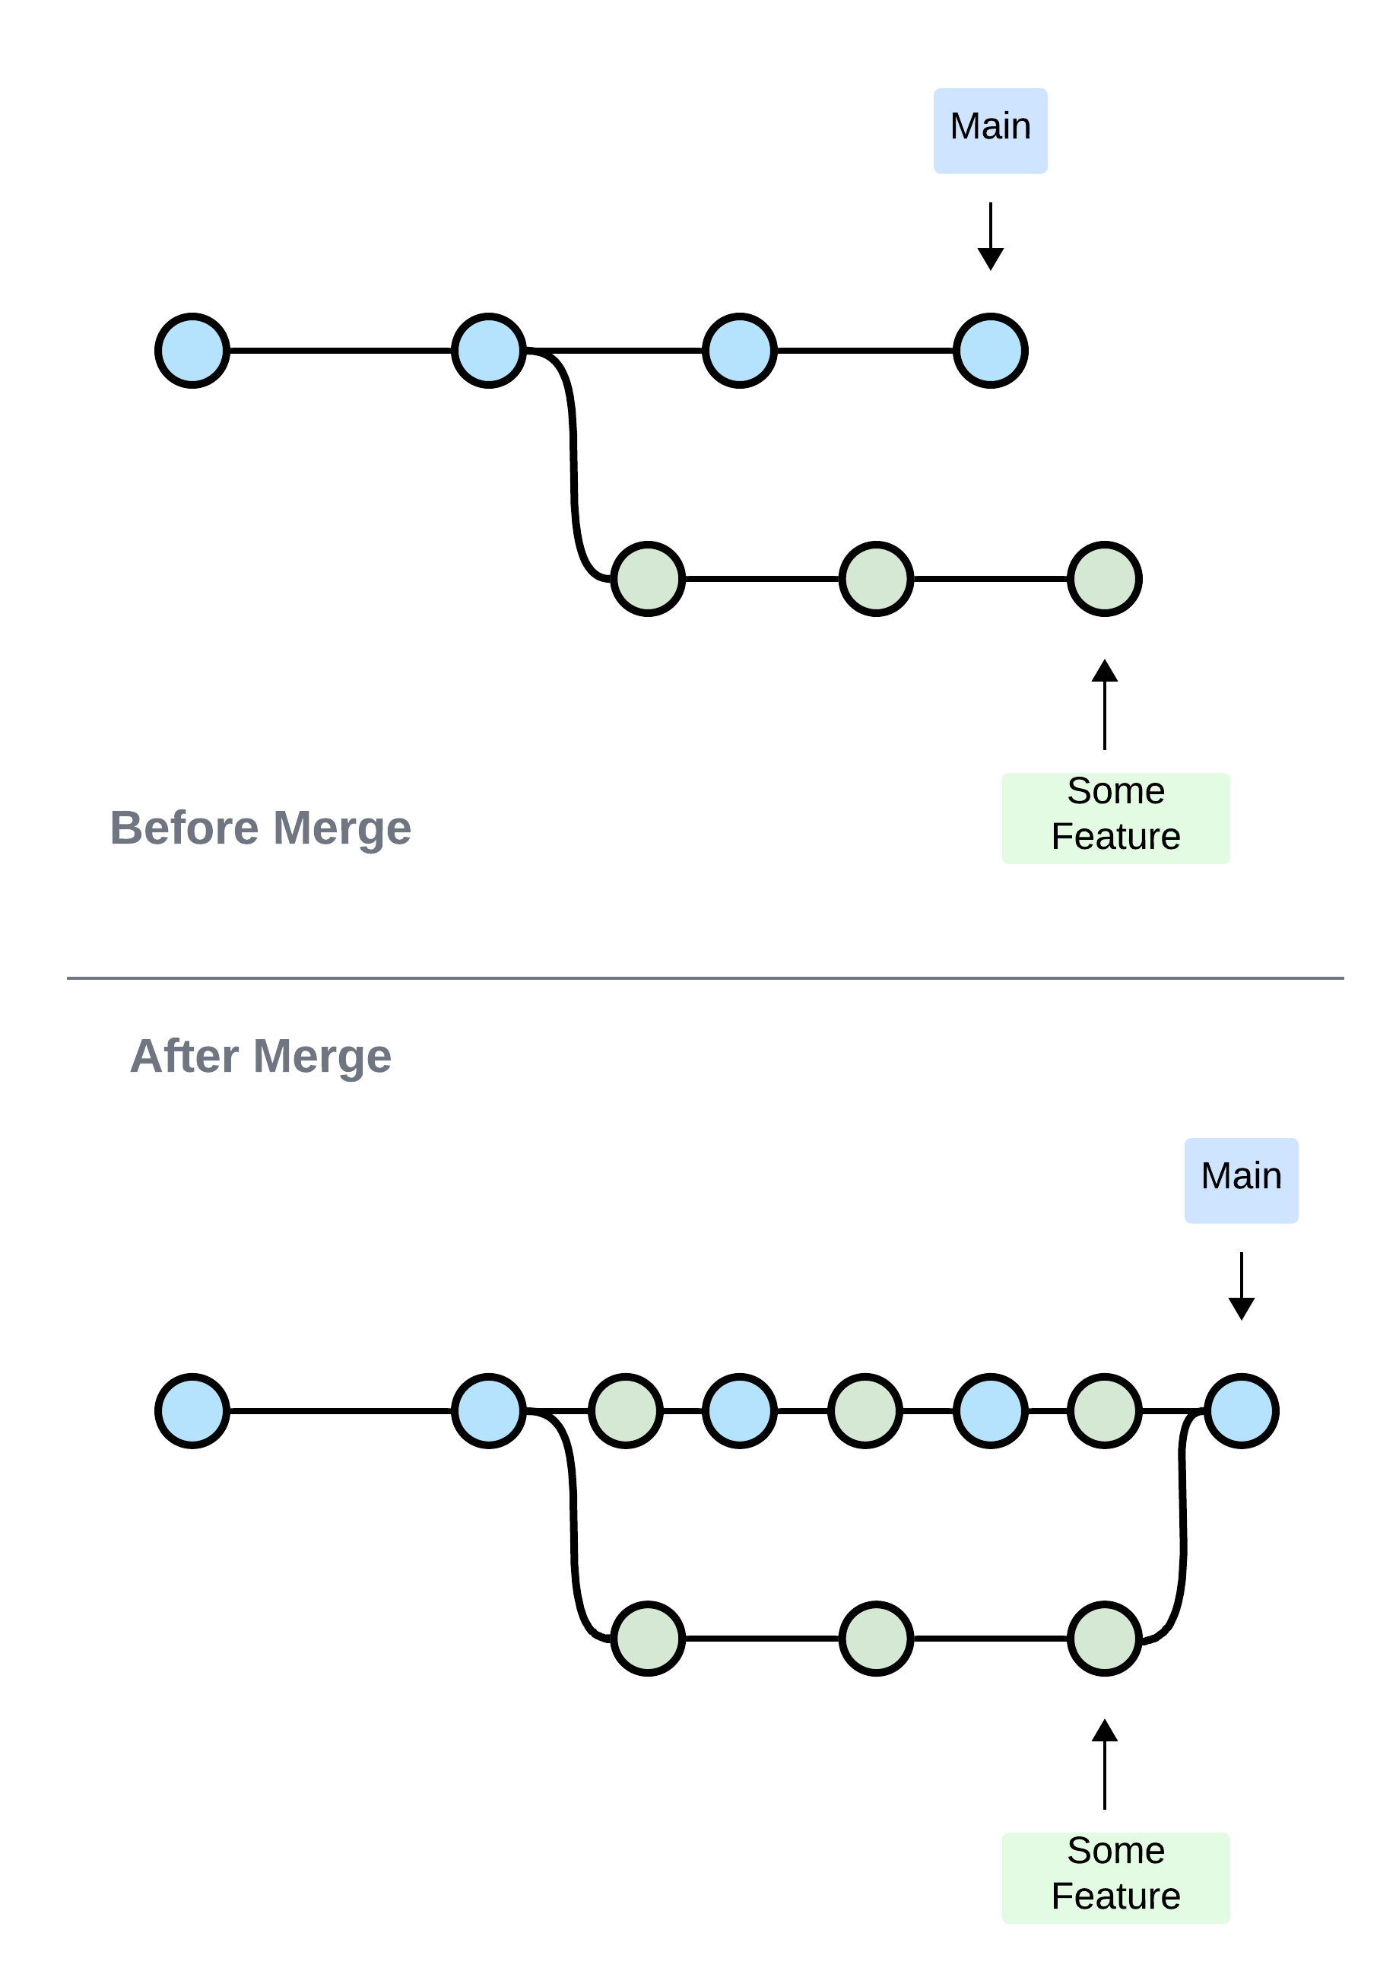
3-Way Merge

Slide 64
Merge Conflicts
Merge conflicts arise when changes in the source and target branches overlap and cannot be automatically merge.
This happens with conflicting changes are made in the same part of a source file.
It can also happen the same file is deleted in one branch but modified in another.
When trying to merge branches with conflicts, you will have to resolve conflicts manually.
You can decide to abort the merge by using:
$git merge --abort

Slide 65
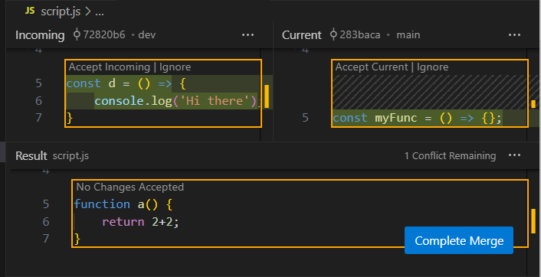
VS Code Merge Conflict Editor

Slide 66
Git Rebase
Git rebase is a technique for combining and rearranging commits from one branch onto another.
The rebase command helps to create a cleaner, more linear commit history by incorporating changes from different branches.
Rebase is useful when you want to clean and organized commit history.
It is ideal for feature branch updates before merging.

Slide 67
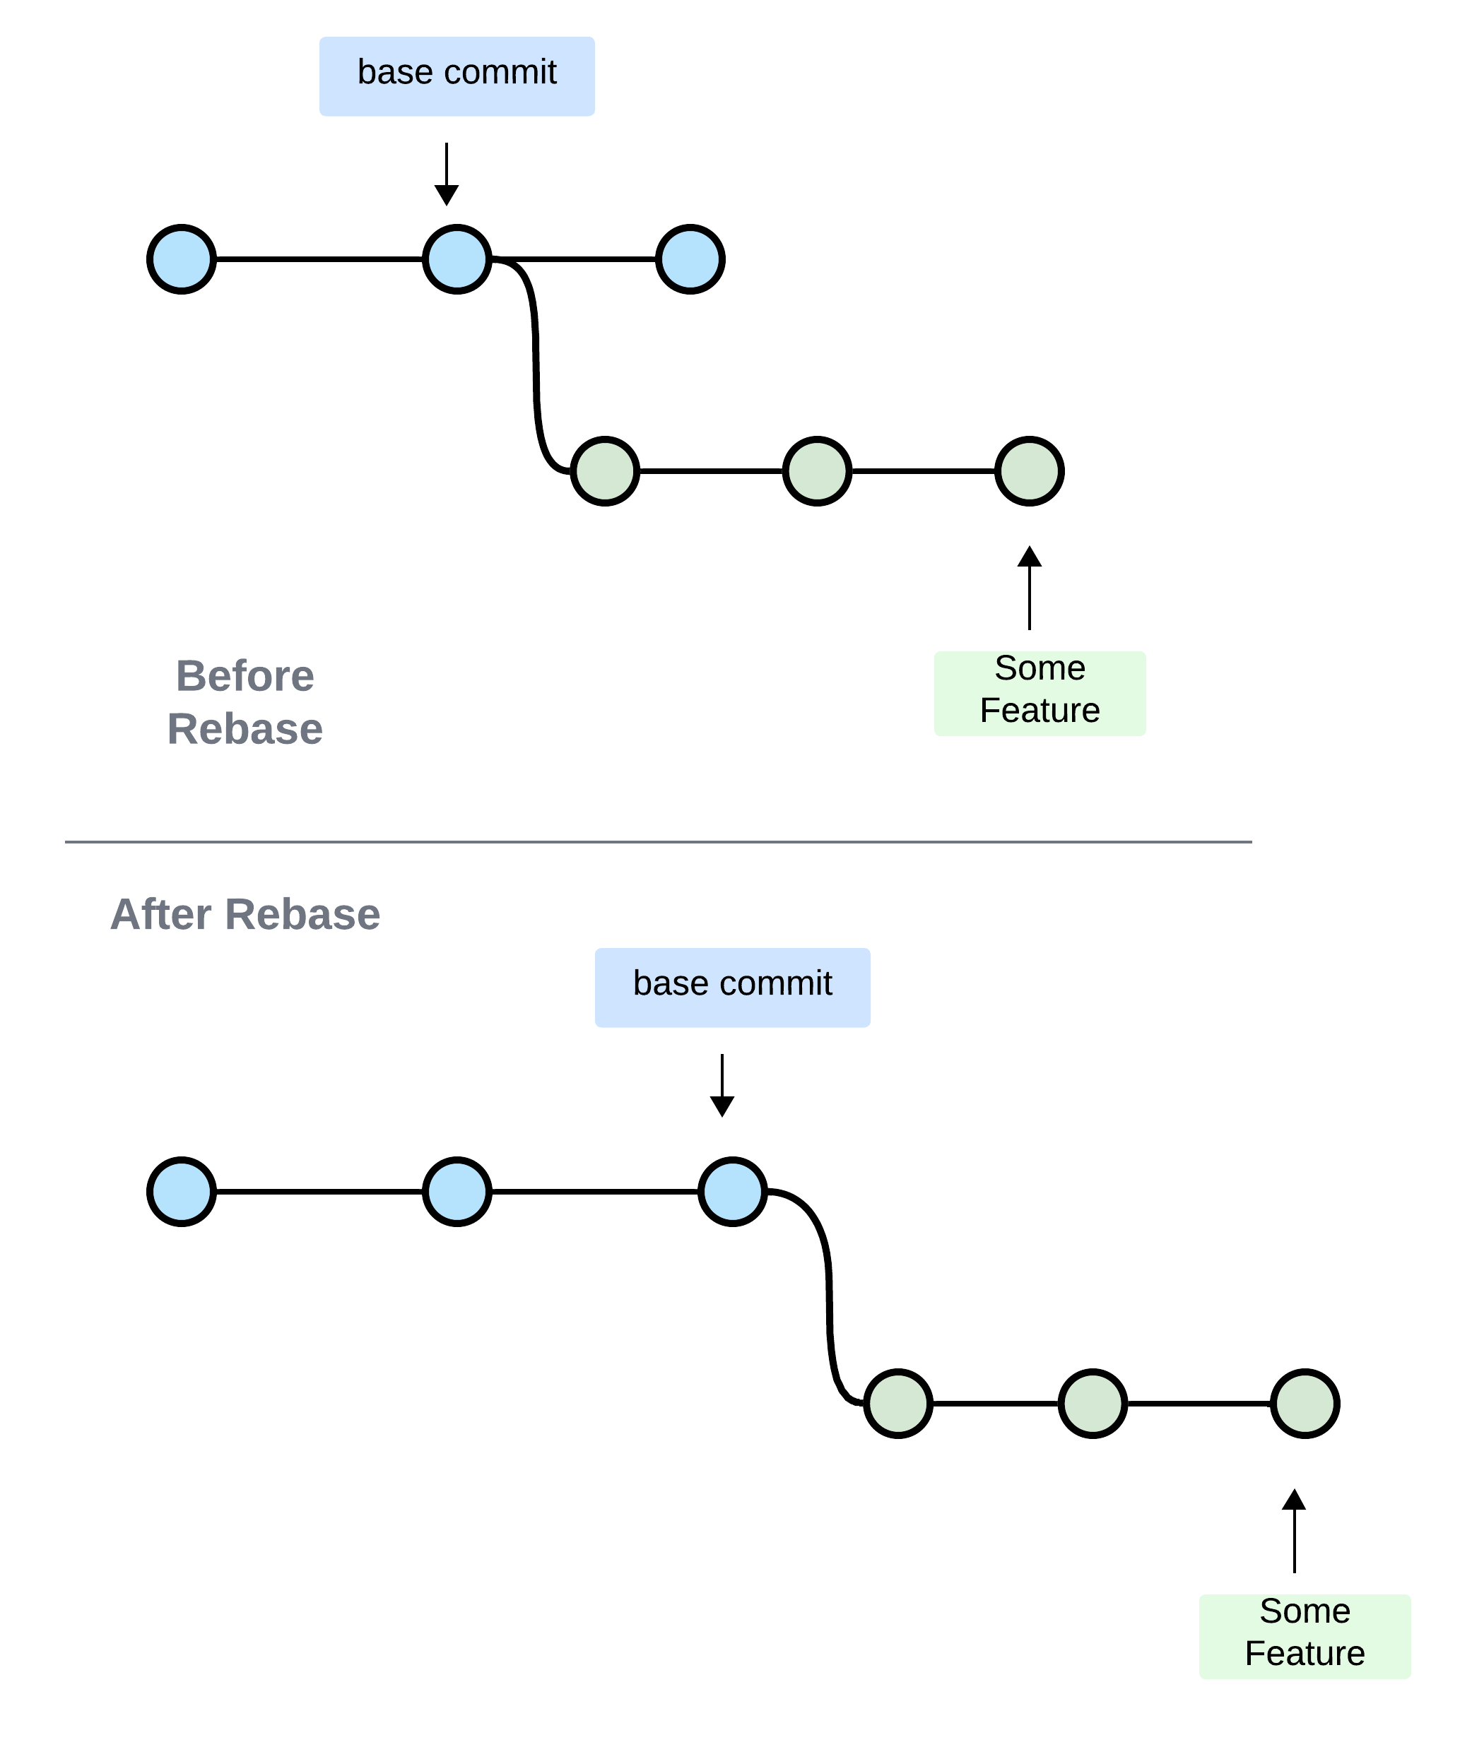
Git Rebase

Slide 68
Rebase Command
To perform a rebase, issue the following command from the feature branch:
$git rebase <base>

Slide 69
Merge and Rebase Advice
Avoid conflicts by encouraging developers not to over step into each other files.
Merge features into the main branch.
Rebase features on the main branch, not the other way around.
Avoid branching out on features, unless necessary.

Slide 70
Your Turn: Activity 14
Merging and Resolving Conflicts
Draw diagrams that illustrate two primary merging methods: fast-forward and 3-way merge.
Demonstrate a fast-forward merge using git merge.
Show a 3-way merge using git merge when there are new commits in both branches.

Slide 71
Your Turn: Activity 15
Handling Merge Conflicts
Discuss what merge conflicts are.
Demonstrate how to resolve merge conflicts manually in a text editor.
Show how to abort a merge using git merge --abort.

Slide 72
Merging Branches on GitHub

Slide 73
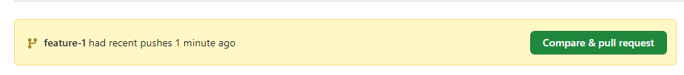
Compare and Pull Request in GitHub
Compare and Pull Request are essential feature in GitHub for collaborative software development.
When you introduce commits into a feature branch, GitHub notifies you through an alert message.

Slide 74
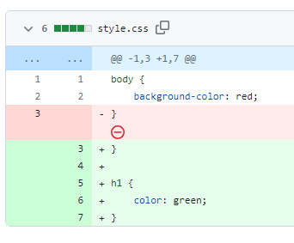

Compare
A compare allows you to view the difference between two branches, typically feature branch and a main branch. It helps you review the changes before integrating them.

Slide 75
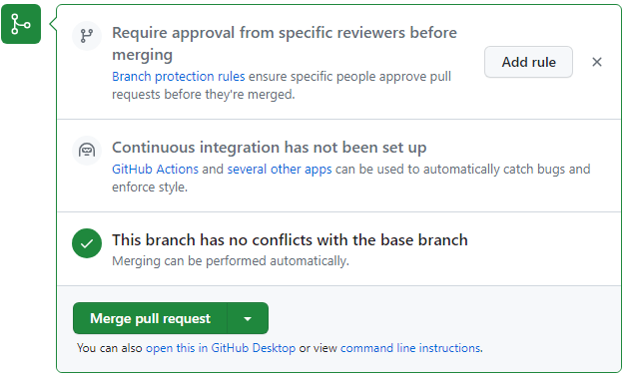

Pull Request
Pull Request is a mechanism for proposing changes from your branch into another. It is often used to merge feature branches into the main, especially when there are many collaborators in a repo.

Slide 76
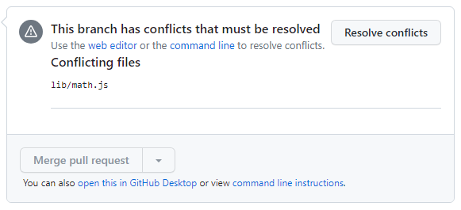
Merge Conflicts
Just as in a local git, GitHub detects and requires handling of merge conflicts sometimes if the commits overlap

Slide 77
Your Turn: Activity 16
Compare and Pull Request
Create a branch in GitHub
Make a commit on that feature branch
Create Pull Request to merge the changes from the feature branch into the main branch.

Slide 78
Contributing to GitHub Projects

Slide 79
Forking a Project
Note, You will need a second account to follow with the remaining slides. Alternatively, you can pair with a colleague when doing the upcoming activities
Forking is the process of creating a personal copy of a repository hosted on GitHub. It's a way to contribute to or modify a project without directly impacting the original repository.
Why Fork?
Fork a repository to propose changes or bug fixes.
Use a fork for experimenting with a project.
Collaborate on open-source projects.

Slide 80
How to Fork
Search for the project you want to fork
Make sure to use both the user name and project name
Click on the fork button to create the fork
repo:<user-name>/<project-name>

Slide 81
Cloning a Project
Cloning is the process of creating a local copy of a remote repository from GitHub to your computer. It allows you to work on the code locally.
Why Clone?
Clone a repository to work on it offline.
Make code changes and commits locally.
Collaborate on a project without needing a constant internet connection.

Slide 82
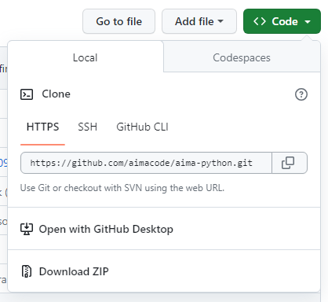
How to Clone
Go to the repository on GitHub.
Click the "Code" button and select "HTTPS" or "SSH" to get the repository URL.
Open your terminal and use $git clone <repository-url> to create a local copy.

Slide 83
Making Contributions to Open Repo
Fork the Repo
Clone Your Forked Repo
Create a New Branch (Optional): $git checkout –b <branch-name>.
Make changes
Commit the changes
Push the changes: $git push origin <branch-name>
Describe the changes
Collaborate and review

Slide 84
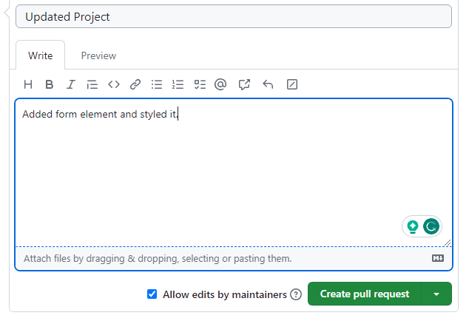
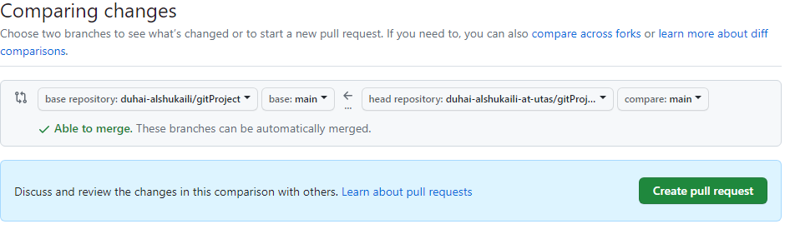
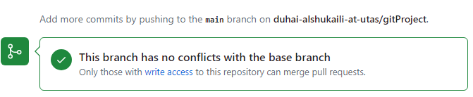
Creating a Pull Request

Slide 85
Managing Conflicts
When contributing to another repo conflicts may arise.
As someone who is submitting a pull request, you will get a notification of a conflict. You can resolve the conflict after creating the pull request.
Alternatively, you can let the repo owner deal with the conflict.

Slide 86
Your Turn: Activity 17
Compare and Pull Request
Find a project on GitHub and create a fork of the project.
Clone the fork into you local machine.
Make a commit on the cloned copy and push the changes to the remote repo.
Create a pull request based on your changes.

Slide 87
Collaboration on GitHub

Slide 88
Collaborators in GitHub
Collaborators in GitHub are individuals who have specific access rights to a repository, allowing them to contribute to the project alongside the repository owner.
Why Collaborators?
Enable multiple contributors to work together on a project.
Simplify collaboration, as collaborators can push directly to the repository.
Grant permissions to trusted team members.

Slide 89
Working as A Collaborator
Collaborator Permissions:
Collaborators have different levels of access, including:
Read: Viewing the repository.
Write: Making changes, creating branches.
Admin: Managing settings and access, merging pull requests.
Collaboration Workflow:
Collaborators can clone, branch, make changes, commit, and push directly to the repository.
They can create and merge pull requests.
Communication and collaboration are essential for successful project development.

Slide 90
Protecting Branches
Protecting branches in GitHub is a security and quality control feature that helps prevent accidental or unauthorized changes to important branches, such as the main branch.
Why Protect Branches?
Ensure the stability and security of vital branches.
Prevent force-pushes, accidental deletions, or unauthorized changes.
Enforce code review and continuous integration (CI) checks.

Slide 91
Key Taleaways
Understanding Git: You've learned the fundamentals of Git, including commits, branches, and how to manage changes in your codebase.
Collaborative Work: You now know how to fork, clone, and contribute to open-source projects on GitHub.
Collaboration in GitHub: You've explored concepts like Pull Requests, Collaborators, and Branch Protection, enabling effective teamwork in the GitHub ecosystem.

Slide 92
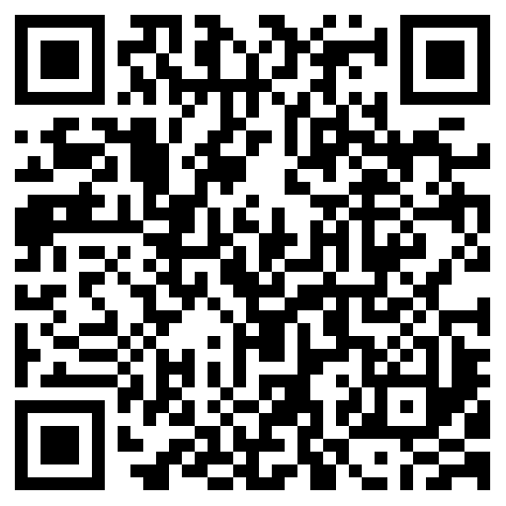
Before you go.
Join at:
https://ahaslides.com/G471H

Slide 93


Get In Touch
https://github.com/duhai-alshukaili
https://www.linkedin.com/in/duhai-alshukaili/

Slide 94


