Slide 1
Python For Programmers Introduction to Python
Duhai Alshukaili
Ibri College of Technology
http://chapter10.wordpress.com
Nov 3, 2019

Slide 2
Me?
2001-2004: BCSC, Dalhousie University
Jun, 2004 – Sep, 2004: Web Developer, Infocomm Oman.
Jan, 2005 – Dec, 2006: Application Support Officer, BankMuscat.
Jan, 2007 – Aug, 2008: Project Manager, BankMuscat.
Oct, 2008 – Sep, 2009: MSc, University of Sheffield.
May, 2010 – Sep, 2012: Assistant Lecturer & HoD ARD, IbriCT
Sep, 2012 – Nov, 2016: PhD, University of Manchester
Dec, 2016 – Apr, 2018: Lecturer, IbriCT
May, 2018 – Now: HoD IT, IbriCT

Slide 3
Me? cont’d
Programming languages:
First programming language: C++
Python, Java, MATLAB and R
Working my way through deep learning.
Computer Systems:
Oracle DB, MySQL, Linux, Windows, Apache Web Server, and others.
Thesis: Integrating Linked Data Search Results Using Statistical Relational Learning (http://bit.ly/2r7eTaA)
Research Interests:
Text Mining, specifically Information Retrieval
Web and distributed systems
Data Modelling for the Web
Machine Learning Applications.

Slide 4
You?

Slide 5
Course Topics
Day | Topics
1 | Environment Setup and Python Basics
2 | Working Basic Datat-ypes: integers, floats and string.
3 | Branching and Iteration
4 | Modular Programing: Importing Modules and Creating Functions
5 | Working with structured data: tuples, lists and dictionaries

Slide 6
Course Topics, cont’d
Day | Topics
6 | File I/O
7 | Interacting with Excel
8 | Processing text using regular expressions
9 | Basic object oriented programming
10 | Capstone Projects Presentations

Slide 7
Capstone Projects Presentations
Capstone Project
Your ideas using what you learned here into something useful
Does not have to be fully complete
Work on groups if you want
See the following website for inspiration
https://realpython.com/intermediate-python-project-ideas/

Slide 8
How to Communicate
Email: Duhai.Alshukaili@ibrict.edu.om
Twitter: #python_for_programmers.
Use it and abuse it.
Share ideas, links, resources.
Keep it civil

Slide 9
Certificates
If and only if you attended all sessions + presentation
We will be ready within two weeks after the completion of the course
A mere attendance certificate
Hopefully your seeking the knowledge.

Slide 10
Nov 6 Session
Graduation Day
Will be cancelled
Security reasons
Course will finish on 17th rather than 14th.

Slide 11
Conduct of the sessions
No presentations, no slide (except for today)
Interactive Demo (~45 minutes)
Follow along
Problem Set (1:00 – 1:15 hours)
Either individually or in groups.
Not every thing covered.

Slide 12

Ready, Set, Go

Slide 13
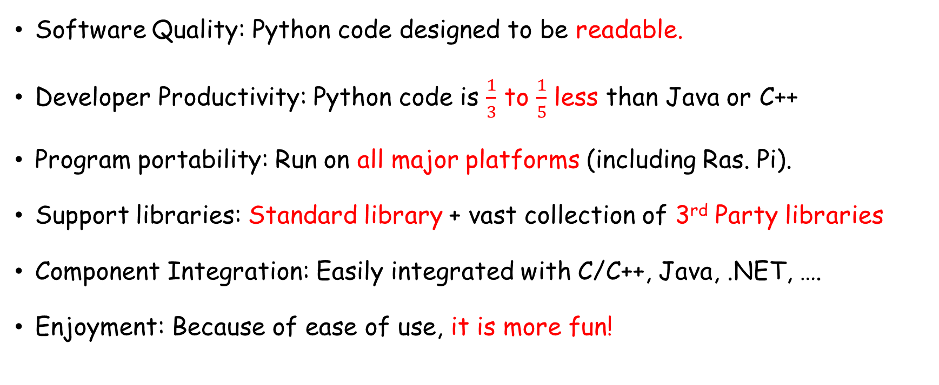
Why Do People Use Python?
Software Quality: Python code designed to be readable.
Developer Productivity: Python code is $\frac{1}{3}$ to $\frac{1}{5}$ less than Java or C++
Program portability: Run on all major platforms (including Ras. Pi).
Support libraries: Standard library + vast collection of 3rd Party libraries
Component Integration: Easily integrated with C/C++, Java, .NET, ….
Enjoyment: Because of ease of use, it is more fun!

Slide 14

How it Works
Source code
Machine code
hello.c
compiler
010001000101011111
run
Hello
hello.py
interpreter
Hello

Slide 15
Developing a Python Program
Two ways
Use the interactive shell
Write code in a file

Slide 16
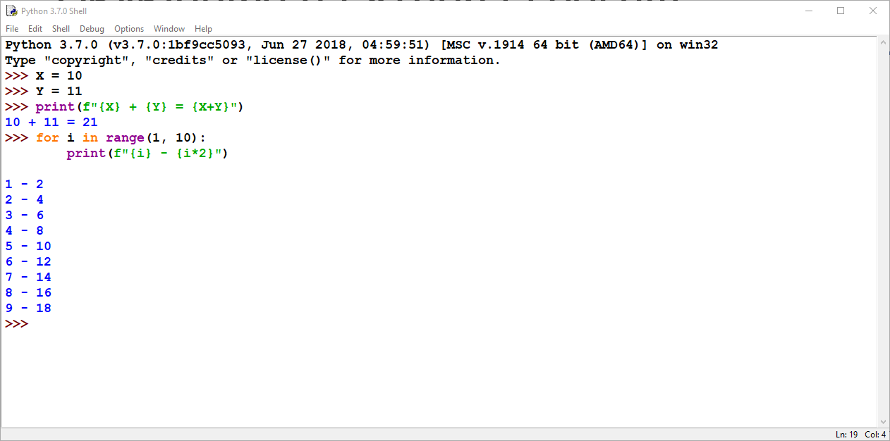
Developing a Python Program

Slide 17
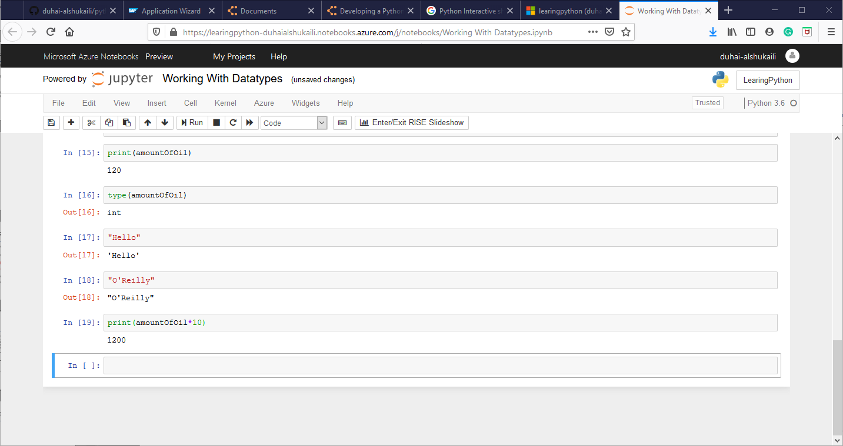
Developing a Python Program

Slide 18
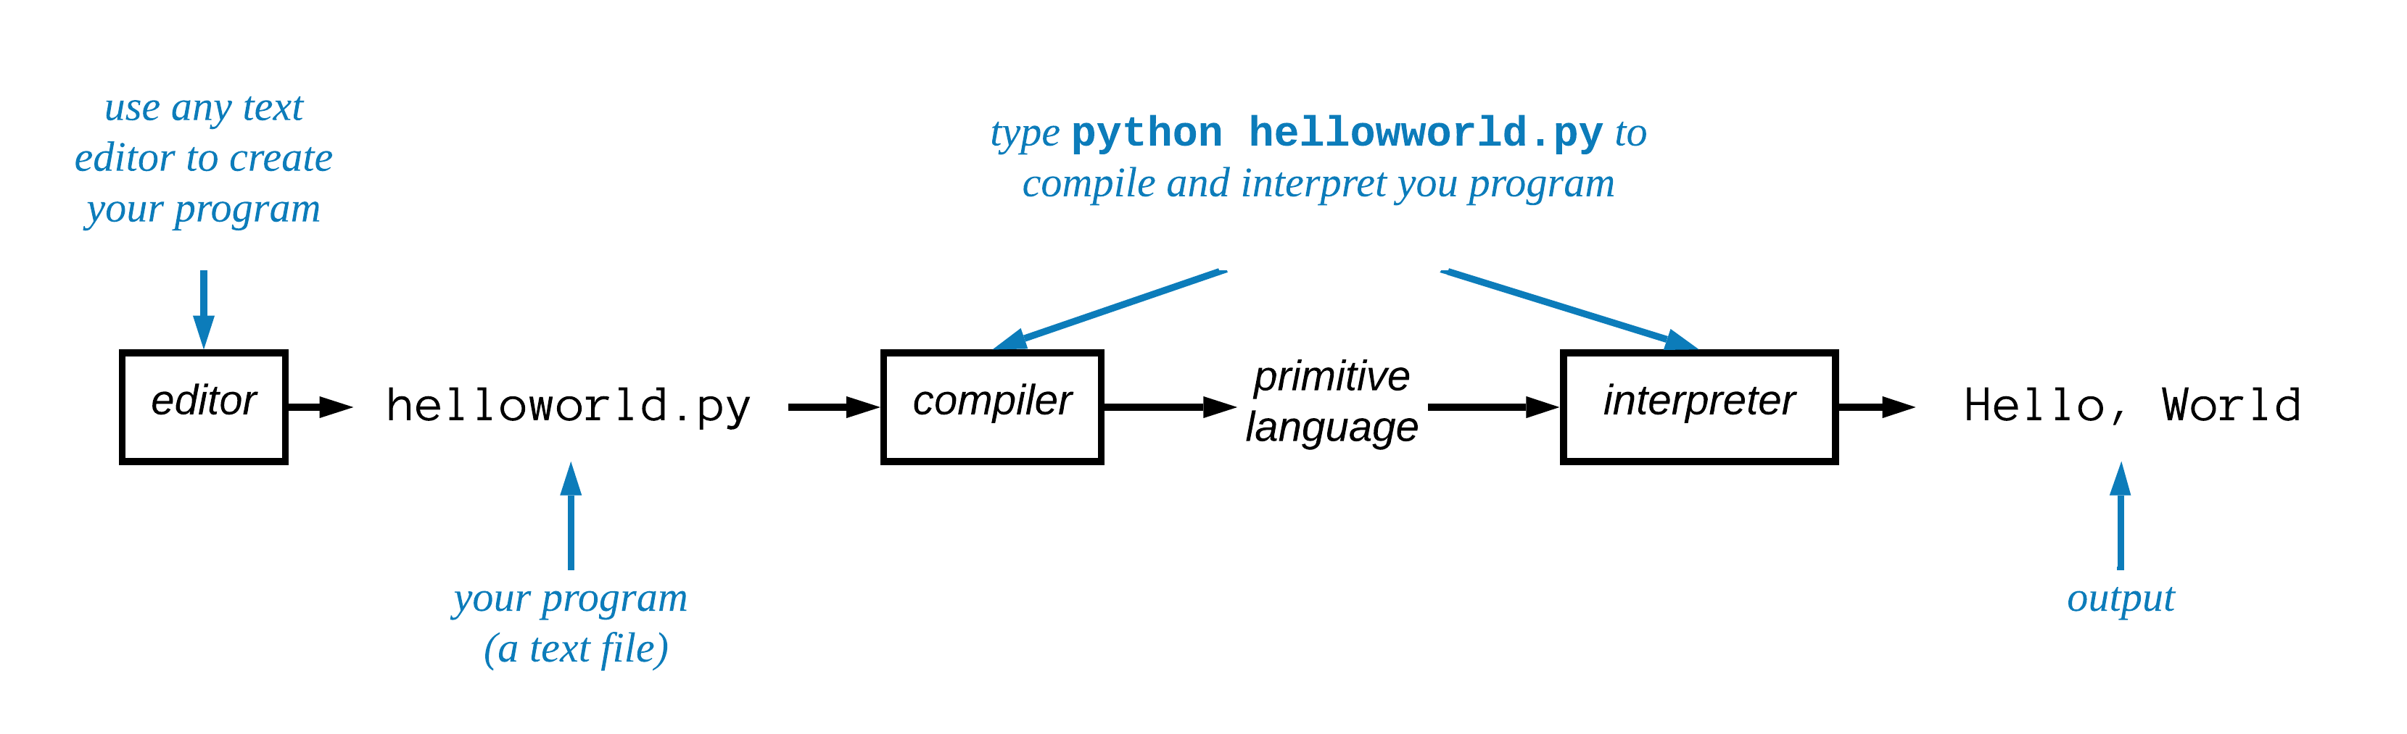
Developing a Python Program

Slide 19
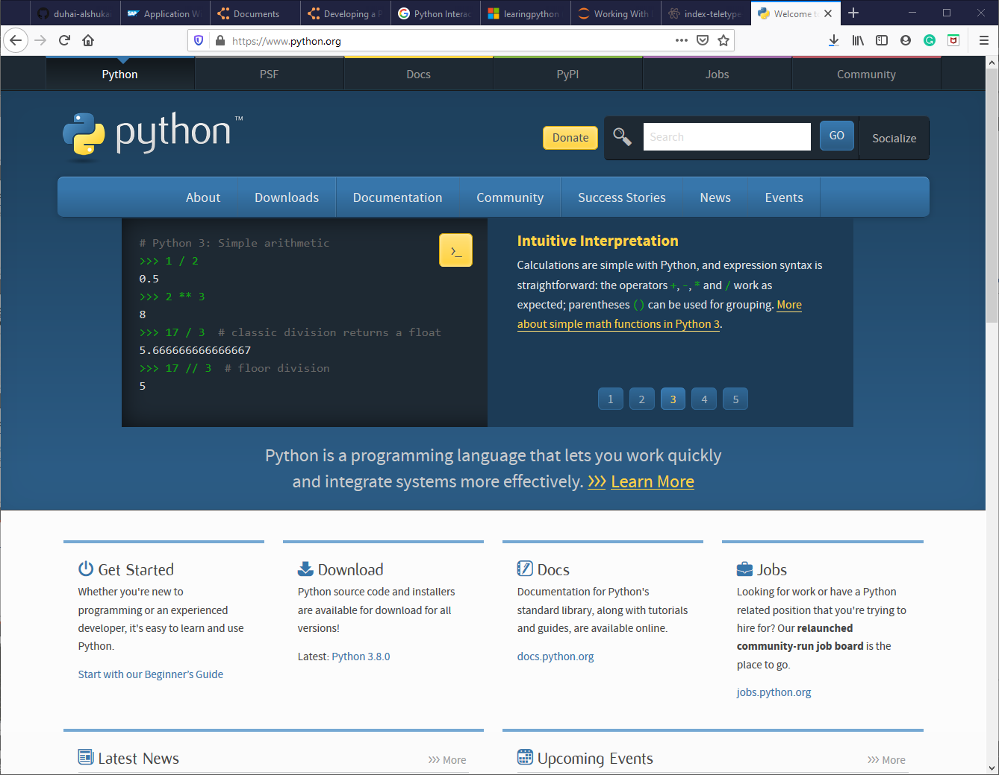
Tools
Python Interpreter

Slide 20
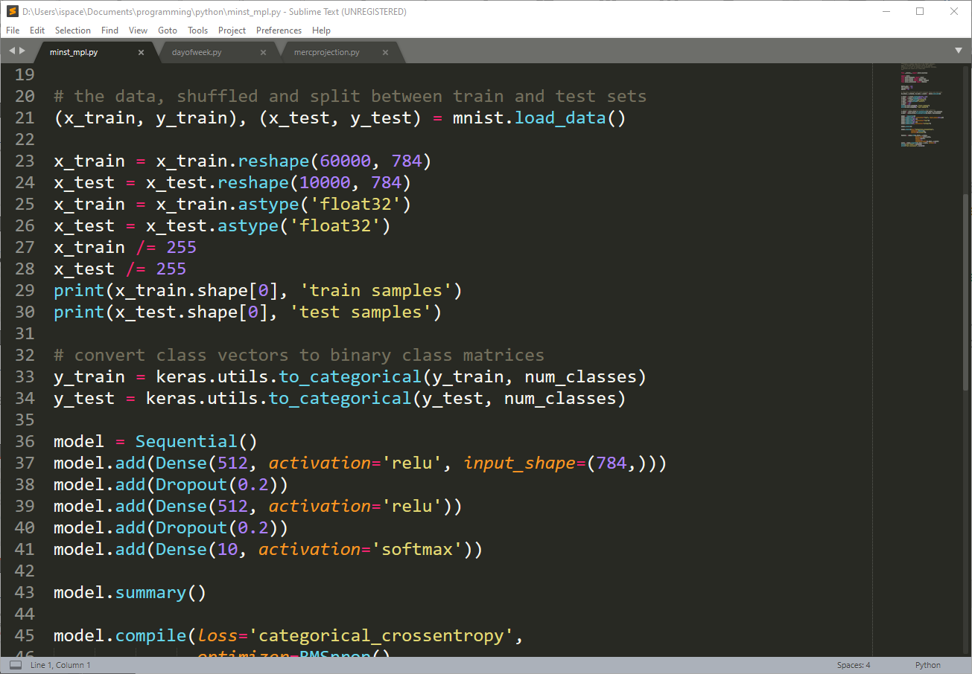
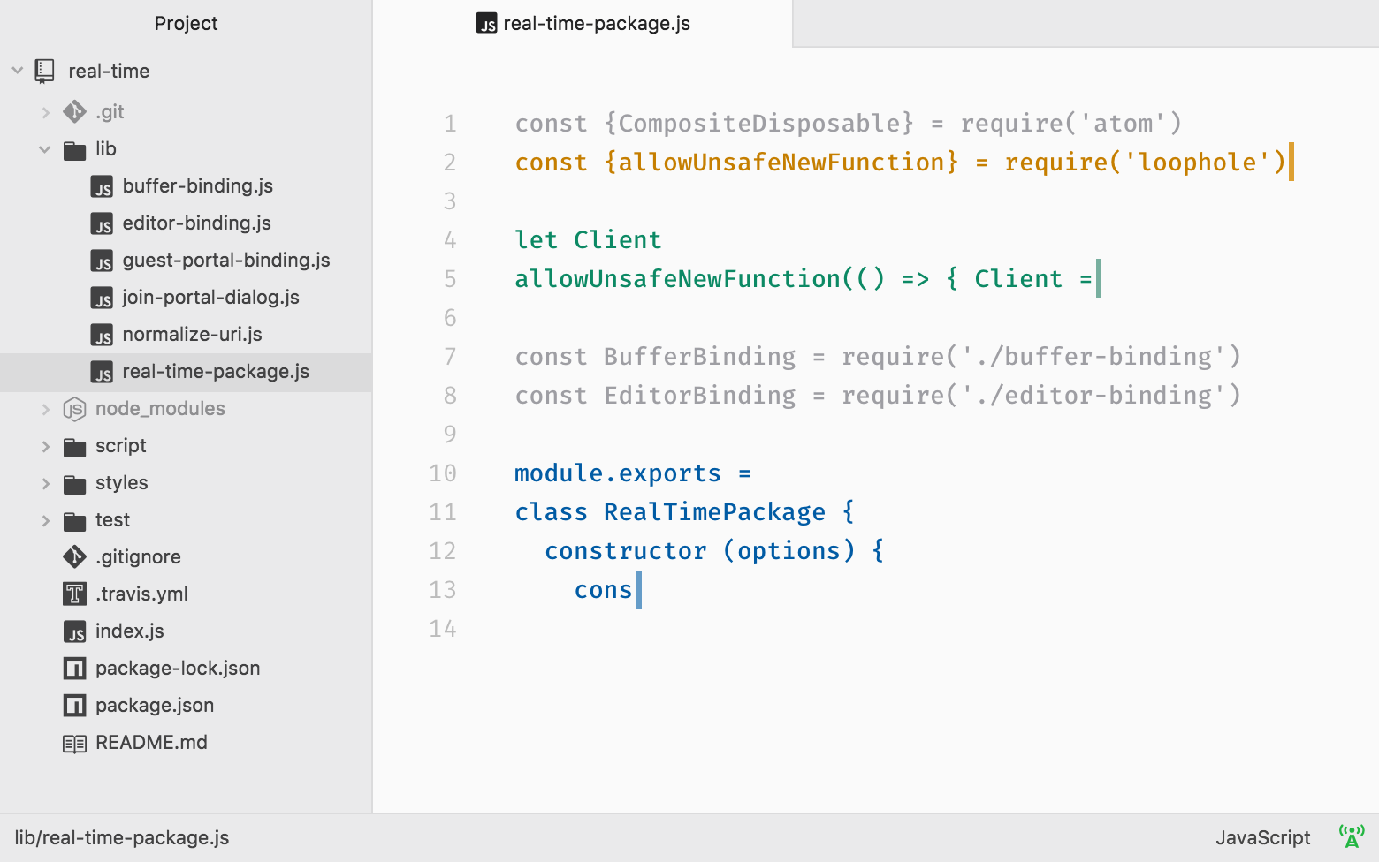
Text Editors
Atom
Sublime Text

Slide 21

IDEs
PyCharm
Community Edition (free)
Professional Edition
Free for academics and students

Slide 22
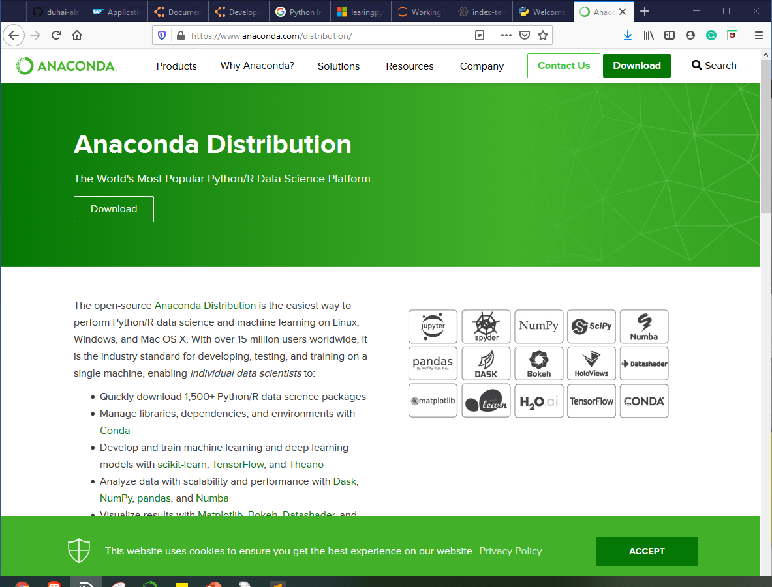
Integrated Platforms
Interpreter, Editors, IDE
Library Management
Out of the box 3rd party libraries

Slide 23
Popular Libraries
Scientific Computing and Statistics: NumPy, SciPy, StatsModels
Data Manipulation and Analysis: Pandas
Data Mining: Orange, Scrapy
Visualization: Matplotlib, Seaborn, Bokeh
Machine Learning: Scikit-learn, Keras, TensorFlow
Natural Language Processing (NLP): NLTK, TextBlob, Gensim
Game Programming: pygame, pyglet, Panda3D
Excel: openpyxl
..

Slide 24
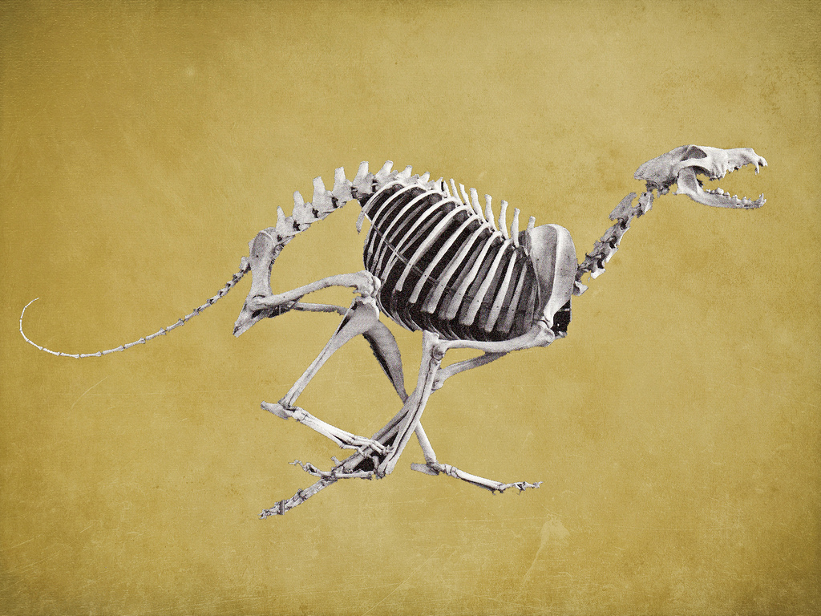
Questions?

