Slide 1

BIRD BOX
GAME DESIGN AND PRINCIPLES FINAL SEMESTER PROJECT
NAME

Slide 2


Game concept
High Concept Statement, Player’s role, Gameplay Mode, Genre, Target Audience, Key characters

Slide 3

GAME WORLD
Physical Dimension, Temporal Dimension, Environmental Dimension, Emotional Dimension, Ethical Dimension

Slide 4
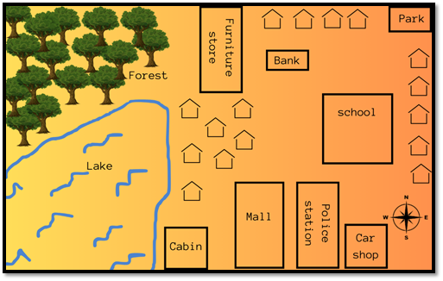
MAPS AND AREAS

Slide 5
WIREFRAMES

Slide 6
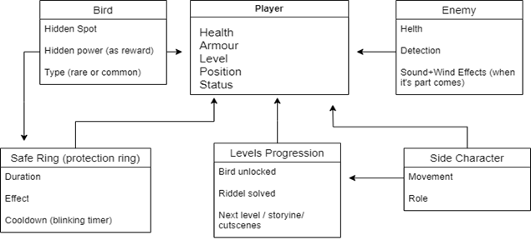
entity and attributes

Slide 7
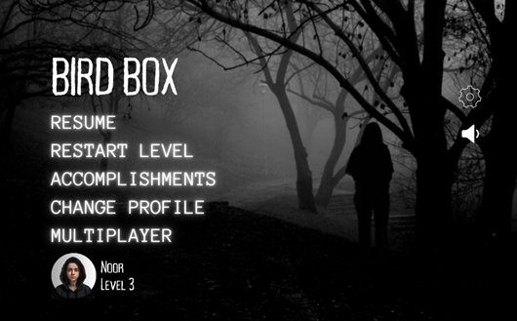
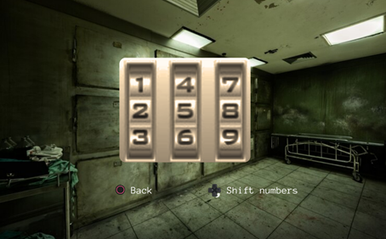
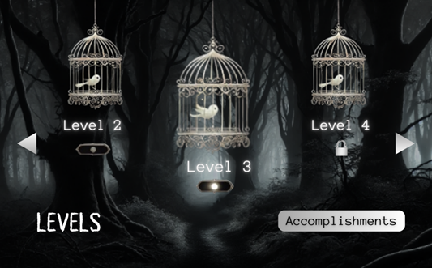
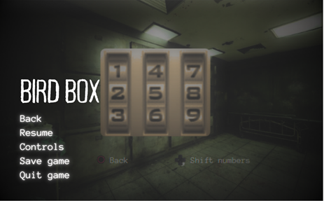

Slide 8
GAME PROGRESSION
Initiation, Progression, Termination

Slide 9
rules
implicit rules
Balance exploration with caution Hiding is essential.
Rely on audio cues
explicit rules
Objective to pass before progressing
Press the designated button
Termination rules

Slide 10
levels
Level 1 (cutscenes, tutorial, backstory)
Level 2 (supermarket)
Level 3+ (exploration)

