Slide 1



WEB BASED SCHOOL ADMINISTRATION SYSTEM
Mentor Name: Ms. Shubhra Saxena
Team Members: ChandraShekhar
Gaurav kumar
Dushyant
Girish Gupta
Team Name:
AALABS

Slide 2

Project Details
The Web based school Administration System is designed for better interaction between students, teachers, parents and administrator.
This WBSA Software very gracefully handles all the requirement for easy Administration.
The System being Web based can be accessed from anywhere which enable the students, teachers, parents, and the Administrator be in touch with each other at all times.

Slide 3
Users
Administrator.
Teacher
Student.
Parents.

Slide 4

Administrators
Admin will login the system .
Admin will add, new student, teacher, class details and can modify them.
Admin can posted the school news, notices, Exam schedules, Time table on the system.
Admin can posted the list of available holidays for the school.
Admin can monitor the whole school fees submission.
Admin can view and update student,faculty, admin profile, photograph and contact information .

Slide 5
Faculty
Faculty will login the system .
Faculty will mark the attendance online.
Faculty will upload the assignment.
Faculty will take the test online.
Faculty will upload the marks online.
Faculty can view and update their profile, photograph and contact information .
Faculty can apply online leave application.
Input from parents feedback and reports to answer queries .
Faculty can view the list of available holidays, school news, notices, Time table, Exam schedule.

Slide 6

Student
Student will login the System.
Student can view their attendance.
Student can view the assignment and complete by the due date.
Student can view the list of holidays, school notices, events, exam schedule, time table etc.
Student can view their results/marks.

Slide 7
Parents :
Parents will login through his child login.
Parents will view the attendance , list of holidays, notices, school events .
Parents will view the report of his child.
Parents can view online if their child fees has been submitted or not.

Slide 8
Non-Functional Requirement
Secure access of confidential data (user’s details).
24 X 7 availability
Better component design to get better performance at peaktime.
Flexible service based architecture will be highly desirable for future extension.
Professional look and feel of user interfaces.
Use of validation with all the forms.
System is easily operable and understanding the system helps people

Slide 9

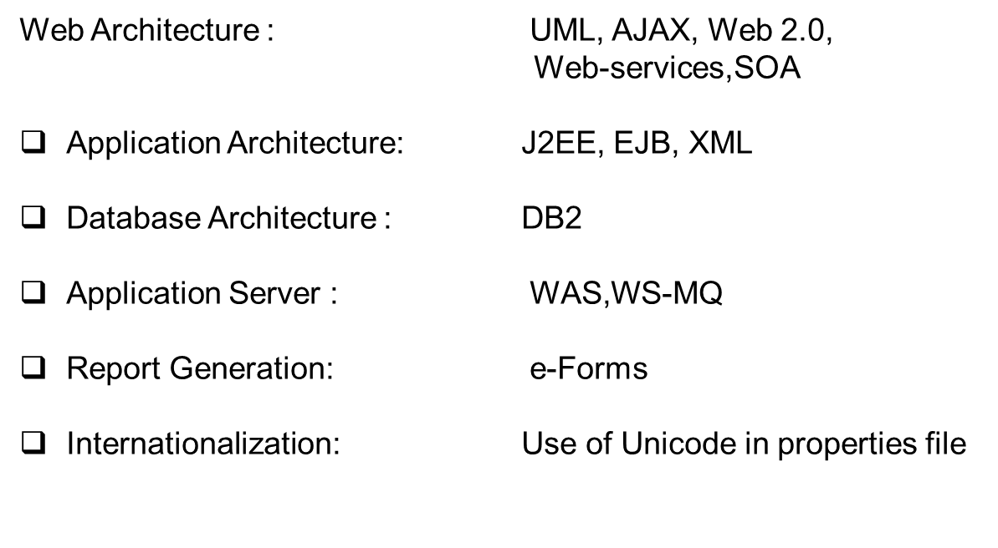
Technologies Used

Slide 10
Tools Used
ROSE/RSA / WebSphere Modeler
Eclipse/ RAD / Lotus Forms Designer / PortletFactory
WebSphere Portal/ WAS/ WAS CE / WPS
DB2 Express – ‘C’ or DB2 UDB
Tivoli CDP/TSM / Tivoli Directory Server
Linux will be the preferred OS.

Slide 11
User –Interface Priority
Professional look and feel
Use of AJAX atleast with all registration forms
Browser testing and support for IE, NN, Mozila, andFirefox.
Use of Graphical tool like JASPER to show strategicdata to admin
Reports exportable in .XLS, .PDF or any other desirableformat

Slide 12
Final deliverables must include
Online or offline help to above said users, Application deployment executive and developer
Application archive ( .war/.ear ) with source code
Database backup and DDL Script
Complete Source code

Slide 13

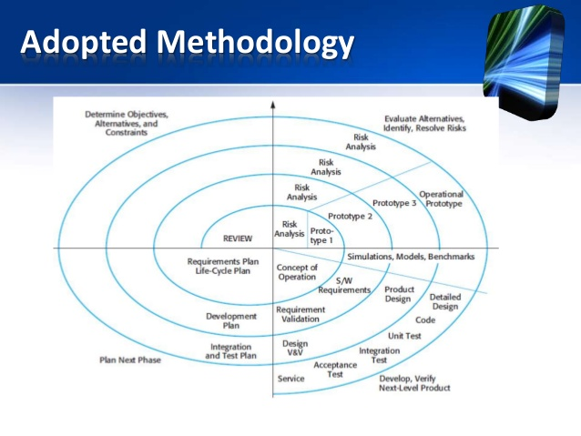
Adapted Methodology

Slide 14
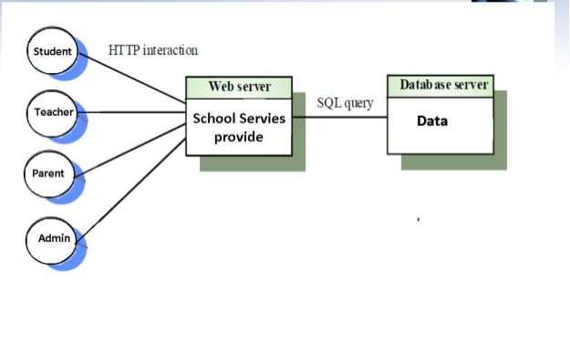

Slide 15
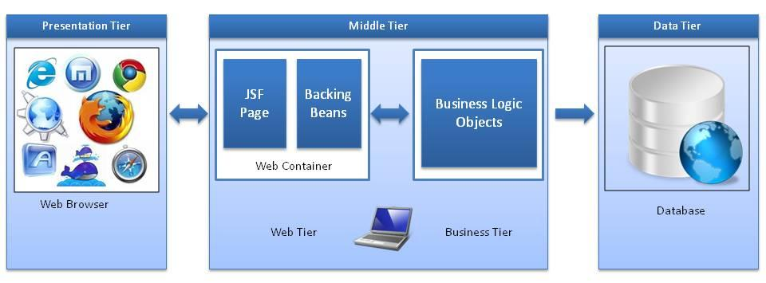
HTTP Server
JSF framework : It is responsible for interacting with client devices, and it provides tools for tying together the visual presentation, application logic, and business logic of a web application.
    High Level overview of JSF framework

Slide 16
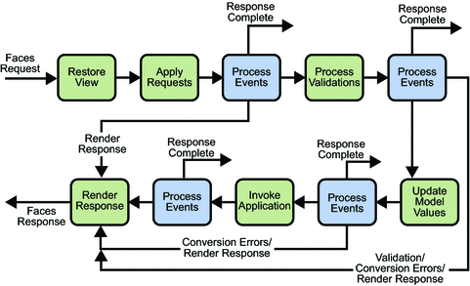
JSF Life cycle

Slide 17
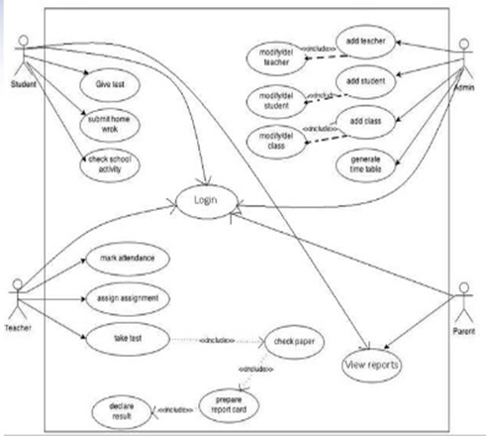
Use Case Diagram

Slide 18


