Slide 1
Sentiment Classification A Text Mining Example

Slide 2
Machine Learning Problems
Classification
Regression
Clustering
Anomaly detection
Recommendation systems
….

Slide 3
Supervised learning
Classification, regression
Label, target value
Training & Validation phases

Slide 4
Unsupervised learning
Clustering, feature selection
Finding structure of data
Statistical values describing the data
..

Slide 5
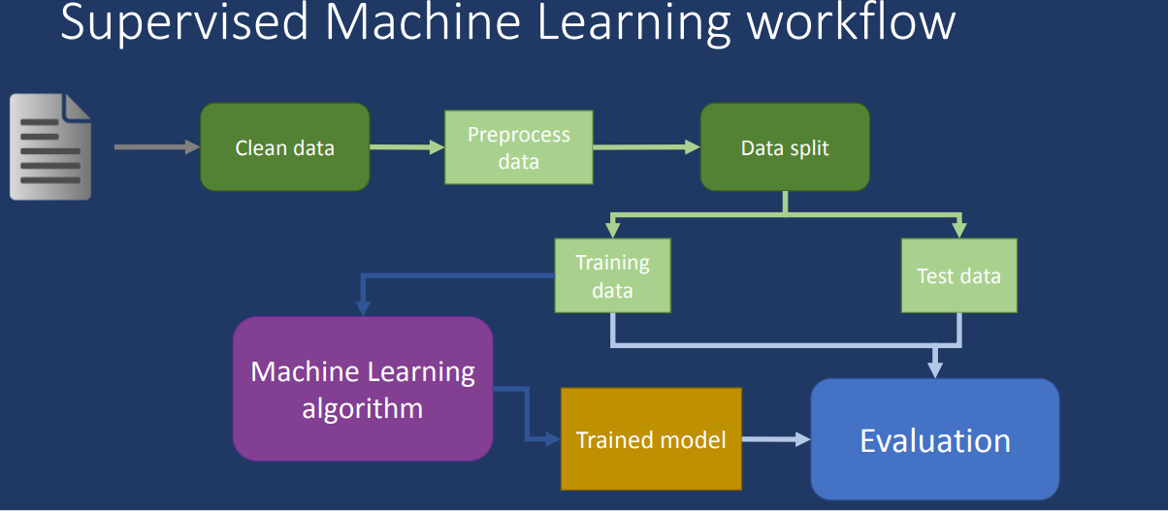

Slide 6
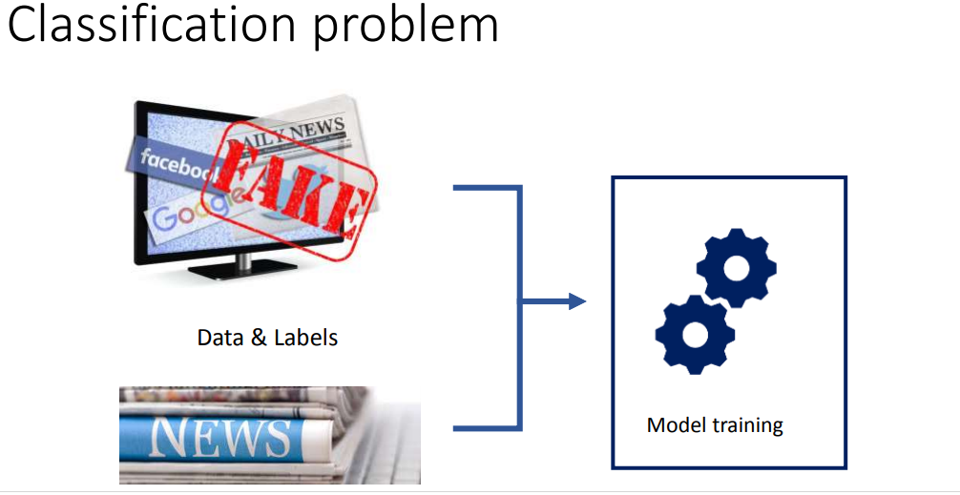

Slide 7
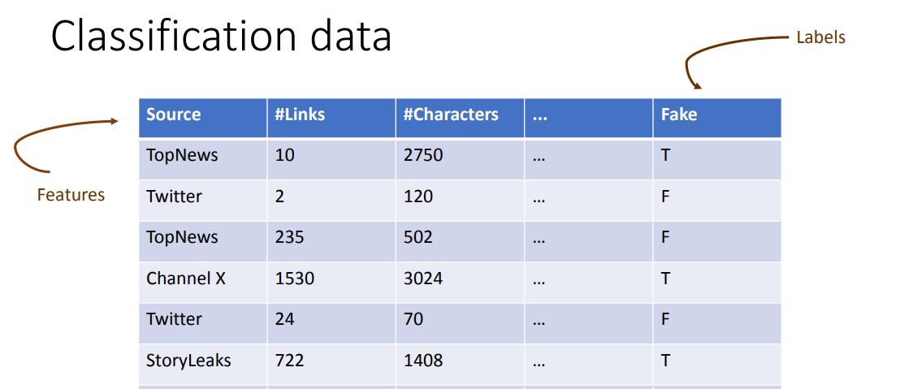
Typical Data for classification – An Example

Slide 8
Data Preprocessing
Data Indexing
Cleansing
Normalizing
Tokenizing
Building a dictionary indexing each of the tokens by frequency.

Slide 9
Some more steps
Post tokenization the vocabulary obtained could be sparse so tried to prevent the remove least occurring words.
It's standard to limit the size of the vocabulary to prevent the dataset from becoming too sparse and high dimensional, causing potential overfitting

Slide 10
Data Cleaning
Missing Data
Unknown demographic data
Impute missing values when possible
Incorrect Data
Hand-typed default values (e.g. 1900 for dates)
Misplaced Fields
Data does not always match documentation
Missing Relationships
Foreign keys missing or dangling

Slide 11
Classification: Train, Validation, Test split
Results Known
+
Model
Builder
+
Training set
-
-
Data
+
Evaluate
Model Builder
Predictions
+
-
+
-
Y
N
Validation set
+
-
+
-
Final Evaluation
Final Test Set
Final Model

Slide 12
There are different types of Classifiers/estimators
Decision Trees
Simple Bayesian models
Nearest neighbor methods
Logistic regression
Neural networks
Linear discriminant analysis (LDA)
Quadratic discriminant analysis (QDA)
Convolutional Neural Nets
Recurrent Neural Nets

Slide 13
A Practical Example worked out

Slide 14
DataSet – IMDB Movie Review Dataset
IMDB is a dataset for binary sentiment classification containing substantially more data than previous benchmark datasets.
Provides a set of 25,000 highly polar movie reviews for training, and 25,000 for testing.
Raw text and already processed bag of words formats are provided.

Slide 15
Data Example
A BOLD, BRASH AND EXCITING MESS OF A FILMjarrod76 12 May 2000
The critics have been less than kind to 'Sample People' - so I had expectations that the film will be somewhat of a dud when I saw it. Many of the criticisms of the film are correct; it's a little derivative and quite a messy film - but that's part of it's charm. It's quite brave for an Australian film - it's noisy, colourful and never boring. It contains strong performances from Nathan Page, Ben Mendelsohn, Kylie Minogue and David Field; and a brilliant soundtrack of Australian artists covering classic Australian songs. The film's production design is excellent - it looks like a Gregg Araki film, and the editing and cinematography are relentlessly brash. It's imperative that people go and support films such as this - a low budget Aussie indie pic, because lack of support from critics and lack of distribution and publicity will mean that it remains unseen by the young adult demographic it is intended for. 'Sample People' (brilliant title) is as good as any film I have seen this year.

Slide 16
Classifying text with TensorFlow Estimators
Tools
Python
Packages
TensorFlow ( Machine Learning/Deep Learning)
Pandas (Data Frames)
Numpy (Arrays)
Matplotlib (Visualisation)

Slide 17
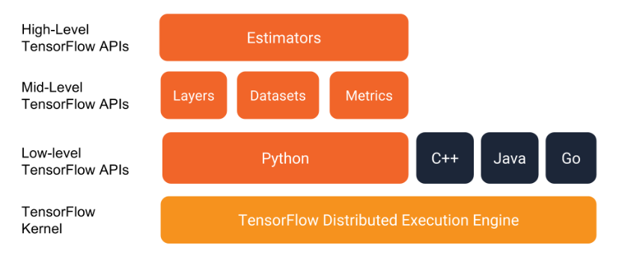
A high level view of TF

Slide 18
Tensors … in TF
. A tensor is a generalization of vectors and matrices to potentially higher dimensions.
Internally, TensorFlow represents tensors as n-dimensional arrays of base datatypes.
TensorFlow, as the name indicates, is a framework to define and run computations involving tensors
When writing a TensorFlow program, the main objective is to manipulate and pass around is the tf.Tensor

Slide 19
From arrays to Tensors
There's one more thing we need to do get our data ready for TensorFlow.
We need to convert the data from numpy arrays into Tensors.
Fortunately for us the Dataset module has us covered.
from_tensor_slices that creates the dataset to which we can then apply multiple transformations to shuffle,
batch and repeat samples and plug into our training pipeline.
With just a few changes we could be loading the data from files on disk and

Slide 20
Continue..
The framework does all the memory management.
We define two input functions:
One for processing the training data and one for processing the test data.
We shuffle the training data and do not predefine the number of epochs we want to train,
While we only need one epoch of the test data for evaluation.
We also add an additional "len" key to both that captures the length of the original,
unpadded sequence, which we will use later.

Slide 21
Baselines
Trying out one of the simplest models out there for text classification
That is, a sparse linear model that gives a weight to each token and adds up
The fact that we don't care about the order of the words in the sentence is the reason why this method is generally known as a Bag-of-Words (BOW) approach.
Let's see how that works out all of the results, regardless of the order
And then we create a simple function that trains the classifier and additionally creates a precision-recall curve
Here we do not aim to maximize performance so we only train our models for 25000 steps

Slide 22
Embeddings
The next step of complexity we can add are word embeddings.
Embeddings are a dense low-dimensional representation of sparse high-dimensional data.
This allows our model to learn a more meaningful representation of each token, rather than just an index.
While an individual dimension is not meaningful, the low-dimensional space-
when learned from a large enough corpus such as tense, plural, gender, thematic relatedness, and many more. We can add word embeddings by converting our existing feature column into an `embedding_column`.

Slide 23
Getting Predictions
To get predictions on new sentences we can use the predict method in the Estimator instances
Which will load the latest checkpoint for each model and evaluate on the unseen data.
But before passing the data into the model we have to clean up, tokenize and map each token to the corresponding index

