Slide 1
Introduction to Data Management
Krysha Dukacz, GWF Data Manager
September 3, 2019

Slide 2
Agenda
Introduction: Overview of Research Data Management (RDM)
Documentation
Data Management Quick Hits
Data Management Plans

Slide 3
Getting to Know You
Data
Use
Collect
Methods
Storage
Standards
Process
Documentation
Huh
Challenges

Slide 4
Introduction

Slide 5
What is Research Data Management?
Research Data Management is the …
Active organization and maintenance of data
Use of best practices to ensure the data security, integrity and accessibility
Defining and following processes which result in data that is self-describing and discoverable to enable re-use for verification or new endeavors

Slide 6
What is Research Data Management?
Plan and Structure
Active Management
Accessible
Standards and Best Practices
Self-Described Data
Documentation so data can be reused

Slide 7
The Data Management Landscape
There is a lot going on in the Research Data Management space. Selected links to explore:
Tri-Agency Research Data Management Policy (Draft) http://www.science.gc.ca/eic/site/063.nsf/eng/h_97610.html
DATAONE (Data Observation Network for Earth)
https://www.dataone.org/
https://dataoneorg.github.io/Education/
FRDR (Federated Research Data Repository – Canadian repository to support data sharing/FAIR Data)
https://www.frdr.ca/docs/en/home/
DATAVERSE (Harvard developed repository framework) https://dataverse.org/
Canadian instances such as Scholar’s Portal
https://dataverse.scholarsportal.info/
MANTRA (University of Edinburgh RDM Training)
https://mantra.edina.ac.uk/

Slide 8
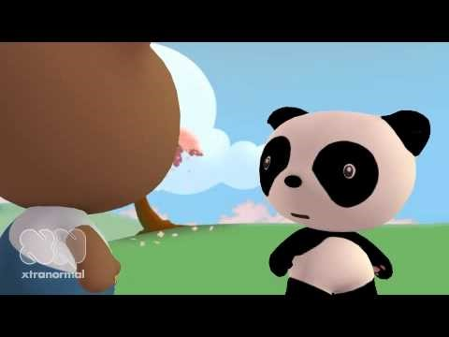
The Practical Need for Data Management
Data Sharing and Management SNAFU in 3 Acts

Slide 9
Data Management Benefits
Researcher
Efficiency
Discover new data
Publishing
Rigourous Peer Review
Funders
Transparency
Credit and Impact
Validation
Reproducibility
Accountability
Return on Investment

Slide 10
RE-USE Example Nurses Health Study(NHS): Blood, Spit and Toenails: How looking at the Long-Term Effect of Contraception Birthed A Thousand Studies
1976 Harvard Medical School questionnaire to nurses about their health and their use of contraception
Longitudinal study of surveys and biological sampling spanning over 40 years with tens of thousands of respondents.
The NHS has “sustained remarkable scientific productivity in the past 40 years, including more than 1200 publications”.
Supplemental surveys have been periodically introduced as new questions and new collaborations give rise to new areas of study.
Given rise to new knowledge in many areas including cardiovascular diseases, colorectal and pancreatic cancer, neurodegeneration, type 2 diabetes, multiple sclerosis, eye disease, multiple sclerosis, and kidney stones.
Influenced policy and health guidelines leading to improved health outcomes.
Graham A. Colditz, Sydney E. Philpott, and Susan E. Hankinson, 2016: The Impact of the Nurses’ Health Study on Population Health: Prevention, Translation, and Control American Journal of Public Health 106, 1540_1545,https://doi.org/10.2105/AJPH.2016.303343

Slide 11
VALIDATION Example Reinhart, Rogoff: The Excel Error That Changed History
2010 - Professor Carmen Reinhart and the former chief economist of the International Monetary Fund, Ken Rogoff, are presenting a research paper called Growth in a Time of Debt
Their finding was that economic growth slows when the size of a country's debt rises above 90% of Gross Domestic Product
Their work was broadly cited and used by politicians and policy makers to support austerity measures
University of Massachusetts Amherst grad student Thomas Heardon given an assignment to pick an economics paper and replicate the results.
He was unable to replicate the results and requested help from Reinhart who provided the spreadsheet used for analysis.
Heardon found a spreadsheet error excluded 5 of the 20 countries being analyzed.
https://www.bbc.com/news/magazine-22223190

Slide 12
Funder Requirements Government of Canada Guide
Public Funders want accountability and contribution:
Government of Canada Guide (excerpt below) The following principles guide the Agencies in promoting access to research results:
Advance Knowledge
The advancement of knowledge depends upon peer review to ensure excellence, as well as long-term preservation to ensure that research can be built upon by others.
Minimize Research Duplication
Broad dissemination increases the effectiveness of public investments in research by reducing the potential for unnecessary duplication.
Maximize Research Benefits
Publicly funded research should be as accessible as possible in order to maximize the economic, social, cultural and health benefits for Canadians.
Promote Research Accomplishments
Improving access to research results will better promote the accomplishments of Canadian researchers throughout the world.

Slide 13
Funder Requirements Tri-Agency Statement of Principles on Digital Data Management: Promote excellence in digital data management practices and data stewardship in agency-funded research
Expectations:
Data Management Planning
Constraints and obligation (commercial, legal, ethical)
Adherence to Standards
Collection and Storage
Metadata
Preservation, Retention and Sharing
Timeliness
Acknowledgement and Citation
Efficient and Cost Effective
http://www.science.gc.ca/eic/site/063.nsf/eng/h_83F7624E.html?OpenDocument

Slide 14
Summary: Overall Goals for Data Management
Neat and Complete
Standard formatting
Raw data
Authoritative version
Well-described
Description collection methods, instrumentation, post-processing, assumptions,
Robust metadata/ Read me files

Slide 15
Data Lifecycle
Data Management woven throughout the Data Lifecycle:
Discovery & Planning
Data Collection
Data Analysis
Publication & Sharing
Long-term Management
Planning
Execution
Publication

Slide 16
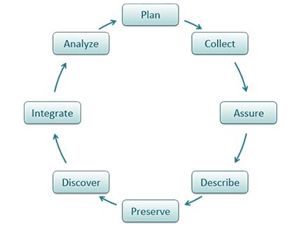
Data Lifecycle Described (DataONE)
Plan – description of data and how it will be managed and shared
Collect: Tools and processes to produce digital datasets
Assure: Data/process checks
Describe: Documentation and Metadata
Preserve: Data submitted to an appropriate archive
Discover: Potentially useful data can be located and is described well enough to be useful.
Integrate: Data from different sources/locations can be combined for analysis
Analyze: Data analysis is completed
https://www.dataone.org/data-life-cycle (Data Observation Network for Earth

Slide 17
Data Management Challenges
~ Observational Data
People
~ Skills/Experience
(Programming, DB, RDM)
~ Remotely Sensed Data
~ Laboratory results
~ Survey (Human) Data
~ Indigenous Knowledge
~ Isolation
~ Requirements
~ Lack of Standards
~ Modelling Data
~ Resources
~ Adoption/Resistance
~ Assessment of adherence
~ Tools to make it happen
~ Applications & Owners
Data Diversity
IT Variation
Actionable Policy

Slide 18
Planning to Succeed in Data Management
Robust Data Management relies on following good practices all the way through a project (and beyond!)
Accessible Data
Discoverable
Publication Readiness
Generate reusable data
Publish Data
Project Level Data Management
Plan
Safeguard Data
Available
Sustainable
Identify Standards
Legacy
Publication
Active Research
Notes:
Data is an important legacy of the has been a focus since the inception of the GWF program.
It’s importance is emphasized by the existence of ‘GWF Data Policy’ and ‘GWF DM Framework’
DM team is tasked with the important role of ensuring that the data is preserved, findable and accessible in the long-term so that data can be used for future science and modelling generations after GWF.
Obligation to make publicly funded research products (e.g. data, software, journal publications) open access for transparency and reusability.
Consistent with emerging data paradigm shift
Journals (Copernicus, AGU) requiring data publication before the paper is accepted
FAIR data principles (published in Nature 2016)
Findable, accessible, interoperable, reusable
Tri-agency funding requirements (CFREF, CIHR, NSERC, SSHRC) on data management

Slide 19
Documentation

Slide 20
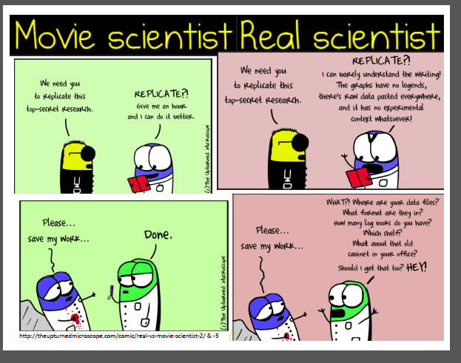
Documentation Fact vs. Fiction

Slide 21
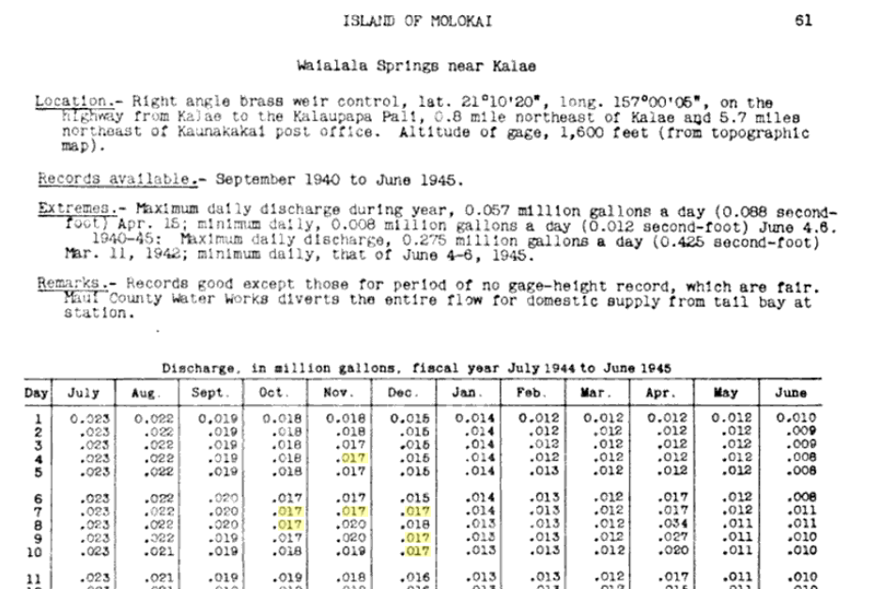
Documentation Make it relevant for today and decades it the future

Slide 22
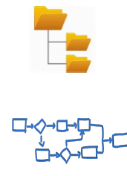
Documentation Methods and Need to Know Information
Document:
Organizational System
Workflow
Data
Need to Know;
Where it is
How to access it
What it can be used for
Known issues/Quality
Collection Methods
Ethical /Privacy issues
Licensing
Who to cite

Slide 23
Metadata is Part of the Dataset
Provides vital information about a dataset
Not a separate entity
Critical component of a complete dataset
Describes data characteristics
Content, condition, quality
Preserves data’s usefulness through time
ftp.ncddc.noaa.gov › pub › Metadata › DISL_June30
Notes:
Also,
Metadata should never be considered a separate entity. This “data documentation” is an integral component of any data or data set, just like a label is an integral component on a can of cat food. Without metadata, no data set can be considered complete.
Again, for some users the label on the can is sufficient information. Other users may need to know what the list of ingredients are; or need to be certain that the food was not manufactured anywhere near peanuts.
Metadata is a critical component of a complete data set.
Metadata is simply descriptive information applied to a digital geospatial file.
Without accompanying metadata, the fitness for use of any given data set is unknown, and its usefulness is significantly impaired.
Metadata is created and maintained as an integrated part of the data creation process — instead of something that might get done at end of project, if time allows.

Slide 24
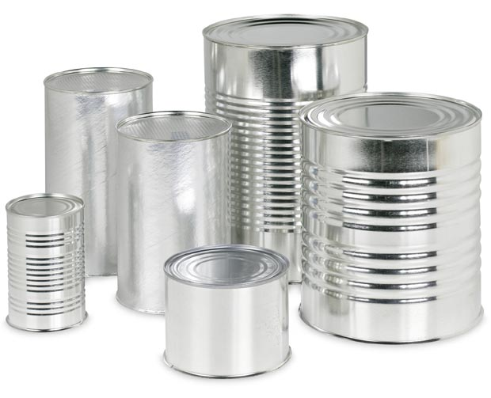
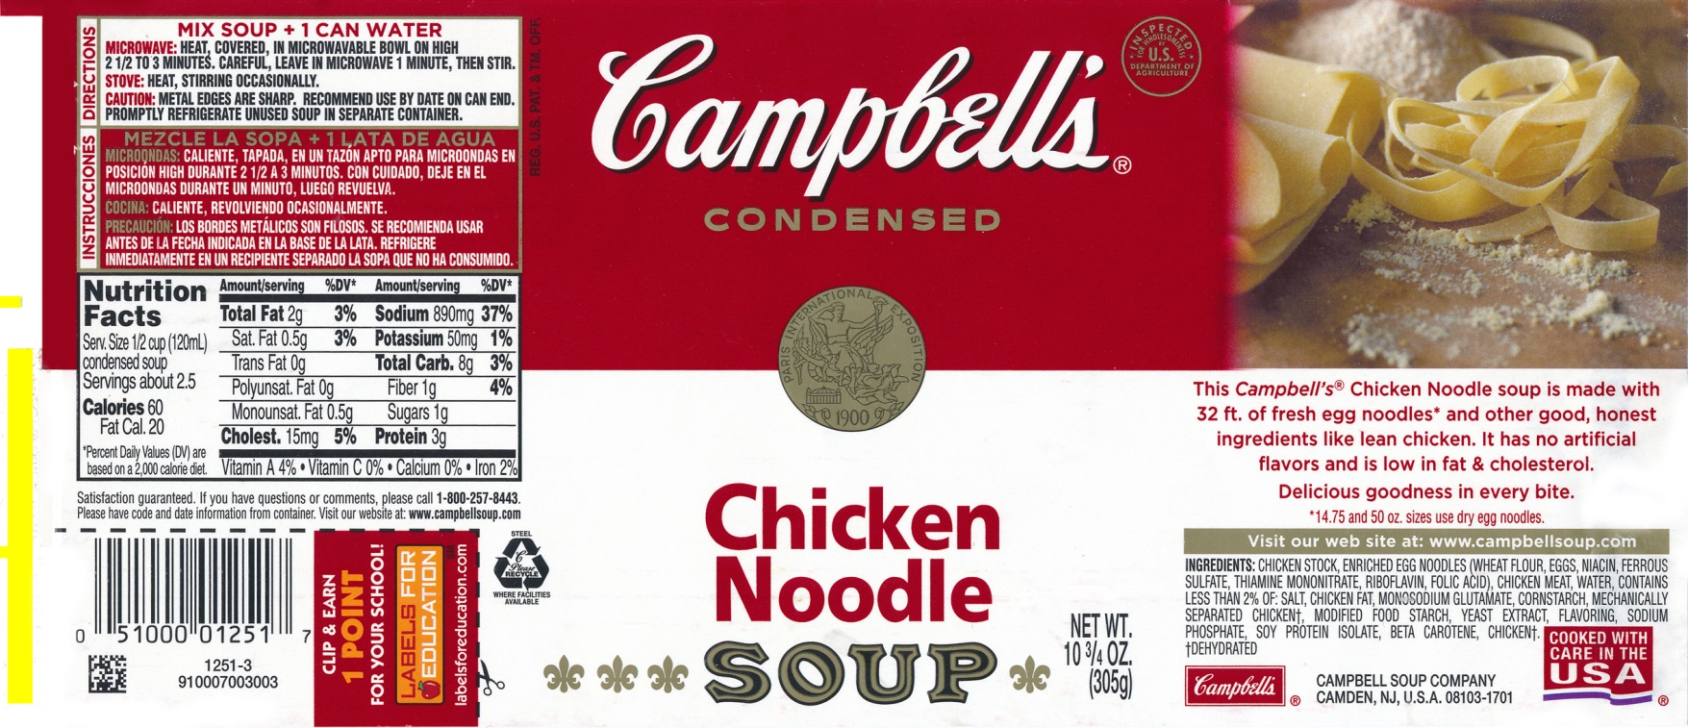
Metadata and its Importance
On a very basic level, metadata is a like a label on canned food. It provides information about the “content” of a “dataset”. Think of a label on a can. First, it lets us know what’s inside, but also…
Without a label, how would you know which one to open?
Soup?
Beans?
ftp.ncddc.noaa.gov › pub › Metadata › DISL_June30
Notes:
Metadata refers to background information about something.
Metadata is just like the information you would learn on the labels of tuna and cat food.
On the labels, you could learn everything about the can’s contents: the nutritional values of the food, the number of calories and fat grams, whether it contains preservatives, the weight, the company that packed it and its location, and more.
Then you would use that information to make a decision about what to do with the contents of the can — whether to eat it yourself or feed it to your cat.
The labels on the cans contain the metadata.
Labels tell what is inside… whether it is on a package or a CD ROM...

Slide 25
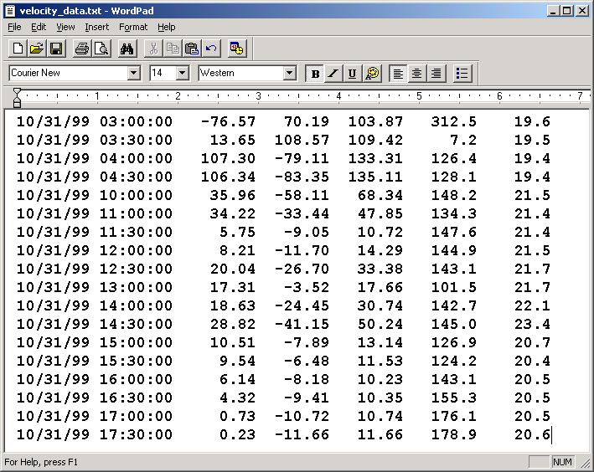
No Assumptions Ensure information in your brain is explicitly stated!
Use headers, define parameters, define missing data value
BE EXPLICIT!! Without relaying this knowledge the data is useless and unreliable.
ftp.ncddc.noaa.gov › pub › Metadata › DISL_June30
Notes:
How many of you have had to search for data?
You find the data source, request the data,
and when you get it you cant use it!!!!!
To belabor the can analogy, have you ever bought the bargain basement cans with no labels?
How can we improve this?

Slide 26
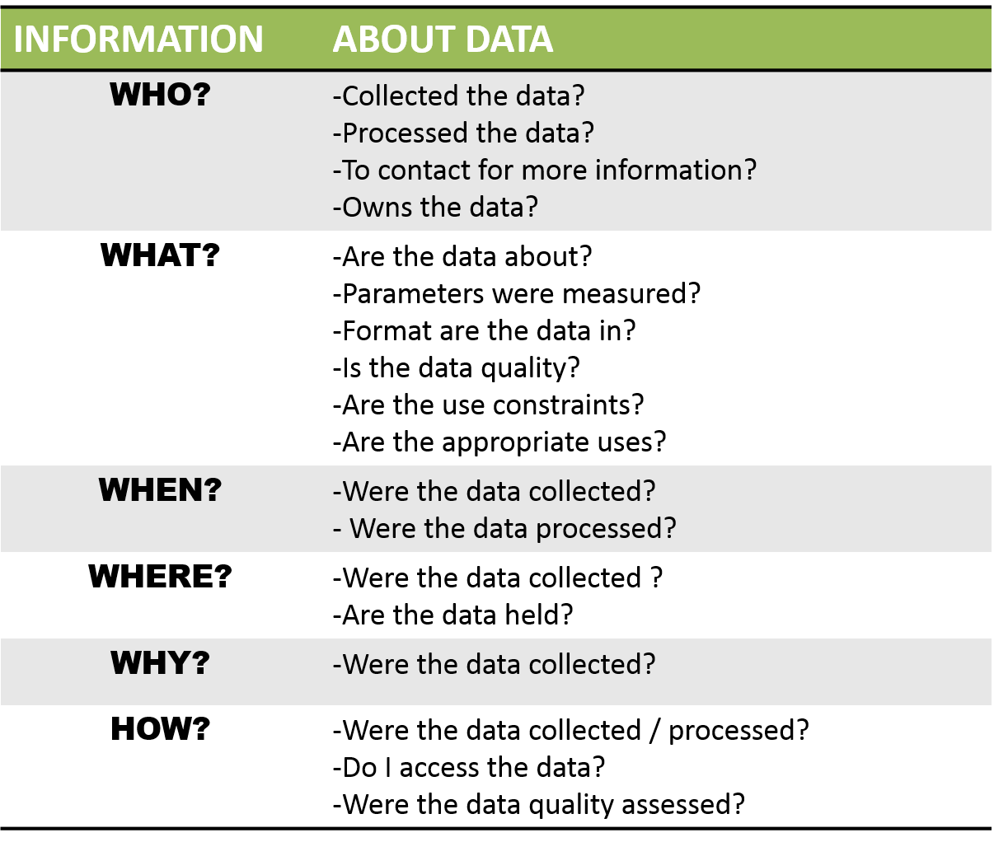
Questions to Answer Need to Know the 5 Ws (and how)
ftp.ncddc.noaa.gov › pub › Metadata › DISL_June30
Notes:
Metadata refers to background information about something.
Metadata is just like the information you would learn on the labels of tuna and cat food.
On the labels, you could learn everything about the can’s contents: the nutritional values of the food, the number of calories and fat grams, whether it contains preservatives, the weight, the company that packed it and its location, and more.
Then you would use that information to make a decision about what to do with the contents of the can — whether to eat it yourself or feed it to your cat.
The labels on the cans contain the metadata.
Labels tell what is inside… whether it is on a package or a CD ROM...

Slide 27
Metadata Exercise
Exercise: 15 minutes
Learning objective: being able to create metadata for research data
Select a file you are currently working on:
Who created the content?
Where was the data collected?
What is the content?
When was the content created?
How was the content created?
Why was the content created?
Notes:
Most often, metadata is described as “data about data.”
Metadata captures information about a data set or data product that describes certain characteristics of that data. It allows others to make certain determinations about its potential uses. It does not reproduce the data. It describes the data.
This is better, but still lacks more information. What is season_ID 1? Can you further define the elements in the table?

Slide 28
Quick Hits

Slide 29
Data Management Quick Hits
Backups
File Naming
Security
File Formats
QA/QC
Standarize

Slide 30
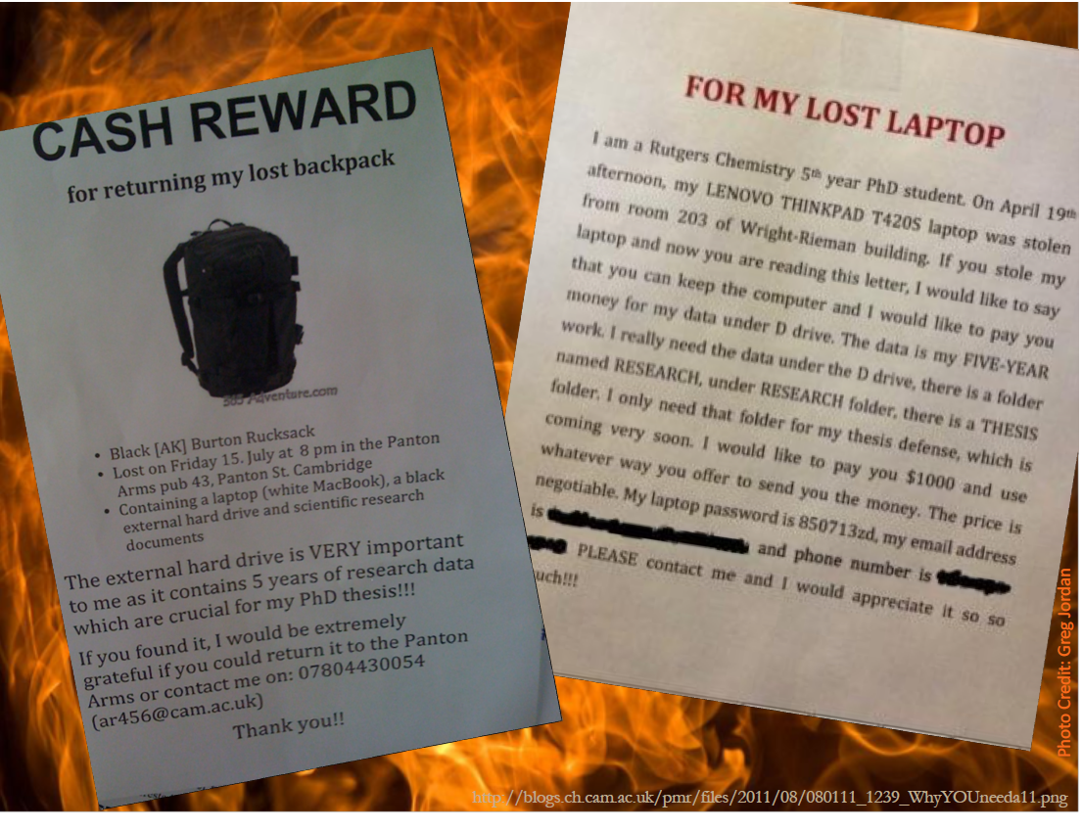
Backups
Christine Malinowski. MIT Libraries https://www.dropbox.com/s/e8j0ttbd517yap2/QuickDirtyDataMgmt_Slides_MIT.pdf?dl=0

Slide 31
Backups: 3-2-1 Rule
3
Store 3 copies of your data
2
Use at least 2 media
1
Have one remote copy

Slide 32
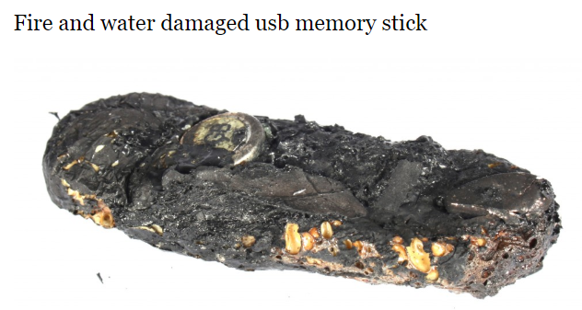
Backups: Here Near Far
Here (local)
Near (external storage)
Far (remote/cloud)
http://www.savemyusb.com/broken-memory-stick-recovery-case-studies/fire-and-water-damaged-usb-memory-stick

Slide 33
Security Ensure storage locations meet security needs dictated by the data.
Sensitive Data
Personal Information
Restricted Data
Data under licence
Traditional Knowledge
Endangered Species Habitat
Industrial Data
*Store Constraints with your data

Slide 34
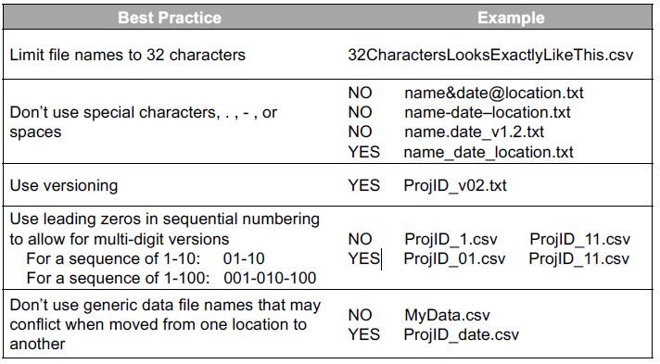
File Naming
Date format: YYYYMMDD will maintain chronological order
Create a file structure and naming standard and place in a readme in the directory structure for easy reference
Additional Resources:
Renaming Utilities: Bulk Rename Utility (Windows), PSRenamer (Linux/Mac/Windows)
Smithsonian DM Best Practices: https://library.si.edu/sites/default/files/tutorial/pdf/filenamingorganizing20180227.pdf

Slide 35
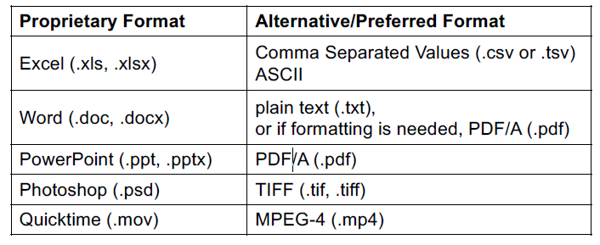
File Formats and Media
Best Practices:
Non-Proprietary
Unencrypted and uncompressed

Slide 36
QA/QC
Know what your data should look like
Check output regularly
Ensure you schedule time for data review
Prioritize tasks

Slide 37
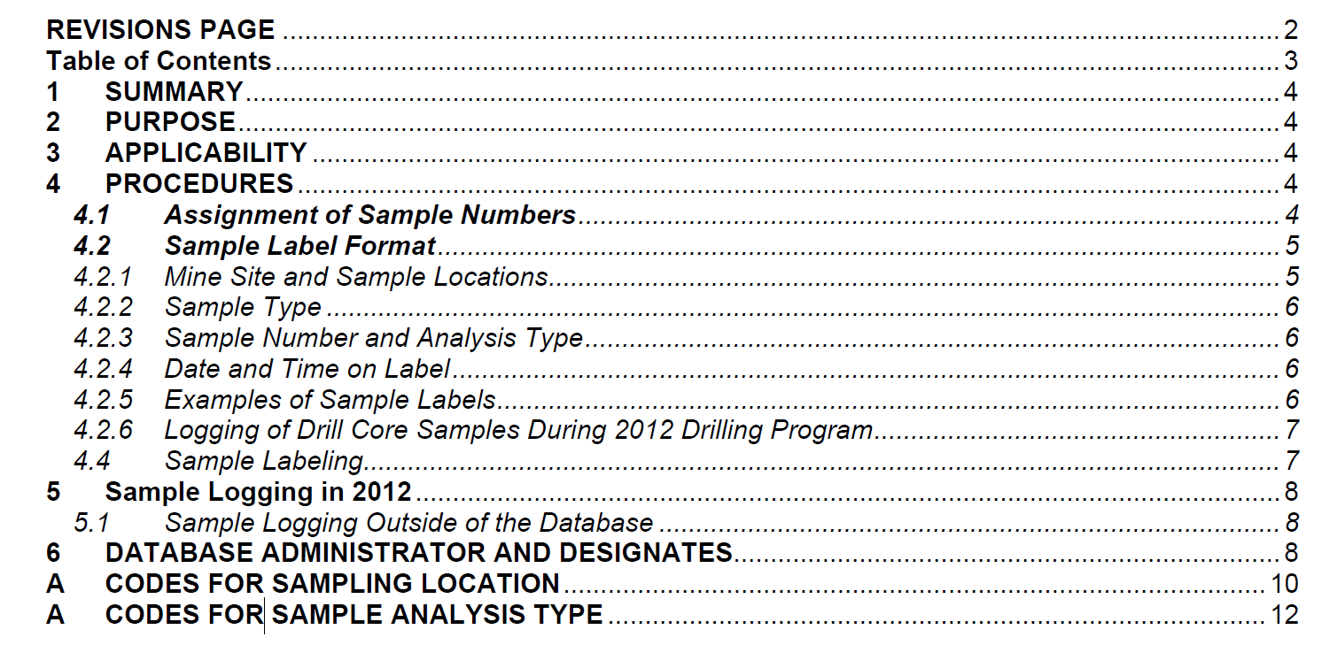
Standardize
Standard Operating Procedure

Slide 38
Reproducible Research
Reproducible Research
Standard, machine readable files
Use tools to facilitate/manage analysis (R, MatLab, GitHub)
Write/Borrow snippets of code to process or analyze your data
Comment, comment, comment

Slide 39
Making Room for Data Management
Plan It
Schedule it
Find ways to make yourself accountable

Slide 40
Keep a Diary
Collect procedures as you go
Build it
Make it a journal not a biography that requires research

Slide 41
Data Management Plans

Slide 42
Portage Data Management Plan Assistant
The following slides are extract from the Portage Network Data Management Assistant (guiding questions)
URL: https://assistant.portagenetwork.ca/
Export to pdf, csv, text, xml, html, json, docx

Slide 43
DMP Assistant: Data Collection
- What types of data will you collect, create, link to, acquire and/or record?
- What file formats will your data be collected in? Will these formats allow for data re-use, sharing and long-term access to the data?
- What conventions and procedures will you use to structure, name and version-control your files to help you and others better understand how your data are organized?
https://assistant.portagenetwork.ca/

Slide 44
DMP Assistant: Documentation and Metadata
- What documentation will be needed for the data to be read and interpreted correctly in the future?
- How will you make sure that documentation is created or captured consistently throughout your project?
- If you are using a metadata standard and/or tools to document and describe your data, please list here.
https://assistant.portagenetwork.ca/

Slide 45
DMP Assistant: Storage and Backup
- What are the anticipated storage requirements for your project, in terms of storage space (in megabytes, gigabytes, terabytes, etc.) and the length of time you will be storing it?
- How and where will your data be stored and backed up during your research project?
- How will the research team and other collaborators access, modify, and contribute data throughout the project?
https://assistant.portagenetwork.ca/

Slide 46
DMP Assistant: Preservation
- Where will you deposit your data for long-term preservation and access at the end of your research project?
- Indicate how you will ensure your data is preservation ready. Consider preservation-friendly file formats, ensuring file integrity, anonymization and de-identification, inclusion of supporting documentation
https://assistant.portagenetwork.ca/

Slide 47
DMP Assistant: Sharing and Reuse
- What data will you be sharing and in what form? (e.g. raw, processed, analyzed, final).
- Have you considered what type of end-user license to include with your data?
- What steps will be taken to help the research community know that your data exists?
https://assistant.portagenetwork.ca/

Slide 48
DMP Assistant: Responsibilities and Resources
- Identify who will be responsible for managing this project's data during and after the project and the major data management tasks for which they will be responsible.
- How will responsibilities for managing data activities be handled if substantive changes happen in the personnel overseeing the project's data, including a change of Principal Investigator?
- What resources will you require to implement your data management plan? What do you estimate the overall cost for data management to be?
https://assistant.portagenetwork.ca/

Slide 49
DMP Assistant: Ethics and Legal Compliance
- If your research project includes sensitive data, how will you ensure that it is securely managed and accessible only to approved members of the project?
- If applicable, what strategies will you undertake to address secondary uses of sensitive data?
- How will you manage legal, ethical, and intellectual property issues?
https://assistant.portagenetwork.ca/

