Slide 1
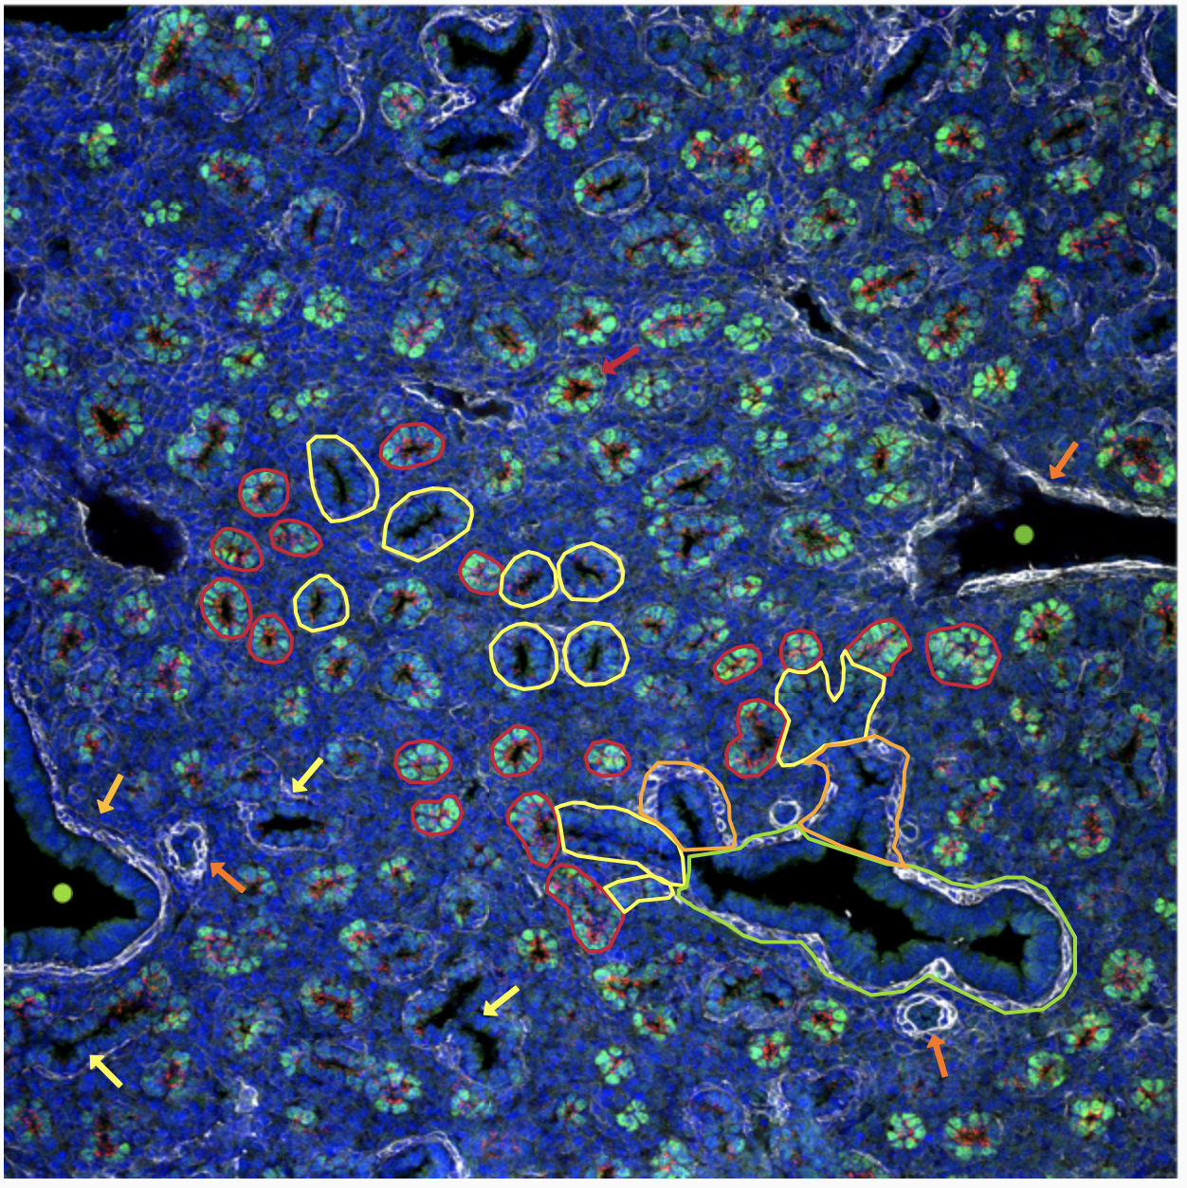
TBr
Red circles and arrows:
Distal acinar tubules /acinar buds.
SOX9 (green nuclie) - marker for
distal acinar tubules.
Yellow circles and arrows:
Proximal acinar tubules – lack SOX9.
Tend to be larger in diameter &
have single layer of smooth
muscle cells (ACGA2/white)
adjacent to epithelium
SFTPC red punctate apical
cytoplasmic staining found in both
proximal & distal tubules.
Expression greater in distal tubules
than in proximal tubules.
ACTA2 staining is normally not
found (or very weak) around the
distal tubules.
V
V
V
DAT
PAT
TBr
A
LBr
LBr
No staining for SOX9 or SFTPC in
the lateral or terminal bronchioles.
PAT
A

