Slide 1
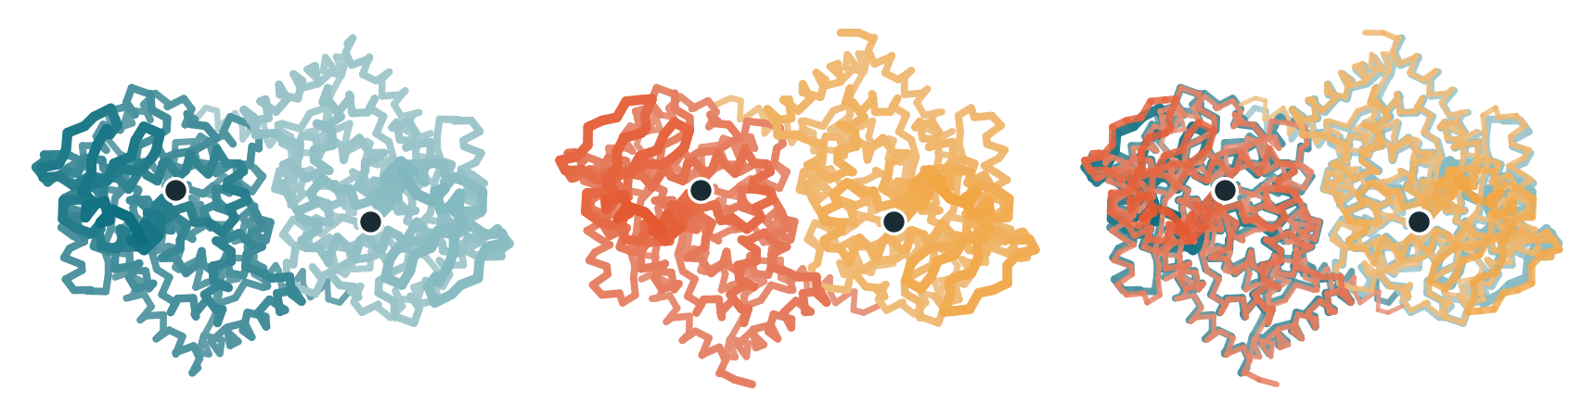
Search for DADA2
Pranshul Bhatnagar, Xianyu Wang, Canyang Xu, Dr. Bent
Which sequence and structural differences between human and pig ADA2 could account for the reported lower pig activity on free adenosine, and which experiments best discriminate them?
1 Computational evidence
Alignment, ESM-2 scoring, APBS electrostatics, AlphaFold 3 dimers
2 LLM hypothesis generation
A0–A4: baseline vs. adding sequence, surface, structure or all
3 Testable hypotheses
3–5 ranked, with evidence IDs and discriminating experiments
Where we are: week 2 of 7
AlphaFold 3 dimer models, with Zn²⁺
Done
Spec set: signal peptides removed, Zn²⁺ retained. Matched human and pig dimers modeled.
Now (Oct 27)
First human–pig comparison: do differences exceed seed variation?
Next
Verify findings, A0–A4 LLM runs, medical review, report Dec 8.
Human
Pig
Overlay
Top-ranked model, seed 101. Cα traces, one colour per chain, Zn²⁺ as dark spheres. Pig fitted to human (Cα RMSD 1.2 Å).
70.2%
sequence identity (355 of 506 aligned positions)
0
substitutions at catalytic and Zn²⁺-binding residues (UniProt)
0.46 Å
human dimer Cα RMSD to 3LGD (pig: 1.1 Å)
LLM test conditions (A0–A4): evidence added to the shared biological context
A0 Baseline
question + literature only
A1 + Sequence
alignment, ESM-2 scores
A2 + Surface
APBS electrostatics
A3 + Structure
AlphaFold 3 models
A4 + All three
all evidence sets
Notes:
Project: compare human and pig ADA2 with computational tools, then test whether giving that evidence to an LLM improves its experiment suggestions for the medical team.
Where we are: week 2 of 7. Shared inputs agreed (signal peptide removed, zinc kept). Matched human and pig AlphaFold 3 dimers predicted: both confident (ipTM 0.91-0.93, pTM 0.94-0.95), human matches the 3LGD crystal structure closely (0.46 A), pig dimer chain arrangement differs slightly (about 2 A for chain B after fitting chain A).
Figure: top-ranked models (seed 101, templates on) drawn as C-alpha traces; pig fitted onto human using residues aligned by the draft position map (C-alpha RMSD 1.2 A).
Sequence facts: 506 aligned positions, 355 identical (70.2%); catalytic residues and UniProt-annotated zinc ligands identical in pig.
Caveats: predictions only; UniProt reference sequences; unresolved items are glycans, DNA scope and the lab's constructs. Status of the sequence and surface analyses should be confirmed with Yang and Sienna before presenting.

