Slide 1


Optimizing Real Estate Pricing Strategy for Maximized Profits
A statistical analysis of king county, Washington, USA.

Slide 2

overview
Premiere Property Group, a prominent real estate agency in King County, has experienced a decline in profits over the past three years. To address this challenge, the agency has sought analytical expertise to devise a strategic pricing approach aimed at optimizing profits.

Slide 3
Objectives
Age and Price Analysis:
Condition/Grade and Location Assessments:
Seasonal Pricing Trends:
Effect of Views and Waterfront Accessibility:

Slide 4

DATA
Utilizing the King County Housing Data Set, which encompasses details such as house size, location, condition, and various features, this project endeavors to construct an advanced multiple regression model.

Slide 5

terminology
id - unique identified for a house
date - Date house was sold
price - Price is prediction target
sqft_living - square footage of the home
sqft_lot - square footage of the lot
waterfront - House which has a view to a waterfront
condition - How good the Overall condition is
grade - overall grade given to the housing unit, based on King County grading system

Slide 6

Data Cleanup
Data cleanup is the crucial process of identifying and rectifying errors and inconsistencies within the dataset we collected and analyzed.
This includes tasks such as removing duplicate records, imputing missing values, standardizing data formats, and correcting any inaccuracies present in the dataset.
The significance of data cleanup in our project lies in its ability to ensure the quality and reliability of the data we used for our analysis.
By performing thorough data cleanup, we aimed to enhance the accuracy and integrity of our findings and ultimately make well-informed decisions based on trustworthy data.

Slide 7

Feature Engineering
Feature engineering was also critical to our project, involving the creation and transformation of input variables (features) to improve the performance of our machine learning models and analytical algorithms.
It included tasks such as selecting relevant features, creating new ones, scaling data, and encoding categorical variables.
Feature engineering is pivotal as it directly influences the predictive power and efficiency of our models.
Through thoughtful feature engineering, we aimed to enhance the representational power of our data, enabling our algorithms to extract meaningful patterns and make more accurate predictions or classifications, ultimately contributing to the success of our project.

Slide 8
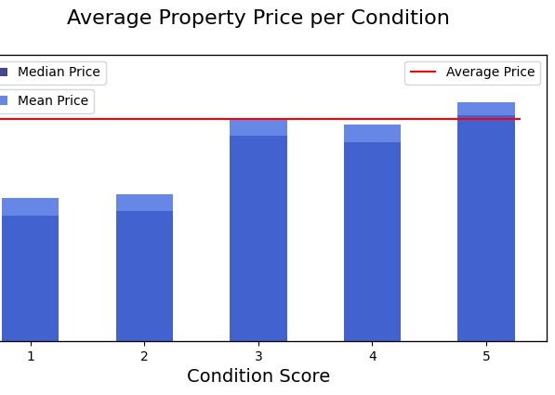
Average Property Price per Condition

Slide 9
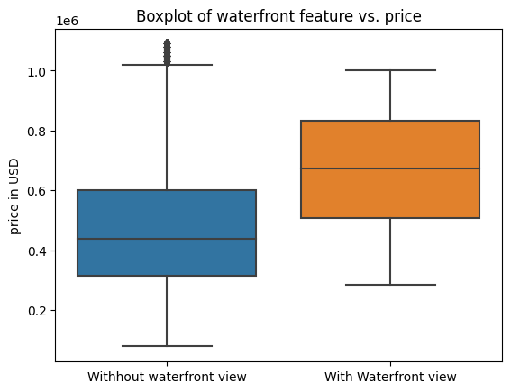
Waterfront Price Analysis
The bar plot provides a visual representation of how average prices vary across different property condition scores.

Slide 10
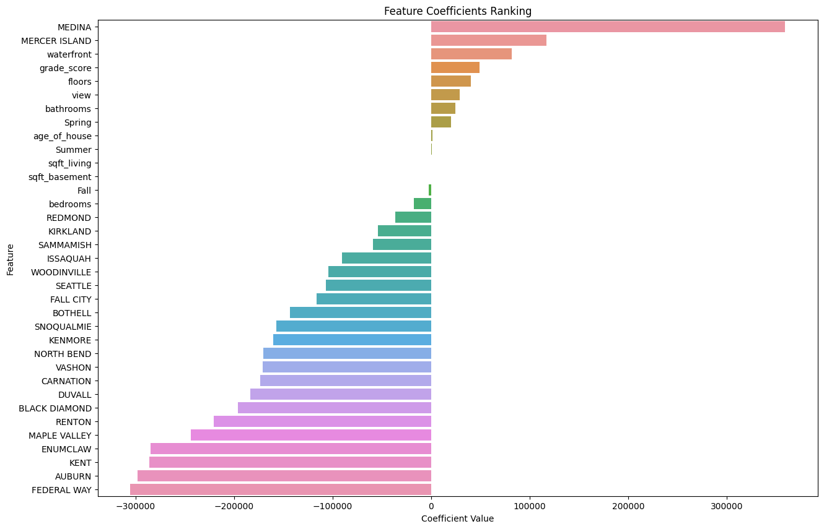
Predictive Modeling RESULTS
^{FEATURE RANKING RESULTS}
As the value of the independent variable increases, the predicted value of the dependent variable also increases.
e.g., If the coefficient for 'waterfront' is positive, it suggests that houses with waterfront access are, on average, associated with higher prices compared to houses without waterfront access.

Slide 11

Key takeaways
Positive Influencers on Price:
The presence of additional bathrooms, increased square footage, higher floors, waterfront access, captivating views, and elevated grade scores positively impact house prices.
Notably, the inclusion of cities like Medina and Mercer Island in the analysis reveals their positive association with higher property values.
Negative Influencers on Price:
The number of bedrooms, certain city affiliations (e.g., Auburn, Federal Way, Kent), in reference to Bellevue, and specific features (e.g., Fall Season, City) exhibit a negative correlation with house prices.
Premiere Property Group should be cognizant of these factors when devising pricing strategies.
Seasonal and Unique Factors:
While some seasonal variables do not significantly impact prices, it's crucial to note that the age of the house and the presence of a basement can influence pricing dynamics.
City-Specific Considerations:
Each city has a unique influence on house prices, emphasizing the need for tailored strategies for different locations

Slide 12

Recommendations
Dynamic Pricing Strategy
Seasonal Marketing and Sales Tactics
Location-Focused Investment
Data-Driven Decision Making

Slide 13

Opportunities for Further Analysis
Micro-Location Trends
Long-Term Market Trends
Economic and Demographic Factors
Economic and Demographic Factors
Advanced Predictive Modeling
Impact of Renovations
Customer Segmentation and Targeting
Impact of External Factors
By continuously leveraging data analytics and staying attuned to market trends, Premiere Property Group can maintain a competitive edge in the dynamic King County real estate market.
This Photo by Unknown author is licensed under CC BY-SA.

Slide 14
Queries

