Slide 1
Proto kev incQuery
Experimenting runtime architecture model analyze using kevoree and incQuery

Slide 2
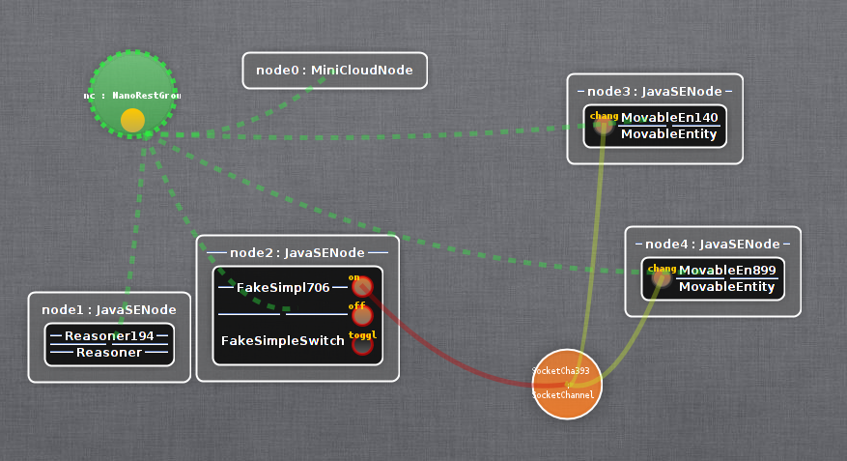
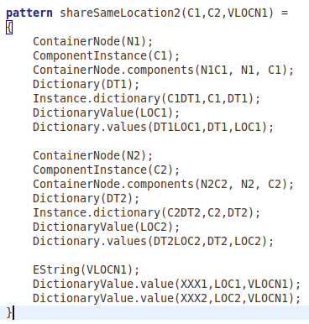
Use case
Detect components which share a same location attribute.
Model to analyze
Property description

Slide 3
Components description
MovableEntity
  Dictionary contains a Location value.
Reasoner
  Listen for model changes.
  When notified, running model is analyzed

Slide 4
Model changes
Change notification are triggered when the Location value of a MovableEntity component instance is updated.

Slide 5
Model analyze
The model is analyzed using two techniques :
  The first one consist to navigate the model in order to retrieve components which share a same location attribute value. Each time the model changes, the model is analyzed from scratch.
  The second one rely on incQuery, which propose to analyze the model incrementally.

Slide 6
Workflow
Location updated
2
Location updated
2
3
3
1
1
0
Analyze architecture number 3

Slide 7
Measures
Time to analyze a model with 3 movable entities
  Kevoree
  IncQuery
Time to propagate modifications
  Kevoree
Time system not consistent :

