Slide 1

Model Selection in Machine Learning
Brendan Duke
Notes:
First we’re going to review what a neural network is, then we’re going to implement one.

Slide 2
Contents
Brief overview of model selection in machine learning
Gradient boosting (interactive playground)
Machine learning flowcharts
Learning to rank (Jupyter notebook)
Realtime vehicle detection with Dlib

Slide 3
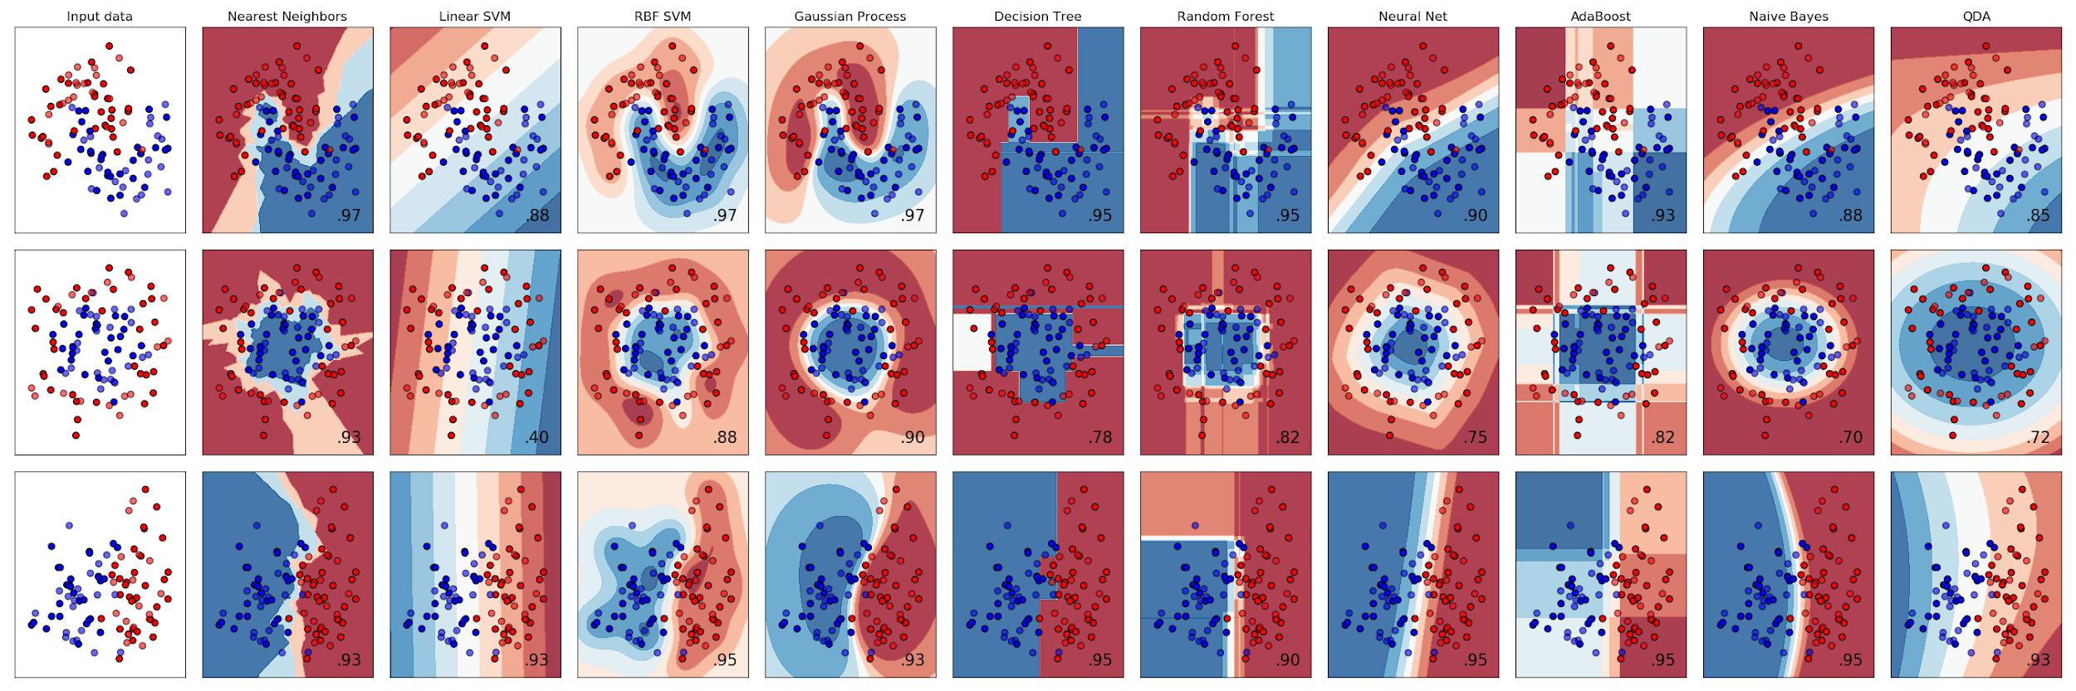
Selecting a Model
There are many different options:
  Gradient Boosting
  Random Forest
  Linear Regression
  SVM
  Naive Bayes
  Gaussian Process
  Nearest Neighbour
  LDA/QDA
  Neural Networks
Notes:
-All models behave differently
-For tabular data, it is probably best to try random forest or gradient boosting first to see if that works well enough
-If working with images, audio, or text, use neural networks

Slide 4
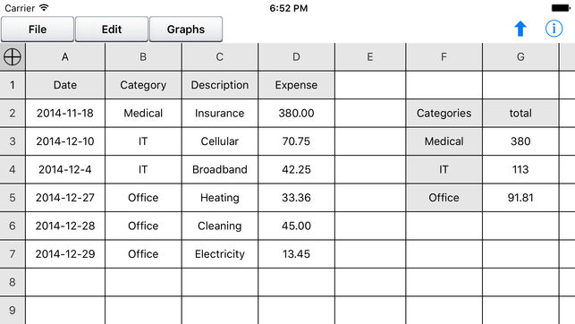
Model Selection - Rule of Thumb
Does the dataset contain tabular data (i.e. spreadsheet)?
  Use gradient boosting or random forest
  Works well for >90% of problems
  XGBoost: the first model to try, and ultimately winning model, in Kaggle competitions
    Feature engineering help: feature importance (https://bit.ly/2mdjOSd)

Slide 5
Gradient Boosting (Explanation)
Decision trees: classifier with trivial splitting (e.g., x < 2.4)
Build a regression tree greedily, by splitting to minimize Mean Squared Error (MSE)
  Fast algorithm, suboptimal results
Gradient boosting: ensemble of decision trees. (N + 1)th tree minimizes the N-tree ensemble’s residual error (or in general, negative gradient of loss).
Explanation: https://bit.ly/2Jf9bao

Slide 6
Gradient Boosting (Interactive Playground)
Underfitting vs. overfitting
High training and test error, what can you do?
  More powerful model/algorithm
Low training, but high test error, what can you do?
  Regularization
  More data/data augmentation
  Simpler model
Playground: https://bit.ly/2JgaGoP

Slide 7
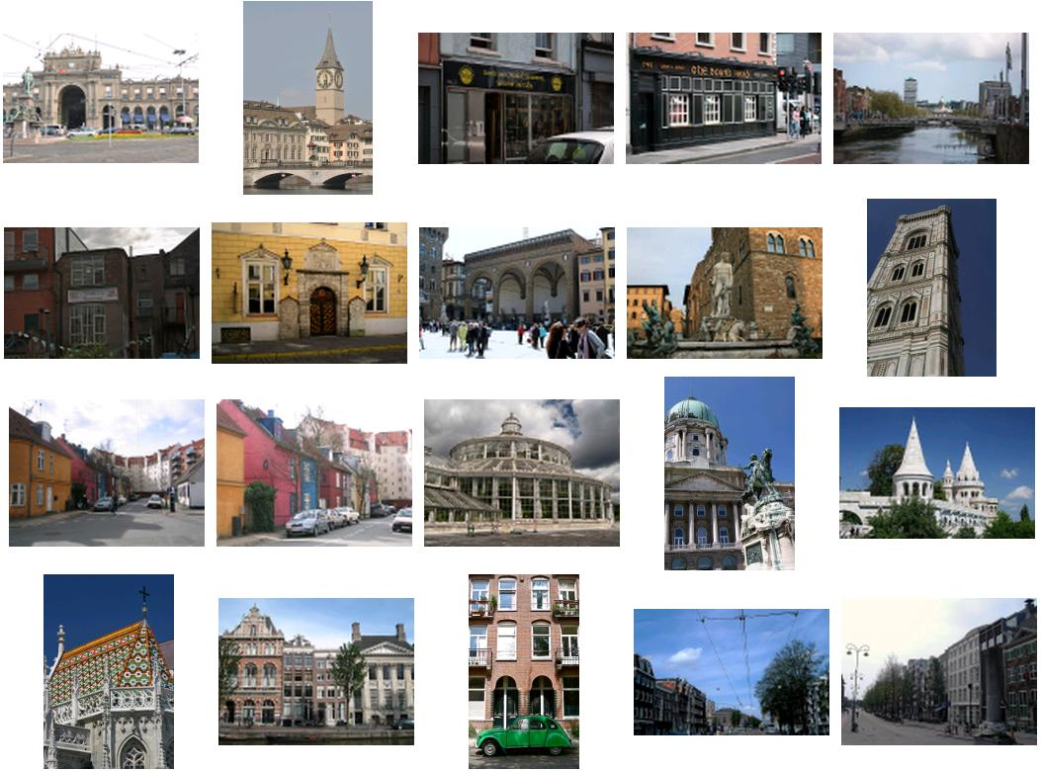


Model Selection - Rule of Thumb
Does your dataset contain images, audio, time series, or text data?
  Use neural networks, if the dataset is sufficiently large
  Works well for problems that humans are generally good at

Slide 8
Model Selection – Flow Charts
Sci-kit Learn: https://bit.ly/1IxDsim
Dlib: http://dlib.net/ml_guide.svg

Slide 9
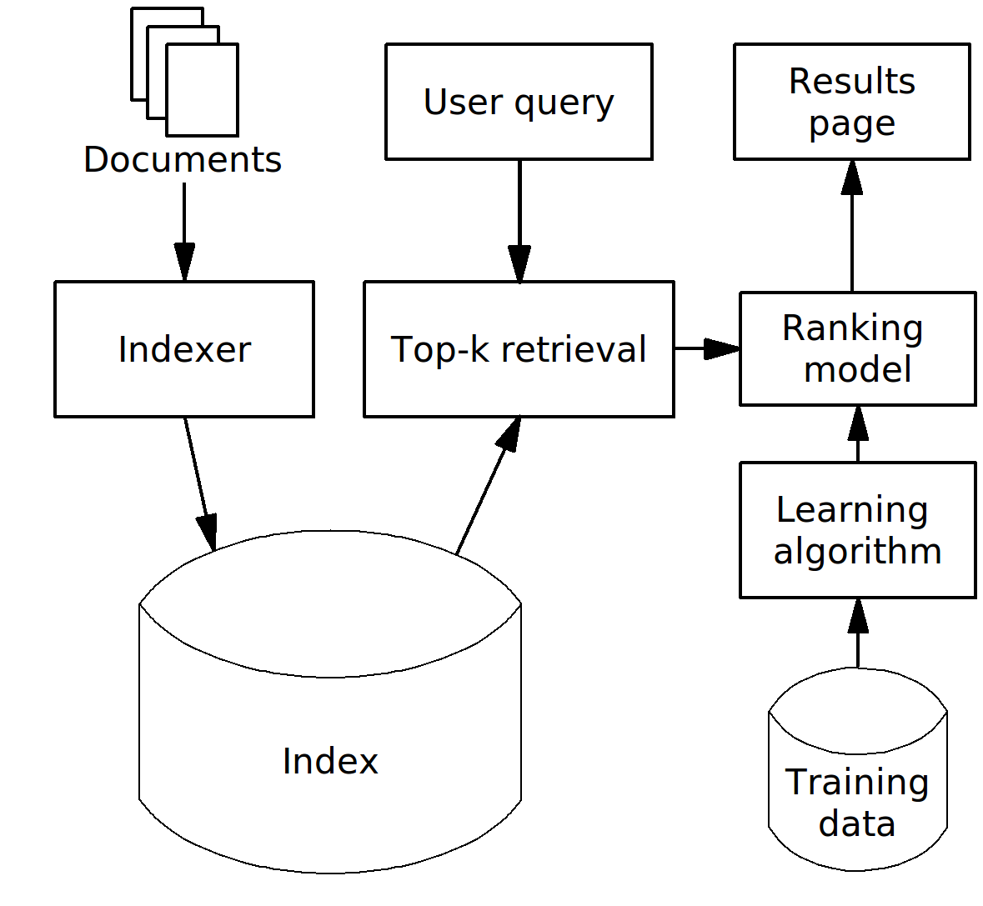
Learning to Rank
We want to use machine learning to improve a search engine
Two parts: top-k retrieval, and ranking of k retrieved documents
Let’s focus on the ranking model
To the Jupyter notebook!
https://github.com/dukebw/ml-model-selection

Slide 10
Realtime Vehicle Detection with Dlib
http://blog.dlib.net/2017/08/vehicle-detection-with-dlib-195_27.html

