Slide 1
Wskaźniki ogólnej oceny zawodników NBA z sezonu 2020-2021 przy użyciu analizy czynnikowej
Jakub Niedziela & Karol Zioło

Slide 2
Agenda
01
Wprowadzenie do analizy czynnikowej.
02
Przegląd literatury.
03
Wprowadzenie do badania.
04
Wyniki i podsumowanie.

Slide 3
Klasyczna analiza czynnikowa
2 Obszary zastosowań
Analiza Wyjaśniająca
Grupowanie czynników w skorelowane zbiory
Wykrycie zależności pomiędzy dostępnymi zmiennymi a zmiennymi ukrytymi
Analiza Potwierdzająca
Potwierdzenie hipotez o występowaniu nieobserwowalnych zmiennych
Testowana jest określona struktura czynników, w której zmienne pierwotne zależą od zmiennych ukrytych

Slide 4
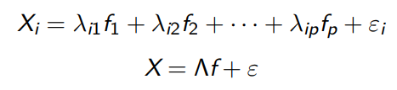
Istota Analizy Czynnikowej
Cel
1
Znalezienie ukrytych czynników
Funkcja
2
Określenie związków pomiędzy zmiennymi pierwotnymi
Założenie
3
Zmienne pierwotne mogą być przedstawione w postaci funkcji liniowej zmiennych ukrytych
extrêmement froid

Slide 5
Przegląd literatury
A. Montero, M. Ezquerro & M. Saavedra
Wei Yin
Factorial Analysis of the Skills Preferred by Basketball Players: A Study in Young Players
Principal component factor analysis-based NBA player comprehensive ability evaluation research
Berri, D.J., Brook, S.L. & Fenn, A.J.
S. Zhang, A. Lorenzo, M.A. Gómez, N. Mateus, B. Gonçalves & J. Sampaio
From college to the pros: predicting the NBA amateur player draft
Clustering performances in the NBA according to players’ anthropometric attributes and playing experience

Slide 6
Wprowadzenie
do badania

Slide 7
Zastosowane zmienne
Age
Minutes Played
Field Goals
FG%
3 Pointers
3P%
2 Pointers
2P%
Free Throws
FT%
Assists
Steals
Blocks
Offensive Rebounds
Defensive Rebounds
Turnovers
Personal Fouls

Slide 8
Analiza czynnikowa
Model 1:
Model 2:
Zastosowanie zmiennych relatywnych.
Zastosowanie zmiennych nominalnych.

Slide 9
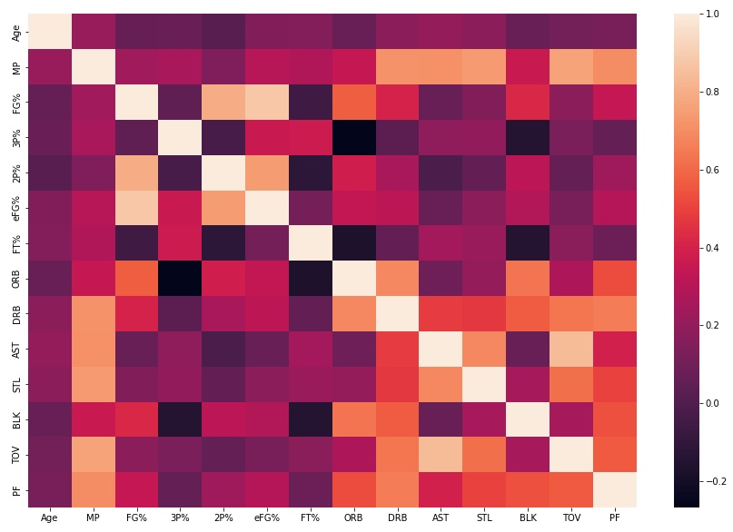
Mapa korelacji Model 1

Slide 10
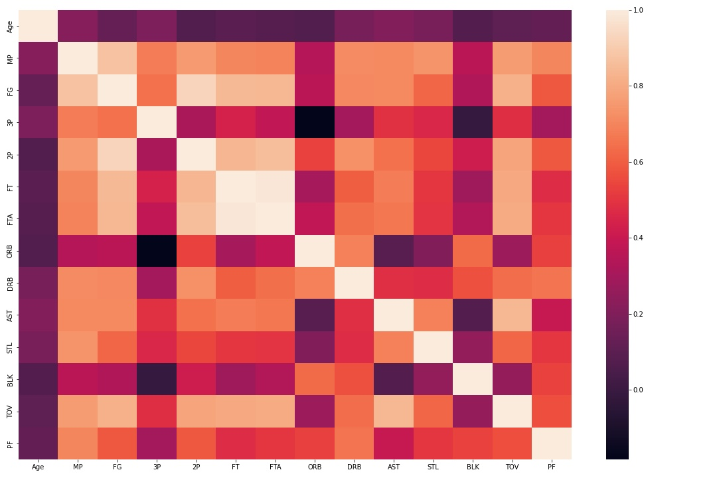
Mapa korelacji Model 2

Slide 11
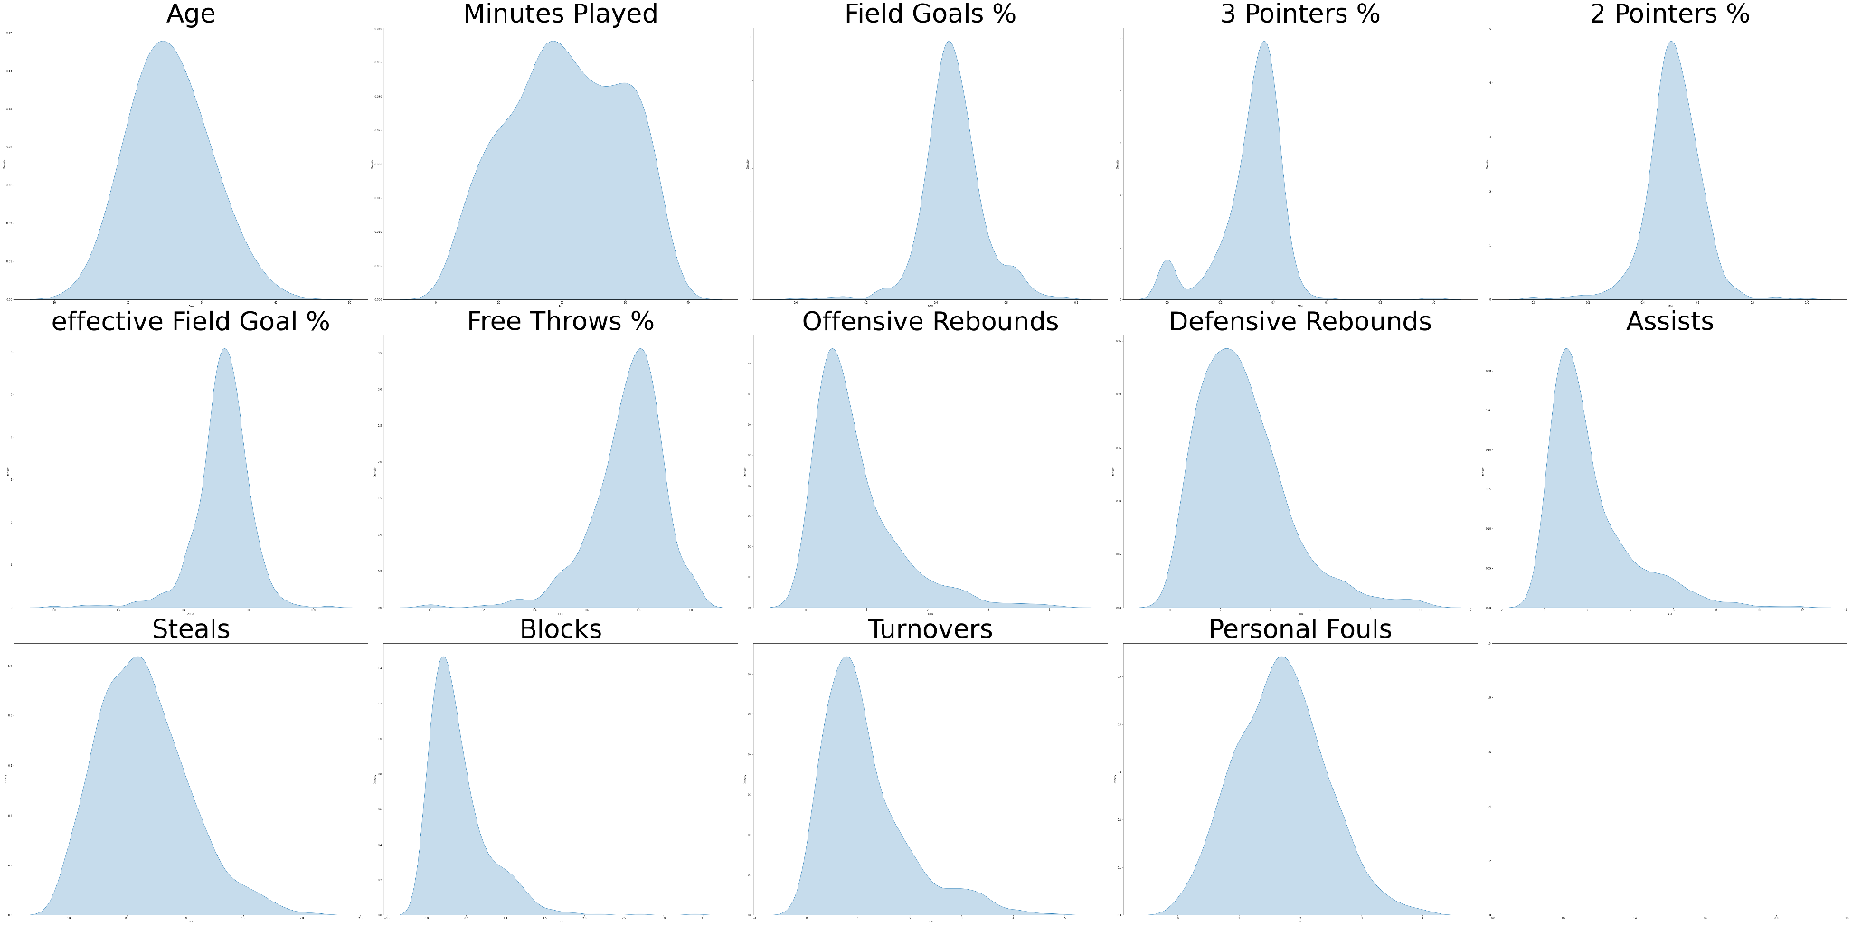
Rozkład zmiennych - model 1

Slide 12
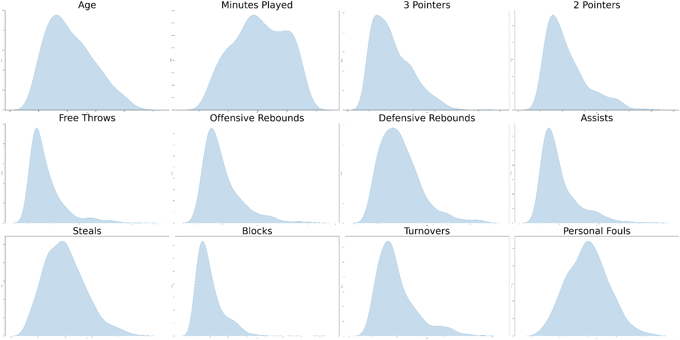
Rozkład zmiennych - model 2

Slide 13
Badanie współliniowości – model 1
Feature | VIF
Age | 1,16
MP | 6,08
FG% | 11,30
3P% | 2,19
2P% | 3,17
eFG% | 11,00
FT% | 1,32
ORB | 3,98
DRB | 4,28
AST | 5,20
STL | 2,64
BLK | 2,04
TOV | 5,32
PF | 2,66
Feature | VIF
Age | 1,12
MP | 5,68
FG% | 3,98
3P% | 1,51
2P% | 2,97
FT% | 1,31
ORB | 3,74
DRB | 4,27
AST | 5,09
STL | 2,64
BLK | 2,03
TOV | 5,18
PF | 2,66

Slide 14
Badanie współliniowości – model 2
Feature | VIF
Age | 1,14149
MP | 9,82703
FG | 2357,32
3P | 352,127
2P | 1535,62
FT | 4,42754
ORB | 3,77016
DRB | 4,257
AST | 5,20271
STL | 2,70845
BLK | 1,98828
TOV | 6,39564
PF | 2,78936
Feature | VIF
Age | 1,14035
MP | 9,80897
3P | 3,38628
2P | 6,63386
FT | 4,42106
ORB | 3,72499
DRB | 4,22824
AST | 5,20197
STL | 2,70841
BLK | 1,98828
TOV | 6,38869
PF | 2,7892

Slide 15
Testy adekwatności
Model 1:
Model 2:
Zastosowanie zmiennych relatywnych.
Zastosowanie zmiennych nominalnych.
Bartlett's test:
Statystyka: 4248,98
P-value: 0,0
KMO Value: 0,789
Bartlett's test:
Statystyka: 5274,96
P-value: 0,0
KMO Value: 0,855

Slide 16
Eigenvalues
Model 1
1 | 2 | 3 | 4 | 5 | 6 | 7 | 8 | 9 | 10 | 11 | 12 | 13
5,015 | 2,508 | 1,298 | 0,960 | 0,805 | 0,623 | 0,473 | 0,378 | 0,347 | 0,233 | 0,109 | 0,121 | 0,133
Model 2
1 | 2 | 3 | 4 | 5 | 6 | 7 | 8 | 9 | 10 | 11 | 12
6,309 | 1,932 | 1,024 | 0,729 | 0,545 | 0,395 | 0,347 | 0,268 | 0,070 | 0,104 | 0,124 | 0,153

Slide 17
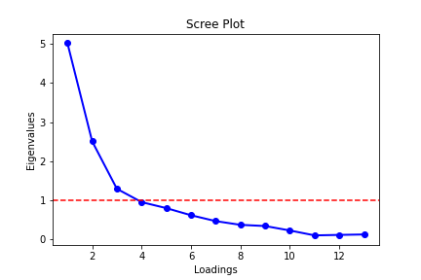
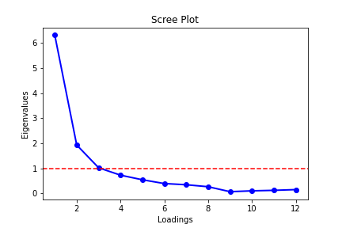
Osypisko
Model 1:
Model 2:
Zastosowanie zmiennych relatywnych.
Zastosowanie zmiennych nominalnych.

Slide 18
Wyniki
badania

Slide 19
Obliczenie Indeksu
1
2
3
4
Dla każdego zawodnika
Eigenvalues
Regresja liniowa, gdzie:
Y - wartości zmiennych pierwotnych,
X - macierz ładunków czynnikowych
Y ~ a*X
Przemnożenie współczynników regresji przez procent wariancji wyjaśnionej przez dany czynnik
Finalny wynik
Obliczenie ładunków czynnikowych
Wyskalowanie otrzymanej zmiennej do wartości od 66 do 96
Notes:
Obliczenie wartości wariancji wyjaśnianej – biore eigenvalue dla każdego użytego faktora i dziele przez sume eigenvalues użytych faktorów
Zastosowaliśmy rotację varimax w celu łatwiejszej interpretacji – maksymalizuje ona objaśnianą wariancje – to nasz cel

Slide 20
Ładunki czynnikowe Model 1
Model 1
 | Factor1 | Factor2 | Factor3 | Uniquenesses
Age | 0,2080 | 0,0380 | 0,0358 | 0,9540
MP | 0,8528 | 0,2905 | 0,0833 | 0,1815
FG% | 0,1014 | 0,2559 | 0,9588 | 0,0050
3P% | 0,3008 | -0,3275 | 0,1020 | 0,7919
2P% | 0,0099 | 0,1567 | 0,7868 | 0,3562
FT% | 0,3283 | -0,2294 | -0,0333 | 0,8385
ORB | 0,1209 | 0,8144 | 0,3672 | 0,1872
DRB | 0,5795 | 0,6559 | 0,1841 | 0,2000
AST | 0,8933 | -0,0416 | -0,0109 | 0,2002
STL | 0,7568 | 0,1148 | 0,0410 | 0,4124
BLK | 0,1532 | 0,6697 | 0,2468 | 0,4672
TOV | 0,8666 | 0,1828 | 0,0414 | 0,2139
PF | 0,5426 | 0,5213 | 0,1620 | 0,4075
Model 1 (bez zmiennej Age)
 | Factor1 | Factor2 | Factor3 | Uniquenesses
MP | 0,7669 | 0,4725 | 0,0588 | 0,1852
FG% | 0,0578 | 0,2971 | 0,9505 | 0,0050
3P% | 0,3632 | -0,2494 | 0,1027 | 0,7954
2P% | -0,0127 | 0,1761 | 0,7827 | 0,3562
FT% | 0,3660 | -0,1519 | -0,0351 | 0,8418
ORB | -0,0536 | 0,8295 | 0,3465 | 0,1890
DRB | 0,4241 | 0,7714 | 0,1572 | 0,2004
AST | 0,8826 | 0,1533 | -0,0285 | 0,1968
STL | 0,7120 | 0,2788 | 0,0226 | 0,4148
BLK | 0,0058 | 0,6941 | 0,2282 | 0,4661
TOV | 0,8102 | 0,3680 | 0,0192 | 0,2078
PF | 0,4164 | 0,6322 | 0,1387 | 0,4077

Slide 21
Ładunki czynnikowe Model 2
Model 2
 | Factor1 | Factor2 | Factor3 | Uniquenesses
Age | 0,0491 | 0,0645 | 0,2179 | 0,9459
MP | 0,5313 | 0,3631 | 0,7621 | 0,0050
3P | 0,3295 | -0,1669 | 0,7398 | 0,3162
2P | 0,7191 | 0,5080 | 0,2470 | 0,1638
FT | 0,7827 | 0,2662 | 0,2469 | 0,2555
ORB | 0,1134 | 0,9313 | -0,0670 | 0,1153
DRB | 0,4447 | 0,6942 | 0,3013 | 0,2296
AST | 0,8095 | 0,0123 | 0,3613 | 0,2140
STL | 0,4855 | 0,1876 | 0,5391 | 0,4385
BLK | 0,0814 | 0,6895 | 0,0858 | 0,5106
TOV | 0,8653 | 0,2133 | 0,2978 | 0,1170
PF | 0,3130 | 0,5697 | 0,4296 | 0,3929
Model 2 (bez zmiennej Age)
 | Factor1 | Factor2 | Factor3 | Uniquenesses
MP | 0,4963 | 0,4061 | 0,7641 | 0,0050
3P | 0,2917 | -0,1232 | 0,7637 | 0,3165
2P | 0,7077 | 0,5189 | 0,2526 | 0,1661
FT | 0,7697 | 0,2774 | 0,2697 | 0,2578
ORB | 0,1242 | 0,9250 | -0,1177 | 0,1151
DRB | 0,4357 | 0,7090 | 0,2797 | 0,2293
AST | 0,7939 | 0,0296 | 0,3975 | 0,2108
STL | 0,4616 | 0,2172 | 0,5491 | 0,4382
BLK | 0,0825 | 0,6931 | 0,0480 | 0,5105
TOV | 0,8521 | 0,2268 | 0,3262 | 0,1161
PF | 0,2962 | 0,5932 | 0,4093 | 0,3928

Slide 22
Wyniki Model 1
Player | Rating
Russell Westbrook | 96,0
James Harden | 94,3
Julius Randle | 92,3
Domantas Sabonis | 92,2
Luka Dončić | 91,9
Nikola Jokić | 91,8
Trae Young | 90,7
LeBron James | 90,5
Draymond Green | 90,3
Damian Lillard | 90,2
Kyle Lowry | 90,2
Giannis Antetokounmpo | 90,1
De'Aaron Fox | 90,1
Fred VanVleet | 89,8
Ben Simmons | 89,4
Karl-Anthony Towns | 89,3
Jimmy Butler | 89,3
Stephen Curry | 89,3
Jayson Tatum | 89,3
Kyrie Irving | 89,2
Player | Rating
Rayjon Tucker | 68,2
James Nunnally | 68,1
Bol Bol | 68,1
Cristiano Felício | 68,0
Tyrell Terry | 68,0
Juwan Morgan | 68,0
Gary Payton II | 68,0
Cassius Winston | 67,8
Nate Hinton | 67,7
Adam Mokoka | 67,3
Vincent Poirier | 67,3
Tyler Bey | 67,2
Elijah Hughes | 67,2
Cassius Stanley | 67,1
Robert Woodard | 67,0
Nick Richards | 66,9
Ty-Shon Alexander | 66,8
Jalen Lecque | 66,7
Brian Bowen | 66,3
Jared Harper | 66,0

Slide 23
Wyniki Model 2
Player | Rating
Russell Westbrook | 96,0
Trae Young | 94,7
Giannis Antetokounmpo | 93,5
Nikola Jokić | 92,6
James Harden | 92,5
Joel Embiid | 92,2
Luka Dončić | 91,8
Jimmy Butler | 90,7
Zion Williamson | 90,1
LeBron James | 89,6
DeMar DeRozan | 89,5
Kevin Durant | 88,4
Bradley Beal | 88,2
De'Aaron Fox | 87,8
Ja Morant | 87,7
Domantas Sabonis | 87,5
Bam Adebayo | 86,8
Damian Lillard | 86,3
John Wall | 86,2
Shai Gilgeous-Alexander | 86,2
Player | Rating
Sterling Brown | 69,9
Trevor Ariza | 69,8
Wayne Ellington | 69,6
Tony Snell | 69,6
Jaden McDaniels | 69,5
Jae Crowder | 69,1
Buddy Hield | 69,1
Royce O'Neale | 68,5
Gary Trent Jr, | 68,3
P,J, Tucker | 68,2
Armoni Brooks | 68,1
Maxi Kleber | 68,0
Dāvis Bertāns | 67,7
Joe Harris | 67,5
Danny Green | 67,3
Justin Holiday | 67,2
Dorian Finney-Smith | 66,9
Reggie Bullock | 66,8
Robert Covington | 66,6
Duncan Robinson | 66,0

Slide 24
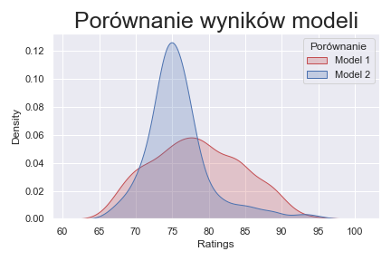

Slide 25
Dziękujemy za uwagę!
Jakub Niedziela & Karol Zioło

Slide 26
Variables
Venus
Mercury
Venus is terribly hot, even hotter than Mercury
Mercury is the smallest planet in the Solar System
Saturn
Earth
Saturn is a gas giant and has several rings
The Earth is the beautiful planet where we all live

Slide 27
Przykład
Saturn
1
2
Venus
Saturn is a gas giant and has several rings
It is terribly hot, even hotter than Mercury
Jupiter
3
4
Earth
It’s the biggest planet in the Solar System
The Earth is the planet where we all live
Mars
5
6
Mercury
Despite being red, Mars is actually a cold place
It’s the smallest planet in the Solar System

Slide 28
Basketball Infographics
Saturn
Earth
Uranus
Mars
Saturn is a gas giant and has several rings
The Earth is the beautiful planet where we all live
Uranus is the seventh planet from the sun
Despite being red, Mars is actually a cold place
Jupiter
Mercury
Neptune
Venus
Jupiter is the biggest planet in the Solar System
Mercury is the smallest planet in the Solar System
Neptune is the farthest planet from the Sun
Venus is terribly hot, even hotter than Mercury

Slide 29
Basketball Infographics
Mercury
Venus
Mercury is the smallest planet in the Solar System
Venus is terribly hot, even hotter than Mercury
Saturn
Mars
Saturn is a gas giant and has several rings
Despite being red, Mars is actually a cold place
Jupiter
Earth
Jupiter is the biggest planet in the Solar System
The Earth is the beautiful planet where we all live

Slide 30
Basketball Infographics
Venus
Venus has a beautiful name and is the second planet from the Sun
Mercury
Mercury is the closest planet to the Sun and the smallest one
Jupiter
Jupiter is a gas giant and the biggest planet in the Solar System
Mars
Despite being red, Mars is actually a cold place full of iron oxide dust

Slide 31
Istota analizy czynnikowej
Venus
1
Venus has a beautiful name and is the second planet from the Sun
Mars
2
Despite being red, Mars is actually a cold place full of iron oxide dust
Mercury
3
Mercury is the closest planet to the Sun and the smallest one
extrêmement froid
Jupiter
4
Jupiter is a gas giant and the biggest planet in the Solar System

Slide 32
Basketball Infographics
Mercury
Mars
Mercury is the closest planet to the Sun and the smallest one
Despite being red, Mars is actually a cold place full of iron oxide dust
Jupiter
Venus
Jupiter is a gas giant and the biggest planet in the Solar System
Venus has a beautiful name and is the second planet from the Sun

Slide 33
Basketball Infographics
Mercury
Uranus
Venus
Jupiter
Mercury is the smallest planet in the Solar System
Uranus is the seventh planet from the Sun
Venus is terribly hot, even hotter than Mercury
Jupiter is the biggest planet in the Solar System
1
7
2
66
99
00
23
16
Earth
Neptune
Saturn
Mars
The Earth is the beautiful planet where we all live
Neptune is the farthest planet from the Sun
Saturn is a gas giant and has several rings
Despite being red, Mars is actually a cold place

Slide 34
Basketball Infographics
Saturn
Mercury
Mars
Venus
Saturn is a gas giant and has several rings
It’s the smallest planet in the Solar System
Despite being red, Mars is actually a cold place
It’s terribly hot, even hotter than Mercury
Basketball Tournament

Slide 35
Basketball Infographics
Jupiter
Saturn
Earth
Mars
It’s the biggest planet in the Solar System
Saturn is a gas giant and has several rings
The Earth is the planet where we live
Despite being red, Mars is actually a cold place

Slide 36
Basketball Infographics
1 | 2 | 3 | 4
Saturn | Jupiter | Mercury | Earth
Saturn is a gas giant and has several rings | Jupiter is the biggest planet in the Solar System | Mercury is the smallest planet in the Solar System | The Earth is the planet where we all live

Slide 37
Basketball Infographics
Mercury
Venus
Mercury is the smallest planet in the Solar System
Venus is terribly hot, even hotter than Mercury
Saturn
Mars
Saturn is a gas giant and has several rings
Despite being red, Mars is actually a cold place
Jupiter
Earth
Jupiter is the biggest planet in the Solar System
The Earth is the beautiful planet where we all live

Slide 38

Basketball Infographics
25%
25%
Saturn
Venus
Saturn is a gas giant and has several rings
Venus is terribly hot, even hotter than Mercury
25%
25%
Earth
Mars
The Earth is the beautiful planet where we all live
Follow the link in the graph to modify its data and then paste the new one here. For more info, click here
Despite being red, Mars is actually a cold place

Slide 39
Basketball Infographics
Saturn
1
2
Venus
Saturn is a gas giant and has several rings
It is terribly hot, even hotter than Mercury
Jupiter
3
4
Earth
It’s the biggest planet in the Solar System
The Earth is the planet where we all live
Mars
5
6
Mercury
Despite being red, Mars is actually a cold place
It’s the smallest planet in the Solar System

Slide 40
Basketball Infographics
Mars
Saturn
Mercury
Earth
Jupiter
Mars is actually a cold place
It’s a gas giant and has several rings
It’s the closest planet to the Sun
The Earth is the planet where we live
It’s a gas giant and the biggest planet

Slide 41
Basketball Infographics
Venus
Saturn
Venus is terribly hot, even hotter than Mercury
Saturn is a gas giant and has several rings
Mars
Earth
Despite being red, Mars is actually a cold place
The Earth is the beautiful planet where we all live

Slide 42
Basketball Infographics
1 | 2 | 3 | 4 | 5 | 6
Mercury | Saturn | Jupiter | Earth | Mars | Venus
It’s the smallest planet in the Solar System | Saturn is a gas giant and has several rings | Jupiter is the biggest planet in the Solar System | The Earth is the planet where we all live | Despite being red, it’s actually a cold place | Venus is terribly hot, even hotter than Mercury

Slide 43
Basketball Infographics
The best-selling basketball equipment in the world
Venus
Venus has a beautiful name and is the second planet from the Sun
Mercury
Mercury is the closest planet to the Sun and the smallest one
Mars
Despite being red, it’s actually a cold place full of iron oxide dust
Jupiter
It’s a gas giant and the biggest planet in the Solar System

Slide 44
Basketball Infographics
Mercury
Earth
Saturn
Earth
Saturn
Mars
Saturn
Earth
Jupiter
Uranus
Neptune
Venus
Neptune
Venus

Slide 45
Basketball Infographics
A
B
A
Mercury
C
Mercury is the closest planet to the Sun
B
Mars
Despite being red, it’s actually a cold place
C
Jupiter
It’s the biggest planet in the Solar System
D
Earth
D
The Earth is the planet where we all live

Slide 46
Basketball Infographics
1
2
3
4
Earth
Mars
Mercury
Saturn
The Earth is the beautiful planet where we all live
Despite being red, Mars is actually a cold place
Mercury is the smallest planet in the Solar System
Saturn is composed mostly of hydrogen and helium

Slide 47
Basketball Infographics
Jupiter
Mars
Mercury
Jupiter is a gas giant and the biggest planet in the Solar System
Despite being red, Mars is actually a cold place full of iron oxide dust
Mercury is the closest planet to the Sun and the smallest one

Slide 48
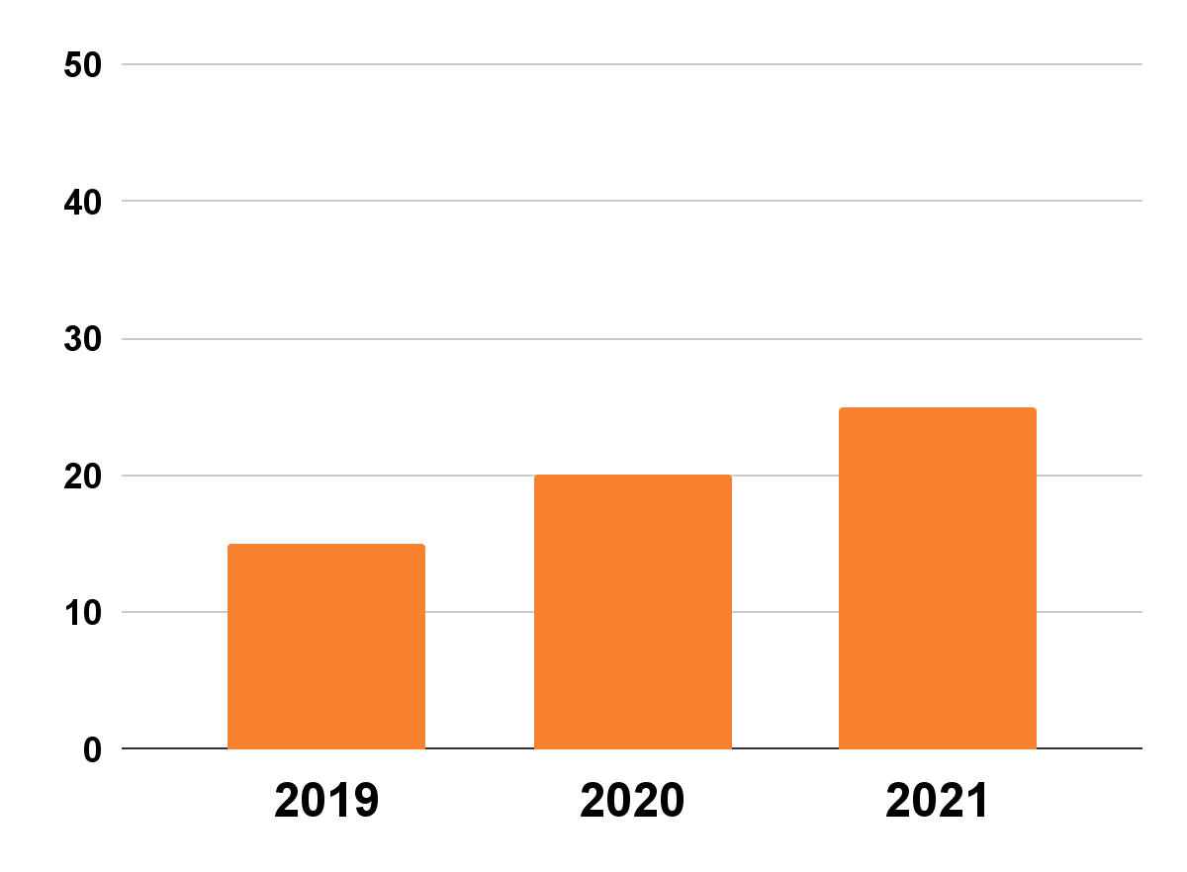
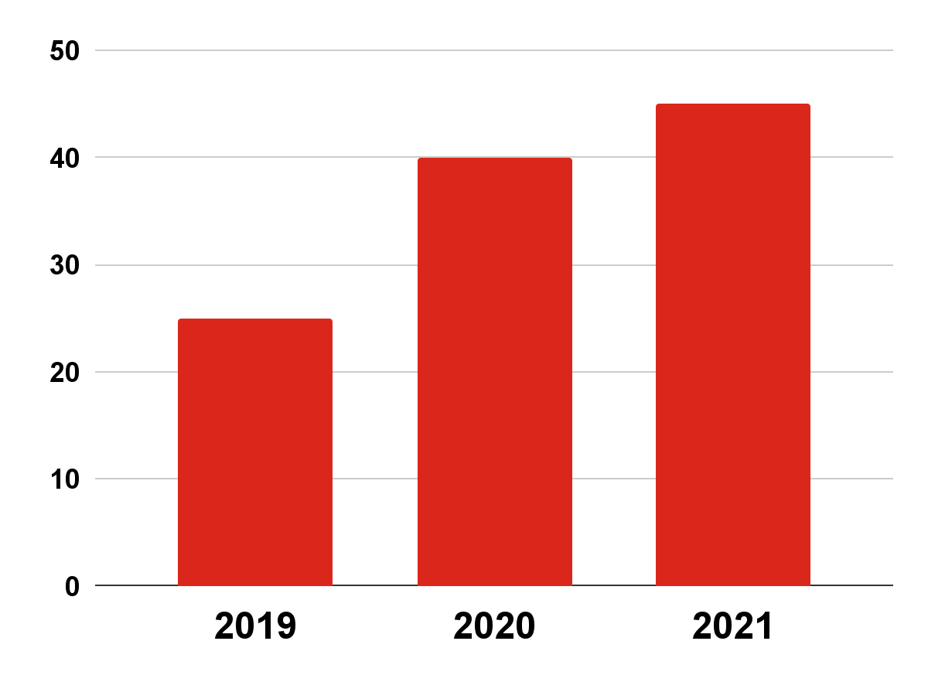
Basketball Infographics
The evolution of professional basketball players
15M
20M
25M
25M
40M
45M
Women
Men
Mercury is the smallest planet in the Solar System
The Earth is the beautiful planet where we all live
Follow the link in the graph to modify its data and then paste the new one here. For more info, click here

Slide 49
Basketball Infographics
The importance of basketball in disabled people
1
Mercury
2
Jupiter
Mercury is the closest planet to the Sun
It’s the biggest planet in the Solar System
3
Saturn
4
Mars
Saturn is a gas giant and has several rings
Despite being red, it’s actually a cold place
5
Venus
6
Earth
Venus is the second planet from the Sun
The Earth is the planet we all live on

Slide 50
Basketball Infographics
Mercury
Venus
Mercury is the closest planet to the Sun and the smallest one
Venus has a beautiful name and is the second planet from the Sun
Jupiter
Mars
Jupiter is a gas giant and the biggest planet in the Solar System
Despite being red, Mars is actually a cold place full of iron oxide dust

Slide 51
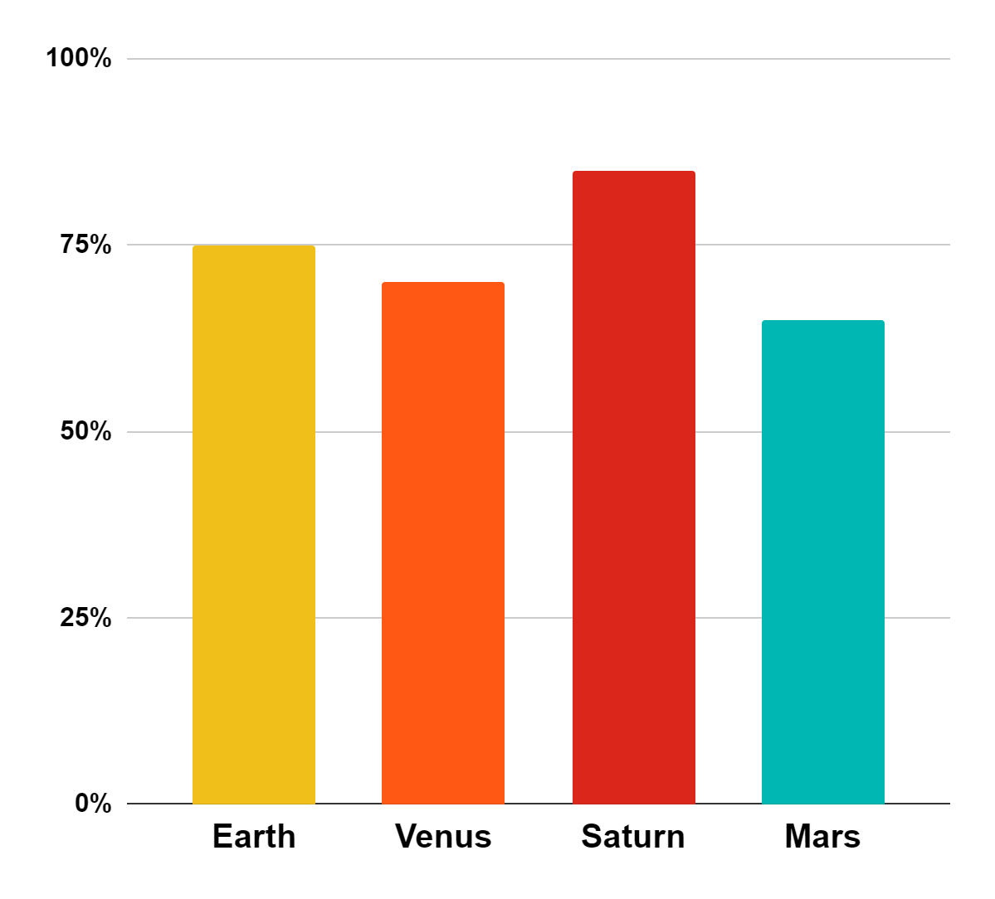
Basketball Infographics
75%
70%
Earth
Venus
The Earth is the beautiful planet where we all live
Venus is terribly hot, even hotter than Mercury
85%
65%
Saturn
Mars
Saturn is a gas giant and has several rings
Despite being red, Mars is actually a cold place
Follow the link in the graph to modify its data and then paste the new one here. For more info, click here

Slide 52
Basketball Infographics
1 vs 1
Jupiter
Mercury
Jupiter is the fifth planet and and is the biggest one in the entire Solar System
The Earth is the third planet from the Sun and the only one that harbors life
Mars is full of iron oxide dust, which gives the planet its reddish cast
Mercury is the closest planet to the Sun and the smallest one
Saturn was named after the Roman god of wealth and agriculture
Venus is has high temperatures, it’s even hotter than Mercury

Slide 53
Basketball Infographics
Jupiter
Earth
Mercury
Mars
Venus
Jupiter is a gas giant and the biggest planet in the Solar System
The Earth is “the Blue Planet” and it’s the only planet that harbors life
Mercury is the closest planet to the Sun and the smallest one
Despite being red, Mars is actually a cold place full of iron oxide dust
Venus has a beautiful name and is the second planet from the Sun
1
2
3
4
5

Slide 54
Instructions for use
In order to use this template, you must credit Slidesgo in your final presentation.
You are allowed to:
- Modify this template.
- Use it for both personal and commercial projects.
You are not allowed to:
- Sublicense, sell or rent any of Slidesgo Content (or a modified version of Slidesgo Content).
- Distribute Slidesgo Content unless it has been expressly authorized by Slidesgo.
- Include Slidesgo Content in an online or offline database or file.
- Offer Slidesgo templates (or modified versions of Slidesgo templates) for download.
- Acquire the copyright of Slidesgo Content.
For more information about editing slides, please read our FAQs or visit Slidesgo School:
https://slidesgo.com/faqs and https://slidesgo.com/slidesgo-school

Slide 55
Instructions for use (premium users)
In order to use this template, you must be a Premium user on Slidesgo.
You are allowed to:
Modify this template.
Use it for both personal and commercial purposes.
Hide or delete the “Thanks” slide and the mention to Slidesgo in the credits.
Share this template in an editable format with people who are not part of your team.
You are not allowed to:
Sublicense, sell or rent this Slidesgo Template (or a modified version of this Slidesgo Template).
Distribute this Slidesgo Template (or a modified version of this Slidesgo Template) or include it in a database or in any other product or service that offers downloadable images, icons or presentations that may be subject to distribution or resale.
Use any of the elements that are part of this Slidesgo Template in an isolated and separated way from this Template.
Register any of the elements that are part of this template as a trademark or logo, or register it as a work in an intellectual property registry or similar.
For more information about editing slides, please read our FAQs or visit Slidesgo School:
https://slidesgo.com/faqs and https://slidesgo.com/slidesgo-school

Slide 56
Infographics
You can add and edit some infographics to your presentation to present your data in a visual way.
Choose your favourite infographic and insert it in your presentation using Ctrl C + Ctrl V or Cmd C + Cmd V in Mac.
Select one of the parts and ungroup it by right-clicking and choosing “Ungroup”.
Change the color by clicking on the paint bucket.
Then resize the element by clicking and dragging one of the square-shaped points of its bounding box (the cursor should look like a double-headed arrow). Remember to hold Shift while dragging to keep the proportions.
Group the elements again by selecting them, right-clicking and choosing “Group”.
Repeat the steps above with the other parts and when you’re done editing, copy the end result and paste it into your presentation.
Remember to choose the “Keep source formatting” option so that it keeps the design. For more info, please visit Slidesgo School.

