Slide 1
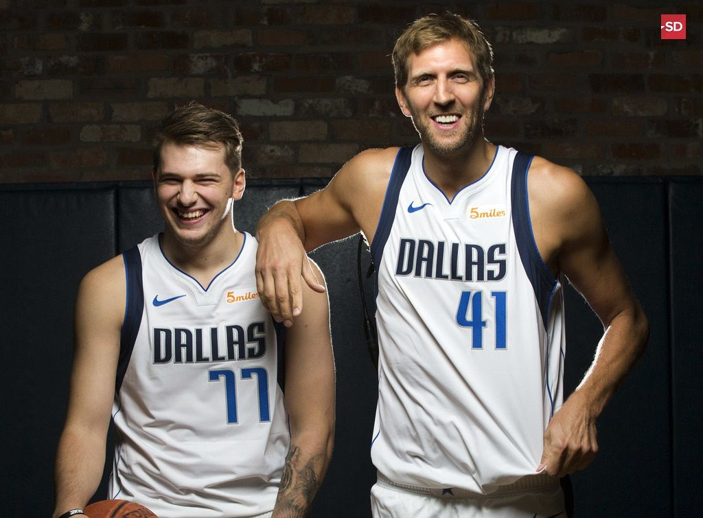
Predicting Results of Basketball Games with Linear Regression
Duc Le
Mathematical Modeling
Dr. Mohamed Allali

Slide 2
DISCLAIMER
The following mathematical model is strictly for experimental and academic purposes. I am not a betting expert nor a financial advisor. If you choose to utilize the following model for alternative purposes, please do so at your own risk. I am not responsible for any potential loss.

Slide 3

Abstract
The following mathematical model uses linear regression to compute a prediction of the final score of any basketball game, given certain required offensive/defensive statistical data and under a few specific assumptions.
The main basketball statistical (offensive and defensive) categories used for this model are:
Field goals (FG) attempts and makes.
Three-pointers (3PT) attempts and makes.
Free-throws (FT) attempts and makes.

Slide 4
Assumptions
We assume most of the players (especially the star/superstar players) from past games participate in the game.
We assume players are healthy/injury-free, prior and throughout the game, and play their usual allocated minutes.
We assume that the game will be held on one of the two team’s basketball arena & the result is decided within regulation period.
The following prediction is made through the observed trend of past games. The method cannot measure nor predict anomalies/outliers.
The model cannot foresee a historically efficient or inefficient shooting night from either participating team or player. (Ex: Rockets vs. Warriors 2018 WCF Game 7).

Slide 5
The Model
From Basketball Reference, I collect the necessary data using the past game logs of the first 17 games in the 2019-2020 NBA season. (Note: the data does not have to belong to professional teams, if there is a sufficient amount of information needed for this model).
Here’s an example of the data used: Toronto Raptors Home (Offensive vs. Defensive) Game Logs
FGM | FGA | 3PM | 3PA | FTM | FTA
42 | 103 | 14 | 40 | 32 | 38
33 | 85 | 10 | 39 | 28 | 30
51 | 86 | 13 | 27 | 10 | 12
43 | 78 | 14 | 29 | 24 | 29
50 | 97 | 20 | 43 | 12 | 15
45 | 87 | 9 | 27 | 14 | 19
38 | 84 | 11 | 34 | 14 | 22
46 | 94 | 21 | 41 | 13 | 17
FGM | FGA | 3PM | 3PA | FTM | FTA
43 | 102 | 19 | 45 | 17 | 20
34 | 89 | 12 | 39 | 15 | 18
41 | 88 | 14 | 30 | 17 | 23
42 | 95 | 20 | 44 | 16 | 21
33 | 78 | 15 | 45 | 15 | 24
35 | 91 | 9 | 32 | 18 | 28
36 | 88 | 15 | 40 | 9 | 16
33 | 88 | 12 | 41 | 20 | 24

Slide 6
The Model
With MATLAB, I extract the data from the tables (stored as CSV files) and convert them into vectors containing numbers.
Note: For better accuracy, it is necessary to use the appropriate data acquired from home or away games, depending on the location of the game.
Ex: From the FGM column, I get a vector FGM = [# # # # # # #]. The same procedure applies to all 6 chosen categories.
Next, I calculate the Expected Field Goal Attempts (EFGA) for each category by taking the mean of the average offensive attempts and the average of the defensive allowed attempts.
Ex: Team A vs. Team B at Team A’s arena.
Team A has the average of x attempts of field goals per game at home and Team B allows the opposing team to attempt y amount of shots per game. Then Team A’s EFGA will be (x+y)/2.
Repeat the same process for 3-point shot attempts/makes and free-throw shot attempts/makes.
Repeat the same process for the second team’s EFGA’s.

Slide 7
The Model
Linear Regression
Using MATLAB’s built-in function, I apply linear regression to both team’s offensive stats using the shots made as the scalar response and shot attempts as the explanatory variable.
With the result, I input the Expected Field Goal Attempts (EFGA) to estimate the Expected Field Goals Made (EFGM). Once this step is completed, I repeat the same process for 3-pointers & free-throws.
Ex: With MATLAB, perform linear regression to observe the trend between Team A’s field-goal attempts vs. makes at home. This will result in 3 outputs: slope, y-intercept & residual. Using this and inputting the EFGA, we can estimate the EFGM. Repeat the same process for other categories and calculate the final score.

Slide 8
Results
Refer to MATLAB files
Mavericks @ Rockets 11/24
Model’s Predicted Score
Mavericks 126 – Rockets 111 (Mavericks +15).
Mavericks: FG 47/93. 3PT 14/39. FT 18/23.
Rockets: FG 42/92. 3PT 7/40. FT 18/26.
Actual Score
Mavericks 137 - Rockets 123 (Mavericks +14).
Mavericks: FG 49/102. 3PT 17/44. FT 22/26.
Rockets: FG 45/98. 3PT 10/44. FT 23/31

Slide 9
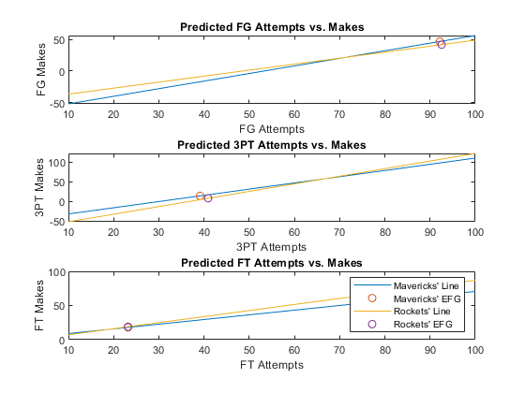
Plots

Slide 10
Results
Mavericks @ Lakers 12/1
Model’s Predicted Score
Lakers 123 – Mavericks 111 (Lakers +12)
Actual Final Score
Lakers 100 – Mavericks 114 (Mavericks +14)
*Mavericks went on a 28-3 run in the 3rd quarter to go up by 20.
*Statistical data from the Lakers is slightly inflated.

Slide 11
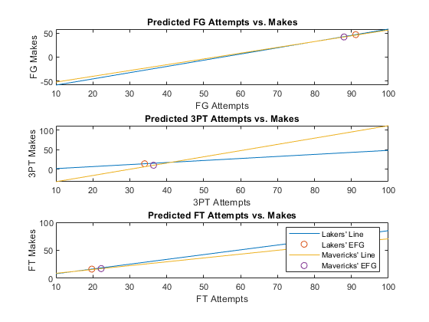
Plots

Slide 12
Results
Rockets @ Spurs 12/3*
Model’s Predicted Scores
When rounding the final score with “round” (MATLAB):
Spurs 117 – Rockets 117 (Draw)
When rounding the final score with “ceil” (MATLAB):
Spurs 118 – Rockets 117 (Spurs +1)
Actual Score
Spurs 135 – Rockets 133 in 2OT. (Spurs +2)
Through 4Q’s, Spurs 115 – Rockets 115. (Spurs were down 22 in the 3rd quarter & 14 with 6 minutes left).

Slide 13
A Closer Look
Model’s Simulated Statistics in Regulation
Spurs 117 – Rockets 117
Spurs: FG 43/91. 3PT 12/30. FT 20/23.
Rockets: FG 42/90. 3PT 12/39. FT 21/25.
Actual Statistics in Regulation
Spurs 115 – Rockets 115
Spurs: FG 43/88. 3PT 11/24. FT 18/26.
Rockets: FG 36/96. 3PT 15/47. FT 24/26.

Slide 14
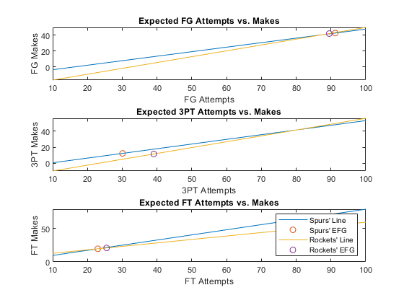
Plots

Slide 15
References
https://www.basketball-reference.com/teams/DAL/2020.html
https://www.basketball-reference.com/teams/LAL/2020.html
https://www.basketball-reference.com/teams/HOU/2020.html
https://www.basketball-reference.com/teams/NOP/2020.html
https://www.basketball-reference.com/teams/TOR/2020.html

