Slide 1

Portfolio Optimiser
Created by Josh, Palmy, Matt

Slide 2
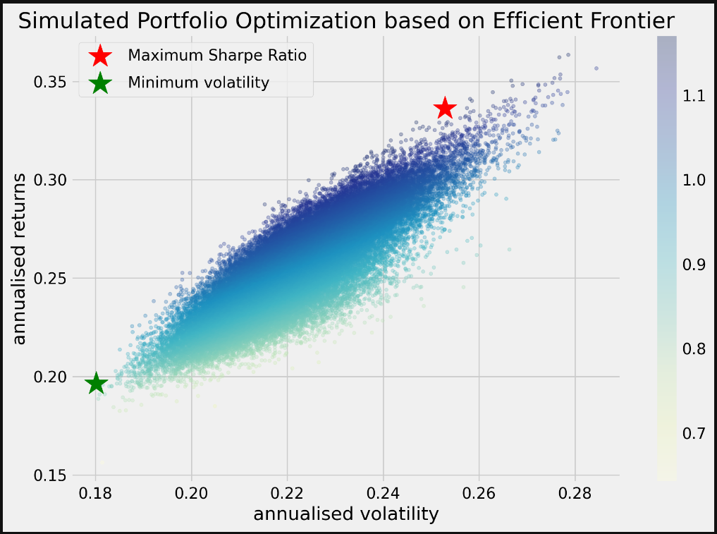
Executive Summary
Portfolio Optimiser is designed to allow the user to input a portfolio of stock along with a corresponding index e.g S&P500. The optimiser will optimise the stocks weights in the portfolio in three different ways:
Max Sharpe Ratio
Min Volatility
Limited to user weights bounds e.g min of 5% weighting across all stocks.
The Optimiser will also run 50000 random portfolios to analyse Max Sharpe and Min Volatility Portfolios.

Slide 3

Concept
Description
The motivation for the development of this project was due to Josh’s interested in investing and wanting to optimise his portfolio using a common financial theory.
User’s can easily input there portfolio and look a different senarios to improve their results on their investments. With some basic coding knowledge users can also adjust the parameters to add additional objectives if they wish.

Slide 4
Data Techniques
The data used for this model is from Yahoo finance (yfinance) API.
Yfinance as an API were you can source
Collection, exploration and cleaning process.

Slide 5
Approach
Technologies used
Breakdown of tasks and roles
Challenges
Successes

Slide 6
Demo

Slide 7
Next Steps
Additional questions that surfaced.
Additional topics to research.
Plan for future development.

Slide 8
Links
Deployed application.
GitHub repo.

