Slide 1
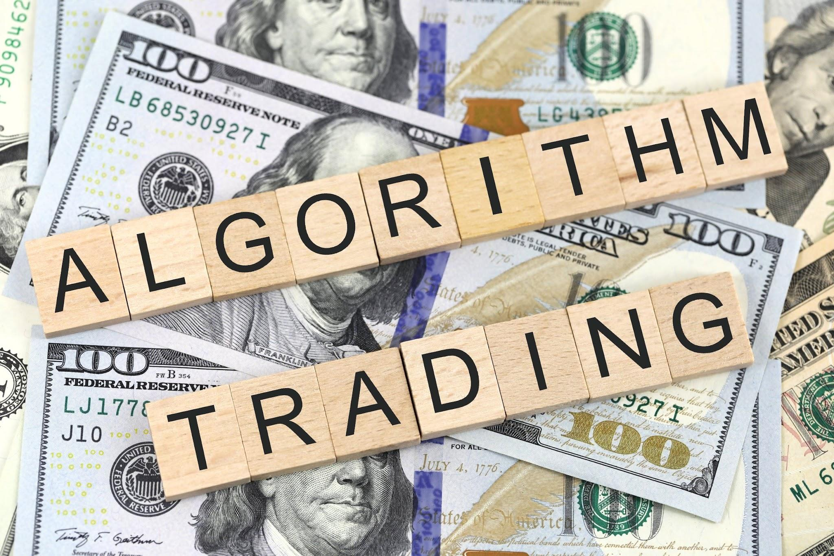
Machine Learning Trading Ideas
By Joshua Woods, David Lewis, Hardy Ty, Anna

Slide 2
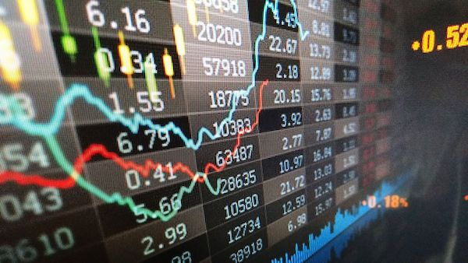
Motivation
With a couple keen traders in the group we were interested to see what machine learning modules we could use to generate returns outperforming the bitcoin daily returns.

Slide 3
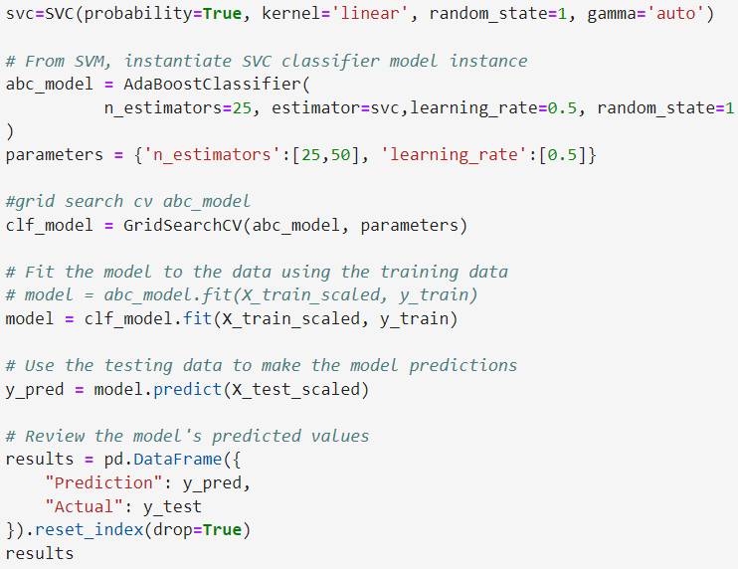
SVM & Adaboost Model Summary
I decided to use the Support Vector Machine classifier with the Adaboost classifier to try and create a model that outperformed the BTC-AUD daily time-frame buy and hold strategy. I also used the GridSearchCV to help find some optimal parameters.

Slide 4
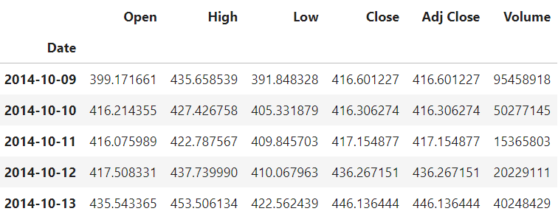
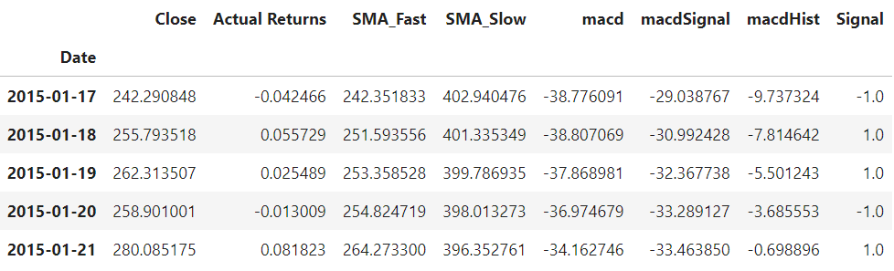
SVM Data Cleanup & Model Training
BTC-AUD data original - open, high, low, close, adj close, volume.
Remove all data apart from close.
Added indicators - SMA_fast(4), SMA_slow(100) and MACD(12,26,9).
Used signal of -1 for negative daily change and +1 for positive daily change to train the model.
X = SMA_Fast, SMA_Slow, macd, macdSignal and macdHist.
Y = Signal

Slide 5
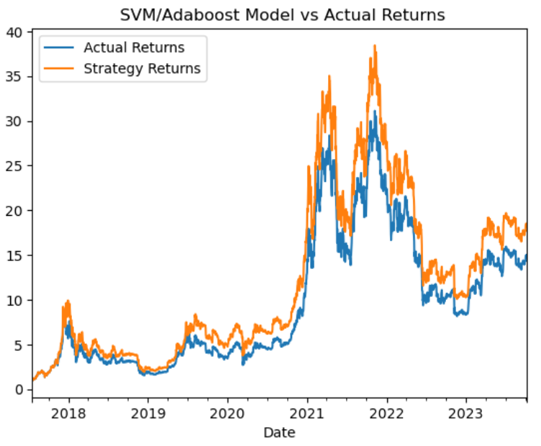
SVM Model Evaluation
As you can see to the right my model closely mimicked the actual returns but did out perform slightly. The results are also only plotted on the test data and the training data has been left out. I trained the model on 30months worth of daily data.

Slide 6
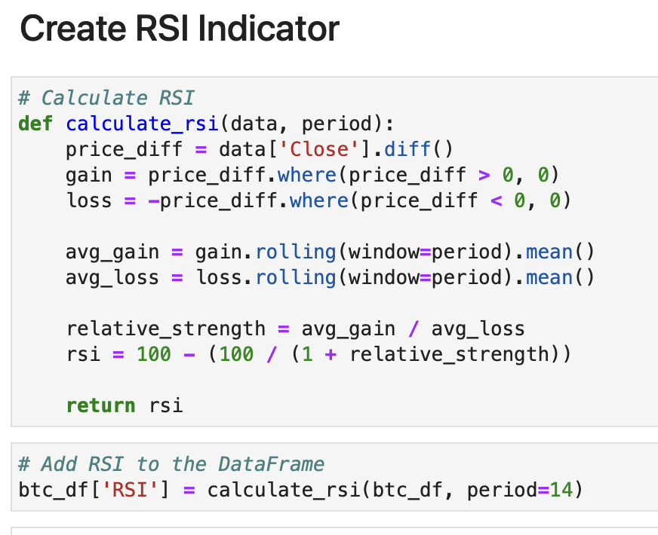
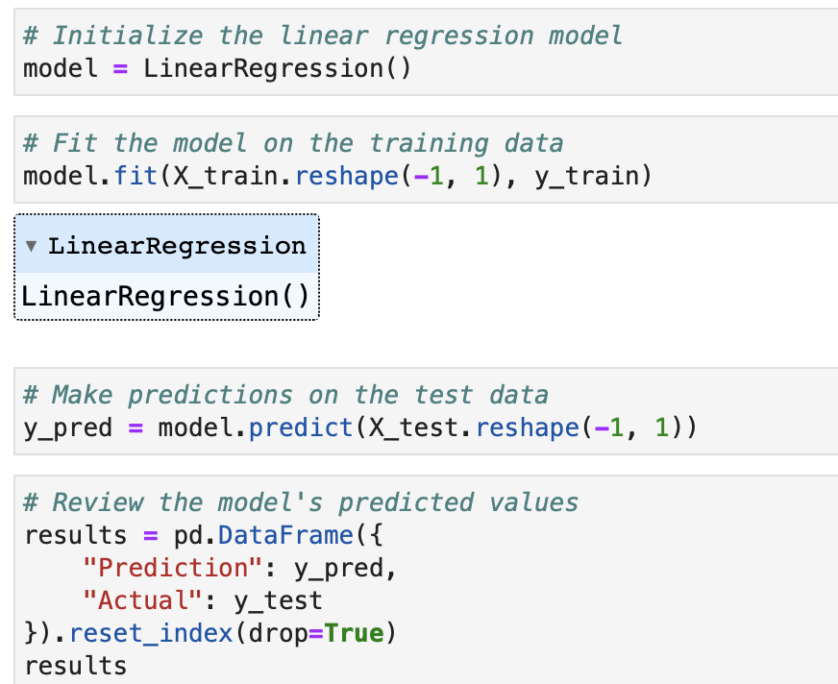
RSI Indicator & Linear Regression Model Summary
I used RSI as indicator and Linear Regression as ml model because while RSI can help identify potential entry and exit points based on short-term market conditions that, I think is the best strategy given the volatility of BTC, linear regression complements it by providing the broader trend perspective. Also, for linear regression’s simplicity and explainability being a basic machine learning model.

Slide 7
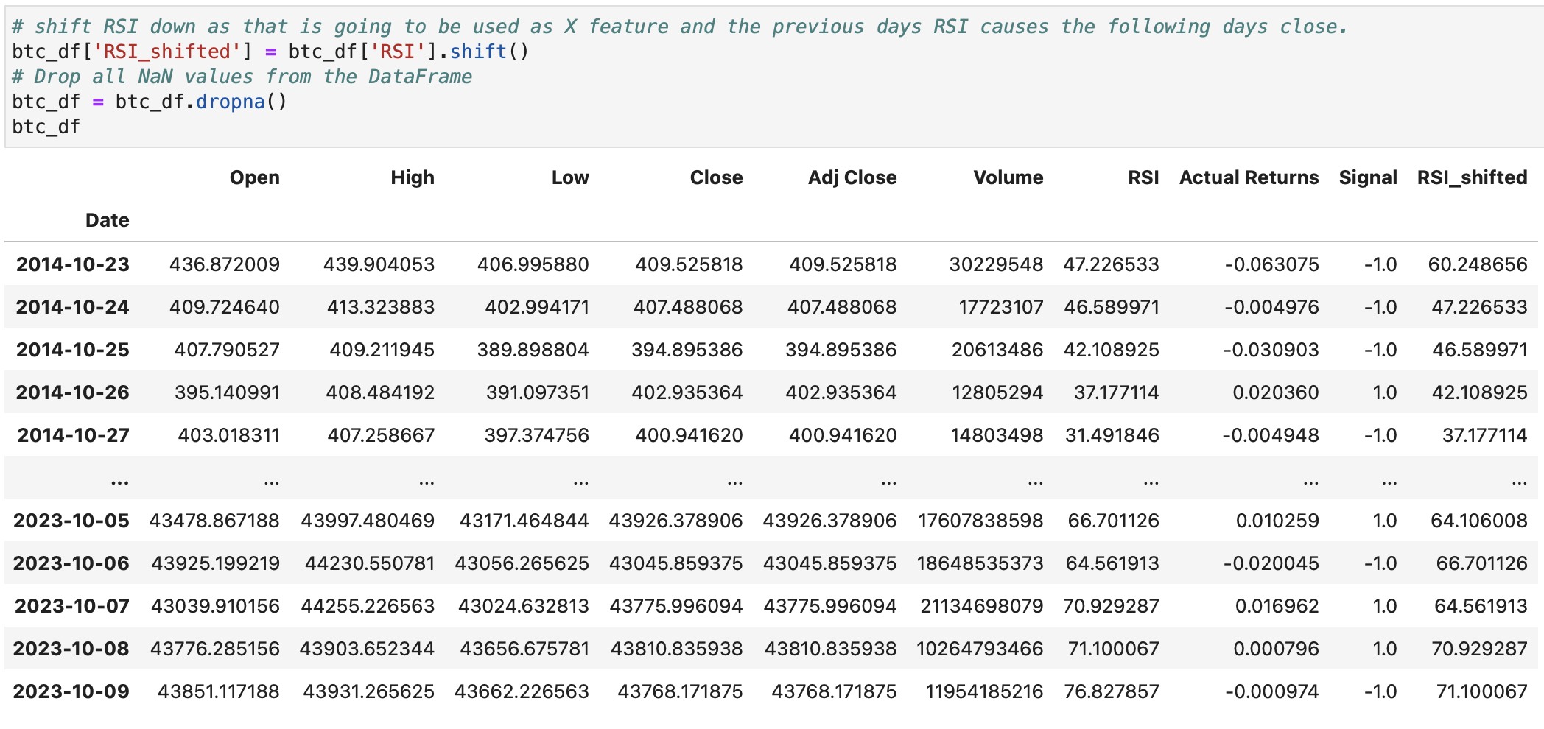
LR Data Cleanup & Model Training
Drop all NaN and Set ‘RSI_shifted’ and ‘Close’ columns as the feature and target values, respectively.

Slide 8
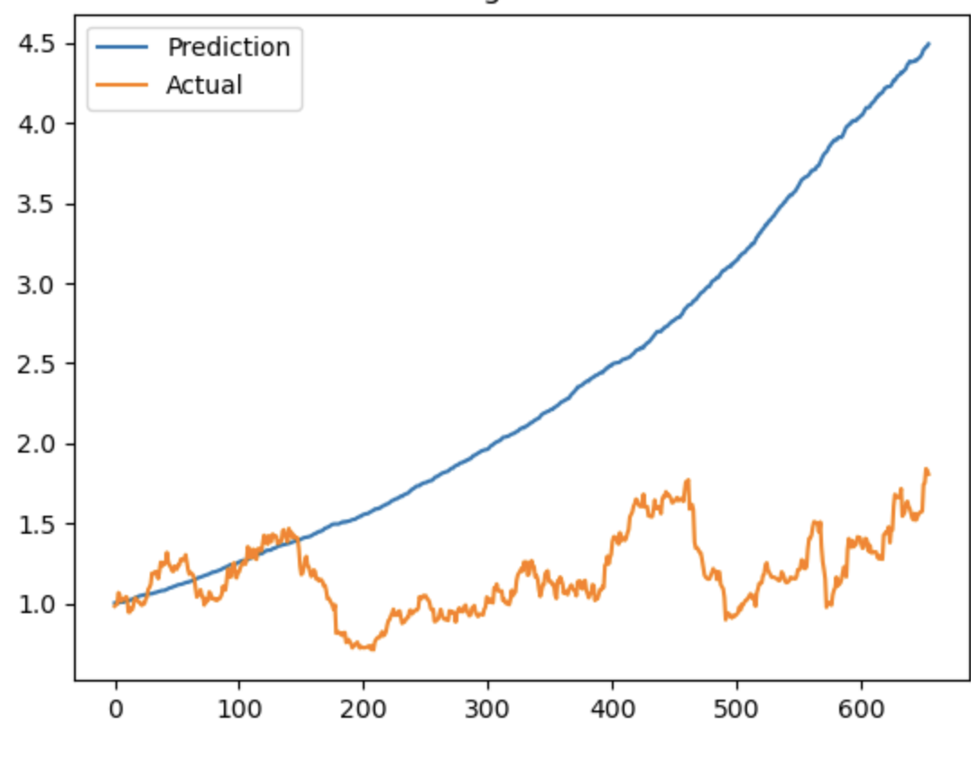
Linear Regression Model Evaluation
The predicted returns outperforms the actual returns in this Linear Regression model.

Slide 9
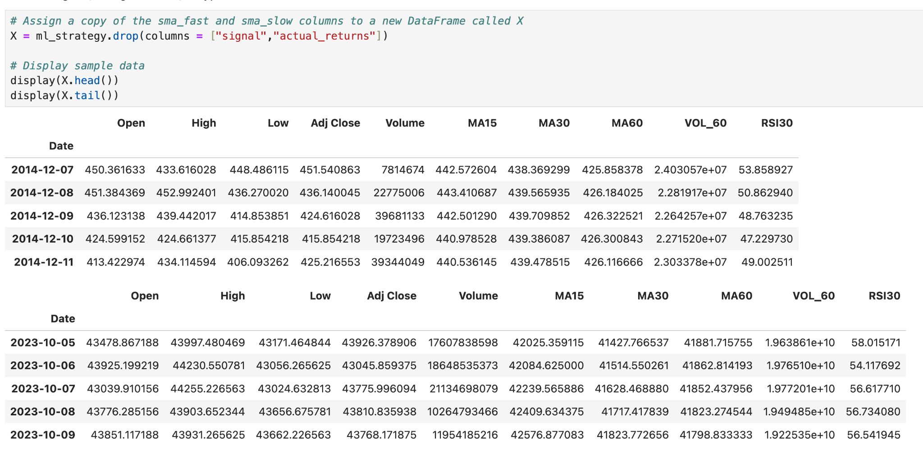
Neural Network Model Summary
Data Feed
X
Training Window: 60 months

Slide 10
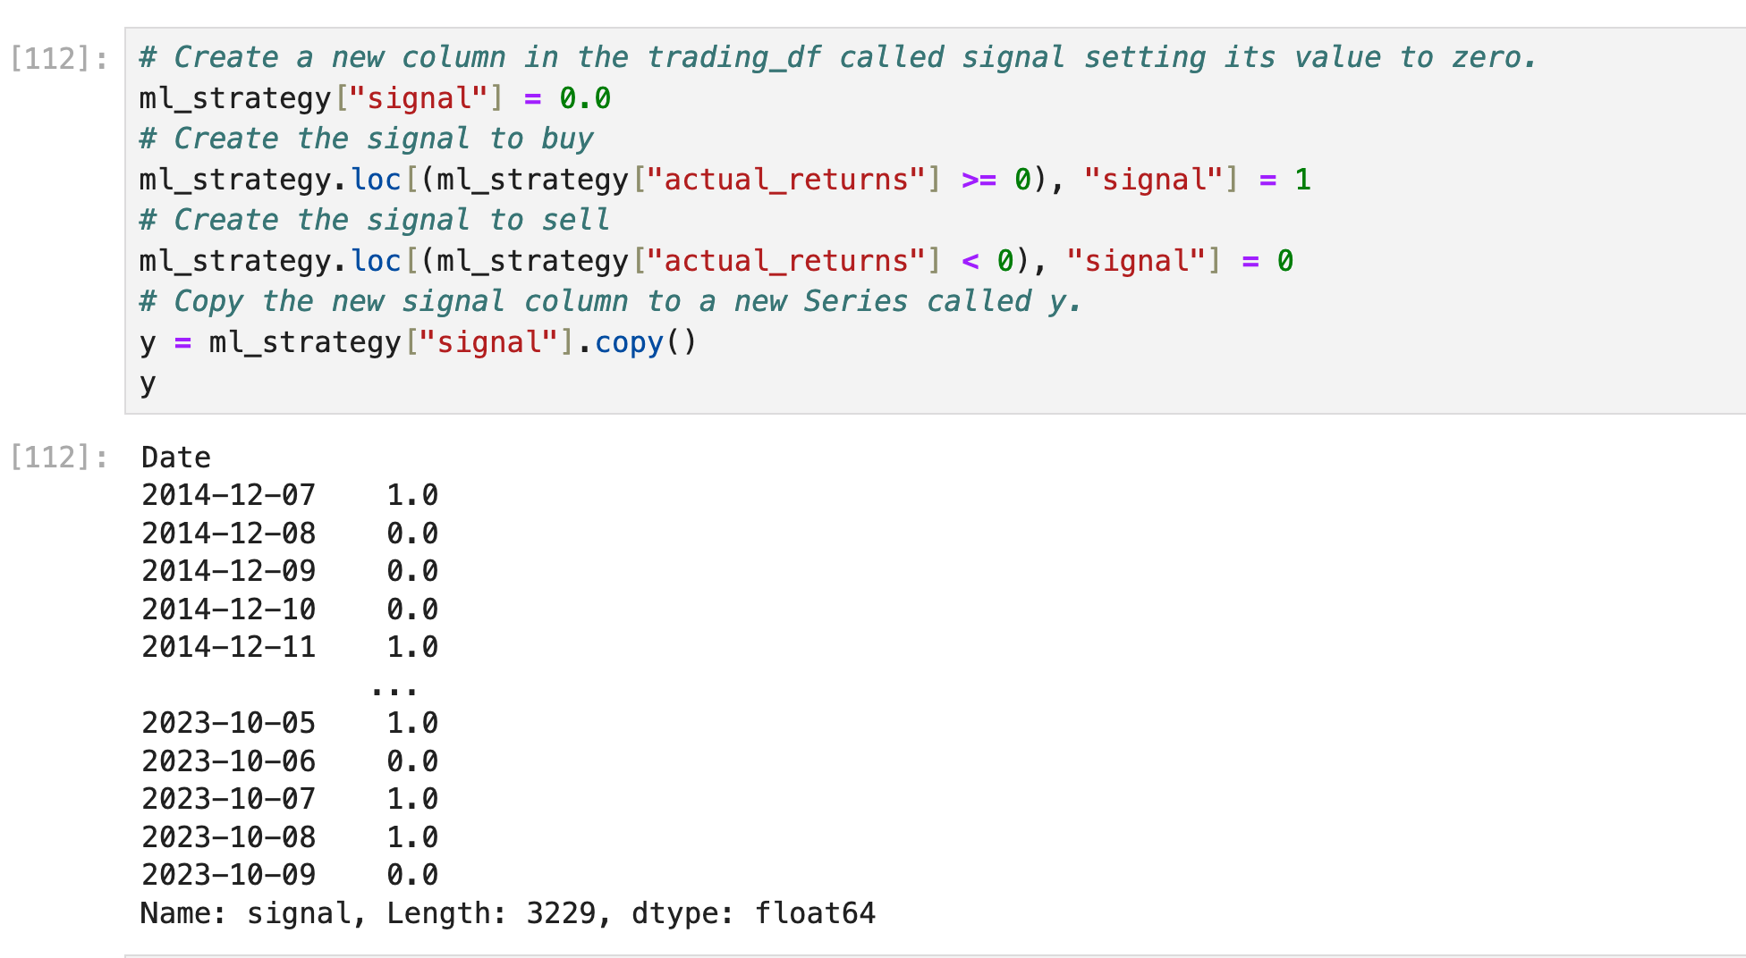
Neural Network Model Summary
Data Feed
Y
Training Window: 60 months

Slide 11
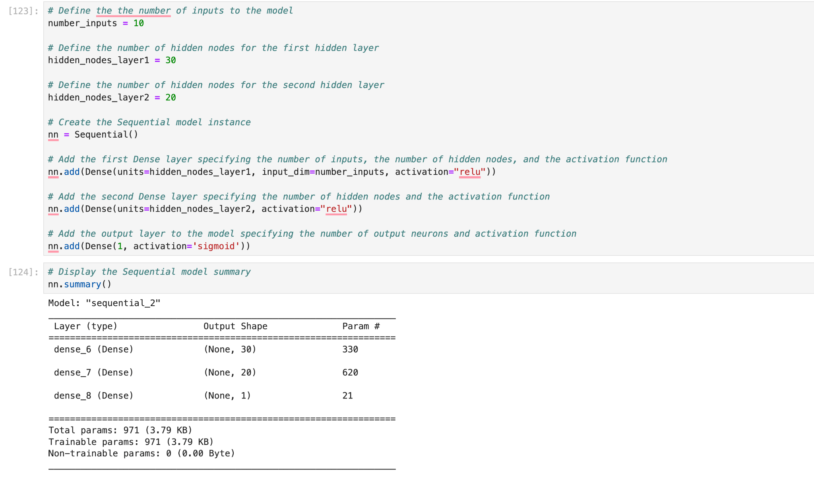
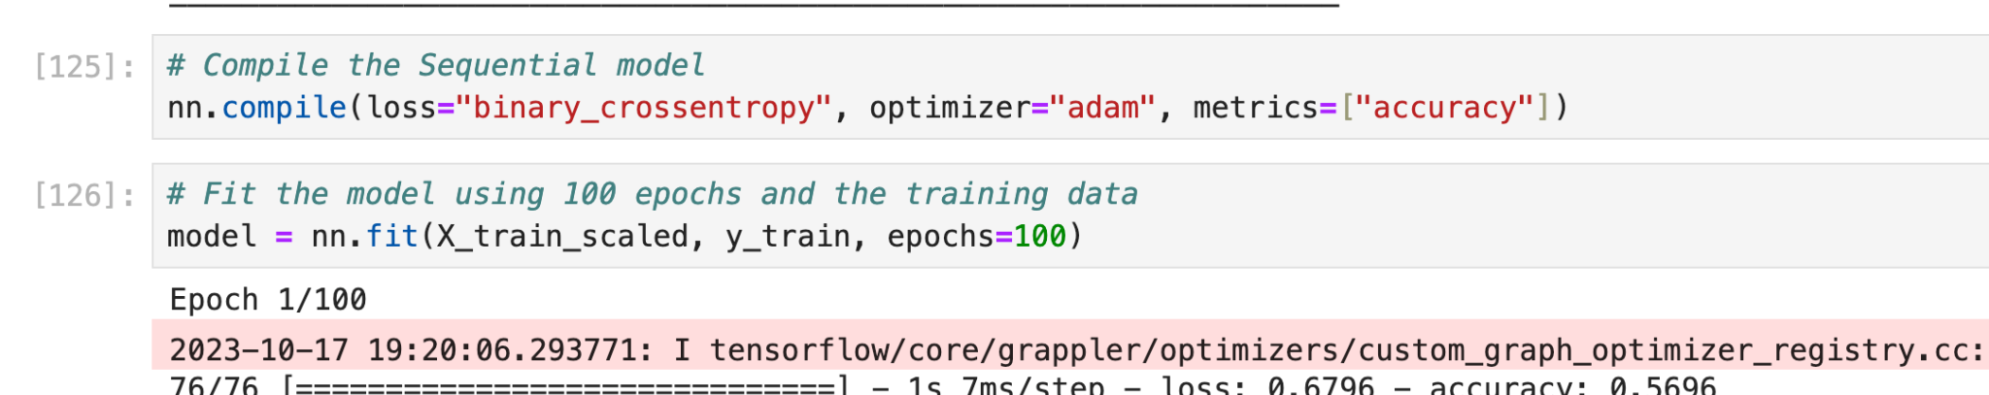
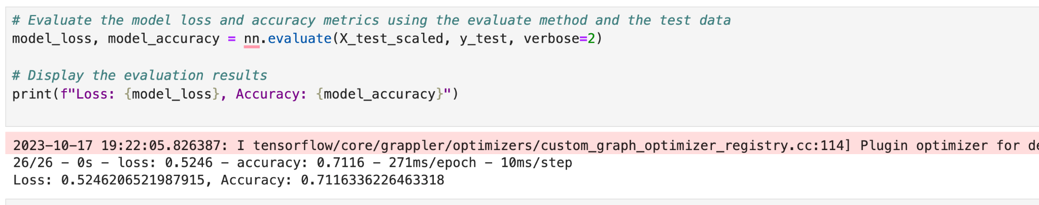
Neural Network Model Summary

Slide 12
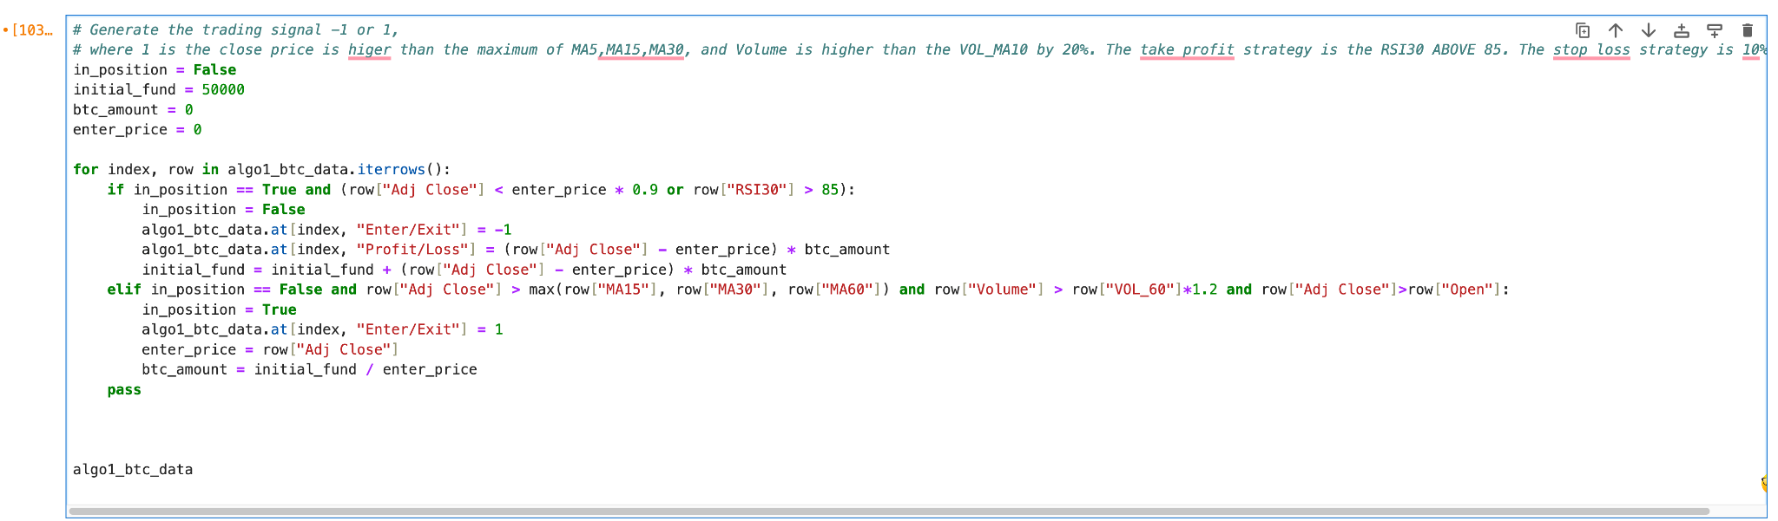
Anna’s algo strategy

Slide 13
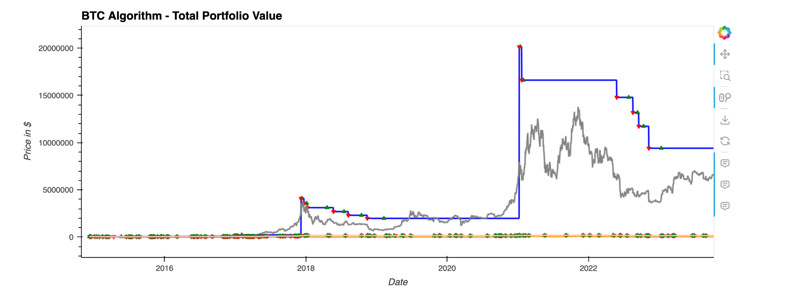
Neuro Network ML vs Anna vs HODL
My algo outperforms (blue line) the HODL strategy(grey line).
Machine strategy is not performing very good (pink line).
*The orange line is BTC close price.
*The initial funds is 50K AUD

Slide 14
Discussion
Discuss your findings. Was the model sufficient for the predictive task? If not, why not? What inferences or general conclusions can you draw from your model performance?
SVM - The SVM model did outperform the market but im not convinced its a reliable model. I believe some more work needs to be done on the model to prove its robustness and also to minimise drawdowns.
Linear Regression -
Neural Network -

Slide 15
Postmortem
Discuss any difficulties that arose, and how you dealt with them.
Discuss any additional questions or problems that came up but you didn't have time to answer: What would you research next if you had two more weeks?
Duke - Had a problem with Adaboost and getting the parameters to work with SVM and then outperform the market. I would research Reinforcement Learning as it seems like that it could be a good model to use for trading. Also had an issue with knowing when to shift() indicators and returns in df.

