Slide 1
Fixed Income Model Research
Zhendi Chen
March 5, 2019
State Street Corporation – Proprietary and Confidential

Slide 2
AGENDA
Blueprint
Base Curve
Short Rate Models
Forward Rate Models
Change of Numeraire*
LIBOR and Swap Market Models

Slide 3
Blueprint
Fixed Income Analytics Platform
Base Analysis
Base Curve Calibration
Short Rate Model
Forward Rate Model
Applications
Pricing
Risk Analytics
Risk Score

Slide 4
General WorkFlow
We describe the general workflow of the interest rate analytics as below.
Market Data
(Contract/Quotes)
Customized Model/Curve Fitter
Calibration Report
Postgre SQL Database
Interest Rate Curves/Models
Performance Report
Greek Profile Report
Instrument Specific Info
Analytics
Price/Risks
Convergence Report
Risk Factor Shocks
Valuation Parameter

Slide 5
Details on the General Framework
Curve Builder:
Market Data: instruments with linear payoff, e.g., MM (depo/repo, rate futures, swaps) and BM (bonds, bond futures);
Curve Fitter: Bootstrap / Calibration, if calibration penalty on curve shape / spline (linear, cubic, tension, exponential family);
Risk Factors: zero rate / discount rate / forecast rate at each bucket level;
Analytics: DCF models,
Model Builder:
Market Data: instruments with nonlinear payoff, e.g., MM (swaption, capfloor);
Model Fitter: use LM to calibrate model;
Risk Factors: we support two base forms of rate models: parametric form model (Hull-White) and market model (BGM);
Analytics: CF solver / MC solver.
Calibration Report
We report the difference between market and implied rate/vol on the calibrated instruments (could be sparse).
Model Scope: short-rate model (Hull white) and Market model (BGM);
Calibration Error: difference between market quote and implied rate/vol;
Calibration Time: time elapsed.
Performance Report
We report the difference between market and implied rate/vol on the model performance instruments (dense).
Model Scope: short-rate model (Hull white) and Market model (BGM);
Calibration Error: difference between market quote and implied rate/vol.;
Calibration Time: time elapsed;
Greek Profiles
We tentatively provide three types of Greek profiles based on bump-and-reval framework.
Instrument Scope: (?)
TV: theoretical value;
delta: we provide bucket level zero rate sensitivity;
vega: this could be in two specific in general, for parametric forms (Hull-White), volatility is implied by the model parameters, for more general term structure models (BGM), volatility risk can be achieved by recalibration based on bumped instruments.
Convergence Report
We provide convergence report associated with instrument greeks and valuation parameters.
Instrument Scope: (?)
Boxplot with numPaths vs. greek profile distribution;

Slide 6
Introduction
Discount factor
Fundamental concept: time value of money
Discount factor at time zero：D(T)
Discount factor in the future: D(t, T)
Discount factor is fundamental way of defining term structure; has no compounding or daycount assumptions
Example of discount curve:
TB
Treasury STRIPS
Stripped coupon
Stripped principal

Slide 7


Introduction
Interest rate
Convention is to use rates rather than discount functions
Annual compounding
Semiannual compounding
Continuous compounding

Slide 8

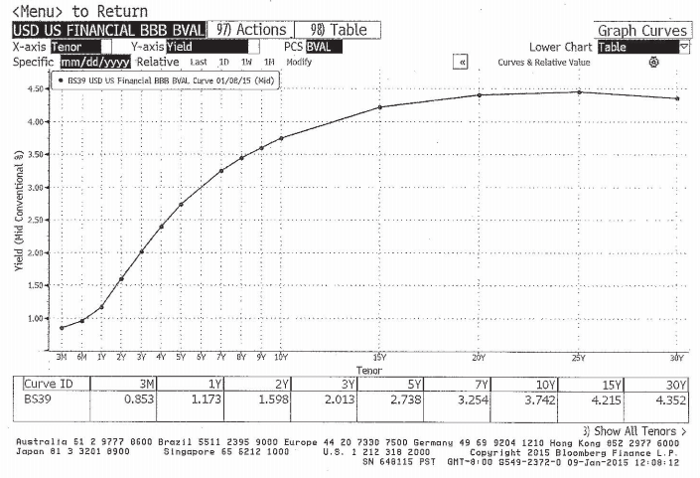
Introduction
Yield to Maturity
YTM is IRR on a bond
YTM for par bond = coupon rate

Slide 9
Curves
Agenda
Spot curve
Par curve
Forward curves
Forward par curves
Bootstrapping curves

Slide 10

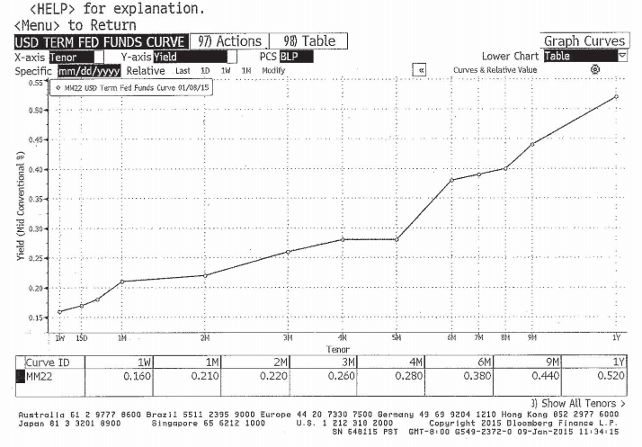
Curves
Spot curve
Def: The term structure of yields on zero-coupon bonds

Slide 11
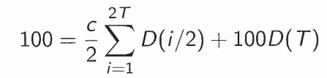
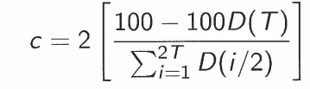
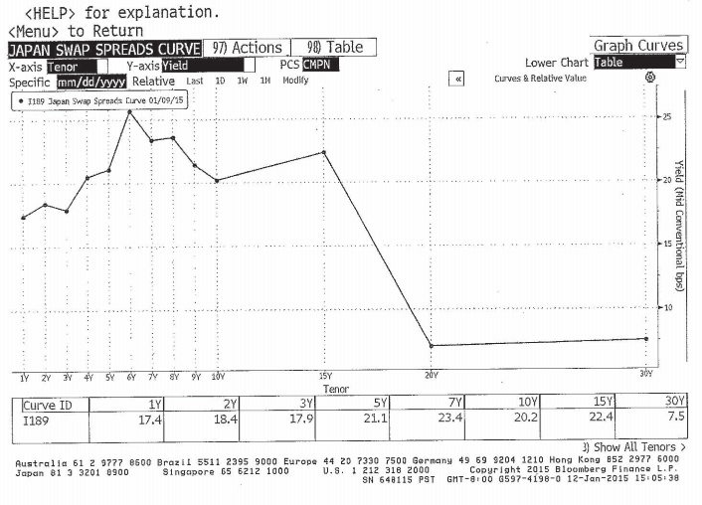
Curves
Par Curve
The term structure of coupon rates for bonds to sell at par
Examples:
Constant maturity Treasury (CMT) curve
Constant maturity swap (CMS) curve
Swap spread = CMS - CMT

Slide 12


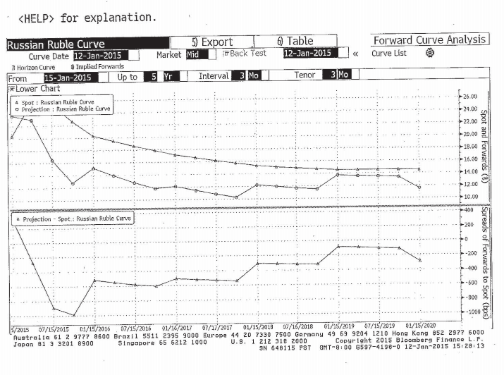
Curves
Forward Curve

Slide 13

Short rate model
One-factor short-term rates
Assume the instantaneous spot interest rate follows a one-dimensional stochastic process.
Having the dynamics of such a process will allow a modeler to price securities and payoffs which are based on interest rates.
Assuming the risk-neutral measure exists, the price of any security will be the expected present value of the future payoff under that measure
where 𝑃𝑡 is the price of the security at time 𝑡,{𝑟𝑠}𝑠≥0 is the process of short-term rates, and 𝑉𝑇 is the payoff of the security at time 𝑇>𝑡. The (∗) means that the expectation is computed under the risk-neutral measure.

Slide 14
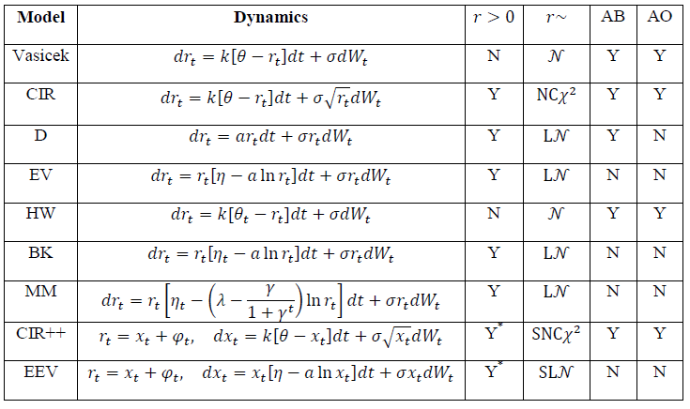
Short rate model
One-factor short-term rates
Summary
AB: Analytical bond price AO: Analytical option price

Slide 15

Short rate model
One-factor short-term rates
Vasicek Model
Properties:
The distribution of r is Gaussian
The model can be solved explicitly
Rates can be negative with positive probability

Slide 16
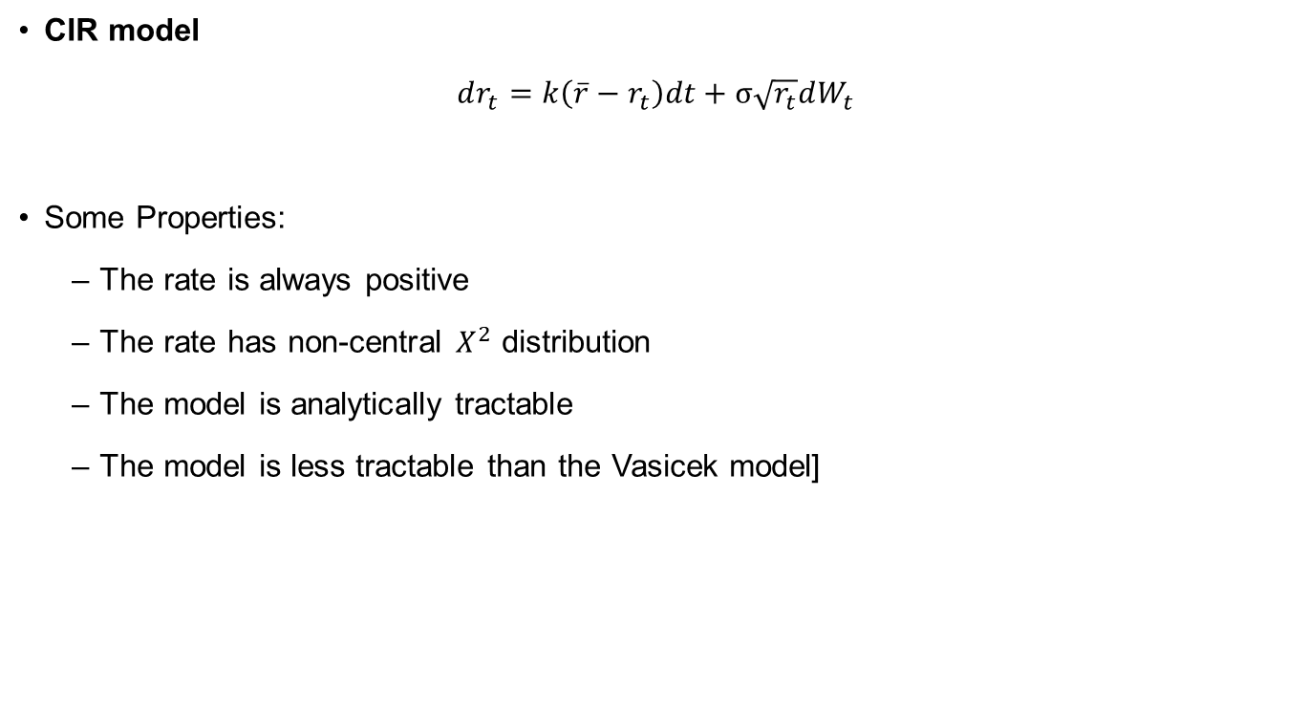
Short rate model
One-factor short-term rates
CIR model
Some Properties:
The rate is always positive
The rate has non-central distribution
The model is analytically tractable
The model is less tractable than the Vasicek model]

Slide 17
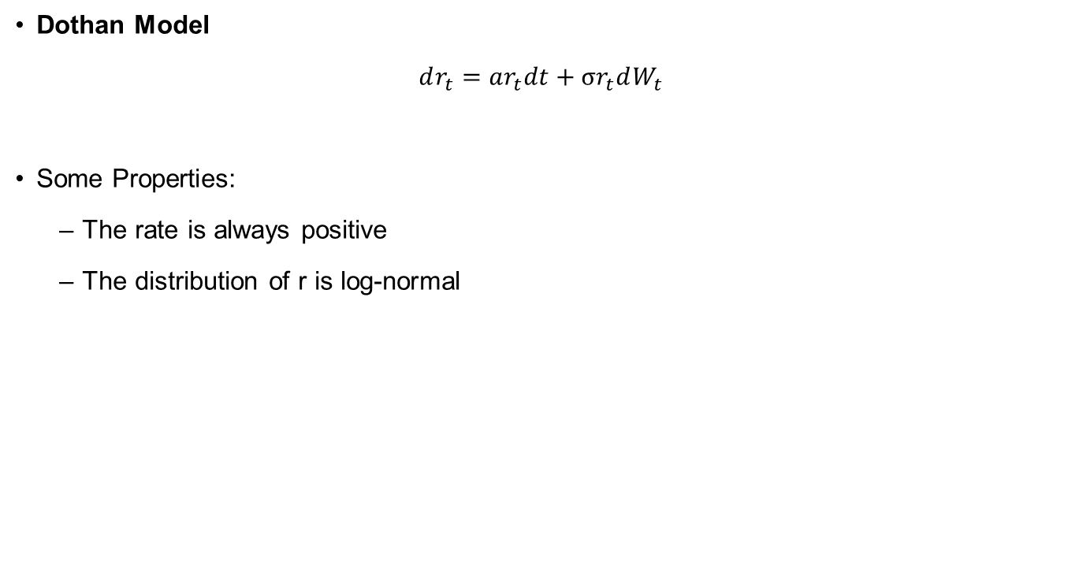
Short rate model
One-factor short-term rates
Dothan Model
Some Properties:
The rate is always positive
The distribution of r is log-normal

Slide 18

Short rate model
One-factor short-term rates
Hull White Model
Some properties:
The rate can be negative with positive probability
The distribution of r is normal
The model is tractable – it yields closed form formulas for bond and option prices

Slide 19

Short rate model
One-factor short-term rates
Black Karasinski Model
Some Properties:
The rate is always positive
The distribution of r is log-normal
The model is not very tractable – it does not yield closed form formulas for bond and option prices

Slide 20
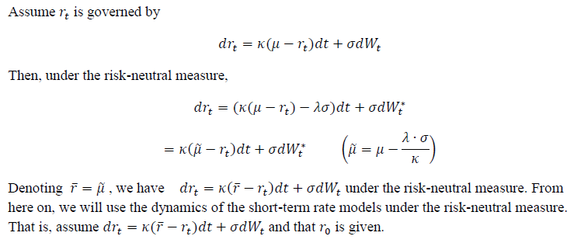
Short rate model
Implementation of Vasicek Model

Slide 21
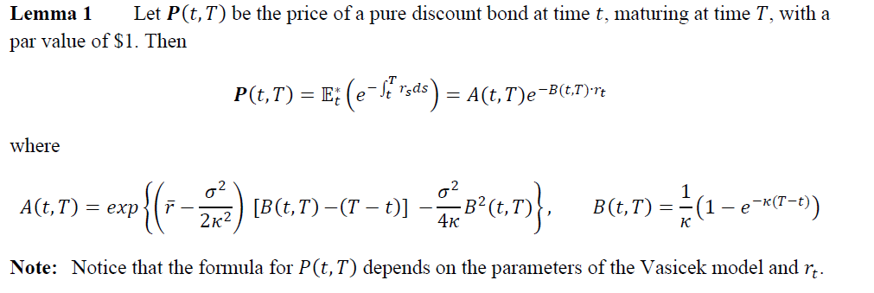
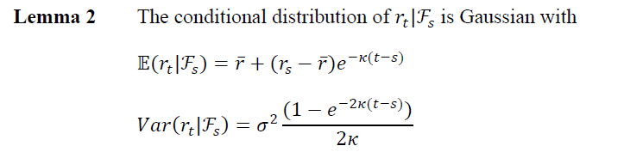
Short rate model
Implementation of Vasicek Model

Slide 22
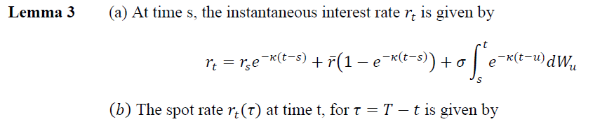
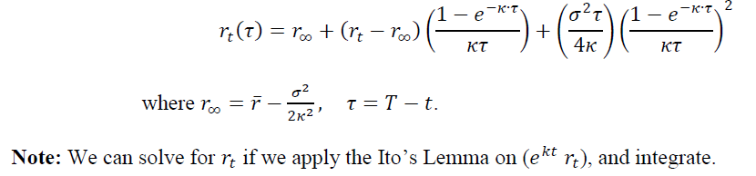
Short rate model
Implementation of Vasicek Model

Slide 23
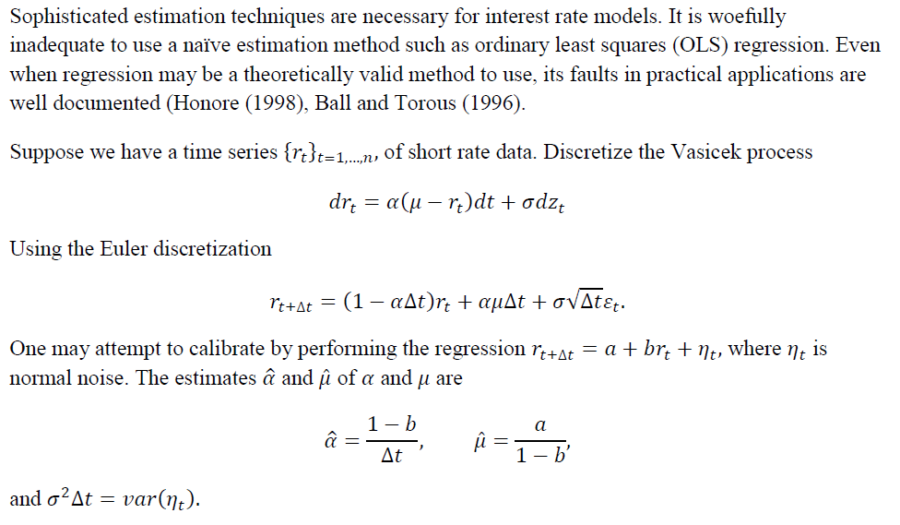
Short rate model
Fitting Vasicek Models

Slide 24
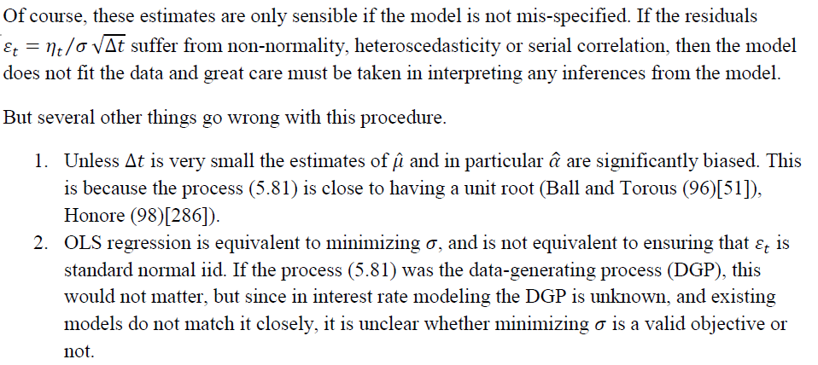
Short rate model
Fitting Vasicek Models

Slide 25
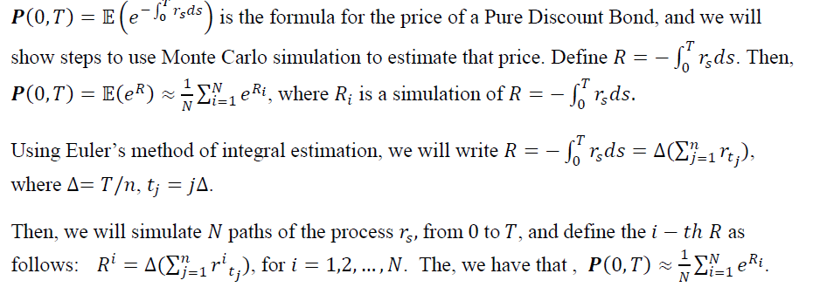
Short rate model
Fitting Vasicek Models

Slide 26
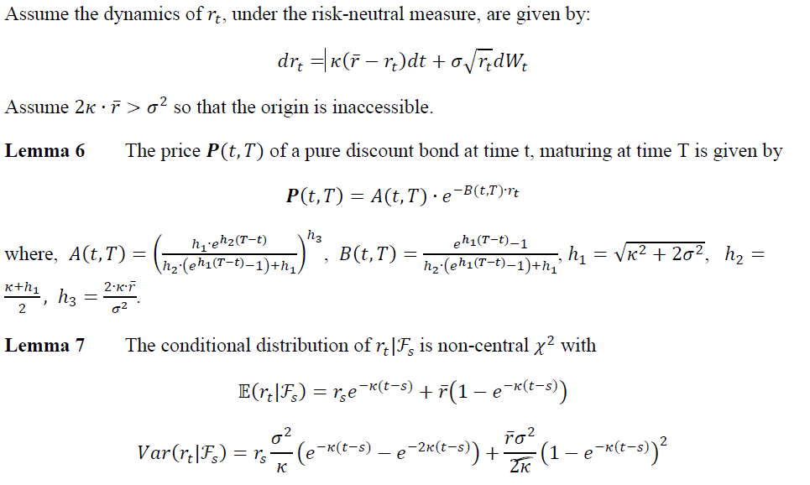
Short rate model
Fitting CIR model

Slide 27
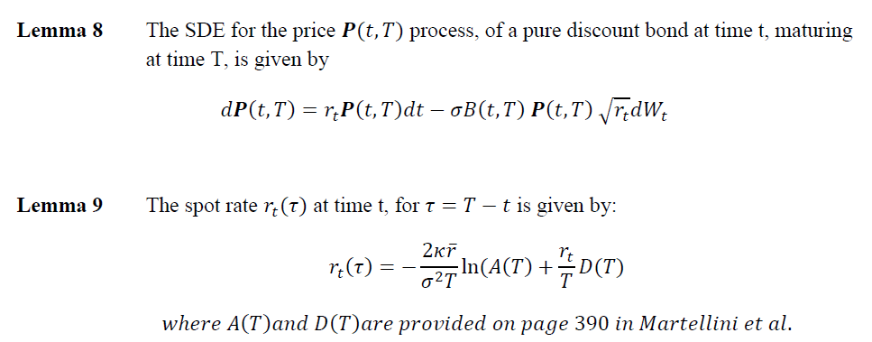
Short rate model
Fitting CIR model

Slide 28
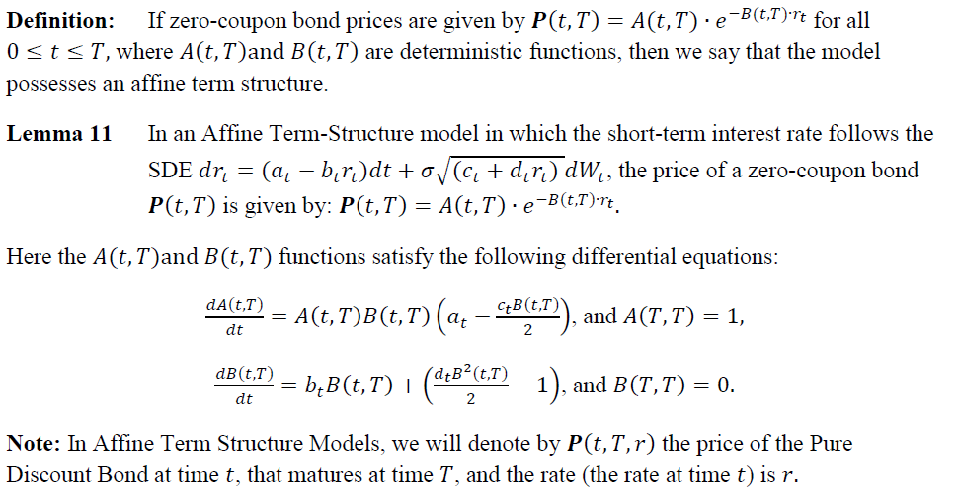
Short rate model
Fitting Affine term-structure Models

Slide 29
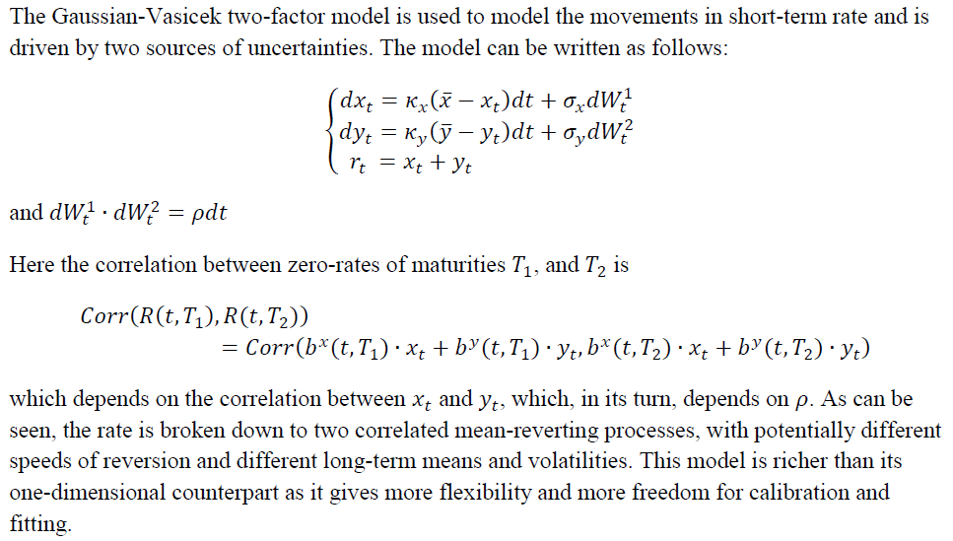
Short rate model
Two-factor short-rate model
Gaussian-Vasicek Two-Factor Model

Slide 30
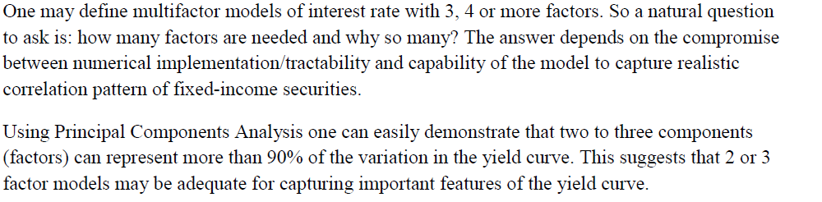
Short rate model
Two-factor short-rate model
Gaussian-Vasicek Two-Factor Model

Slide 31
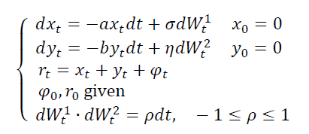
Short rate model
Two-factor short-rate model
G2++ Model

Slide 32
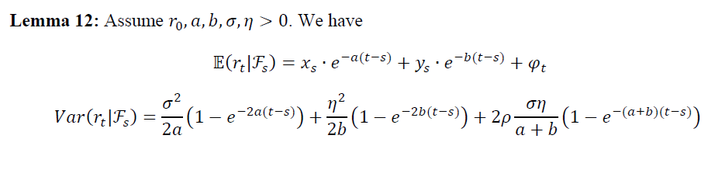
Short rate model
Two-factor short-rate model
G2++ Model

Slide 33
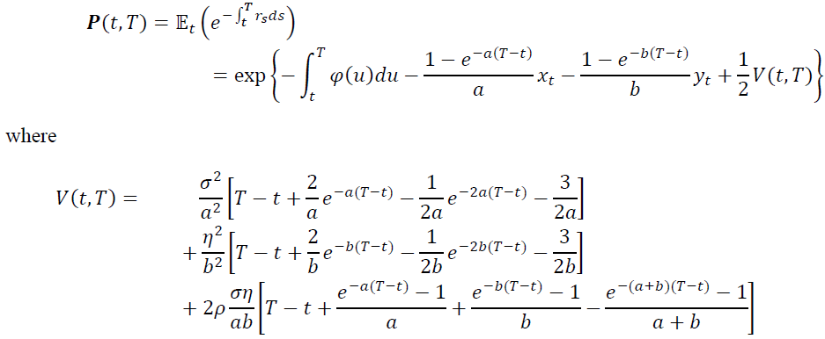
Short rate model
Two-factor short-rate model
G2++ Model
The price of a zero-coupon bond is given by

Slide 34
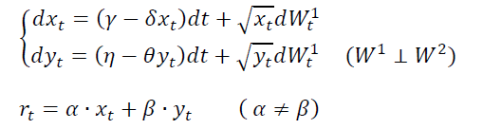
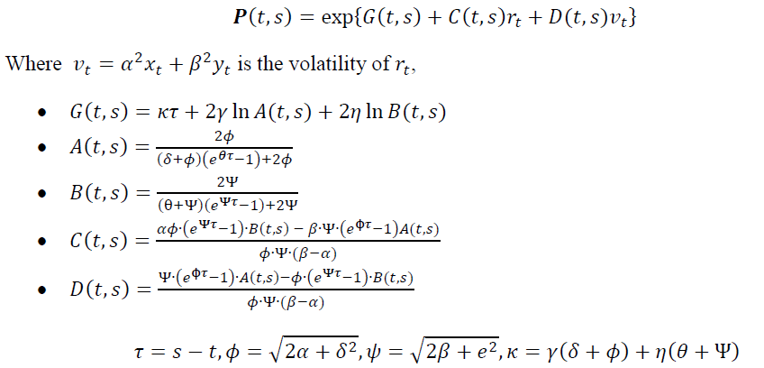
Short rate model
Two-factor short-rate model
Longstaff-Schwartz-1992 model
Discount Bond price

Slide 35
Forward Rate Model
Heath-Jarrow-Morton Framework

Slide 36
Summaries
Comparison of Models
Two criteria:
Strengths and weaknesses of the models
Explaining of historical fixed income prices
Models:
DM: Dynamic mean models
GDM: Generalized Dynamic Mean models
AY: Affine Yield models
HJM: Heath-Jarrow-Morton framework
MM: Market Models

Slide 37
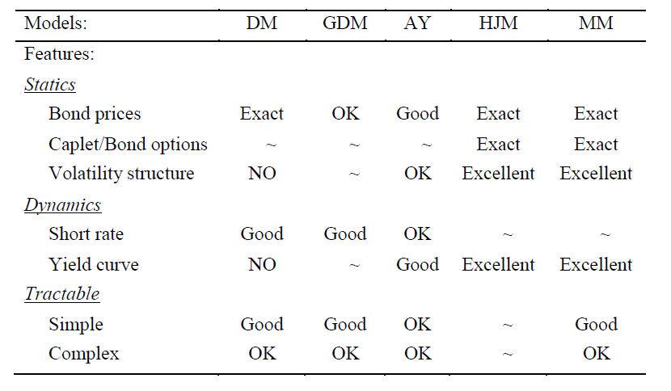
Summaries
Comparison of Models

Slide 38
Summaries
Comparison of Models
The HJM and MM give the best results overall, but for specific applications, Affine term-structure or Dynamic Mean Models may be more appropriate for bond pricing.
The choice of a model for short term rate is not straightforward. It depends on both the modeling objective and on the nature of the risk to be managed. For example, a fund that has large exotics exposure and a commitment to sell anything, may be more likely to implement whole yield curve models. However, simple bond or bond option trading may not require anything sophisticated.

Slide 39
Summaries
Comparison of Models
Comparison based on historical criteria
Criteria:
The behavior of the short rate
The behavior of the long rate
Term structure tilts
Hyperinflations

Slide 40
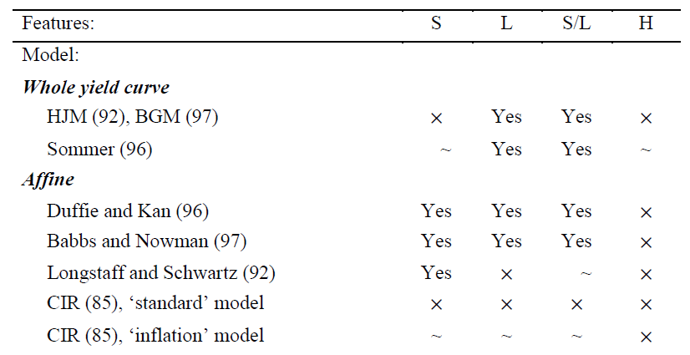
Summaries
Comparison of Models

Slide 41
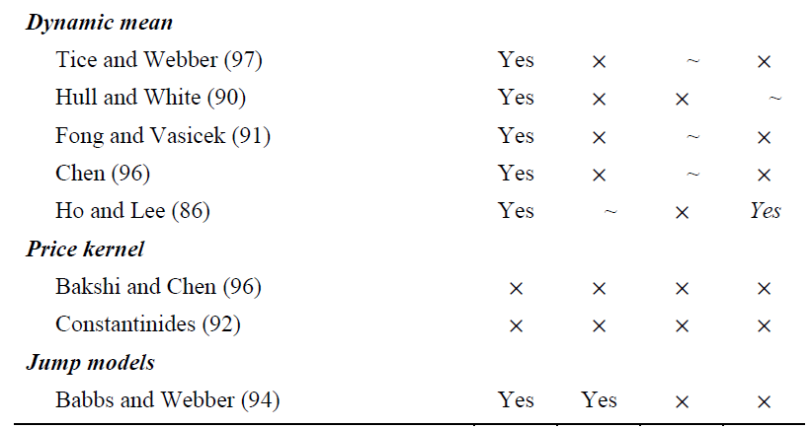
Summaries
Comparison of Models

Slide 42
Local Volatility and Stochastic Volatility
Overview
The motivation of LVSV is to explain the volatility smile phenomenon. It is observed in the option market that the implied vol is low in the ATM/near-ATM level, but higher in the ITM/OTM level. Economically, this can be explained by

