Slide 1







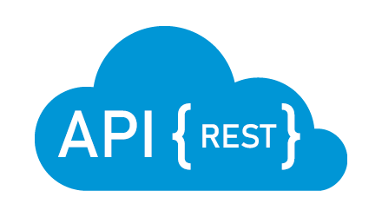
Infra: Development Enviroment
http://localhost:3000
hasura:8888
Hasura built-in queries, mutations,.. (CRUD)
host.docker.internal:3000
database:5432
host.docker.internal:3001
Customize queries, mutation,.. (business logics)
Restful API

Slide 2
Infra: Production Enviroment
http://localhost:3000
hasura:8888
Hasura built-in queries, mutations,.. (CRUD)
frontend:3000
database:5432
backend:3001
Customize queries, mutation,.. (business logics)
Restful API

Slide 3

Development Life Cycle
3.1 Track tables
If created table not shown
Hasura built-in queries, mutations,.. (CRUD)
3. Set table permission
1. Create migration (SQL file)
2. Generate TypeORM entity
5. Using in NextJS
3. Set remote schema permission
Customize queries, mutation,.. (business logics)
If query or mutation not exist
3.1 Create resolver (define queries and mutations)

