Slide 1







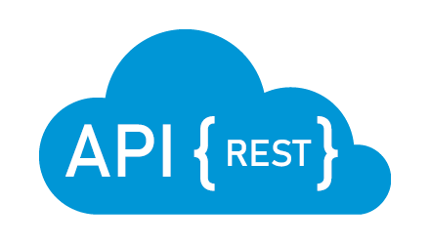
Infra: Development Enviroment
http://localhost:3000
hasura:8888
Built-in queries, mutations,..
(CRUD)
host.docker.internal:3000
database:5432
Customize queries, mutation,..
(business logics)
host.docker.internal:3001
Restful API

Slide 2
Infra: Production Enviroment
http://localhost:3000
hasura:8888
Built-in queries, mutations,..
(CRUD)
frontend:3000
database:5432
Customize queries, mutation,..
(business logics)
backend:3001
Restful API

Slide 3

Development Life Cycle
3.1-b Track tables
If created table not shown
Built-in queries, mutations,.. (CRUD)
3.1-a Set table permission
4. Set tablepermission
1. Create migration (SQL file)
2. Generate TypeORM entity (model)
5. Define gql in NextJS
3.2-a Set remote schema permission
Customize queries, mutation,.. (business logics)
6. Run graphql-codegen
If query or mutation not exist
3.2-b Create resolver (define queries and mutations)
7. Call query, mutation (like call API)

