Slide 1




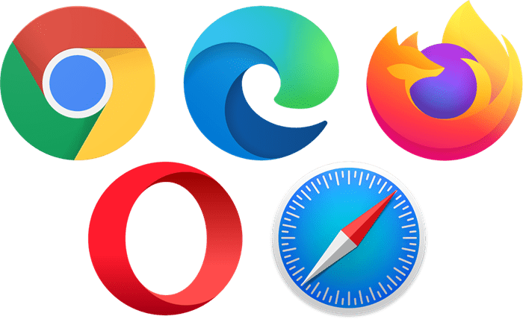




Infra Architecture
/*
Frontend:3000
80/443
Reverse proxy server:80/443
/api/graphql
/api/*
Database:5432
Backend:8080

Slide 2
Development Flow
Define data model in schema.prisma file
npm run migrate:development
Generate SQL files and migrate to database
(@prisma/client)
npm run prisma:generate
Generate CRUD operations for data models
(prisma-nestjs-graphql)
Generate object types, inputs, args,...
npm run start:developement
Generate graphql Schema

