Slide 1




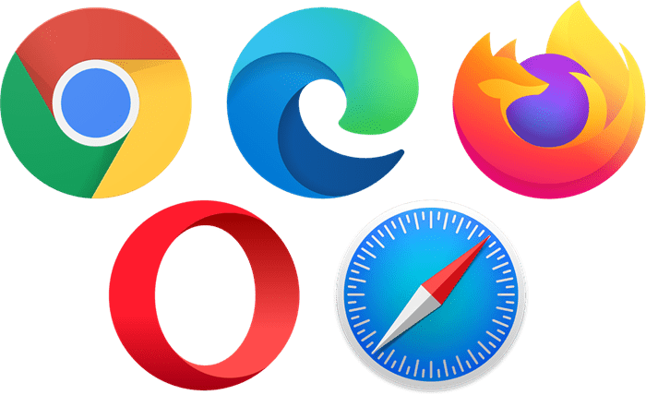




/*
Frontend:3000
80/443
Reverse proxy server:80/443
/api/graphql
/api/*
Database:5432
Backend:8080

