Slide 1
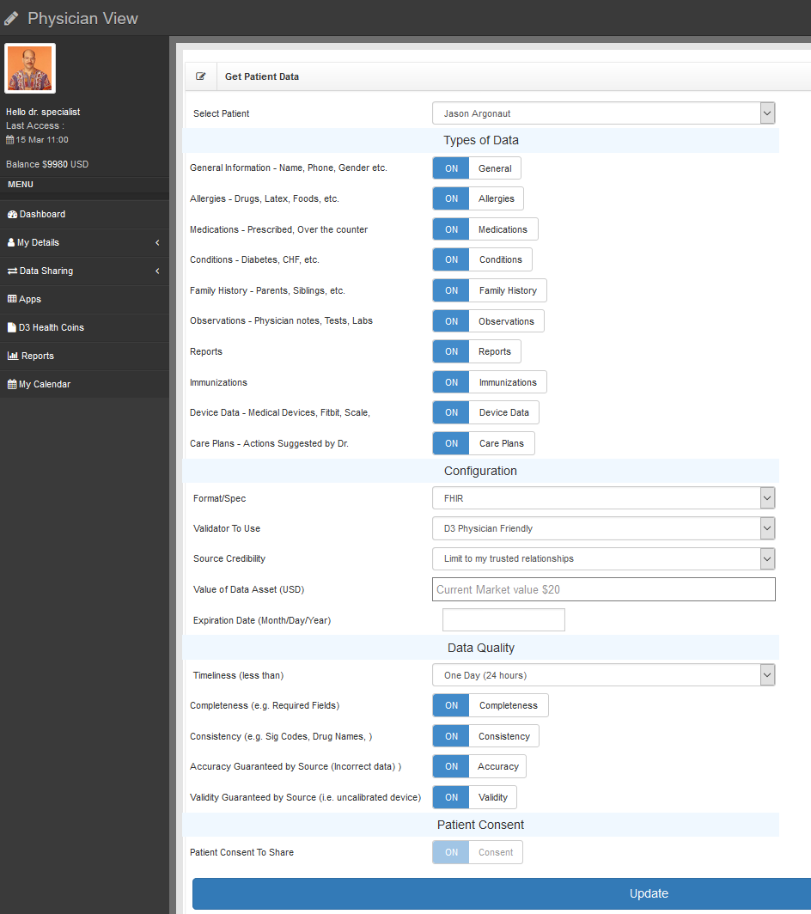
This screen allows you to:
Create a blockchain contract
Set specific data parameters
Set your bid amount for this data
Set specific quality parameters

Slide 2
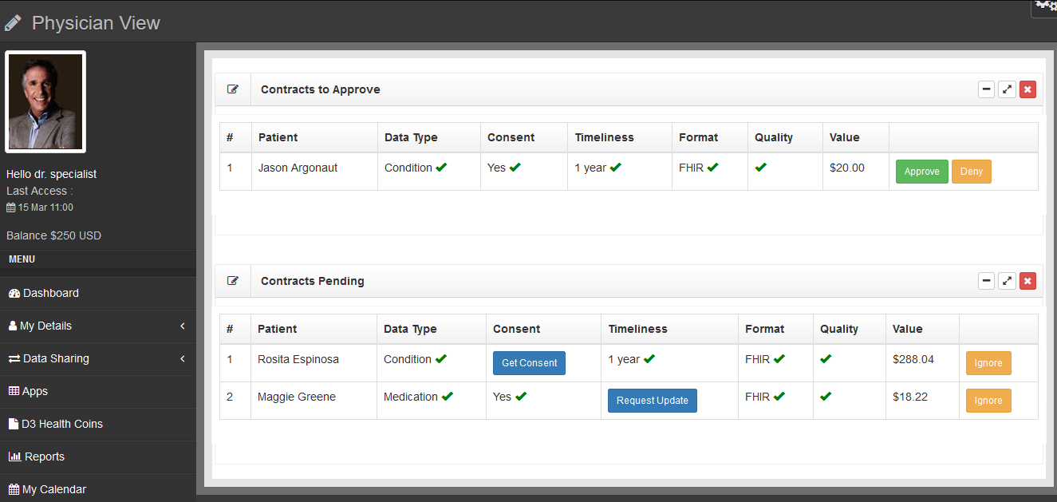
Review data matching Blockchain contracts
Approve contracts, collect money
Review partial matching Blockchain contracts
Initiate actions to complete data

