Slide 1
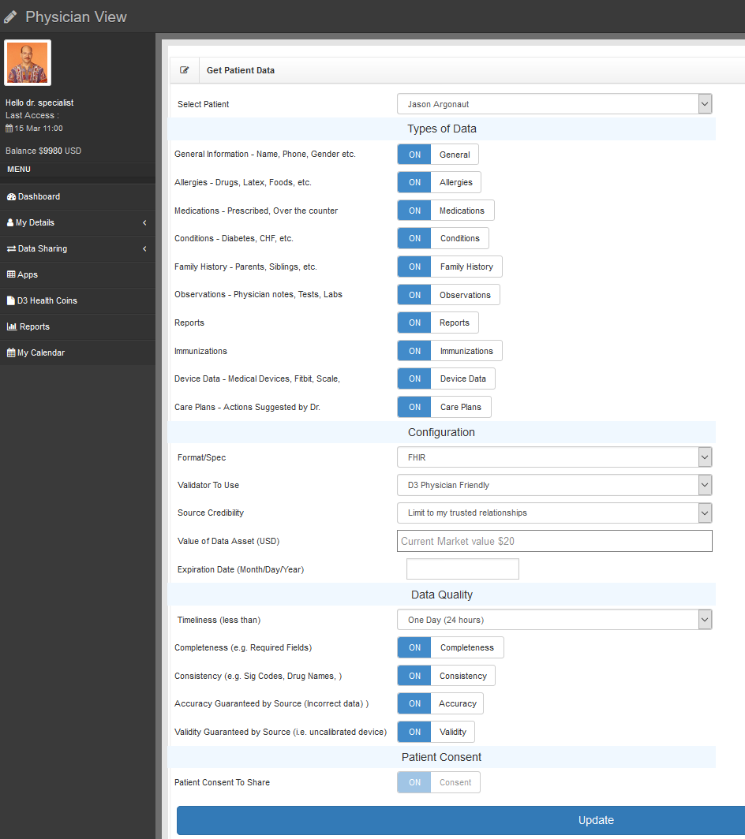
This screen allows you to:
Create a blockchain contract
Set specific data parameters
Set your bid amount for this data
Set specific quality parameters

Slide 2
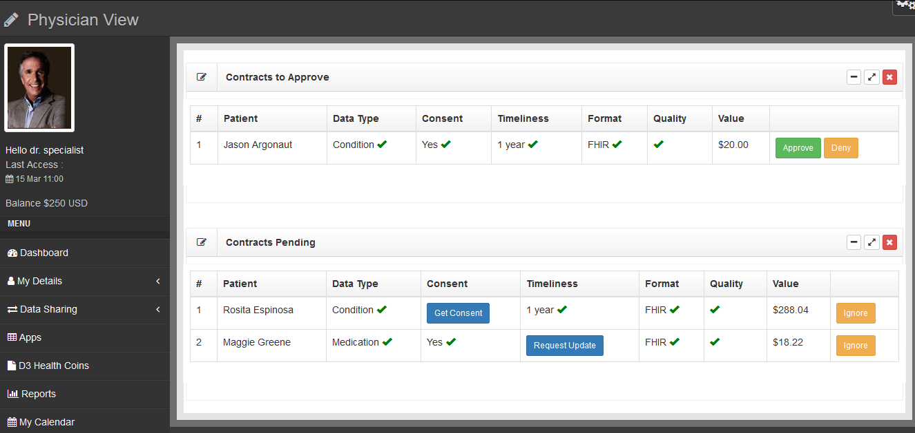
Review data matching Blockchain contracts
Approve contracts, collect money
Review partial matching Blockchain contracts
Initiate actions to complete data

Slide 3

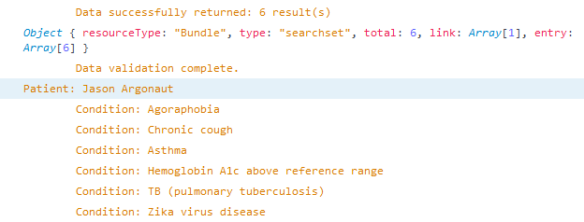
FHIR / Blockchain Interoperability
Raw data being requested from the Blockchain:
Live link to EPIC FHIR:
https://open-ic.epic.com/FHIR/api/FHIR/DSTU2/Condition?patient=Tbt3KuCY0B5PSrJvCu2j-PlK.aiHsu2xUjUM8bWpetXoB
Same raw data being returned in our app (before display):

