Slide 1
Digitally Democratized Data (D3) D3 Health
Blockchain in Healthcare Code-A-Thon
Health IT Track #3: Data Aggregation and Linkage
Kyle Culver
Joshua Kaelin

Slide 2

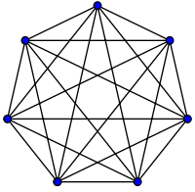

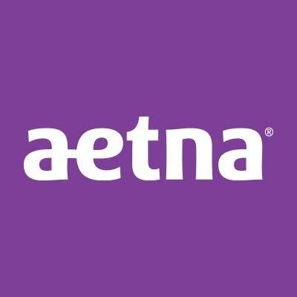
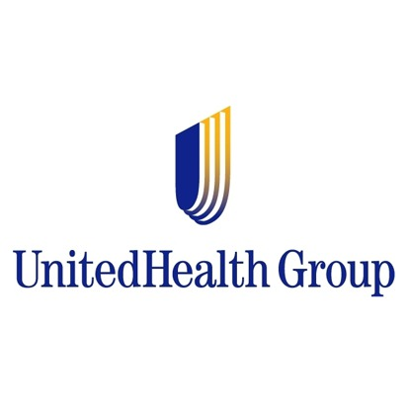

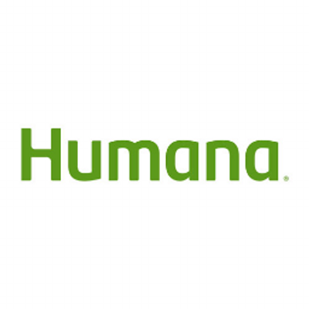

Current Landscape
“Only 41% of non-federal acute care hospitals had clinical information from their patients' outside encounters at the point-of-care” (ONC)
Provider
Expensive one-off integrations - $10,000
Missing data between providers
Undervalued Risk (MRA)
Decreased Quality (HEDIS)
Technology Adoption
Economies of scale driving consolidation
Patient
Gaps in care linked to information deficiencies
Too much effort required
Technology Advancements
More connected than ever
Abundance of electronic health data (MU)
Standardization of formats (FHIR)
Machine Learning and Artificial Intelligence
“only one in six hospitals reported receiving summary of care records from long-term care providers” (ONC)
$
$
$
$
$
$
$
“…about one in three individuals reported experiencing one or more gaps in information exchange” (ONC)
$
$
$
$
$
$
“fewer than one in ten physicians reported sharing with unaffiliated hospitals” (ONC)
$
Notes:
Walled Gardens of Information
41% of non-federal acute care hospitals had clinical information from their patients' outside encounters at the point-of-care, according to the ONC.
Additionally, when seeking care for a medical problem within the last year, about one in three individuals reported experiencing one or more gaps in information exchange,

Slide 3

Opportunity
Provider
Improve Quality Metrics
Increase Reimbursement
Reduce Penalties
Patient
Make it convenient
Seamless experience
Blockchain

Slide 4
Data is an Asset - Provider
There is a need for Better Quality Patient Health Data
Quality = Accuracy + Consistency + Completeness + Timeliness + Validity
Better Data leads to Better Outcomes
Some incentives are already in place to have better data:
HEDIS - Healthcare Effectiveness Data and Information Set
Meet compliance requirements
CMS Stars Ratings
Increase reimbursement rate
More Patients
MRA – Medicare Risk Adjustment
Increase reimbursement rate
Data = Currency

Slide 5
Data is an Asset - Patient
PHR has not caught on:
Microsoft HealthVault
Google Health
Patients are often only engaged when something goes wrong.
They just want their data to be available when they need it
Card Catalog approach
Delegate fine-grained, specific access to:
Point of Care
Home Health Care
Caregivers
Pharmacies

Slide 6


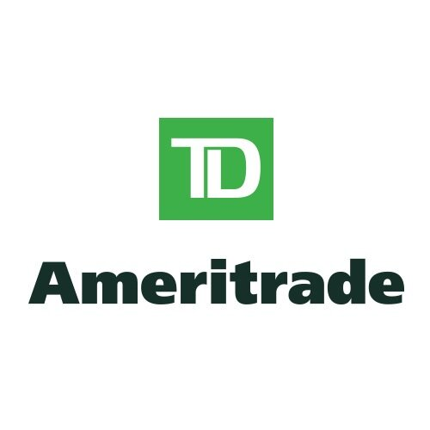





Efficient Market
Investor

Slide 7






Efficient Market
Provider
Emerging
B2C Space
D3

Slide 8
Proposed Solution
D3 Health
APIs
Providers
(via EMRs)
Health Plans
Registry
Validators
Innovators
Researchers
B2C Products
Government
Industry Utility
(Blockchain)
D3 Health Solution

Slide 9
DEMO

Slide 10
Questions

