Slide 1
Introduction to Cryptography

Slide 2
Security requirements
Auditing
Non-Repudiation
Confidentiality
High Level
Authentication
Authorization
ENCRYPTION
Low Level
E.g. Consider online Bank Example

Slide 3
Some definitions
Cryptography – Art/Science of Secret writing
Cryptoanalysis – Art/Science of converting the ciphertext to plaintext without using the secret key
Cryptology – Includes both Cryptography and Cryptoanalysis

Slide 4
Cryptography
Goal: keep information from those who aren’t supposed to see it
Do this by “scrambling” the data
Use a well-known algorithm to scramble data
Algorithm has two inputs: data & key
Key is known only to “authorized” users

Slide 5
Kerckhoff’s Principle (19th century)
A cryptosystem should be secure even if everything about the system, except the key, is public knowledge. (Opposite of ‘security through obscurity’)
A counter example - Enigma in WWII (https://en.wikipedia.org/wiki/Enigma_machine)

Slide 6
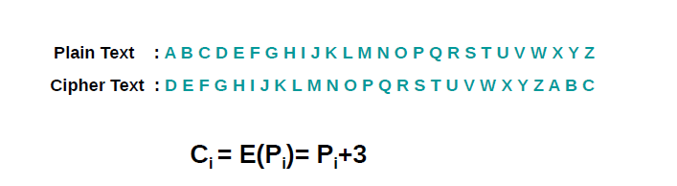
Historic examples
Ceaser cipher

Slide 7
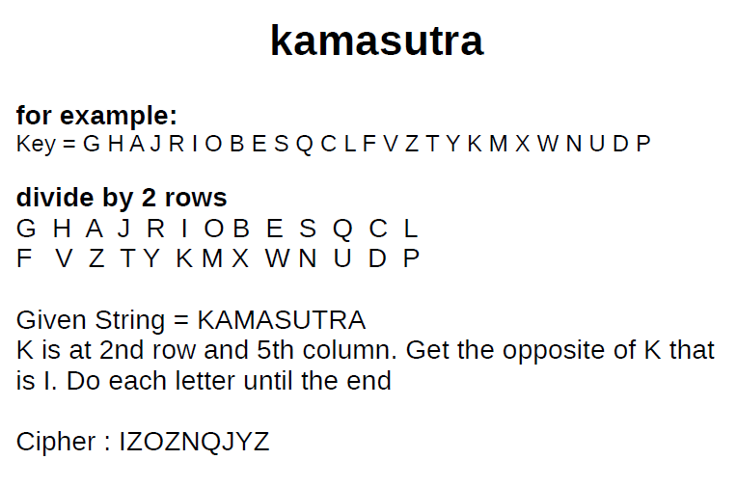

Slide 8
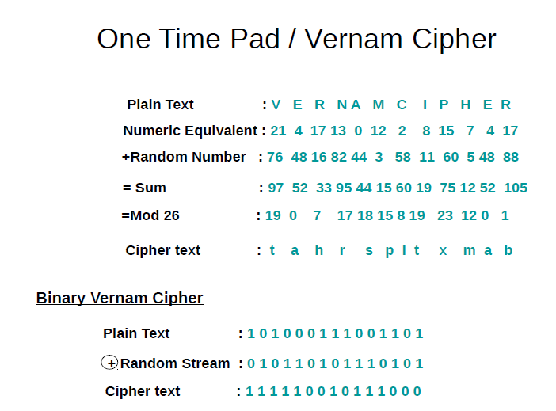

Slide 9
Characteristics of a good cipher
Confusion – Interceptor should not be able to predict how changing one character in plaintext will change the ciphertext
Diffusion – The characteristic of distributing the plaintext over the entire ciphertext

Slide 10
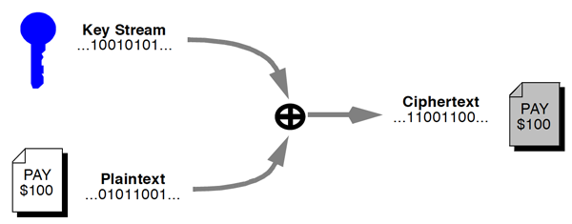
Stream cipher
Pros – Fast, Low error propagation
Cons – Less Diffusion, Susceptible to malicious inserts and modifications

Slide 11
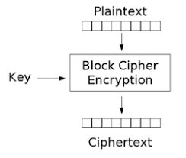
Block cipher
Pros – Diffusion, Immunity to insertion
Cons – Error propagation, slow

Slide 12
Unconditional Vs. Computational security
Unconditional security – Cipher can’t be broken irrespective of the computational power/time available
Computational security – Cipher can be broken using a brute force attack. However, it would take a very (very) long time to do so

Slide 13
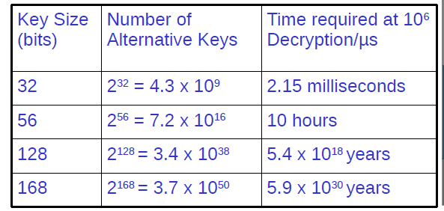
Brute-force attack

Slide 14
Cryptography basics
Algorithms (E, D) are widely known
Keys (K_{E}, K_{D}) may be less widely distributed
For this to be effective, the ciphertext should be the only information that’s available to the world
Plaintext is known only to the people with the keys (in an ideal world…)
K_{E}
K_{D}
Encryption key
Decryption key
C=E(P,K_{E})
E
D
P
P
Plaintext
Ciphertext
Plaintext
Encryption
Decryption

Slide 15
Cryptographic Terminology
Plain text: the message before encryption.
Cipher text: the message after encryption.
Key: information needed to convert from plain text to cipher text (or vice-versa).
Function/cipher: the encryption or decryption algorithm used, in conjunction with key, to encrypt or decrypt message.
Key distribution: How to distribute keys between senders and receivers
Notes:
Let us now introduce some terminology from the area of cryptography that we will later use
Plain text denotes a message before it is encoded (or that is encoded in a commonly accessible scheme, such as ASCII or ECBDIC).
Cipher text denotes the message after it has been encoded. The encoded message can be represented as binary or as ASCII text, whatever is more appropriate to the means of transportation.
A key is the information needed to convert the text from plain text into cipher text or vice versa.
A function is the algorithm used for encryption or description. It usually takes the key and the plain text as input and produces the cipher text and vice versa.
The key distribution service denotes a trustworthy service that hands out keys. If keys must not be publicly known (typically secret keys) the key distribution service is often not computerised.
When I was doing my (compulsory) service in the army, I worked in a signal battalion where we also had to encrypt and decrypt telex messages. Although we had a radio data network in place, key distribution was done by motorbike messengers in order to make sure that keys were not obtained by the forces on the other side of the German wall.

Slide 16
Naming Conventions
Alice – First participant in network communication
Bob – Second participant in network communication
Carol – Third Participant (when applicable)
Dave – Fourth Participant (when applicable)
Eve – Eavesdropper
Mallory – Malicious Attacker
Sara – A Server

Slide 17
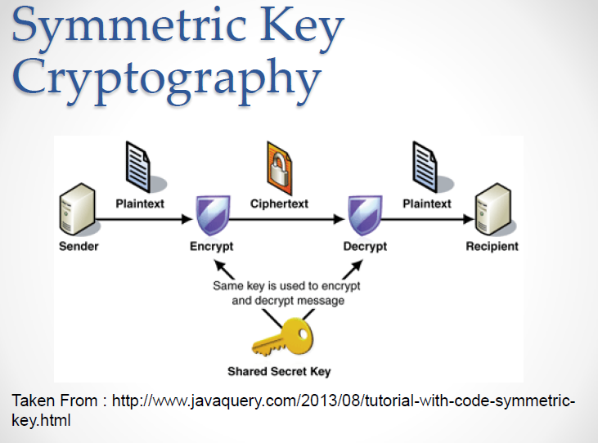
Symmetric key encryption

Slide 18
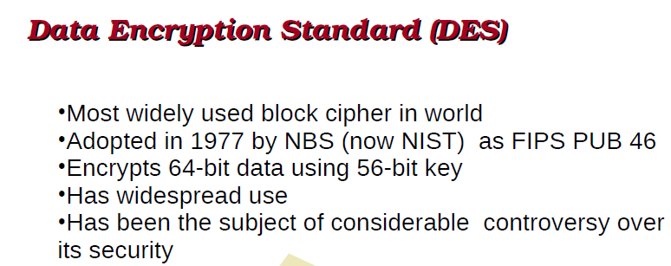

Slide 19
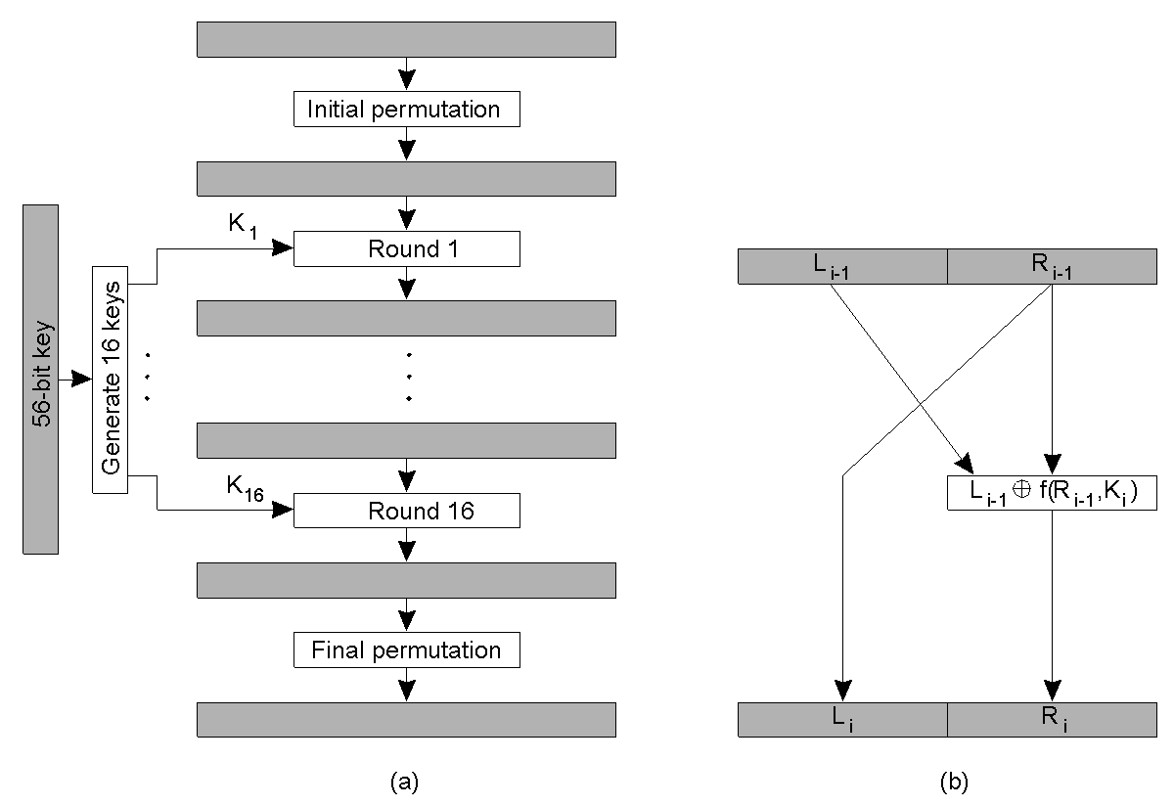
Symmetric Cryptosystem: DES
The principle of DES.
Outline of one encryption round.

Slide 20
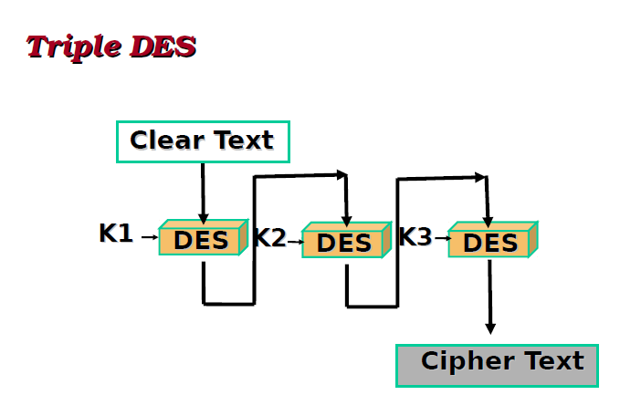

Slide 21
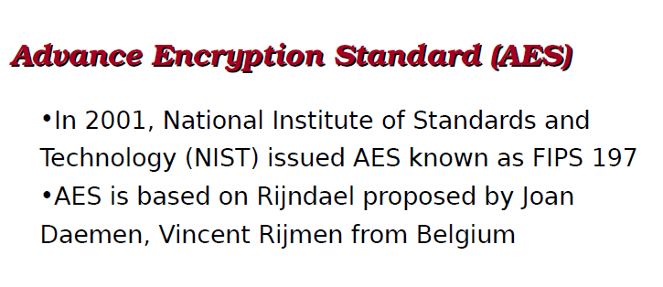

Slide 22
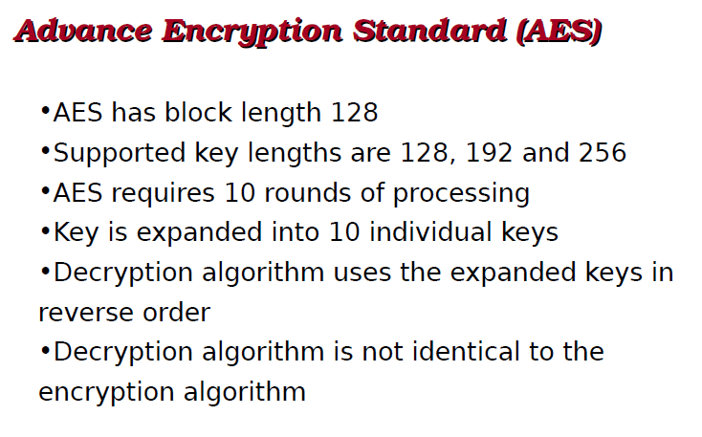

Slide 23
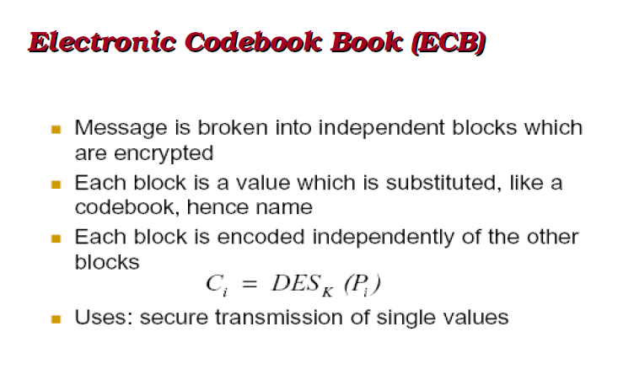

Slide 24
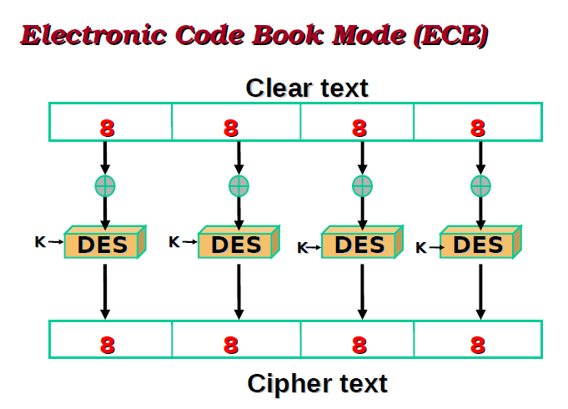

Slide 25
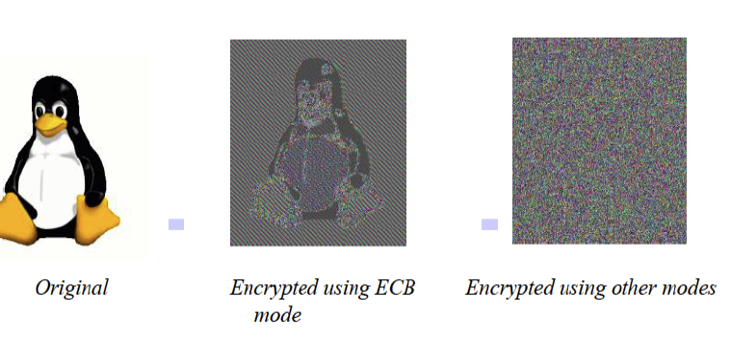

Slide 26
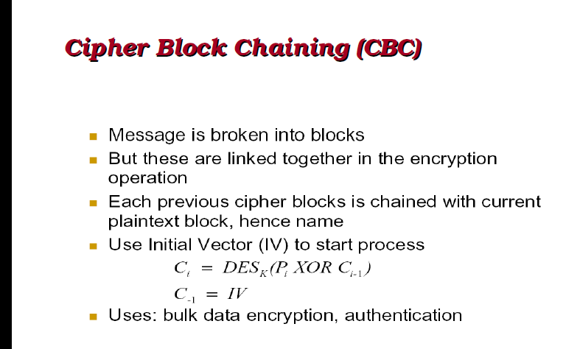

Slide 27
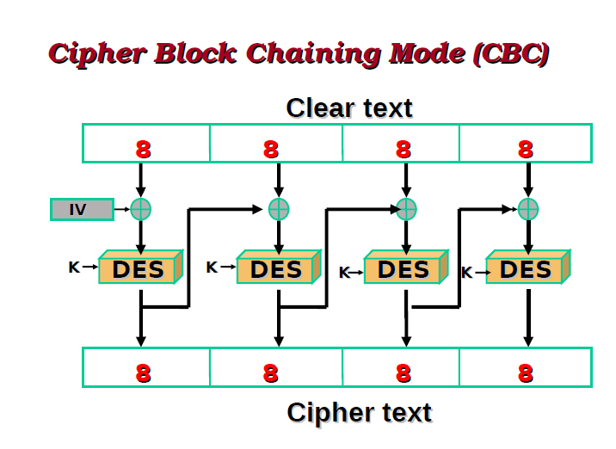

Slide 28
Symmetric key encryption
Pros – Fast, Only one key
Cons –
- Key management (scaling issue)
- Key distribution
- Only confidentiality (not non-repudiation, authentication)
Notes:
https://www.techquintal.com/openssl-commands-examples/

Slide 29
Asymmetric Encryption
Gives 'one-way' security.
Two keys generated, one used with decryption algorithm (private key) and one with encryption algorithm (public key).
Generation of private key, given public key is computationally hard.
Does not need secure key transmission mechanism for key distribution.
Notes:
Public keys only give one way security (as opposed to two way security with secret keys).
The idea of public keys is to have a pair of keys, one key for encryption and another one for decryption. It is the public key that will be used for encryption and the private key will be used for decryption. The public key will be published (e.g. on a Web page on in the signature of e-mails). Hence everybody can obtain the public key and use it to encrypt a message. To decrypt the message, however, the private key that matches with the public key will be needed. Hence only the owner of the private key can decrypt the message.
Keys are generated in a way that it is computationally very hard to compute the private key from the public key.
The advantage that public keys have over private keys is that they do not need a secure key distribution system (which can be very expensive). The disadvantages are that encryption and decryption is usually more complex with public keys than with secret keys and that the system only provides one-way security. Hence two pairs of keys are needed for security in both directions.

Slide 30
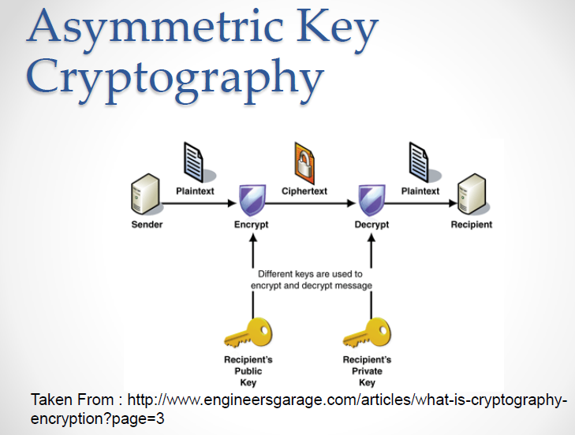

Slide 31
Asymmetric Encryption: Using Public Keys
Recipient generates key pair.
Public key is published by trusted service.
Sender gets public key, and uses it to encode message.
Recipient decrypts message with its private key.
Replies can be encoded using sender’s public key from the trusted distribution service.
Message can be captured but is of no use.
Notes:
The recipient generates a pair of keys. and publishes the public key by a trusted service.
The sender obtains the public key of a recipient and uses it to encode the message, then sends it to the recipient.
The recipient decodes the message using the key that the recipient kept in private. In order to reply, the recipient uses the sender's public key and the recipient decodes the message with his or her private key.
Information cannot be eavesdropped from messages that are captured as the eavesdropper does not have the private key to decode the message. Also messages cannot be tampered in a meaningful way as this would require to get the plain text message.

Slide 32
RSA Algorithm
Alice finds two large prime numbers p, q
Alice computes n=p*q and φ=(p-1)*(q-1)
Alice picks a random number e, between 1 and φ-1 such that e is relatively prime to φ
Alice computes d, where e*d = 1 (mod n)
Alice sends e and n to Bob
Bob encrypts his message as E=M^e (mod n)
Alice decrypts his message with D = E^d (mod n)

Slide 33
Applications of Asym. Encryption
Authentication
Confidentiality
Non-repudiation

Slide 34
Asymmetric Encryption
Pros – Gets rid of the key distribution problem (mostly)
Cons - Slow

Slide 35
Pretty Good Privacy
Public Key encryption used in PGP
Generally available, and can be used for
encryption of messages
digital signatures.
PGP combines Symmetric and Asymmetric
Symmetric has key distribution problem
Asymmetric is slower, but no key distribution problem
Solution: Use Asymmetric to encrypt and distribute key for Symmetric encryption
Notes:
PGP was developed by Philip Zimmermann [Wall93] and is an example of a public key system.
PGP can be used encrypt e-mails and to provide digital signatures. It is now in the public domain and installed here at City on the CSD machines (try man pgp).
PGP can be used to generate a pair of keys (pgp -kg)
PGP simplifies the use of different public keys of different people by managing 'key rings' for them. Any public key of a user can be added to a key ring (pgp -ka). The key can then be used by the user's name.
Then PGP can be instructed to encrypt a text file using a public key from the key ring (pgp -e for a binary and pgp -ea for an ASCII file).
If a user receives a message that is encrypted with the user's public key, PGP is also used to decrypt the message (pgp -d).
Unfortunately, PGP cannot be distributed commercially as it uses the idea of private and public keys which are controlled by the US government. As there is no distributor, commercially available training, and support the commercial relevance of the system is somewhat restricted.

Slide 36
Hash Functions
One way functions
Condenses an input to a unique value
MD-2,3,4,5, SHA-1, SHA-256, SHA-512

Slide 37
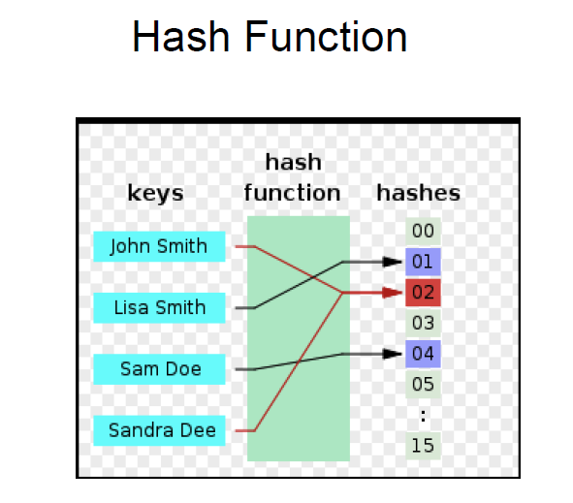

Slide 38
Salted hashing

Slide 39
Collision
https://security.googleblog.com/2017/02/announcing-first-sha1-collision.html
http://shattered.io/

Slide 40
Rainbow tables

Slide 41
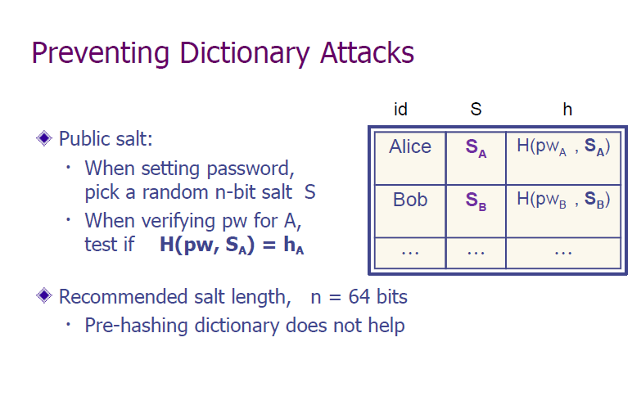

Slide 42
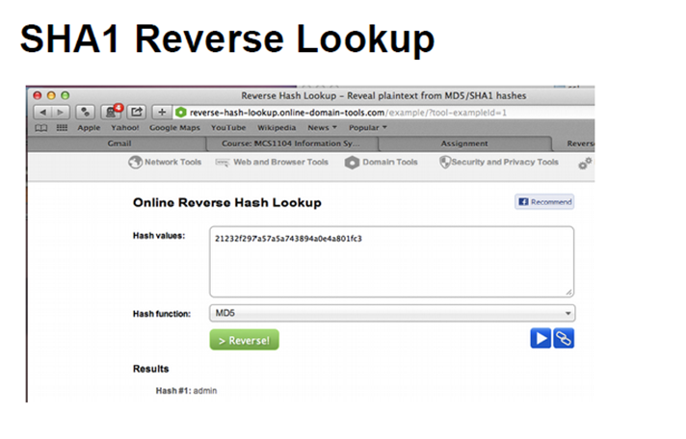
http://reverse-hash-lookup.online-domain-tools.com/

Slide 43
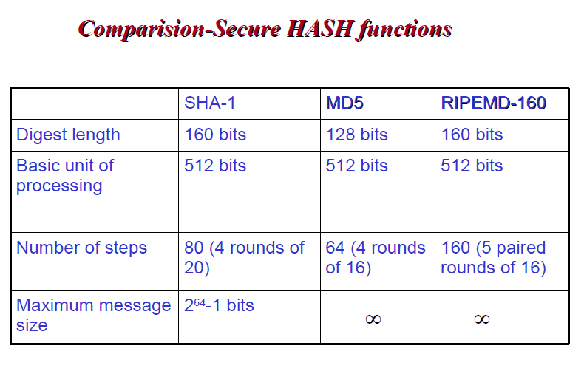

Slide 44
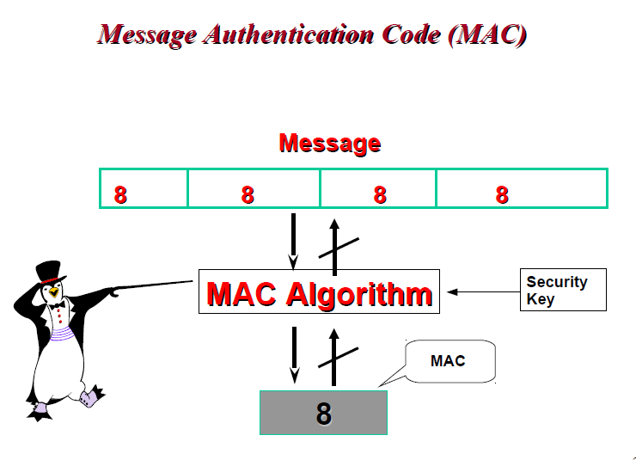

Slide 45
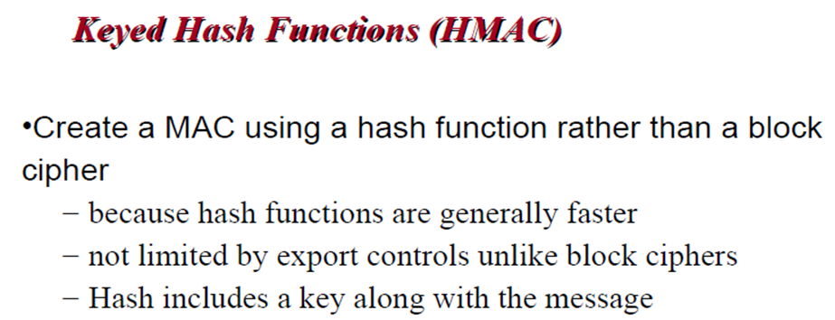

Slide 46
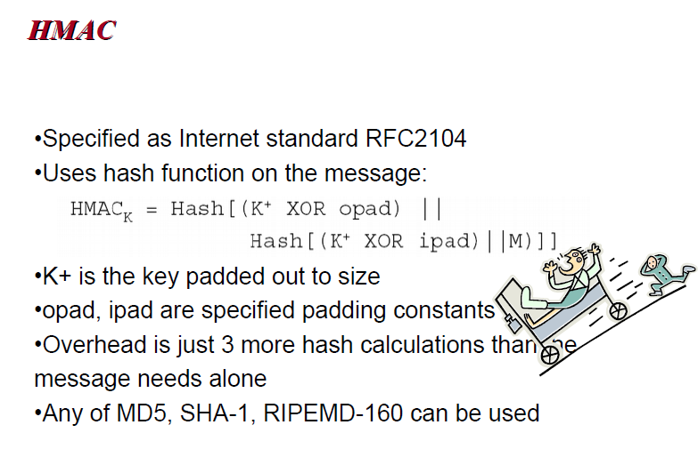

Slide 47
Hashing applications
Passwords
Integrity protection (e.g. software, Digital signatures)
Blockchain

Slide 48
Quantum cryptography
Quantum computers can break algorithms like RSA
Quantum cryptography tries to come up with cryptographic algorithms using quantum mechanics

Slide 49
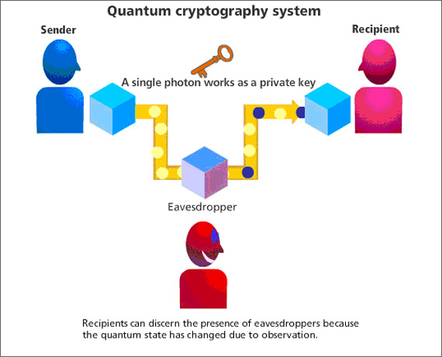

Slide 50

References

