Slide 1

Classification and Recognition of Vegetable Images Using CNN and Transfer Learning
A Final Project on Deep Learning (CS665),Fall 2022
Students : Dipak Dulal,Shusma Kafle,Pooja Rajeev Maheria Padma Priya Poka,Priyanka Bhauji Wankhede
Professor: Dr.Chengcui Zhang
University of Alabama at Birmingham Department of Computer Science
April 21, 2022
1 / 19

Slide 2
Outline
Outline
Introduction Libraries
Data Preparation Deep Learning Models Evaluation
References
2 / 19

Slide 3
Introduction
Vegetables are the most commonly consumed food all around the world. People are using hundred of species of vegetables but we can get some limited numbers of vegetables are in common use.Vegetables are very important sources of nutrients and minerals for human-beings as well.Though varieties of vegetables are distinguished as per its color size and shape,some vegetables looks same due to similarity in some features. Our project is focused on Classifying and recognizing the vegetable image by training 15 thousand vegetable images of 15 different types(class) of labeled images using Convolution Neural Network(CNN) and to get more accurate result we have used Transfer Learning approach also.
3 / 19

Slide 4
Libraries Used
The List of Libraries:
numpy pandas tensorflow keras sklearn matplotlib seaborn
4 / 19

Slide 5
Data Preparation
We downloaded Vegetables Image Dataset from Kaggle data depository
15000 training image data of 15 categories each consisting 1000 images.
3000 images for training and testing purpose and each category contains 200 images
RGB normalization
Rotation:30,zoom range: 0.15,width and height shift : 0.2,shuffle:on,Horizontal Flip:True
5 / 19

Slide 6
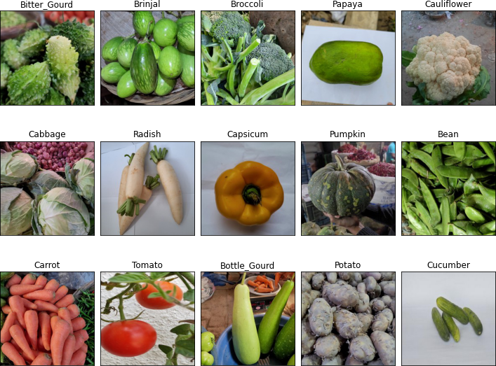
Data Visualization
Figure: Original Vegetable Images
6 / 19

Slide 7
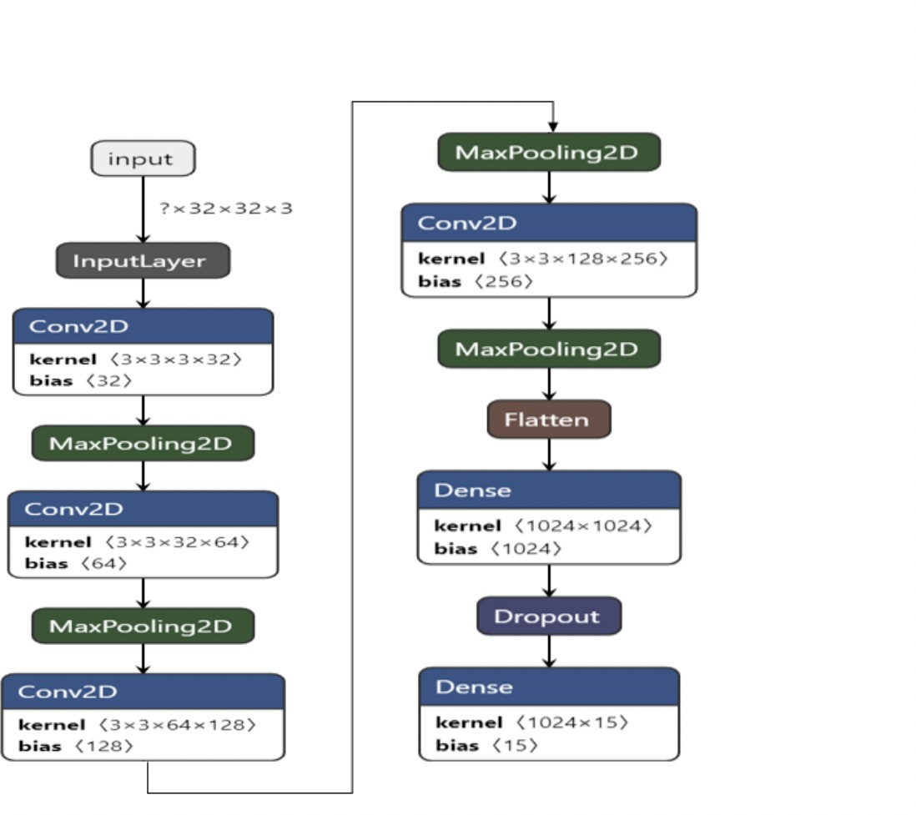
Deep Learning Models
Convolution Neural Network(CNN)
RMSprop Adam SGD
Figure: CNN Architecture
7 / 19

Slide 8
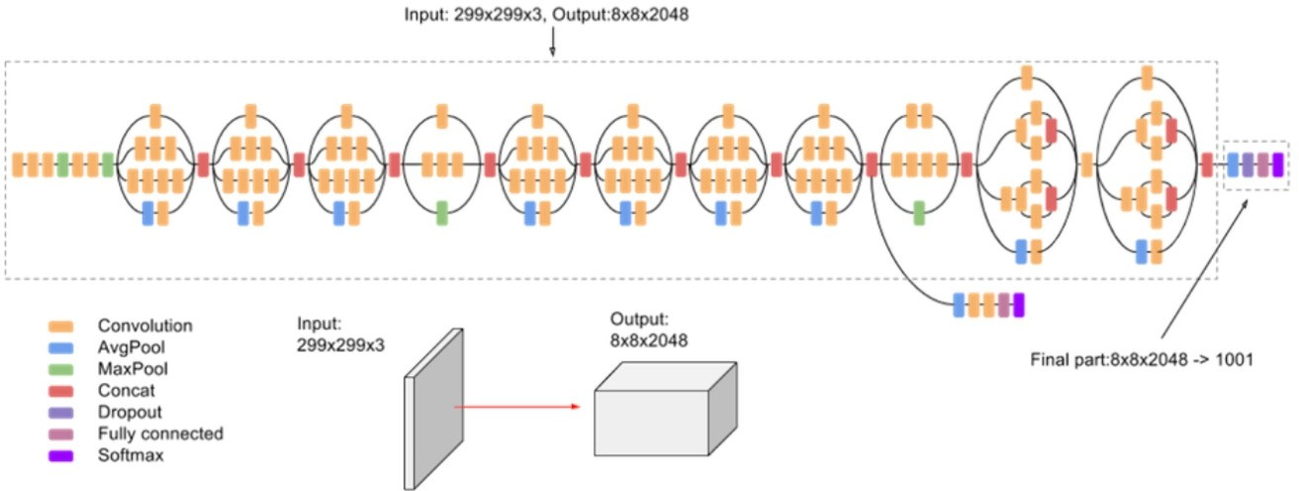
Deep Learning Models
InceptionV3
Factorizes convolutions with Large Filter Size Efficient Gride size reduction
Handles the vanishing gradient problem
Spatial Factorization into Asymmetric Convolutions
Figure: InceptionV3 Architecture

Slide 9
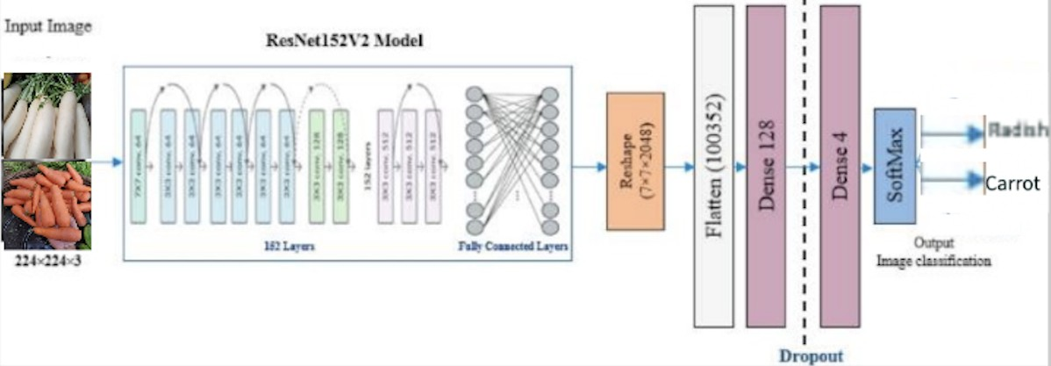
Deep Learning Models
Resnet152V2
Upgraded version.
More layers than previous layers.
Uses batch normalization before weight layer.
Figure: ResNet152V2 Architecture

Slide 10
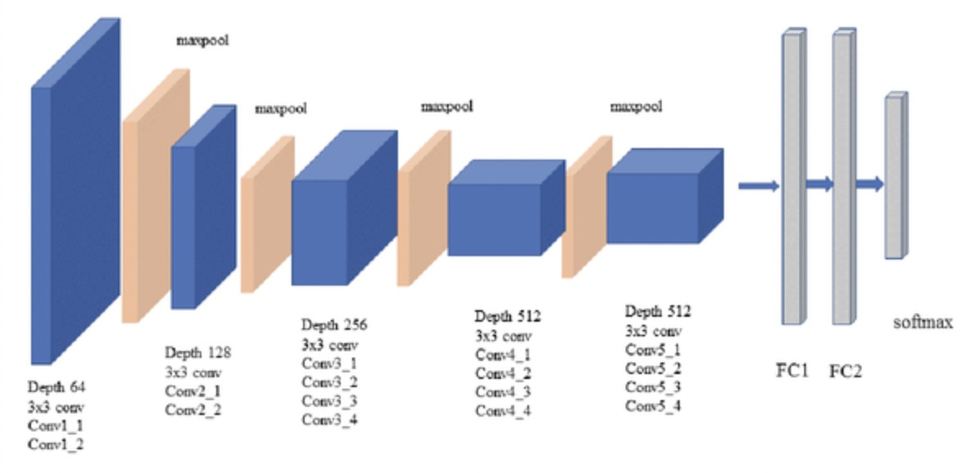
Deep Learning Models
VGG19
Upgraded version
consists of 19 convolutional layers.
extracts more features and examines better
Figure: VGG19 Architecture

Slide 11
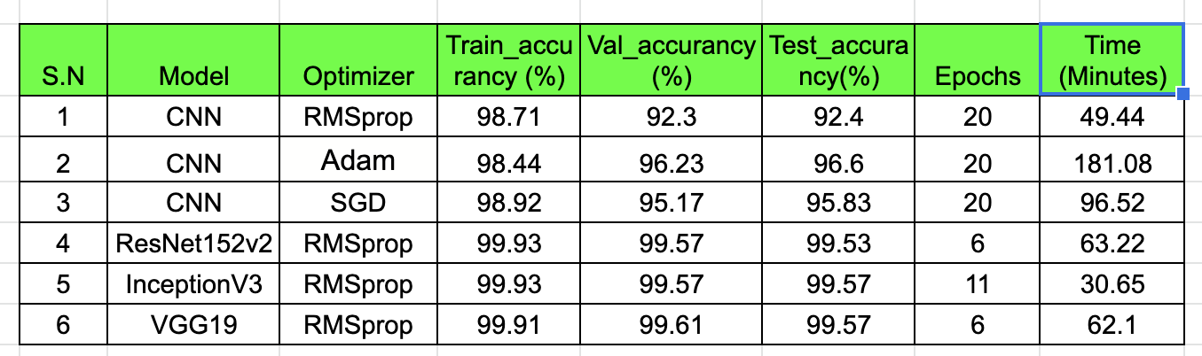
Evaluation
Comparison over Accuracies and Time Costs
Figure: Accuracy Table

Slide 12
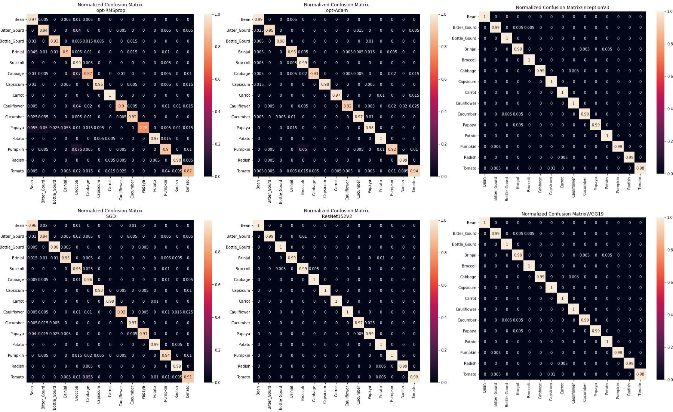
Evaluation
Confusion Matrices(Normalized)
Figure: Confusion Matrices

Slide 13
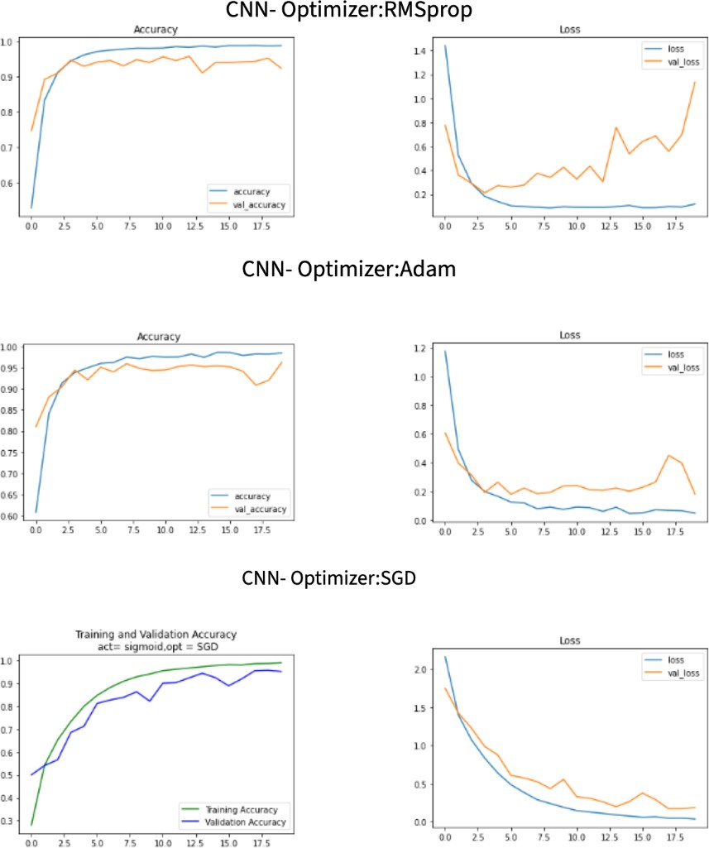
Evaluation
Figure: Loss and Accuracy Values Propagation(CNN)

Slide 14
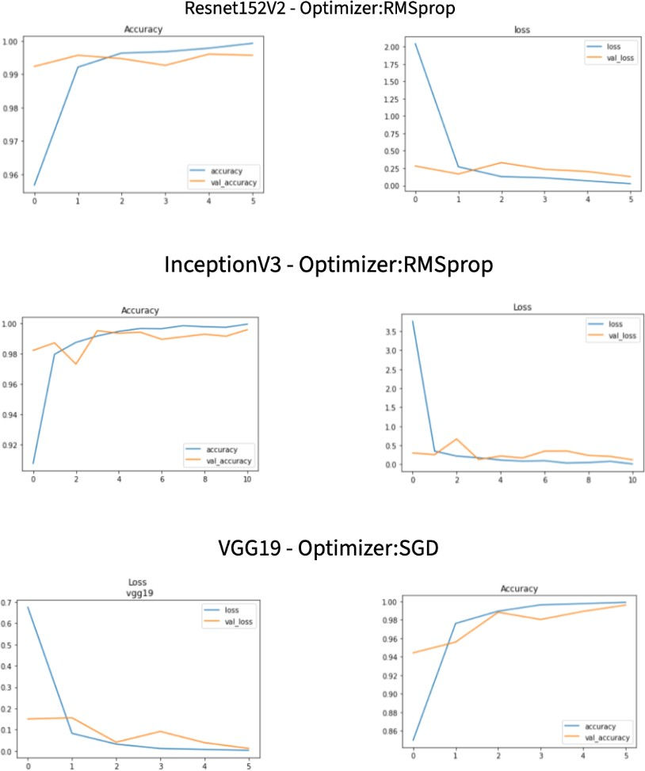
Evaluation
Figure: Loss and Accuracy Values Propagation(TF)

Slide 15
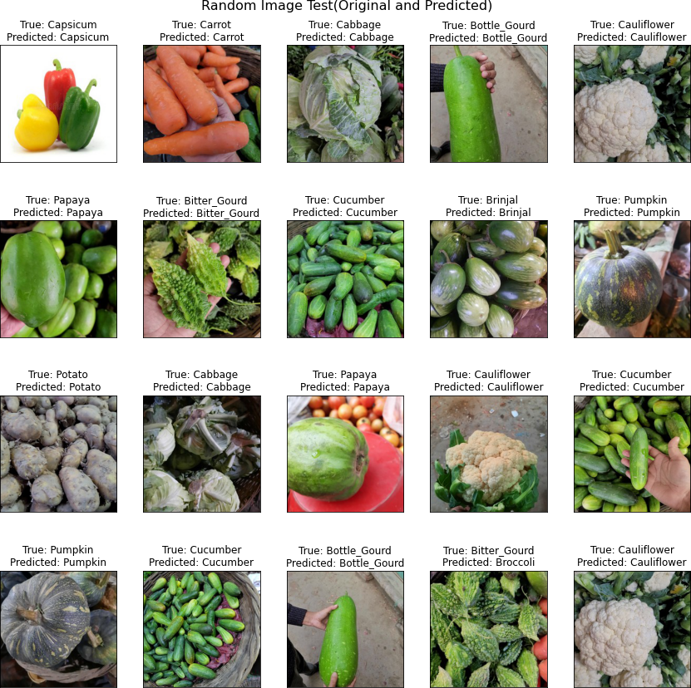
Evaluation
Figure: Random Images Test(CNN:RMSProp)
15 / 19

Slide 16
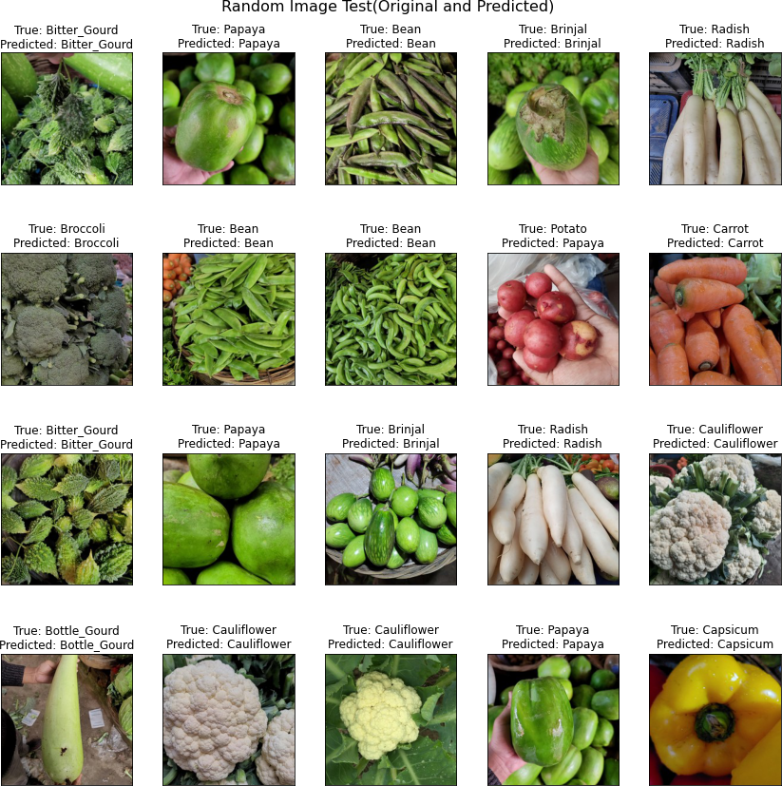
Evaluation
Figure: Random Test Images(INceptionV3)
16 / 19

Slide 17
Conclusion
From the all results we have we concluded as:.
Augmentation is Crucial
Transfer Learning model is highly effective SGD is the best optimizer for CNN
and RMSprop for Trasnfer Learning on our dataset.
17 / 19

Slide 18
References
References
1
Ian Goodfellow,Yoshua Benhio and Aaron Courvile, Deep Learning
Lecture Slides of Data Mining CS663/763,Prof. Dr. Chengcui Jhang
hristian Szegedy, Vincent Vanhoucke, Sergey Ioffe, Jonathon Shlens, Zbigniew Wojna,Rethinking the Inception Architecture for Computer Vision
Lecture Slides of Deep Learning CS665,Prof. Dr. Chengcui Jhang https://www.kaggle.com/datasets/misrakahmed/ vegetable-image-dataset
M. I. Ahmed, S. Mahmud Mamun and A. U. Zaman Asif, ”DCNN-Based Vegetable Image Classification Using Transfer Learning: A Comparative Study,” 2021 5th International Conference on Computer, Communication and Signal
2
3
4
5
6
18 / 19

Slide 19
Thank You! Questions?
19 / 19

