Slide 1

Leaf Classification
USING TRANSFER LEARNING

Slide 2
TEAM NUM:205(Batch no:10) TEAM MATES D.PRADEEP T.SATYA SRI

Slide 3
INTODUCTION: In this project the model is trained to identify the input leaf is belongs to which class means the root specie of the input(leaf)

Slide 4
LIBRARIES USED: Numpy pandas matplot torch cv2 os

Slide 5
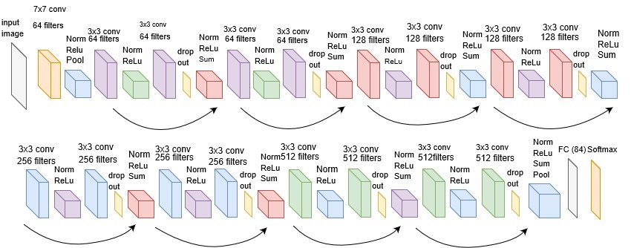
MODEL IS TRAINED USING “RESNET” Resnet architecture:
Proposed Modified ResNet-18 architecture for Bangla HCR. In the diagram, conv stands for Convolutional layer, Pool stands for MaxPool layer, batch norm stand for batch normalization, Relu stands for rectified linear unit activation layer, Sum stands for the addition in ResNet, and FC stand for fully connected hidden layers. In this architecture, we have eight ResNet modules which are modified by adding a dropout layer after the second convolutional layers.

Slide 6
ResNet-18: ResNet-18 is a convolutional neural network that is 18 layers deep. You can load a pretrained version of the network trained on more than a million images from the ImageNet database . The pretrained network can classify images into 1000 object categories, such as keyboard, mouse, pencil, and many animals.
In this project we are using resnet18 model because it is trained over 1000 of classes of ImageNet which includes the category of leaf also…….
“So for this reason resnet is choose for our model to classify the leaf”

Slide 7
THANK YOU……

