Slide 1

Engineering-Graduate-Salary-Prediction

Slide 2
Objective:
Predict the salary of engineering graduates based on relevant features using exploratory data analysis
(EDA).
Data Description:
The dataset includes information on engineering graduates, such as academic performance, internship
experiences, programming skills, and extracurricular activities. The range of variables to capture the
multifaceted aspects influencing salary outcomes. The dataset is sourced from reputable educational
institutions and industry surveys, ensuring a comprehensive representation of the engineering job market.

Slide 3
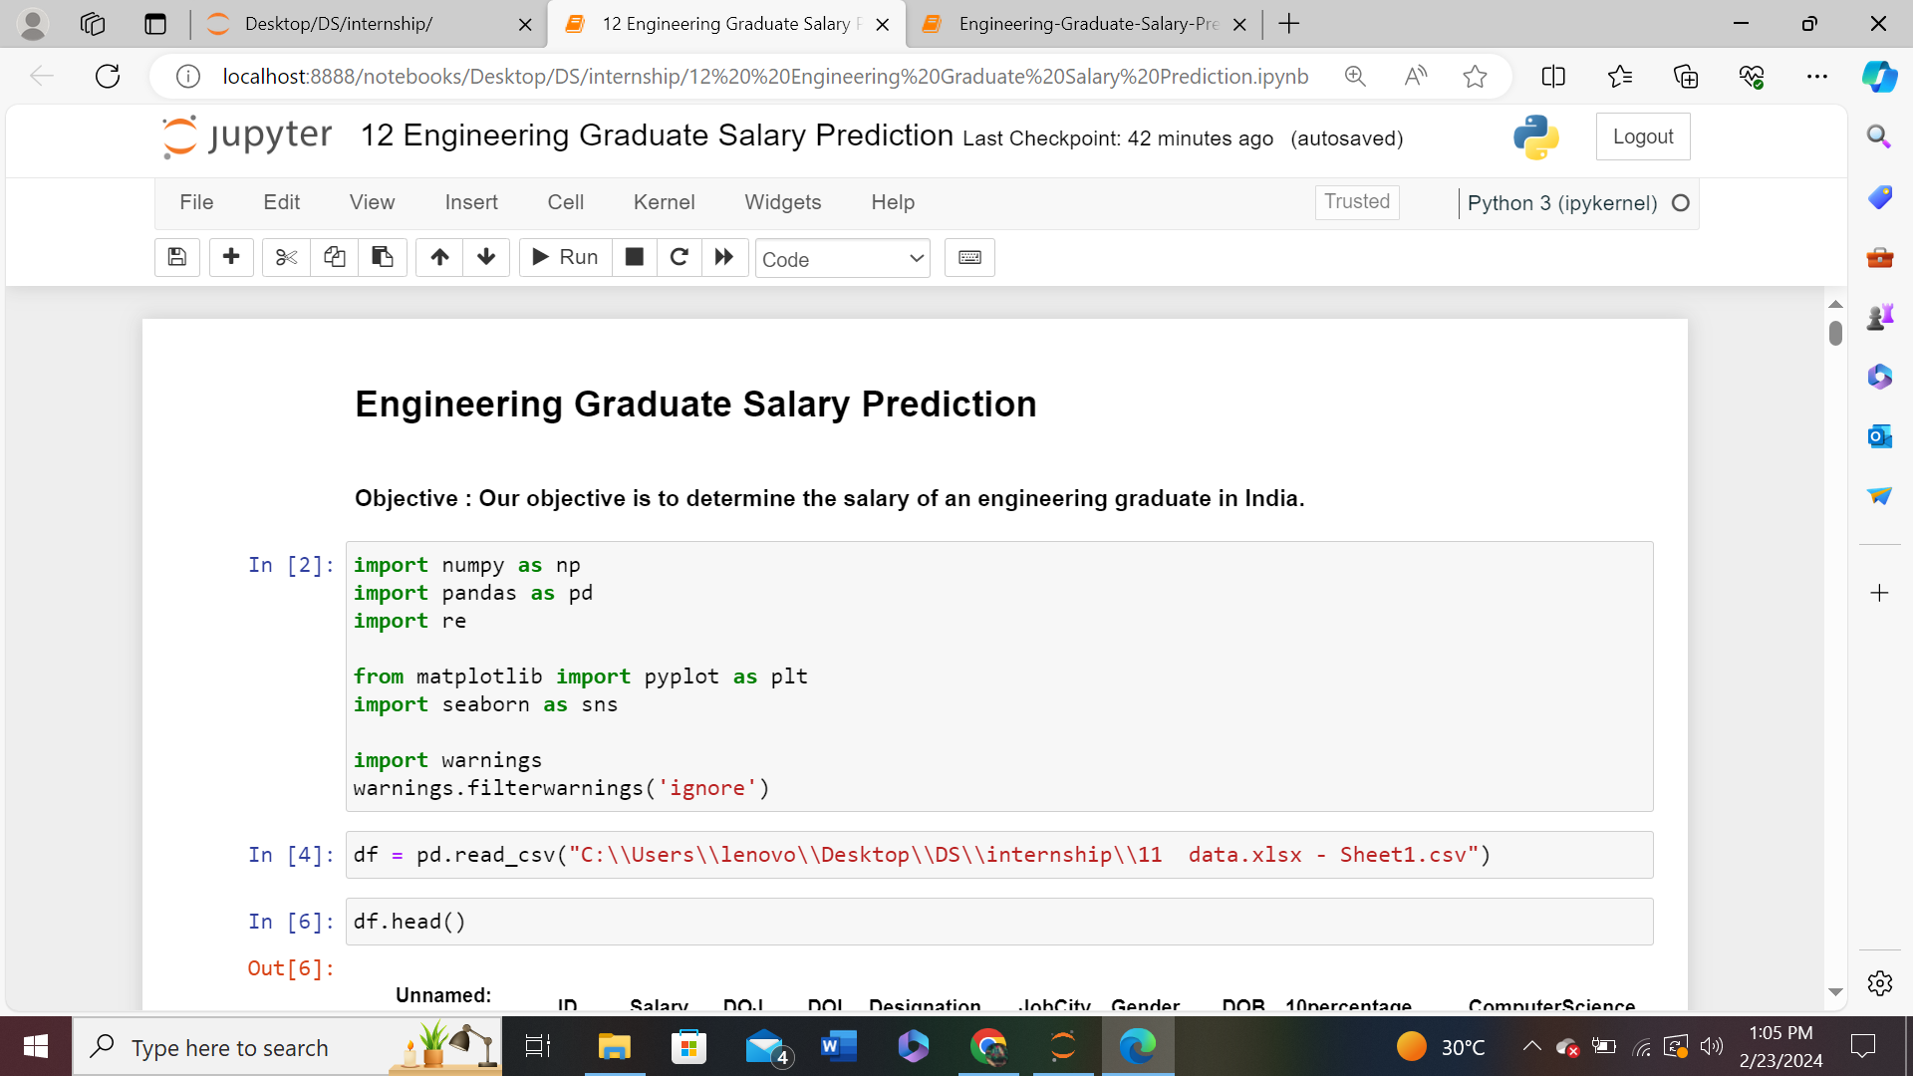
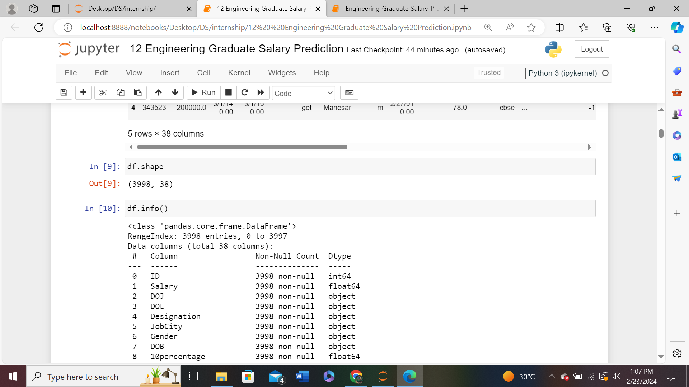
Importing Required Libraries
Shape of Dataset

Slide 4
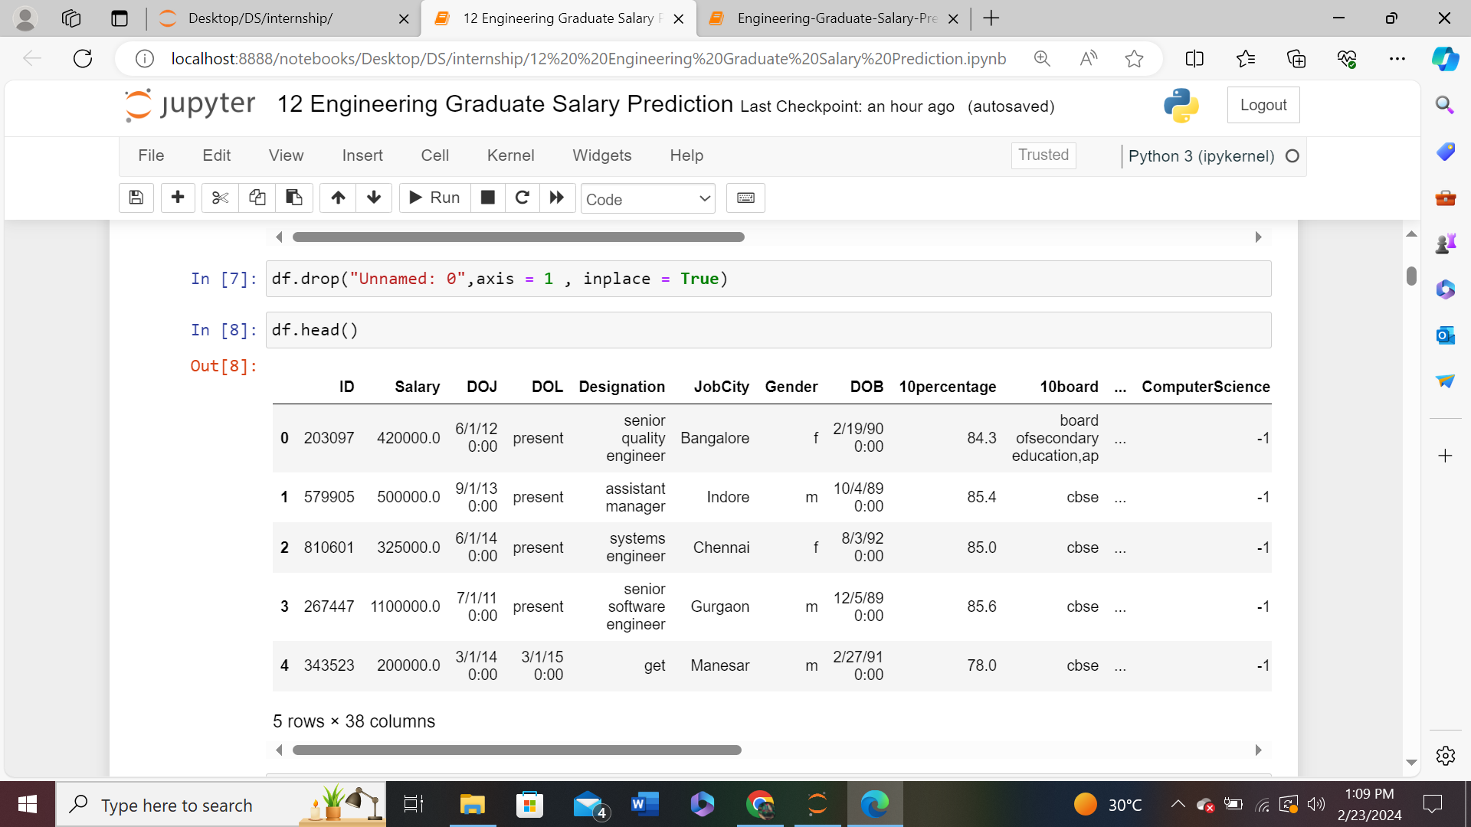
Top 5 Rows of the Dataset

Slide 5
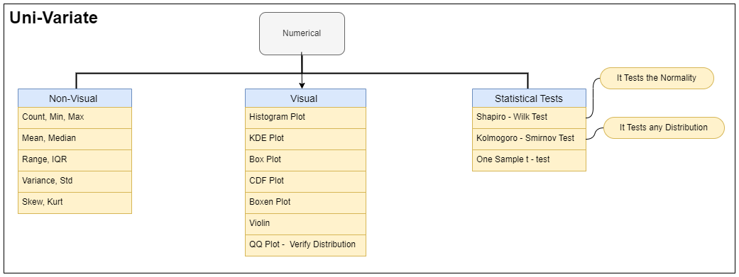

Slide 6
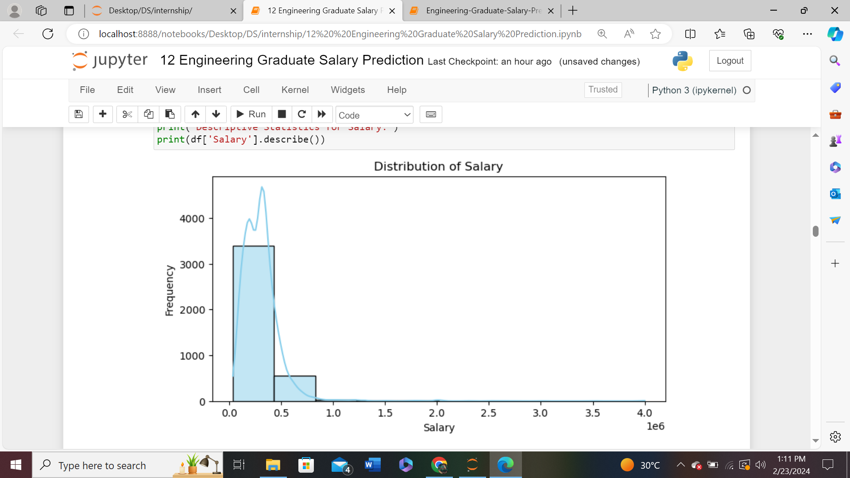
Univariate Analysis
Descriptive Statistics for Salary:
count 3.998000e+03
mean 3.076998e+05
std 2.127375e+05
min 3.500000e+04
25% 1.800000e+05
50% 3.000000e+05
75% 3.700000e+05
max 4.000000e+06
Name: Salary, dtype: float64
Insights :
Most of the graduates having salaries under 5 lakhs.
Long tail of distribution is longer on right hand side as compared to left hand side
which shows that distribution is positively skewed.

Slide 7
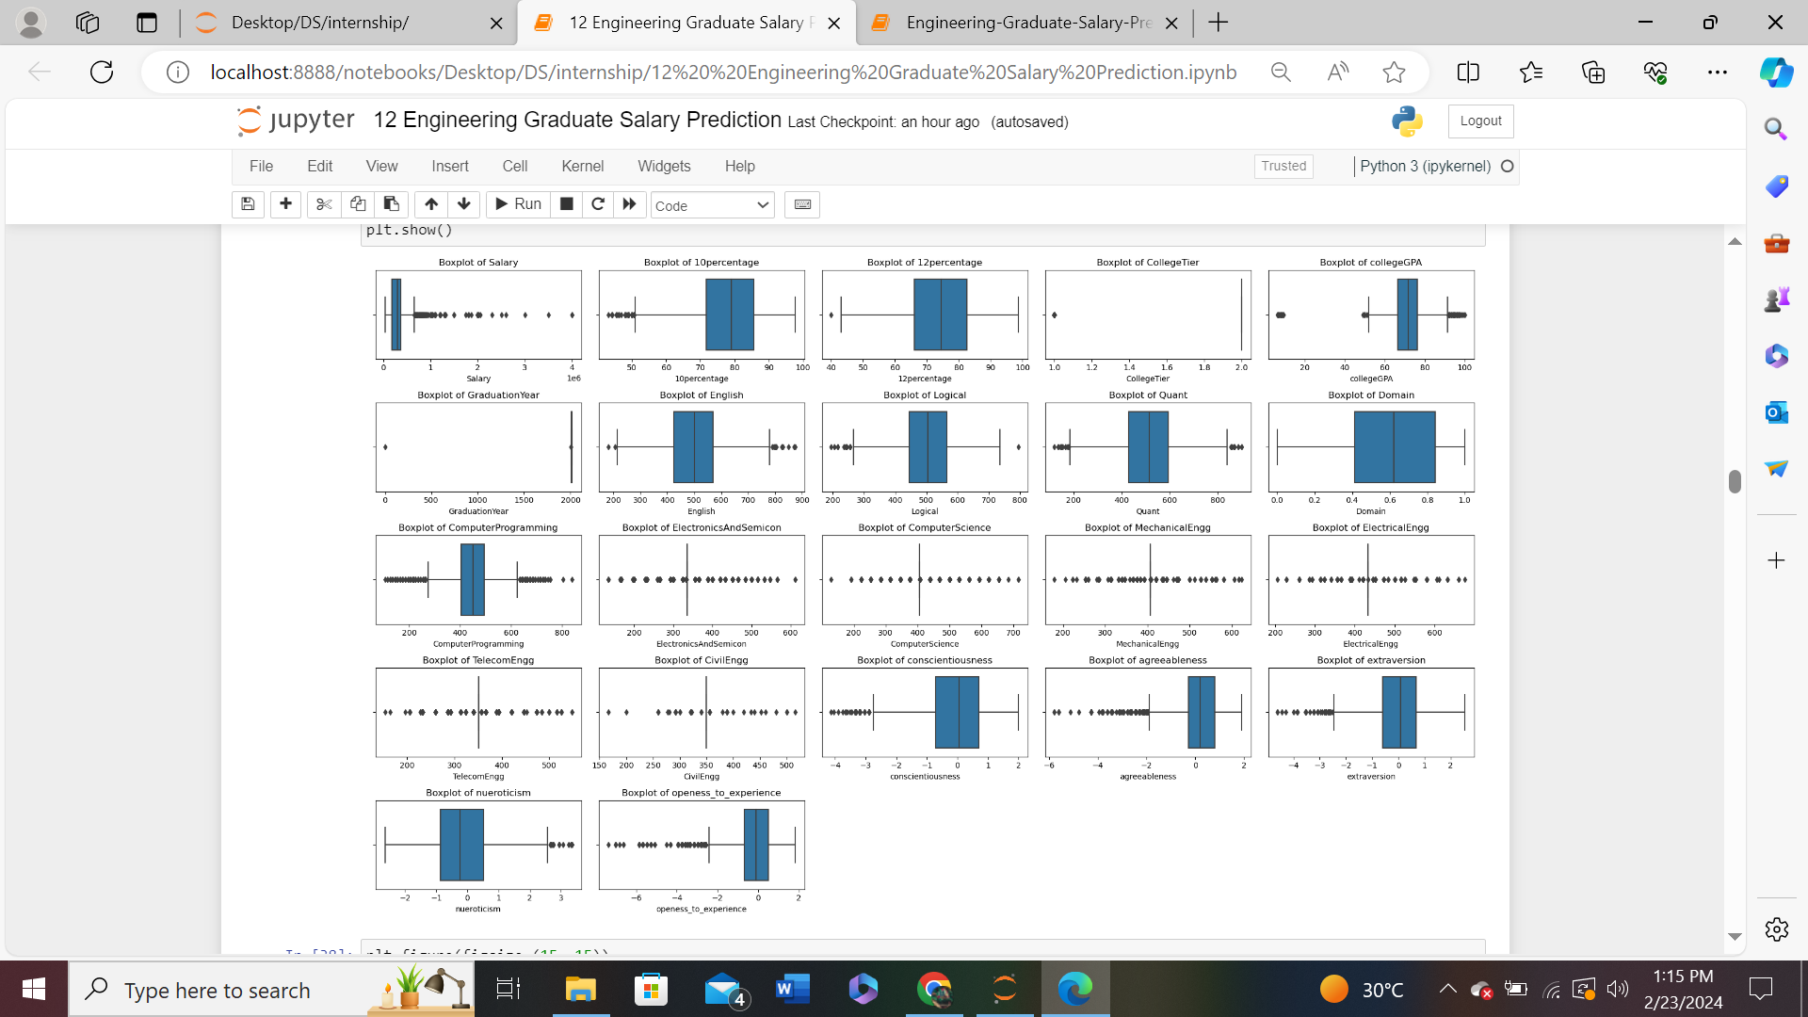
Finding the outliers in each numerical column

Slide 8
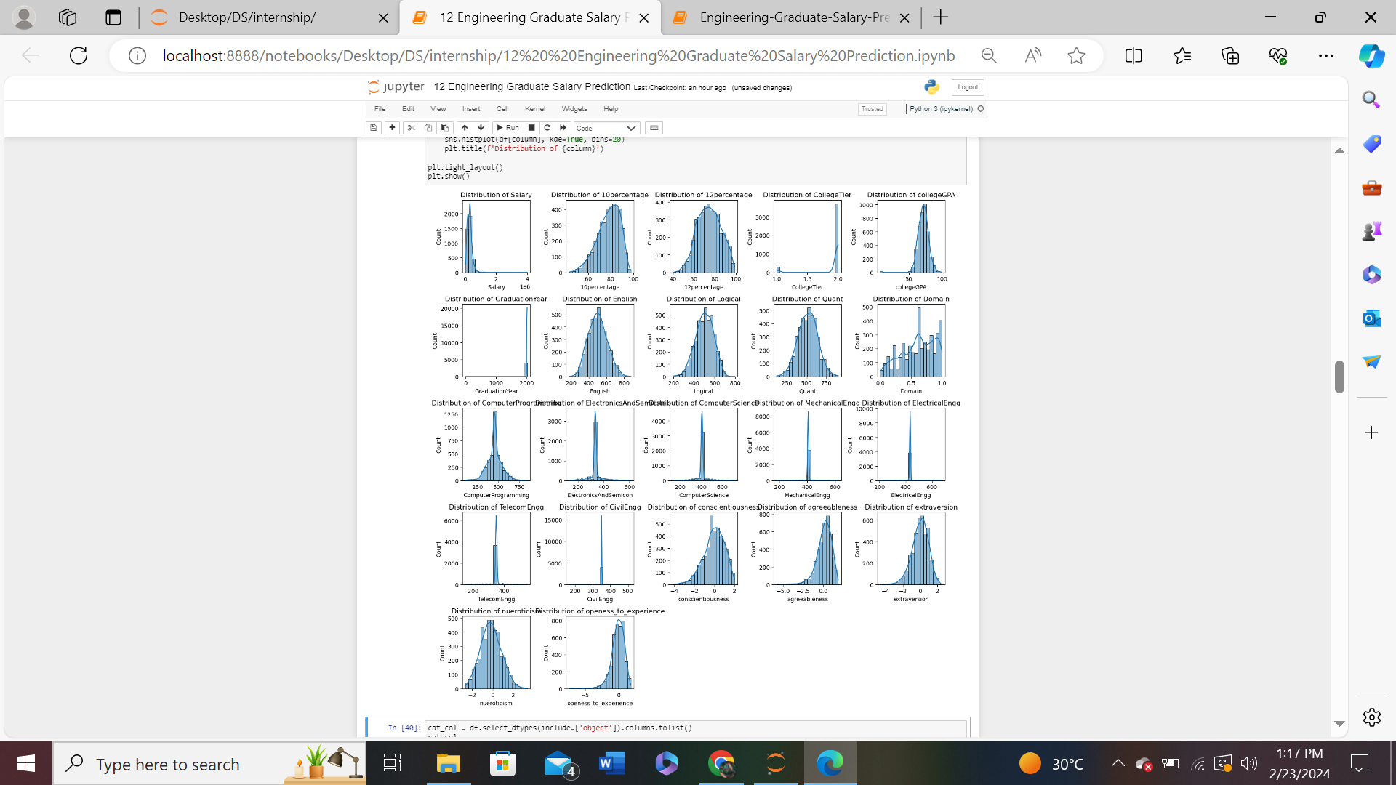
Understanding the probability and frequency distribution of each numerical column

Slide 9
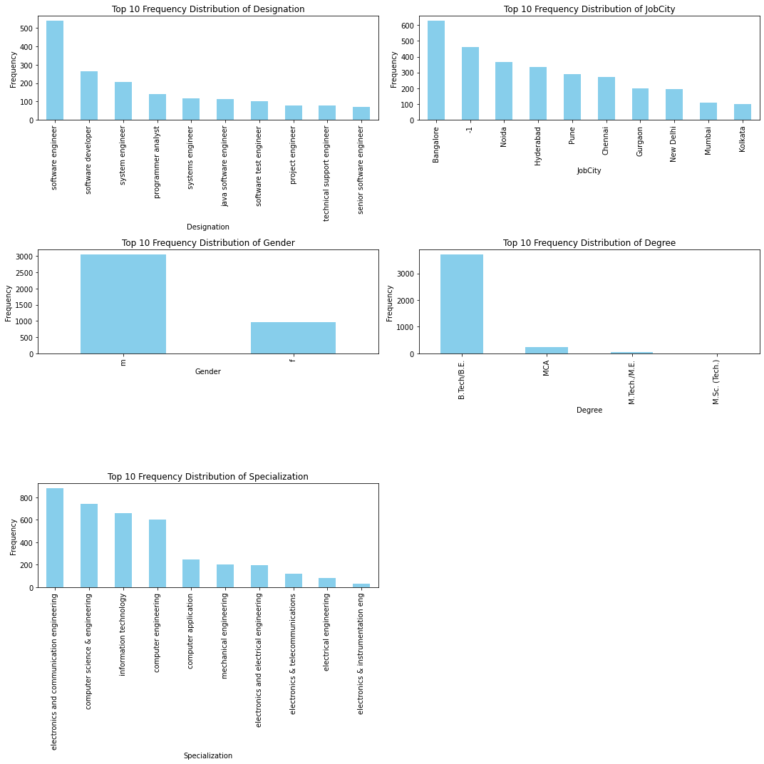
Understanding the frequency distribution of each categorical Column

Slide 10
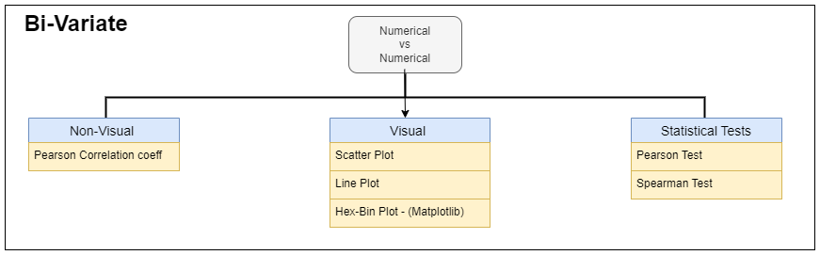
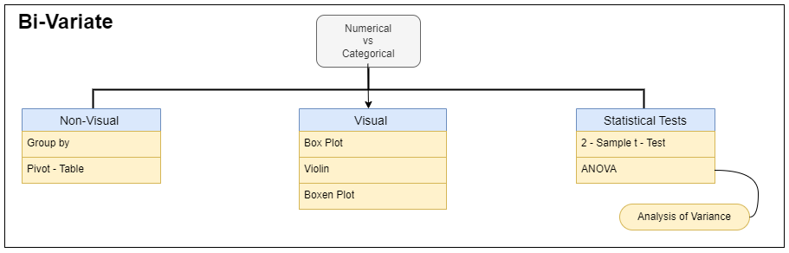
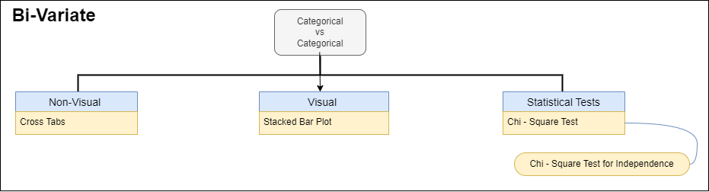
Numerical Vs Numerical
Numerical Vs Categorical
Categorical Vs Categorical

Slide 11
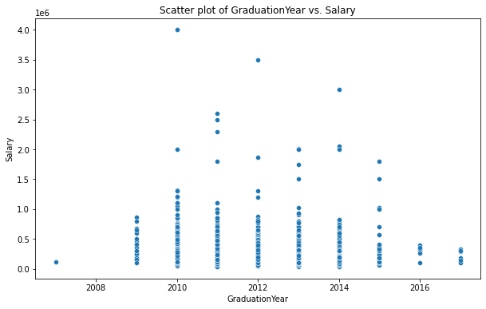
Numerical Vs Numerical Column
Insights :
Positive correlation:
There appears to be a positive correlation between graduation year and salary.
This means that, in general,
people who graduated in more recent years earn more than people who graduated in earlier
years.

Slide 12
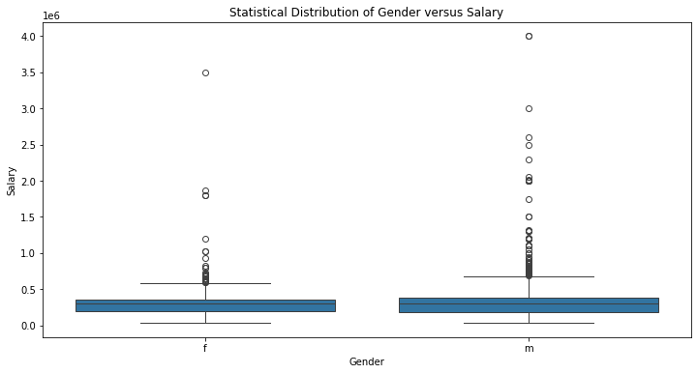
Categorical Column Vs Numerical Column
Insights:
It is clearly visible from
the plot that the Average
salary for men and woman
are looking almost same.
but slightly men are getting
better salary

Slide 13
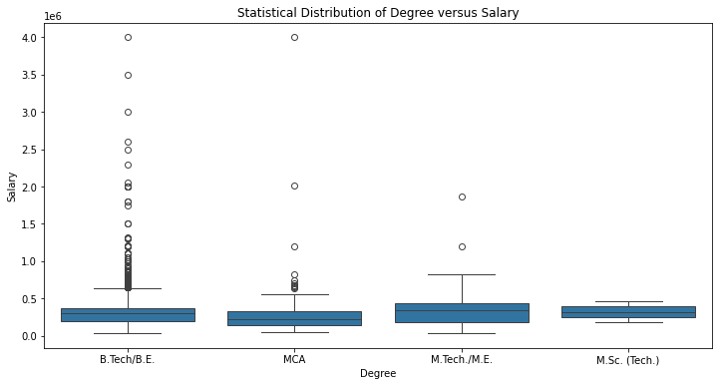
Degree Vs Salary
Insights :
Average salary is highest for
BE / B.tech graduates
as compared to any other degree
graduates.

Slide 14
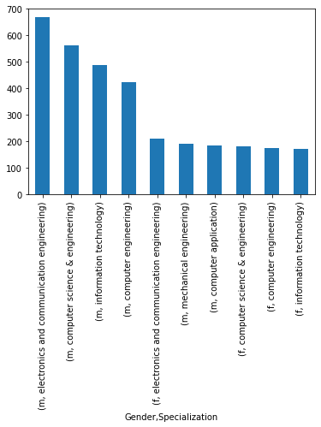
Categorical Vs Categorical Column :
Insights :
As compared to female ,
Male students are getting more jobs from
ECE , CSE & IT .

Slide 15
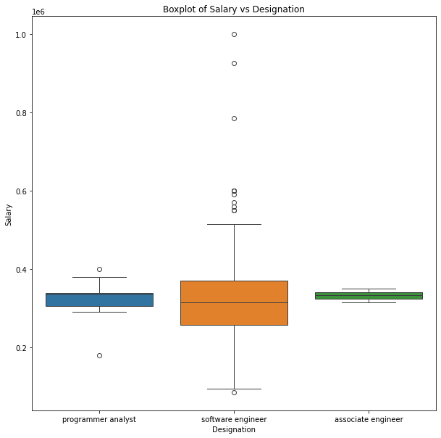
Research Questions
Times of India article dated Jan 18, 2019 states that “After doing your Computer Science Engineering if you
take up jobs as a Programming Analyst, Software Engineer, Hardware Engineer and Associate Engineer you
can earn up to 2.5-3 lakhs as a fresh graduate.” Test this claim with the data given to you.
Insights :
So by above observation it is true that candidates having
" computer science & Engineering "
specialization after then they
pursue their job role in programmer analyst ,
software engineer , associate engineer
they can earn around 2-3 lakh as by above
box plot it is clear that above majority of candidates
between 2-3 lakh but there
are some outliers in software engineer who earning
below 2 lakh.
there is no hardware engineer job in this specialization

Slide 16
Important Note
1 . In this PPT , you can only find 1 to 2 important plots .
2 . You can find rest of the the univariate , bivariate plots in my jupyter Notebooks ,
make sure to visit my Github Link

Slide 17

THANK YOU

