Slide 1
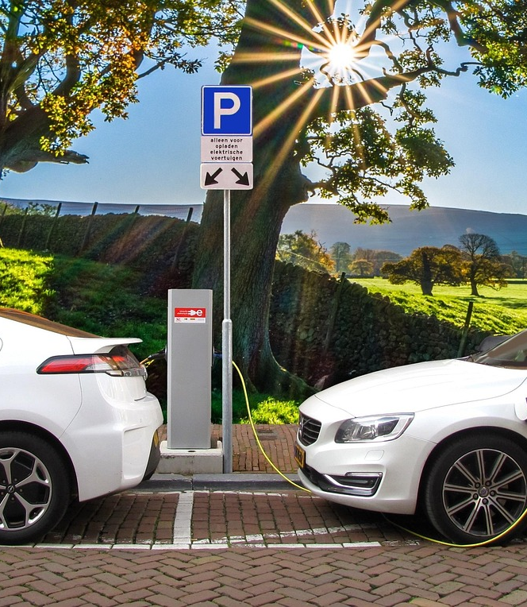
Electric Vehicle Population
DMBI – G03

Slide 2




CONTENT
INTRODUCTION
SCHEMA AND RELATIONSHIPS
VISUALIZATION AND INTERPRETATIONS
FINDING AND FORECASTING

Slide 3
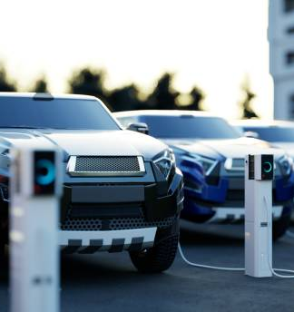
Introduction
Contains data on electric vehicles owned and registered in Washington State.
Has BEV and PHEV information.
Covers registrations from 2002 through 2025 in 481 cities and includes 45 different vehicle models.
Important for tracking electric vehicle uptake trends, offering rich descriptions of vehicle type, geographic reach, and registration patterns.
Help analyze growing shifts to electric mobility, calculate market penetration, and prepare supporting services such as charging facilities.
Showcases Washington's commitment to sustainability and facilitates stakeholders in decision making.

Slide 4
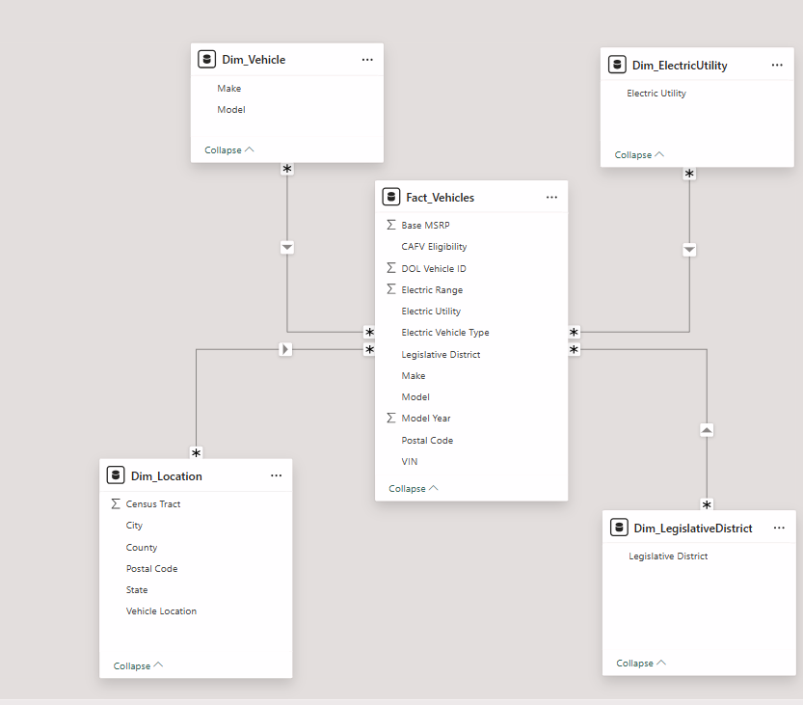
SCHEMA AND RELATIONSHIPS

Slide 5

VISUALIZATION & INTERPRETATIONS

Slide 6
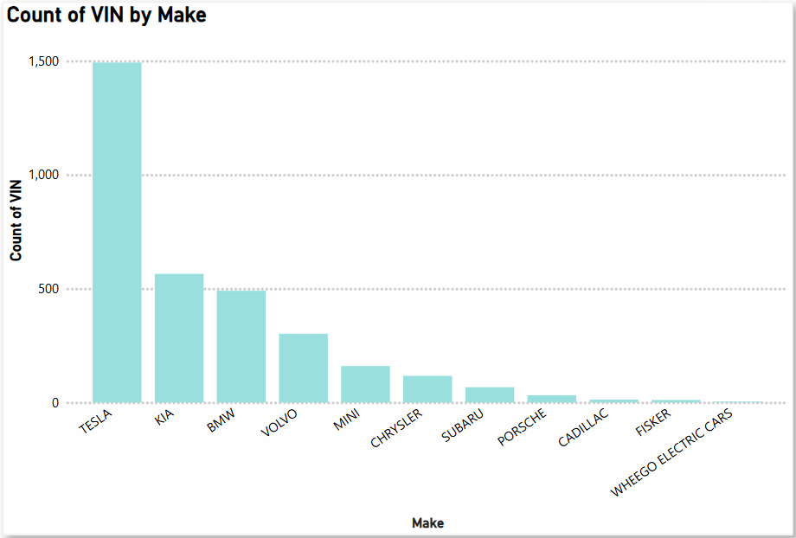
Total number of vehicles (Stacked column chart)

Slide 7
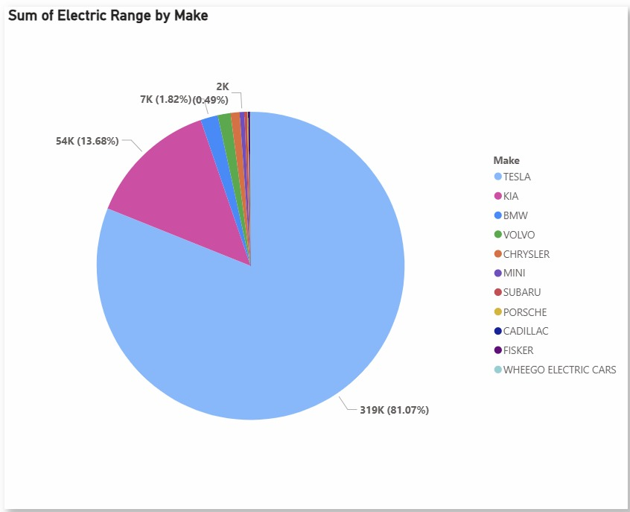
Total Electric Range (Pie Chart)

Slide 8
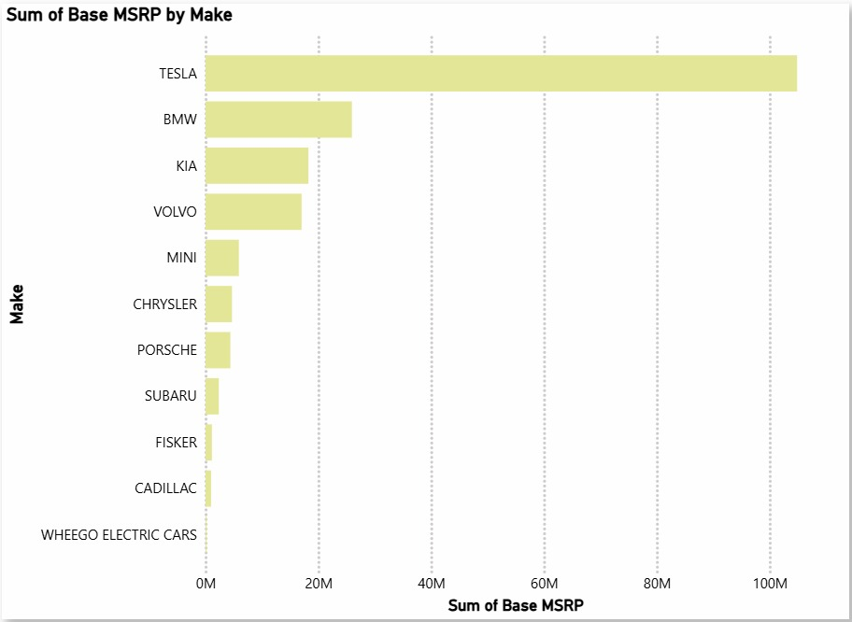
Total Manufacturer’s Suggested Retail Price (Clustered bar chart)

Slide 9
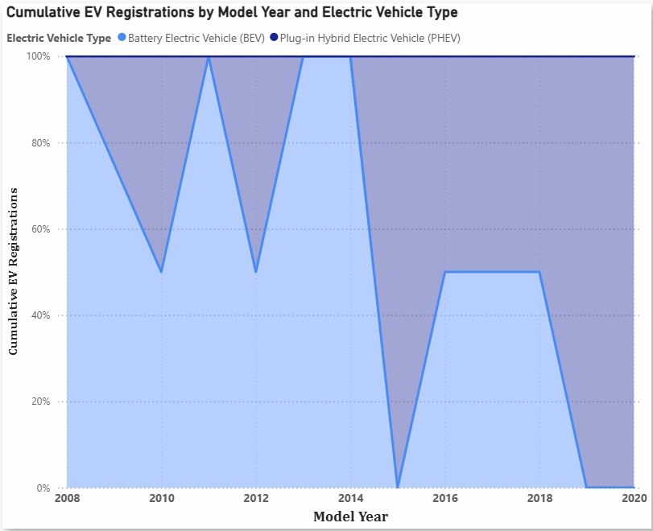
Total Vehicles By Type (Stacked area chart)

Slide 10

Electric Vehicle Population Dashboard

Slide 11
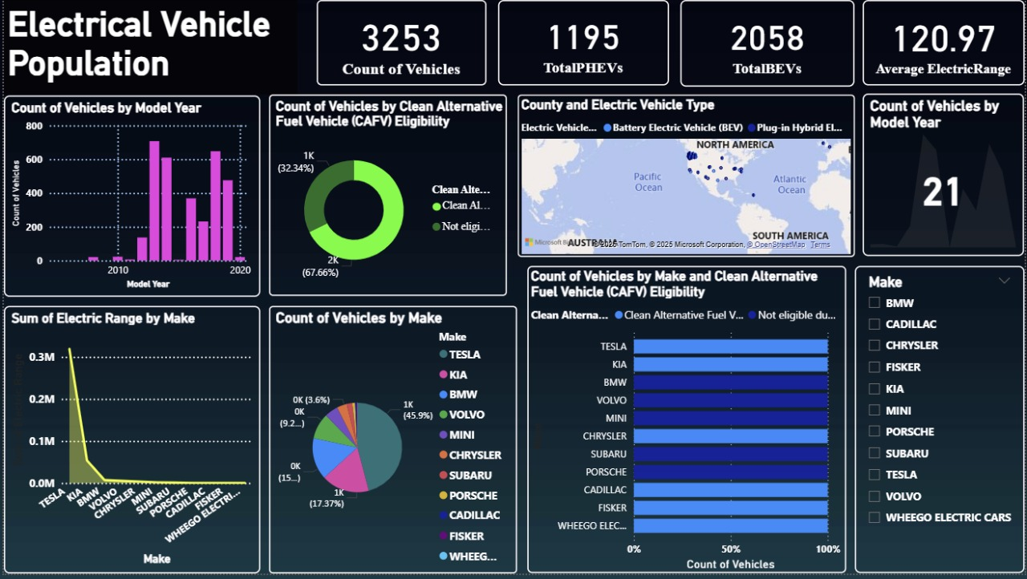

Slide 12

FINDING & FORECASTING

Slide 13
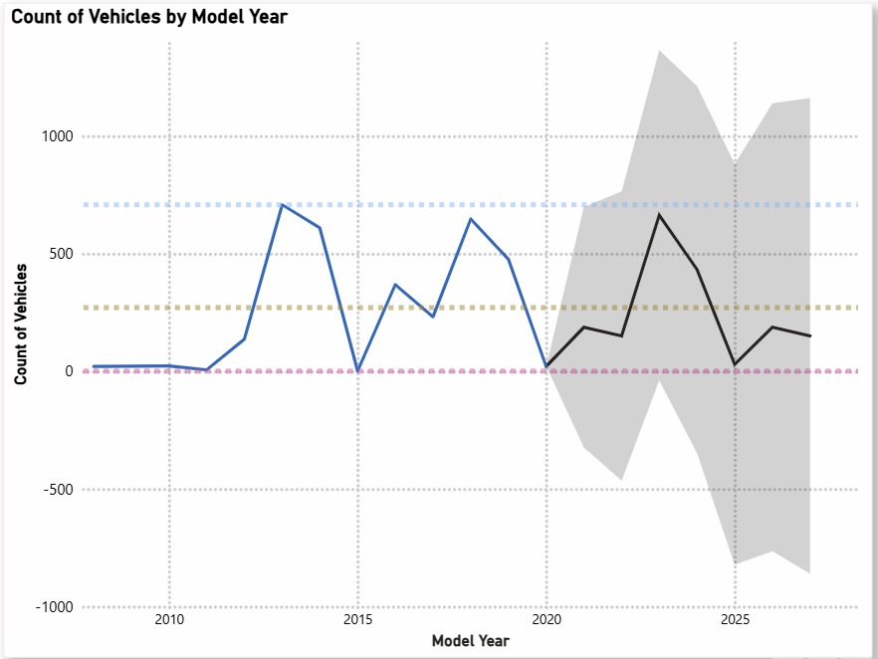
Count of Vehicles by Model Year (Line Chart)

Slide 14
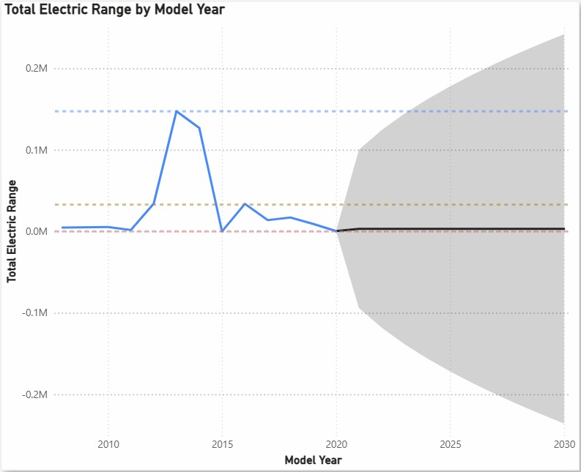
Total Electric Range by Model Year (Line chart)

Slide 15




Thank you

