Slide 1
Group Assignment
STAT 31513
Group 05

Slide 2
Introduction
In order to study customer satisfaction for a particular company, they have evaluated various areas and assigned scores out of 10 for each category.
These categories include: Complaint Resolution (CompRes), Delivery Speed (DelSpeed), Order Billing (OrdBilling), Warranty Claims (WartyClaim), Technical Support (TechSupport), E-commerce (Ecom), Product Quality (ProdQual), Sales Force Image (SalesFImage), Advertising (Advertising), Price (ComPricing), Product Line (ProdLine)

Slide 3
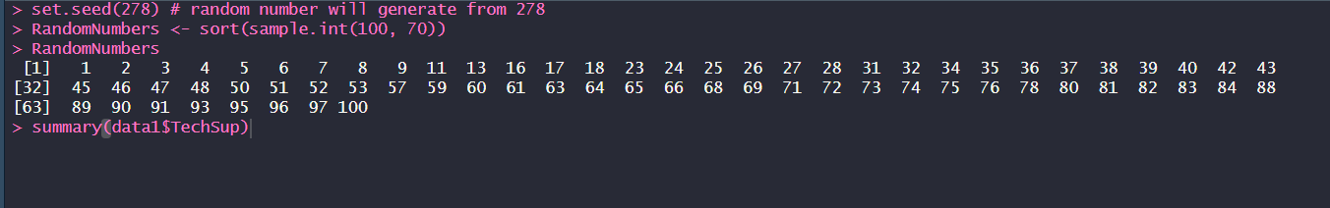
Methodology
Generate random numbers

Slide 4


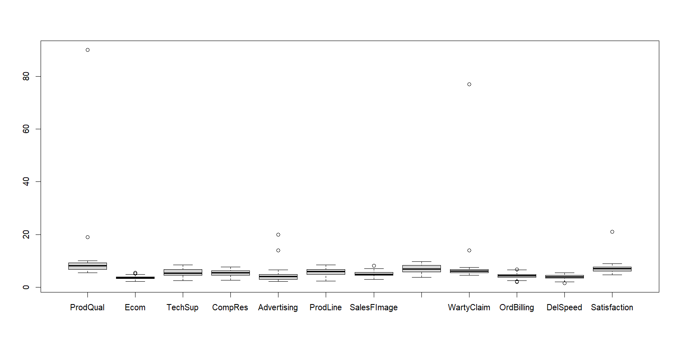
Check whether there are missing values and replace them by corresponding mean of each variable.
Checking outliers

Slide 5
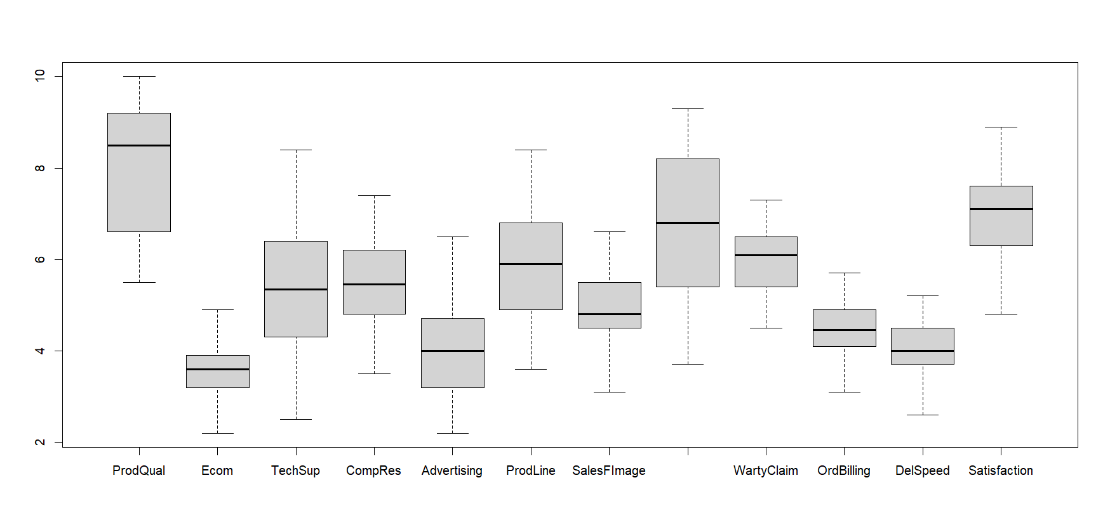
Removing outliers
Minimum and maximum values were found and values greater than the maximum were removed as well as values less than the minimum value.

Slide 6
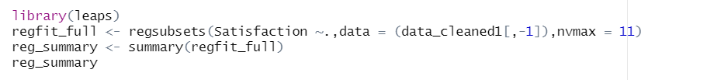
In complex regression situations when there are a large number of predictor variables that may be not relevant for making predictions about the response variables, it is useful to reduce the model to contain only the variables that provide important information about the response variable.
There are several type of variable selection methods. We have used best subset selection method and Stepwise regression procedure.
Best subset selection method

Slide 7
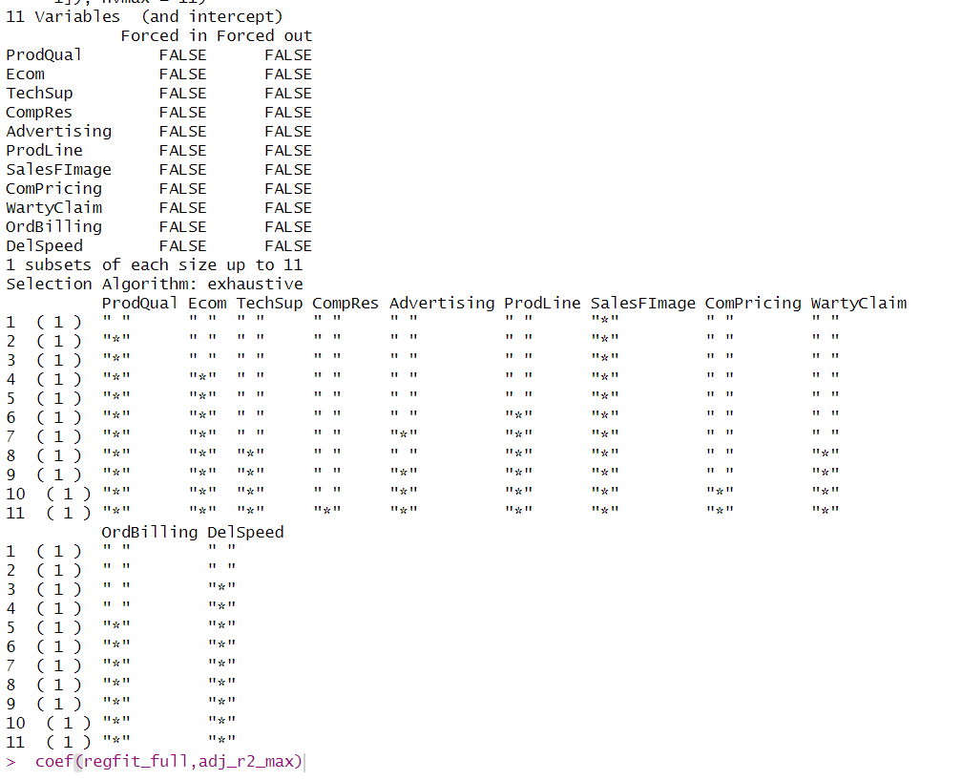

Slide 8
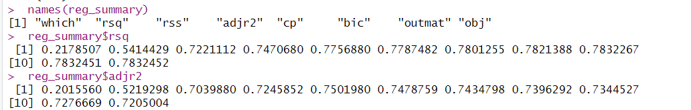
The summary() function also returns R2, RSS, adjusted R2, Cp, and BIC. We can examine these to try to select the best overall model.
We see that the R² statistic increases from 21% when only one variable is included in the model to almost 78% when all variables are included. As expected, the R² statistic increases monotonically as more variables are included.
Plotting RSS, adjusted R², Cp, and BIC for all of the models at once will help us decide which model to select.

Slide 9
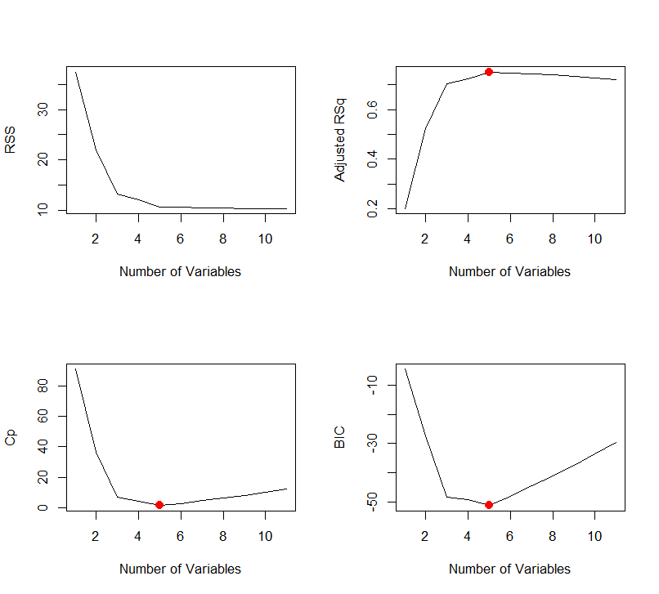
We see that according to BIC, the best performer is the model with 5 variables. According to Cp, 5 variables. Adjusted R² suggests that 5 might be best.
However, the model with the lowest BIC is the 5 variable model that contains only ProdQual, Ecom, SalesFImage, OrdBilling, DelSpeed.

Slide 10
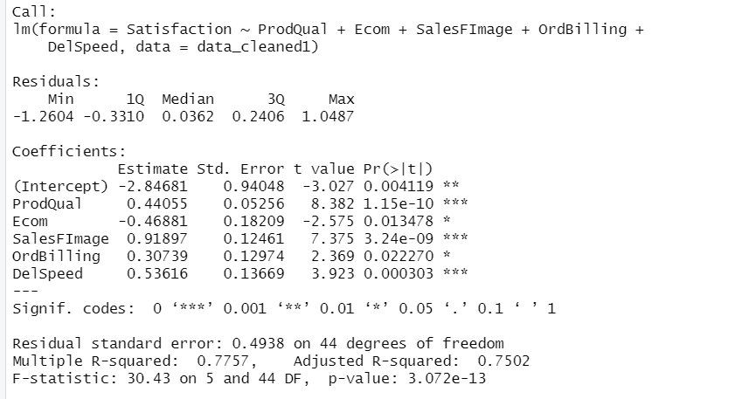
Fit the model for five variables.
Satisfaction=-2.84681 + 0.44055 * ProdQual -0.46881 *Ecom+0.91897 * SalesFImage+ 0.30739 *OrdBilling +0.53616 * DelSpeed

Slide 11
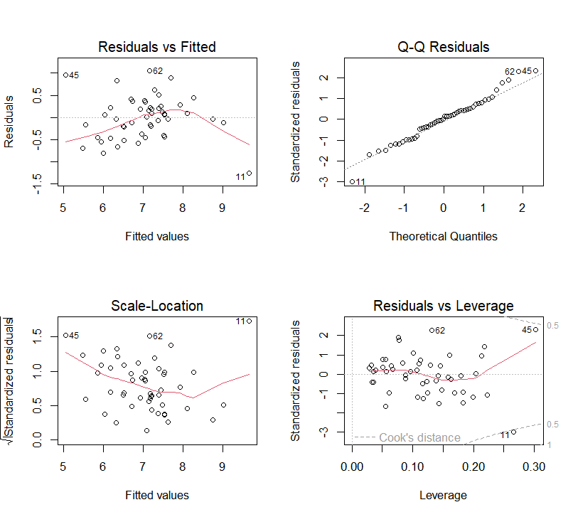
Plotting model
This is an indication that the linear regression model is not adequate.
Transformation on predictor variables or Y may be required in such cases.
There are some residuals. We can remove those using transformation method.

Slide 12

Checking multicollinearity
As a rule of thumb, a VIF value that exceeds 5 or 10 indicates a problematic amount of collinearity. Here we can see all vif values are not exceeding 5.Therefore there is no issue with multicollinearity.

Slide 13
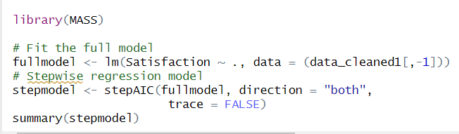
Stepwise regression procedure
stepAIC() which choose the best model by AIC.
It return the best final model.

Slide 14
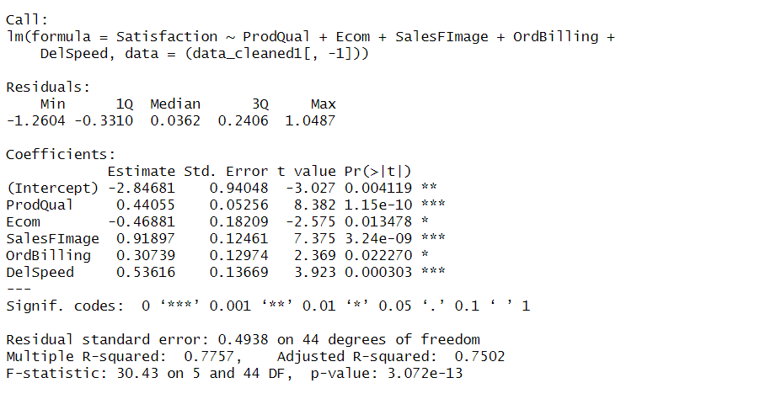
Satisfaction=-2.84681 + 0.44055 * ProdQual -0.46881 *Ecom+0.91897 * SalesFImage+ 0.30739 *OrdBilling +0.53616 * DelSpeed
According to above two methods we received the same model from both models.

Slide 15
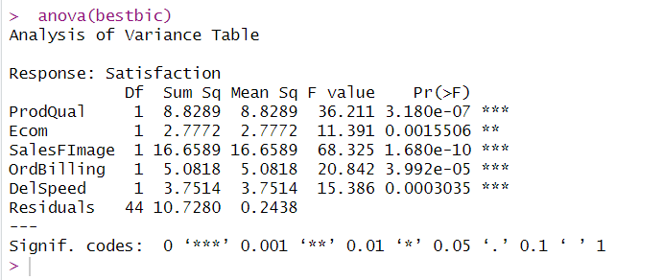
H0: b1=b2=b3=b4=b5=0
Ha: at least one coefficient is not equal to zero
P value of each variables are less than 0.05. therefore, our hypothesis is rejected.
Therefore, the estimated regression model is statistically significant at 5% significance level.

Slide 16
Conclusion
We have taken sample from given subset and using “Best subset selection method” and “Stepwise regression procedure” the following model has been estimated the best linear relationship between customer satisfaction and the different areas.
.
Satisfaction=-2.84681 + 0.44055 * ProdQual -0.46881 *Ecom+0.91897 * SalesFImage+ 0.30739 *OrdBilling +0.53616 * DelSpeed

Slide 17
Thank you
Group members: PS/2019/229
PS/2019/080
PS/2019/278
PS/2019/090
PS/2019/179
PS/2019/059
PS/2019/132

