Slide 1
C
Intermediate
LESSON 1

Slide 2
TABLE OF CONTENTS
01
03
02
04
ARRAY
STRING
MANIPULATION
STRING
LAB

Slide 3

INTRODUCTION
Software Engineer != Programmer
We need to make sure whether this program will work with program design or not and more.
We must satisfy our customer needs.

Slide 4
RULES
Readable code
Appropriate variable name
Type of code

Slide 5
3 THINGS TO LOOK FOR
Speed
Maintenance
Memory
Competitive programming Server Communication
Big project
Working with others
Limited memory of each device

Slide 6
01
ARRAY

Slide 7
What can it do?
Array is use for storing many values with the same type in one variable name.

Slide 8
SYNTAX
Example:
int array[5];
double array [10];
(data type) (arr name)[(size)]

Slide 9
Input Array
scanf(“%d”, &arr[(index)]);
scanf(“%lf”,&arr[(index)]);

Slide 10
Output Array
You cannot display all the value by using one command like Python!
😂
printf(“%d”, arr[(index)]);

Slide 11
Why is it important?
Let’s look at an example question:
Q: Create a program that first ask user how many integers user want to enter then after the user enters all integers then the program must display all value that the user had enter.
Note: Maximum 100 integers

Slide 12
Without Array
Not efficient af
Not dynamic
Bad code
Estimated line: 408 lines
-4.30 %
int val1, val2,...,val100;
int amount;
scanf("%d", &amount);
scanf("%c");
for(int i=0; i<amount; i++){
if(i==0)
scanf("%d", &val1);
else if(i==1)
scanf("%d", &val2);
…
else if(i==99)
scanf("%d", &val100);
}
for(int i=0; i<amount; i++){
if(i==0)
printf("%d", val1);
else if(i==1)
printf("%d", val2);
…
else if(i==99)
printf("%d", val100);
}

Slide 13
With an Array
Very efficient
A little dynamic
Good code
9 Lines of code
int usin;
scanf("%d", &usin);
int arr[usin];
for(int i=0; i < usin; i++){
scanf("%d",&arr[i]);
}
for(int i=0; i < usin; i++){
printf("%d\n",arr[i]);
}

Slide 14

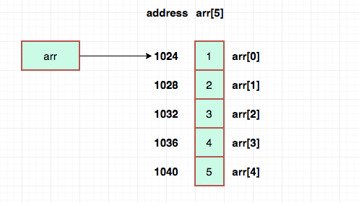
How does it works?

Slide 15

ERROR Cases
Index out of range
Changing the size of array
Type does not match

Slide 16
02
STRING

Slide 17
What is it?
A char array, that’s it XD

Slide 18
SYNTAX
Example:
char str[5] = “Hello”;
char str[] = “Kris”;
char *str = “Test”;
char (string name)[(size)];
char *(string name);

Slide 19
Input String
scanf(“%s”, str);
gets(str);

Slide 20
Output String
printf(“%s”, str);
puts(str);

Slide 21
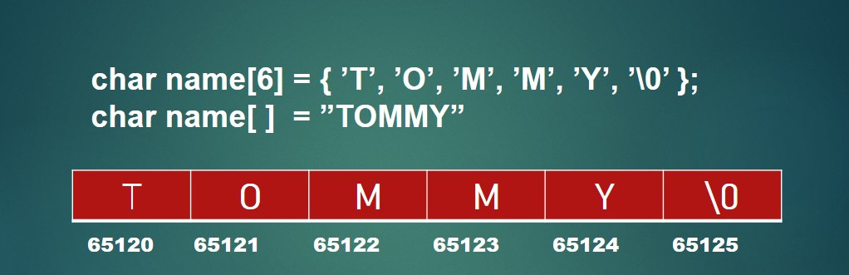
How does it works?

Slide 22
ERROR Cases
Most of the errors you can get from a normal array
Use ‘ ‘ for string will cause error
Use “ “ for char will cause error
Forget about ‘\0’

Slide 23
03
STRING
MANIPULATION

Slide 24
LIBRARY
string.h
#include <string.h>

Slide 25
COMMANDS
strlen() - computes string's length
strcpy() - copies a string to another
strcat() - joins two strings
strcmp() - compares two strings

Slide 26
Example
strcmp == 0: same string
strcmp == 1: if dest has more string than source
strcmp == -1: if dest has lesser string than source
#include <stdio.h>
#include <string.h>
#define BUFSIZE 300
int main()
{
char str[BUFSIZE] , temp[BUFSIZE];
scanf("%s", str);
printf("%d ", strcmp(str,temp));
strcpy(temp,str);
printf("%d ", strcmp(str,temp));
strcat(temp, " World");
printf("%d ", strcmp(str,temp));
}
Input:
Hello
Output:
1 0 -1

Slide 27
04
LAB

Slide 28


