Slide 1
Python Intermediate

Slide 2

What topics are we going to look into?
Lists
Tuples
Sets
Dictionaries
Exception Handling
Recursion

Slide 3
1st Topic
List

Slide 4

Lists
Lists are dynamic sized arrays. A single list can contain datatypes like Integers, Strings, Objects.

Slide 5
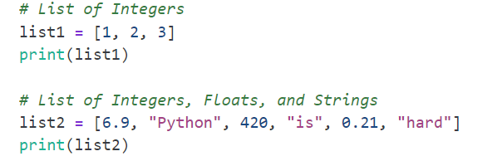


Creating a List

Slide 6
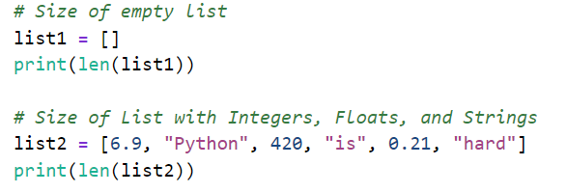

The size of the list

Slide 7
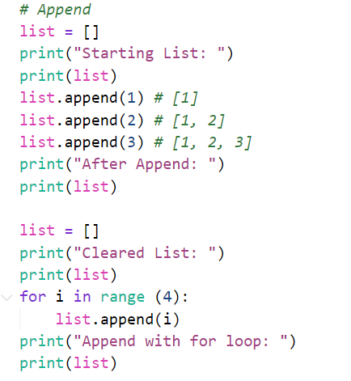
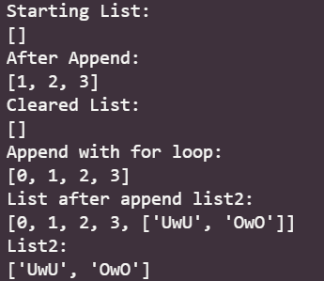
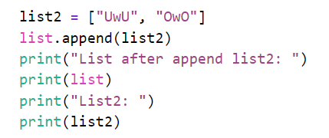
Adding element to a list

Slide 8
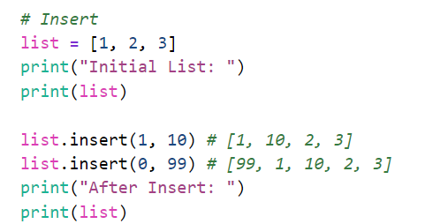
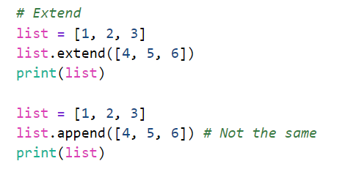
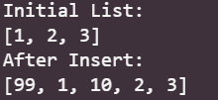


Slide 9
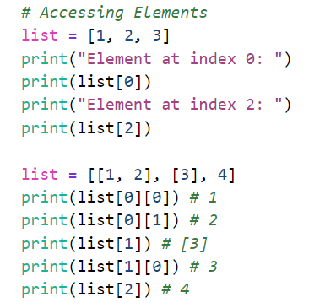
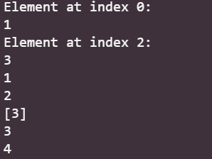
Access to an element in the list

Slide 10
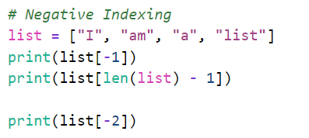

Negative Indexing

Slide 11
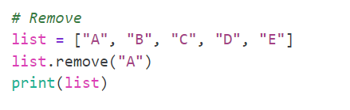
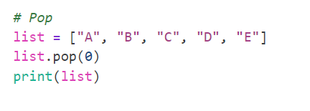
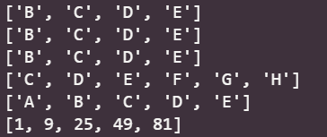
Removing element from a list

Slide 12
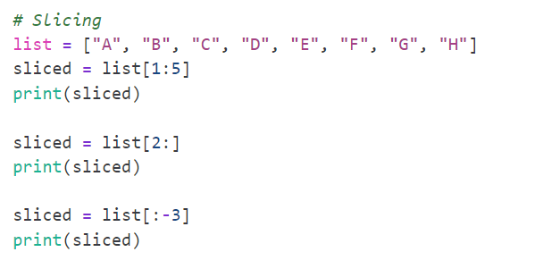


Slicing a list

Slide 13
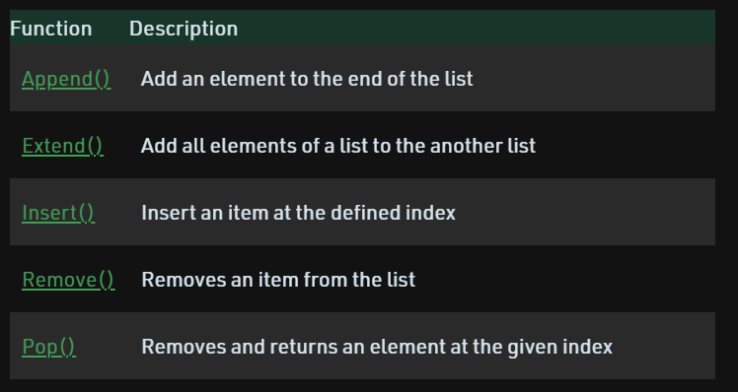
List Methods

Slide 14
2nd Topic
Tuple

Slide 15
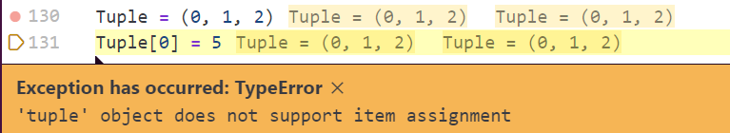

Tuple
Tuple is similar to a list. It can store any data type but it can’t be mutated - the elements inside can’t be changed,

Slide 16
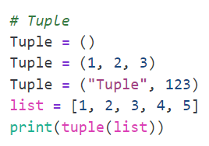

Creating a Tuple

Slide 17

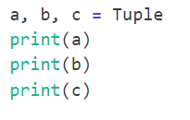

Accessing Tuple

Slide 18
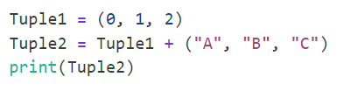
Concatenation of Tuples

Slide 19
3rd Topic
Sets

Slide 20


Set
Sets are an unordered and unindexed collection of data type that are iterable, mutable and have no duplicate elements.
No duplicate (If Integers will order in ascending)
Unordered

Slide 21
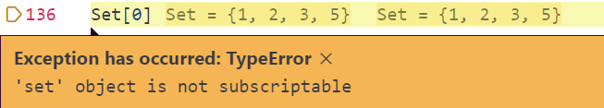


Unindexed
Iterable

Slide 22
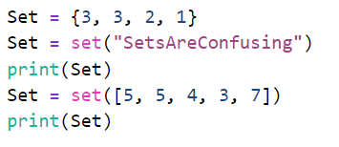
Creating a set

Slide 23
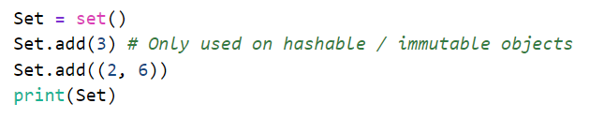


Adding element to a set

Slide 24
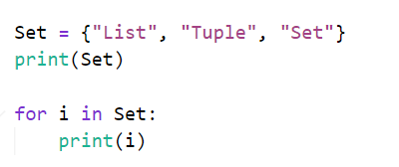
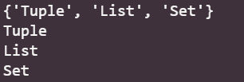

Accessing a set

Slide 25
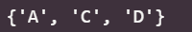

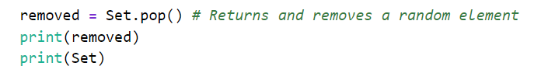


Removing elements from a set

Slide 26
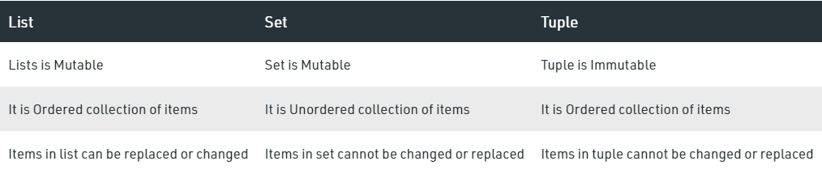
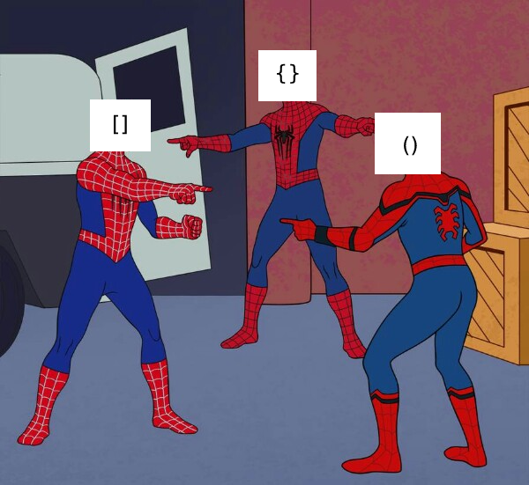
Differences between lists, tuples and sets

Slide 27
4th Topic
Dictionaries

Slide 28
Dictionary
Dictionary is an ordered collection of data values, used to store data values like a map. Unlike other Data Types that hold only a single value as an element, Dictionary holds key:value pair.

Slide 29
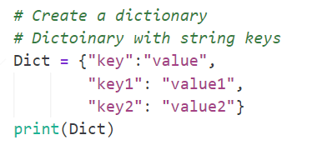
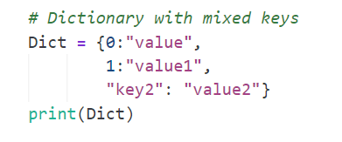
Creating a Dictionary

Slide 30
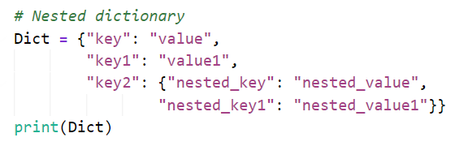

Slide 31
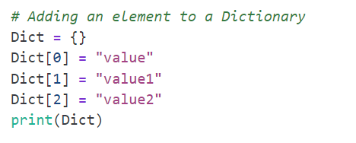
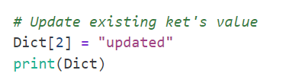

Adding element to a Dictionary

Slide 32
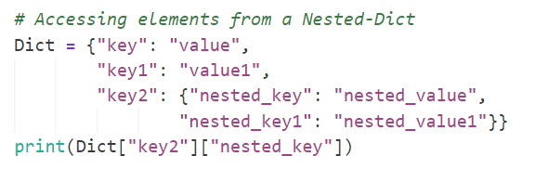
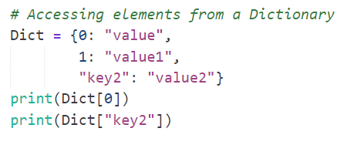


Accessing a Dictionary

Slide 33
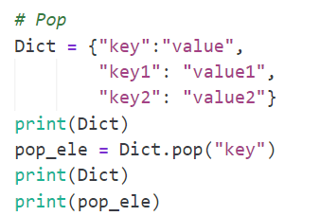
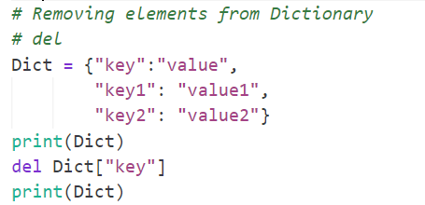


Removing elements from a Dictionary

Slide 34
5th Topic
Exception Handling

Slide 35
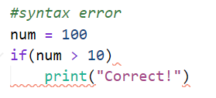
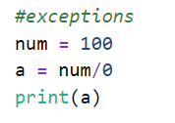
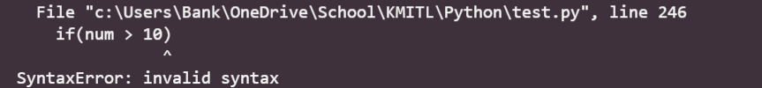
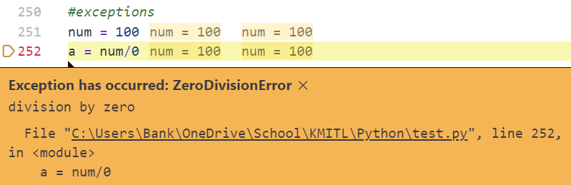
The difference between Syntax Error and Exceptions

Slide 36
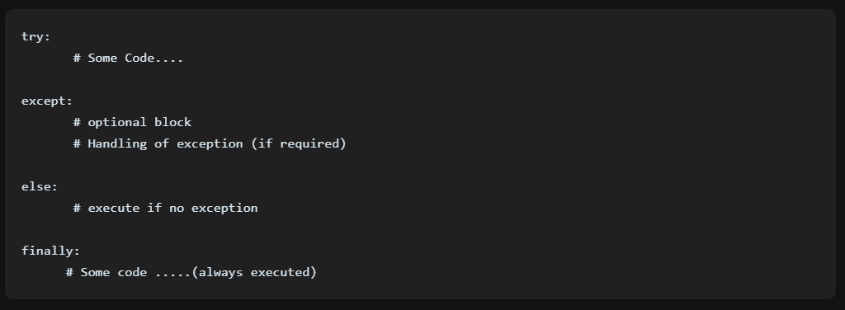

Slide 37
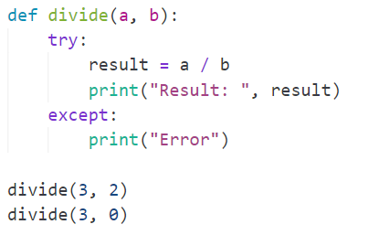

Except all

Slide 38

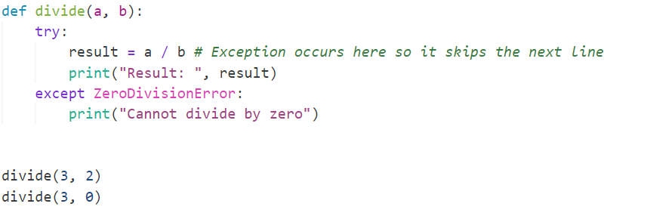
Except specific error

Slide 39
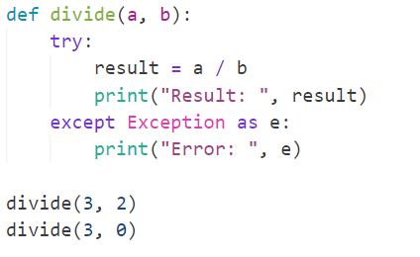

Find exception

Slide 40
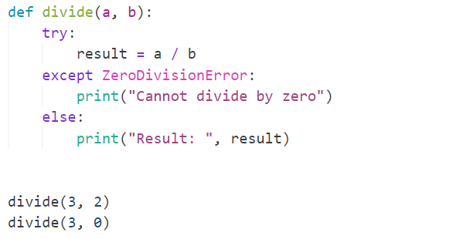

Else

Slide 41
6th Topic
Recursion

Slide 42
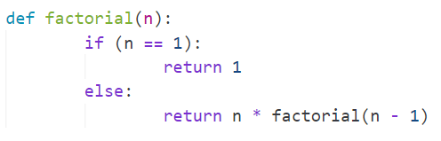
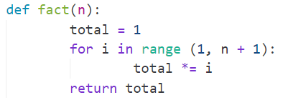
function(n) | Operation | Return value
factorial(5) | 5 * factorial(4) | 5 * 24 = 120
factorial(4) | 4 * factorial(3) | 4 * 6 = 24
factorial(3) | 3 * factorial(2) | 3 * 2 = 6
factorial(2) | 2 * factorial(1) | 2 * 1 = 2
factorial(1) | 1 * factorial(0) | 1 * 1 = 1
factorial(0) | 1 | 1

Slide 43
