Slide 1
Data Analysis
Using Pandas
Dulce Ambrocio

Slide 2


Slide 3
Agenda
Cheat Sheet
Data Frame’s Anatomy
Basics
Indexing
Missing data
Groupby

Slide 4
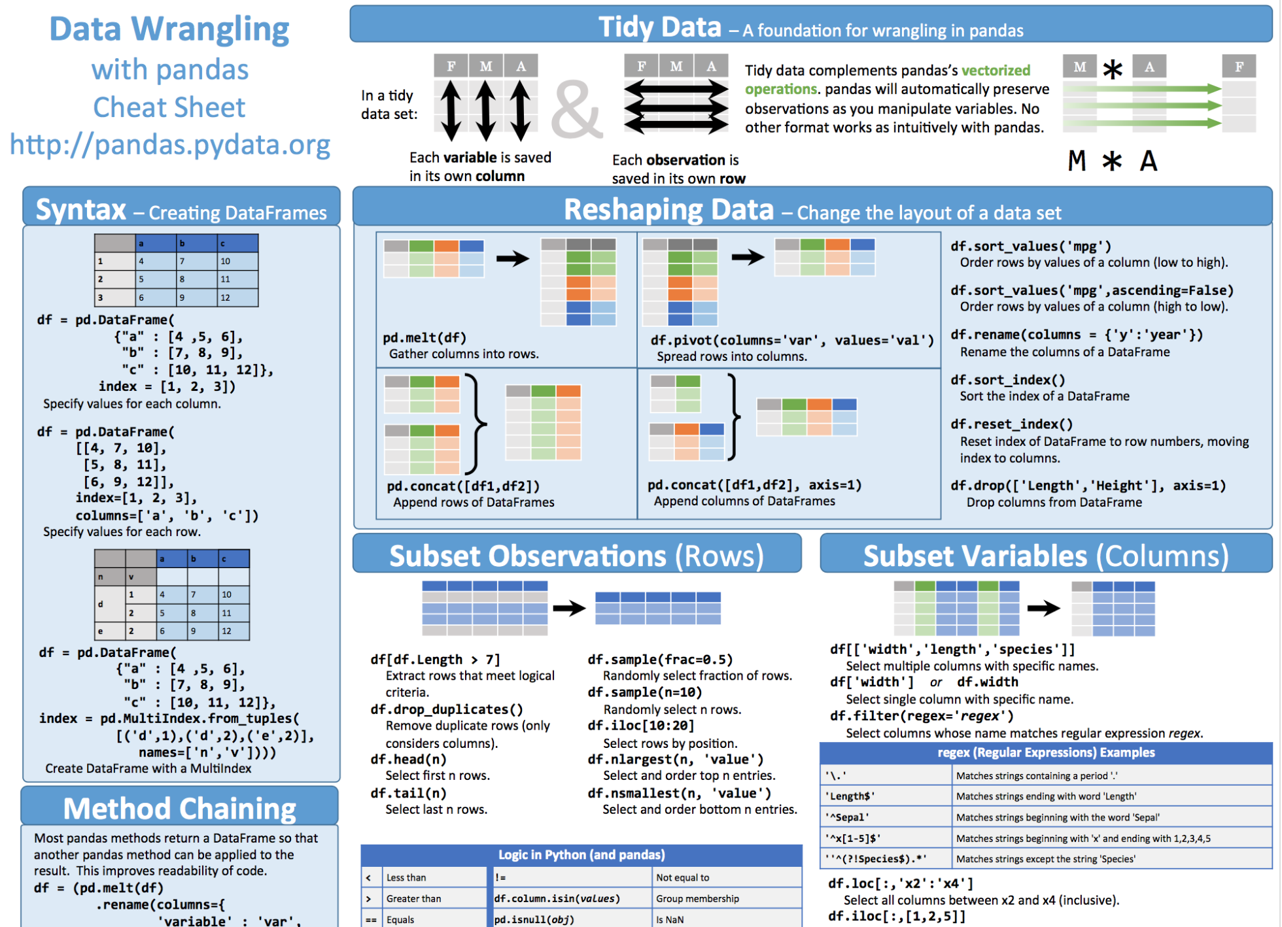
Pandas Cheat Sheet
https://github.com/pandas-dev/pandas/blob/master/doc/cheatsheet/Pandas_Cheat_Sheet.pdf

Slide 5
Reading Data
Reading from many data sources:
>>> pandas.read_csv
>>> pandas_read_excel
>>> pandas_read_html
>>> pandas_read_json
>>> pandas_read_hdf
>>> pandas_read_sql

Slide 6
Dataframe
A dataframe is made up od data, row labels and column labels.
column labels
 | Column_1 | Column_2 | Column_3
a
b
c
2D
row labels
data

Slide 7
Basics
Row labels
>>> df.index
Column labels
>>> df.columns
Dtypes
>>> df.dtypes
Head
>>> df.head(10)

Slide 8
Indexing
There are many ways you want to specify which subset you want to select:
Like list, you can index by integer position
Like dictionaries, you can index by label
Like NumPy array, you can index by boolean mask
Column
Row

Slide 9
Indexing
Select columns of a Dataframe:
>>> df[[‘column_1’,’column_2’]]
Use .loc for label-based indexing (rows and columns)
>>> df.loc[row_labels,column_labels]
Use .iloc for positions-based indexing (rows and columns)
>>> df.loc[row_positions,column_positions]

Slide 10
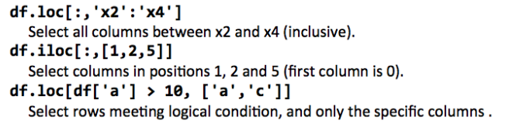
Indexing

Slide 11
Indexing
>>> df.loc[row_indexer,column_indexer]
>>> df.iloc[row_indexer,column_indexer]
An indexer can be:
An scalar or array (of labels or integer positions)
A slice object (: for everything)
A boolean mask
The column indexer is optional

Slide 12
Boolean indexing
Boolean indexers are useful because so many operations can produce an array of booleans.
null checks (.isnull, .notnull)
container checks (.isin)
boolean aggregations (.any, .all)
comparisions (.gt, .lt, etc.)

Slide 13
Handling Missing data
Detecting missing data
Dropping missing data
Filling missing data

Slide 14
Handling Missing data
Detecting missing data
>>> df.isnull()
>>> df.notnull()
>>> df.notnull().head()
>>> other_df = df.notnull()
>>> other_df = df.columnlabel.notnull()

Slide 15
Handling Missing data
Dropping missing data
>>> df.dropna()
>>> df.dropna(axis='index', how='any')
axis:
column
index
how
any
all
Filling missing data

Slide 16
Handling Missing data
Filling missing data
>>> df.fillna(‘fill_with_this’)
>>> df.columnlabel.fillna(‘fill_with_this’)

Slide 17
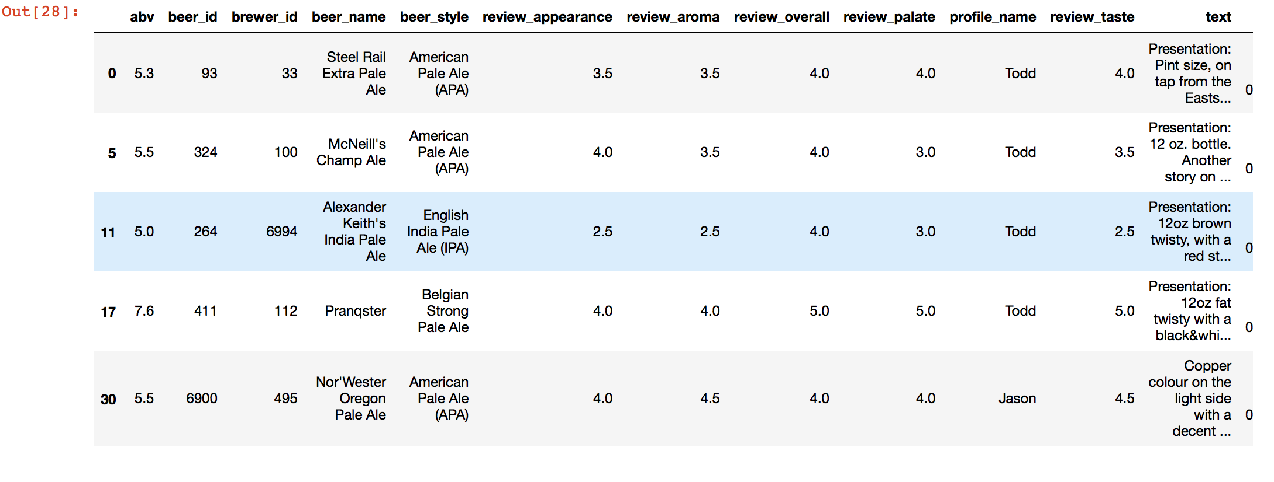
Groupby

Slide 18
Groupby
Components of a groupby:
Split a table into groups
Apply a function to each group
Combine the results into a single Dataframe
>>> df.groupby(grouper)

Slide 19
Groupby: Split
Groupers
>>> df.groupby(grouper)
String indicating a column in your dataframe
>>> df.groupby("beer_name")
Function to be applied on the index
>>> df.groupby(df.review_taste>2.0)

Slide 20
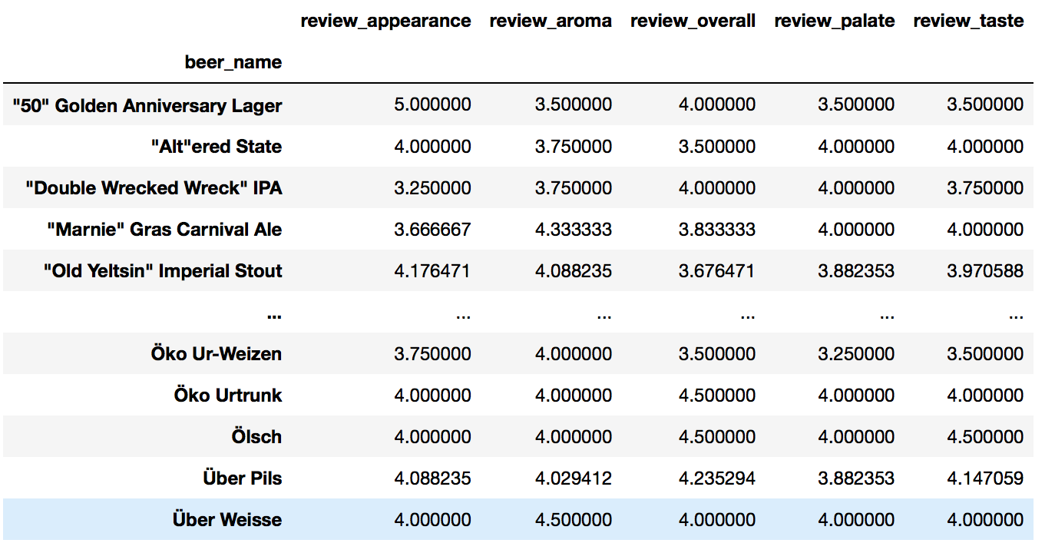
Groupby: Apply & Combine
>>> review_cols = ['review_appearance', 'review_aroma', 'review_overall', 'review_palate', 'review_taste']
>>> df.groupby('beer_name')[review_cols].agg('mean')

Slide 21
Thank you!

