Slide 1
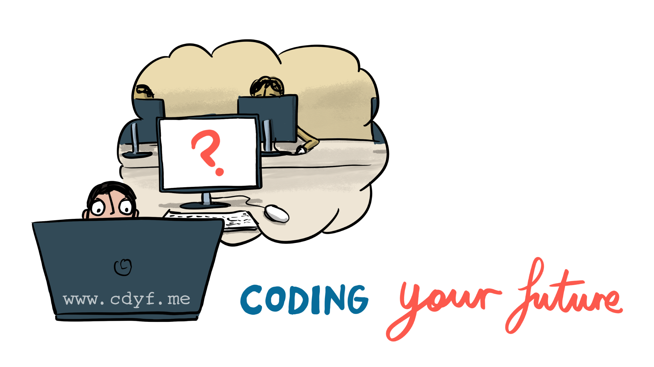

Slide 2
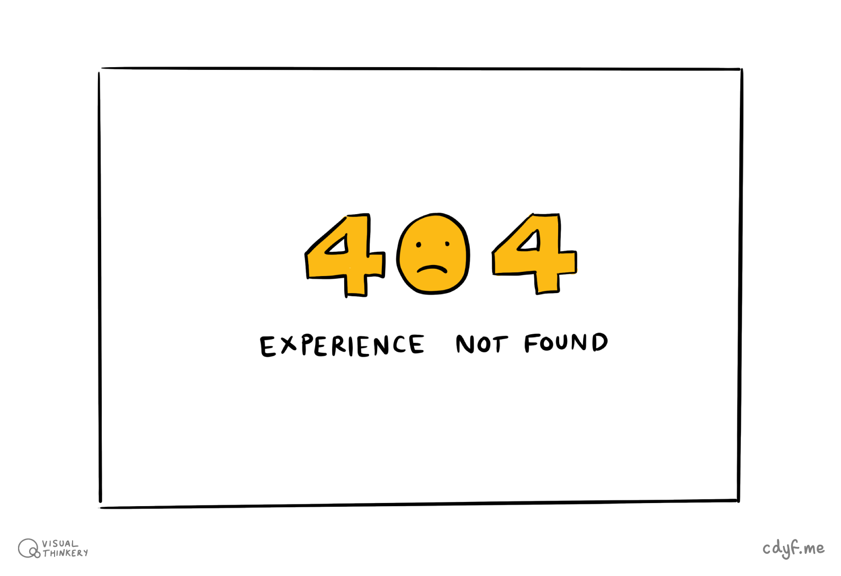

Slide 3
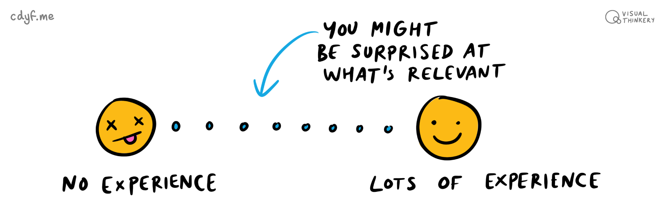
See chapter 5 of Coding your Future: www.cdyf.me/experiencing.html

Slide 4
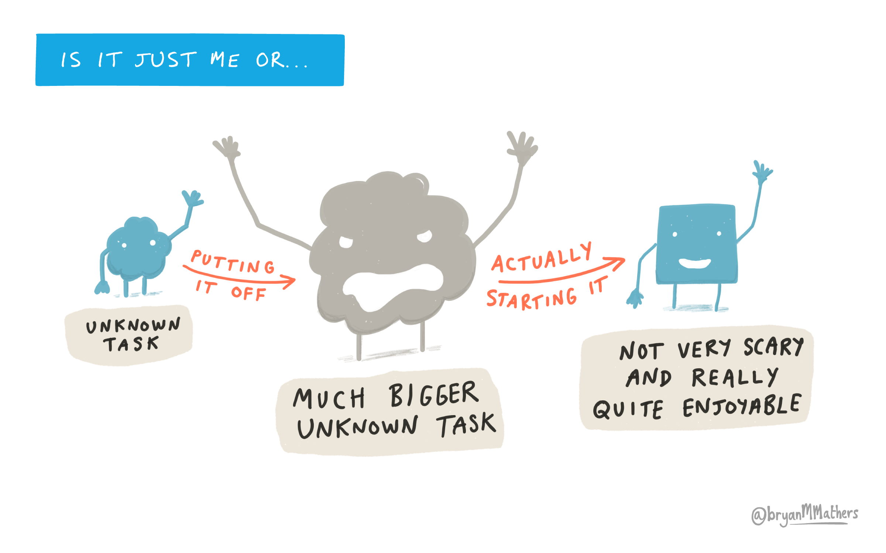

Slide 5
Mondays at midday: COMP2CARS / COMP2TUT
See schedule at www.cdyf.me/scheduling.html
Week 0: Experiencing your future
Week 1 & 2: Debugging your future (CV) etc
Week 3: Finding your future (MECD)
Week 4: See schedule

