Slide 1

Smile2Unlock
一个基于人脸检测的windows登录程序

Slide 2
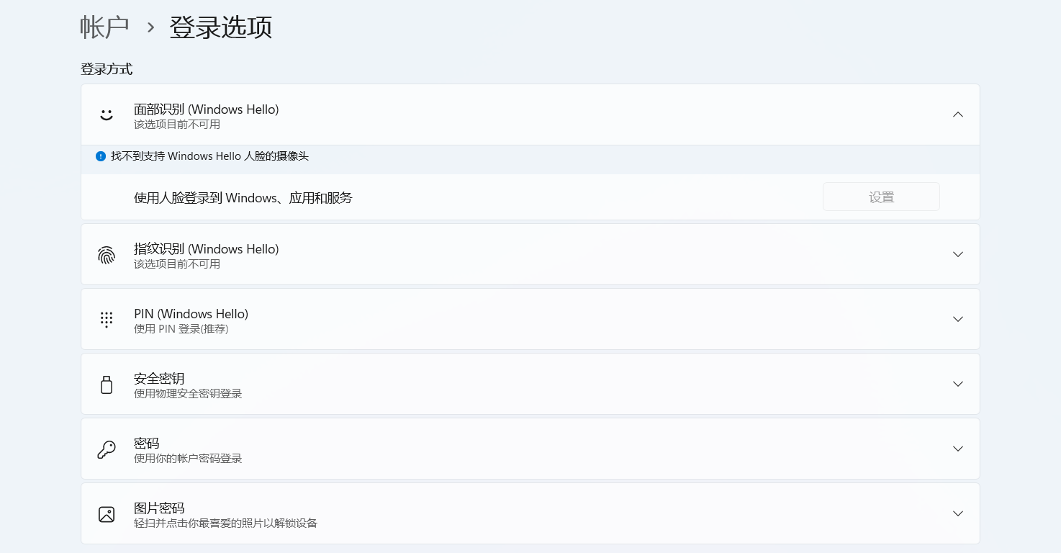
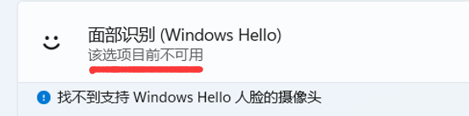

Slide 3
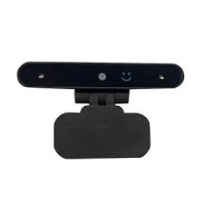
普通摄像头 + 景深

Slide 4
代替“景深”
人脸识别
活体检测
好用安全
Smile2Unlock

Slide 5
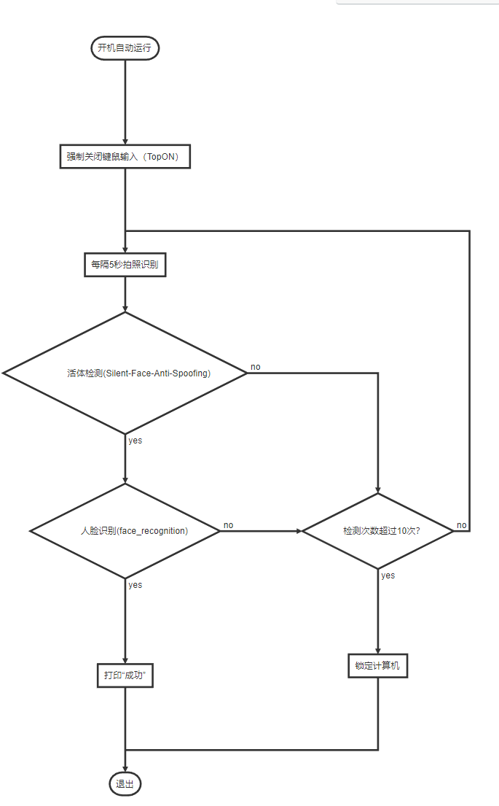
活体检测
（Silent-Face-Anti-Spoofing）
人脸识别（face_recognition）

Slide 6
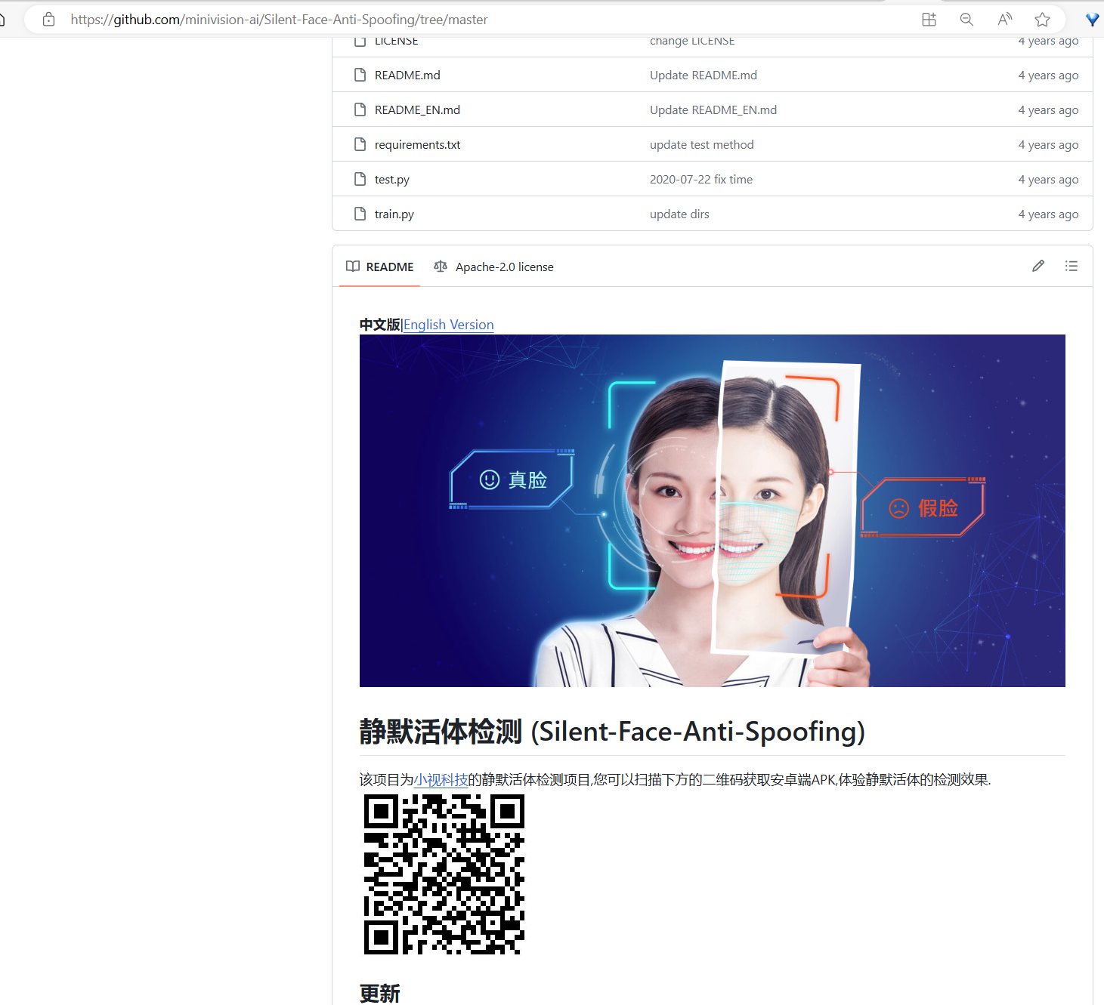
https://github.com/minivision-ai/Silent-Face-Anti-Spoofing/

Slide 7
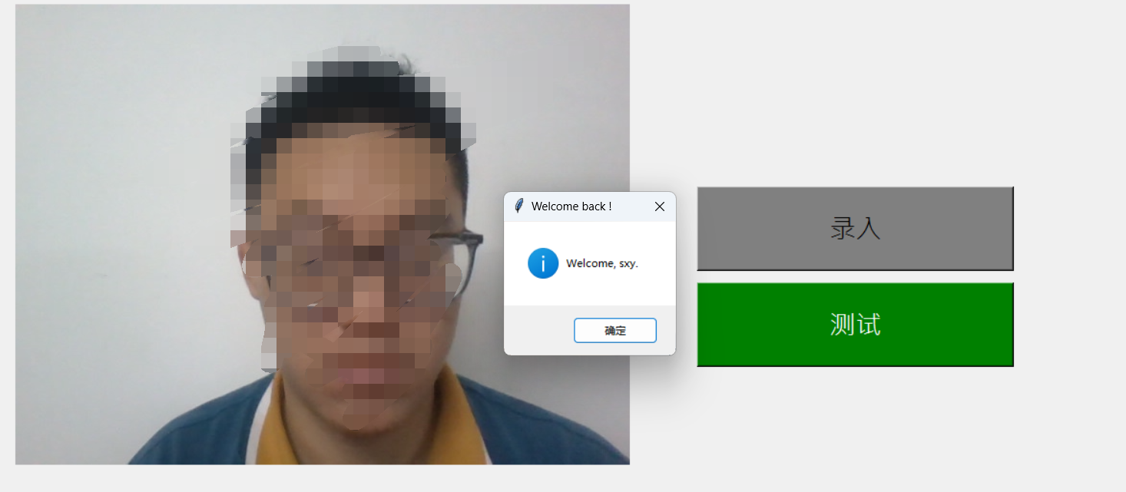
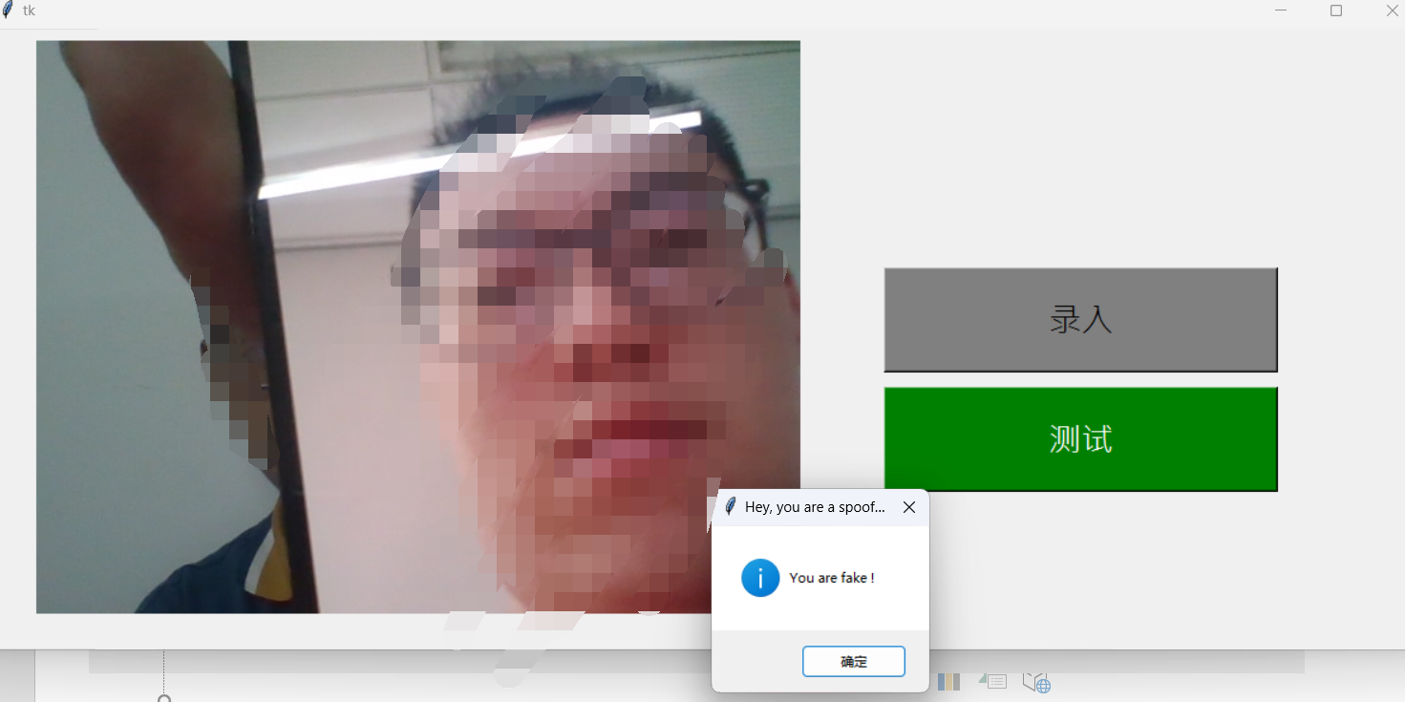
真实人脸：
成功检测
手机相册：
检测出欺骗

Slide 8
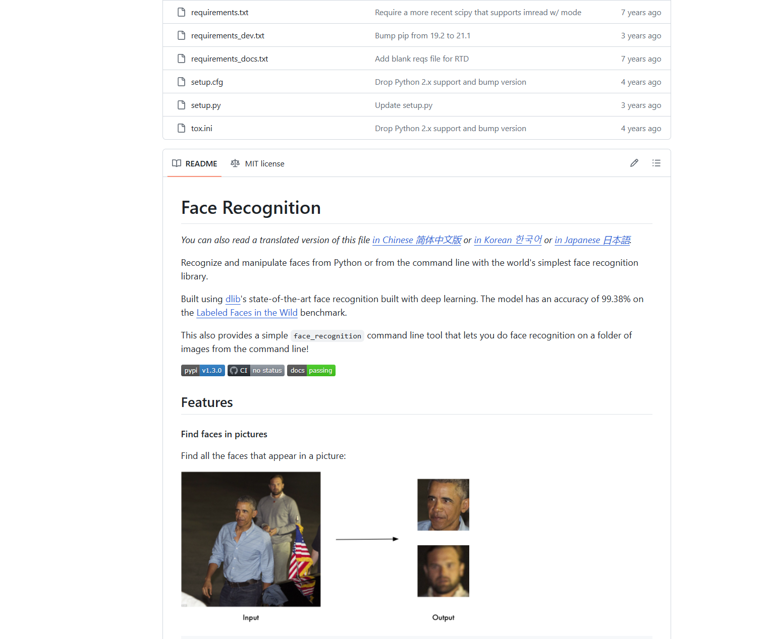
https://github.com/ageitgey/face_recognition/

Slide 9
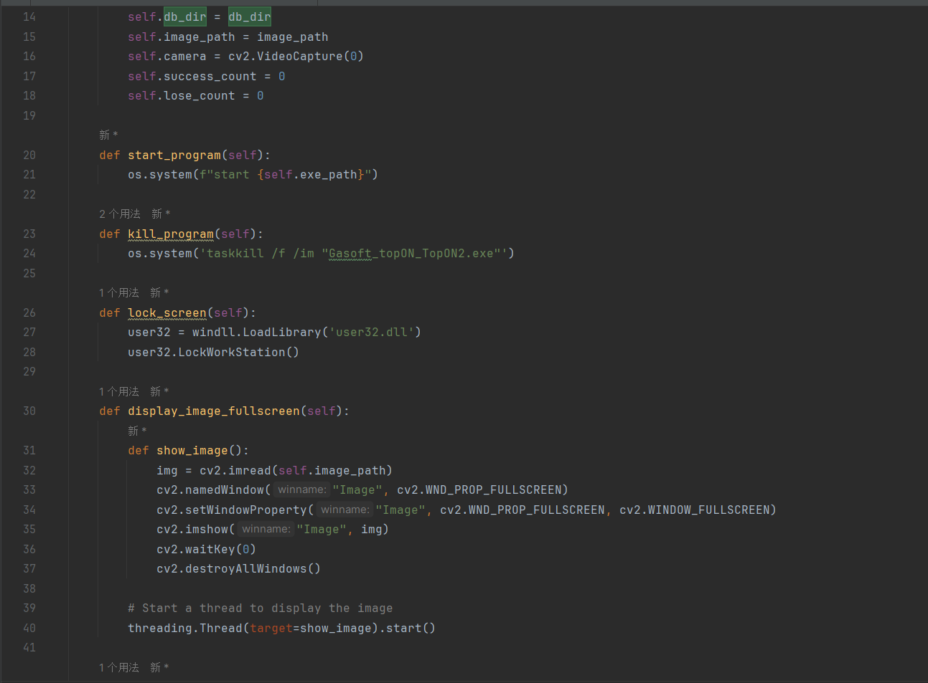
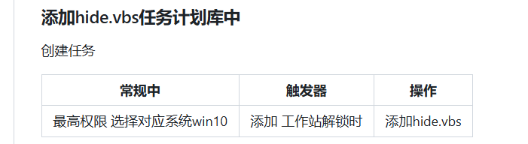

Slide 10
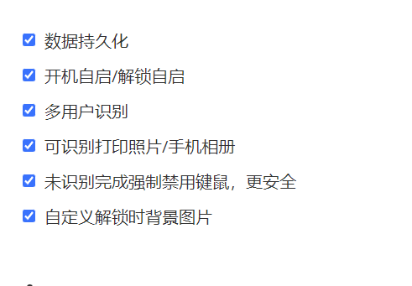

Slide 11
仓库：https://github.com/sxy-1/Smile2Unlock
参考：
https://github.com/Yiqingde/Lock-Unlock-Laptop-PC-Screen-Using-Face-Recognition-Opencv-Tensorflow
saksham-jain/Lock-Unlock-Laptop-PC-Screen-Using-Face-Recognition (github.com)
computervisioneng/face-attendance-system (github.com)
minivision-ai/Silent-Face-Anti-Spoofing: 静默活体检测（Silent-Face-Anti-Spoofing） (github.com)

