Slide 1
Vibration and Oscillaton
Physics 202 Lecture 1

Slide 2

Physical systems will vibrate near and around points of equilibrium
Equilibrium
Displacement
Vibration
Notes:
http://en.wikipedia.org/wiki/Simple_Harmonic_Oscillator

Slide 3
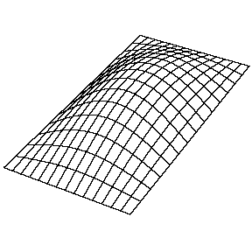
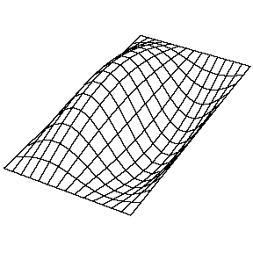
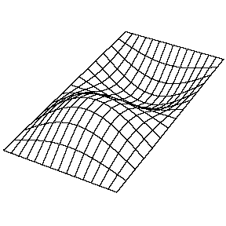
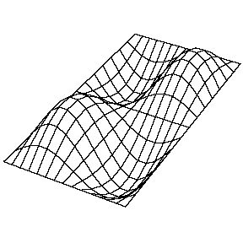
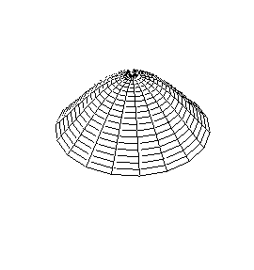
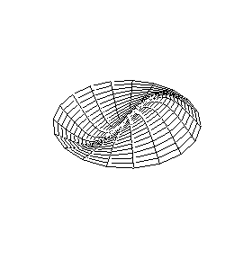
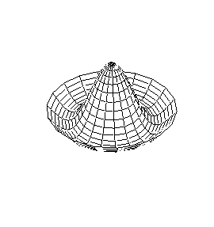
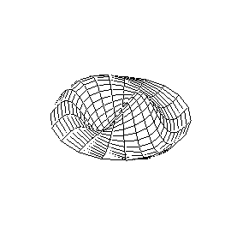
Vibration in multiple dimensions is complicated and depends on boundaries
(1,1) mode
(2,1) mode
(1,2) mode
(2,2) mode
(0,1) mode
0 nodal diameters
1 circular node
(1,1) mode
1 nodal diameter
1 circular node
(0,2) mode
0 nodal diameters
2 circular nodes
(1,2) mode
1 nodal diameter
2 circular nodes
http://www.kettering.edu/~drussell/demos.html
Notes:
http://www.kettering.edu/~drussell/demos.html

Slide 4
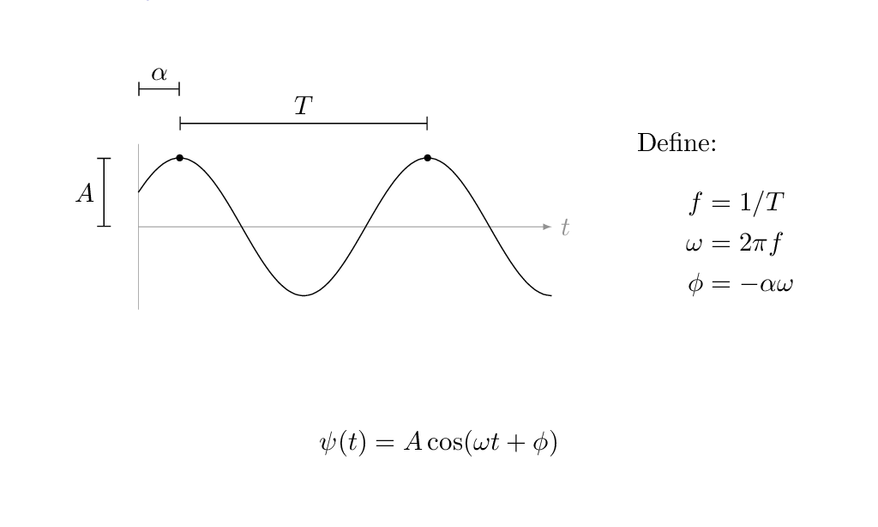
Simple harmonic motion is the motion of vibration with a specific mathematical form

Slide 5
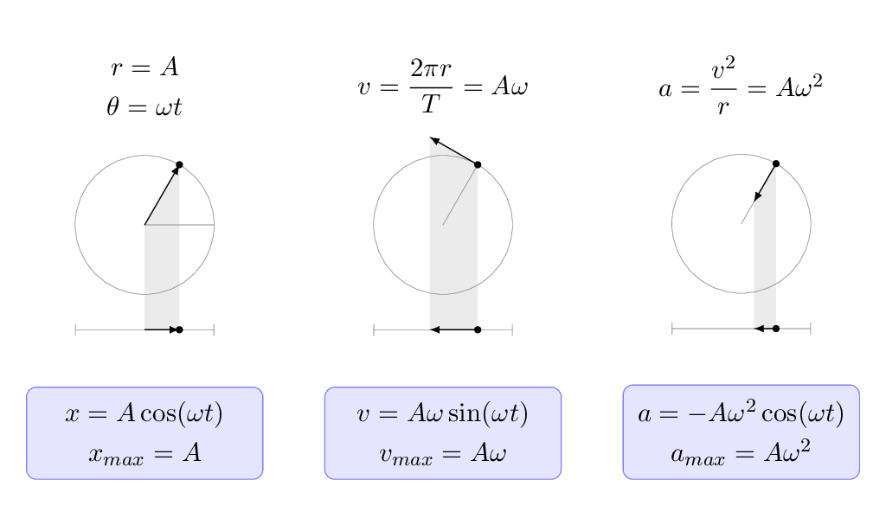
A fortunate fluke: the projection of uniform circular motion is simple harmonic motion

Slide 6
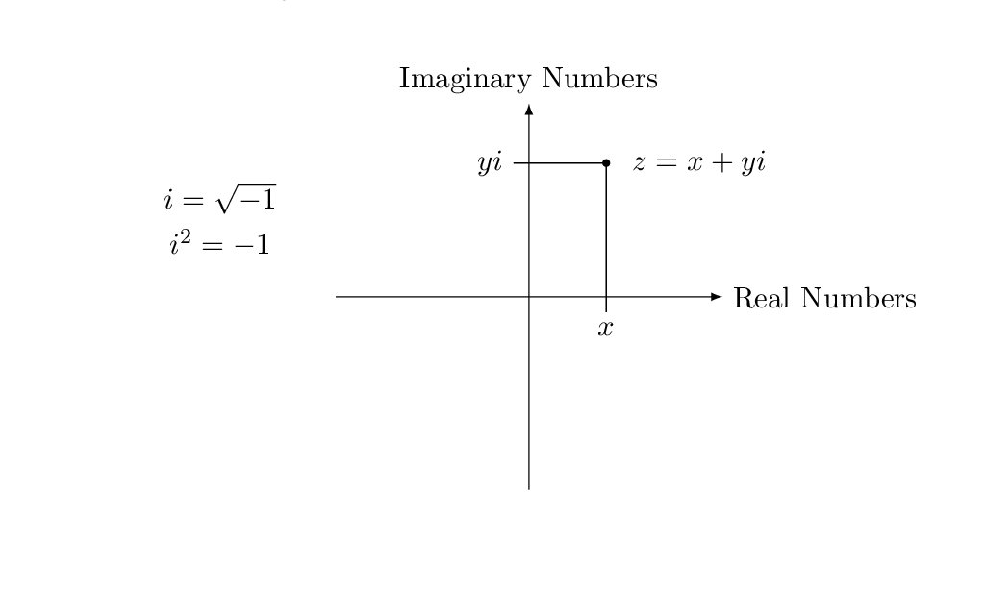
We can use complex numbers to model vibrations – they are called “phasors”

Slide 7
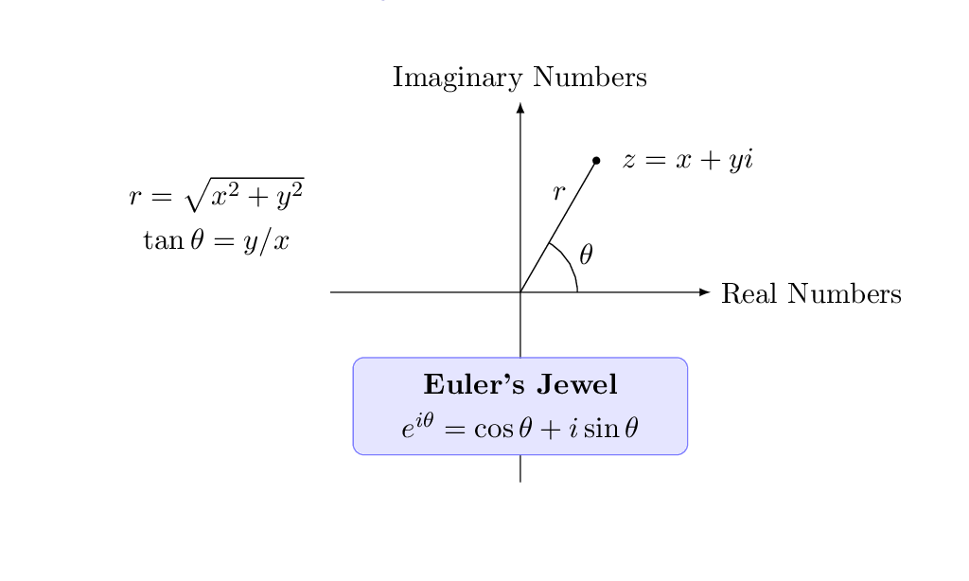
The reason we can get away with using complex numbers is in Euler's jewel

Slide 8
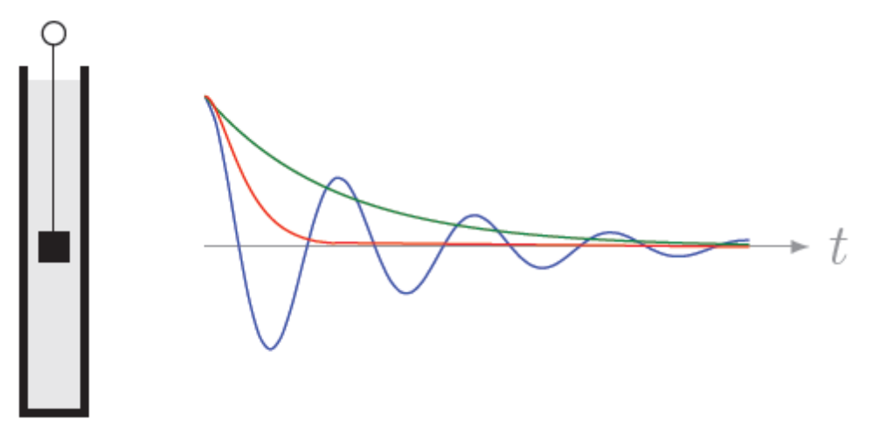



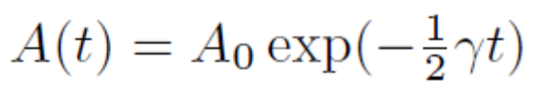


An oscillation is said to be “damped” when energy is drained from the system

Slide 9

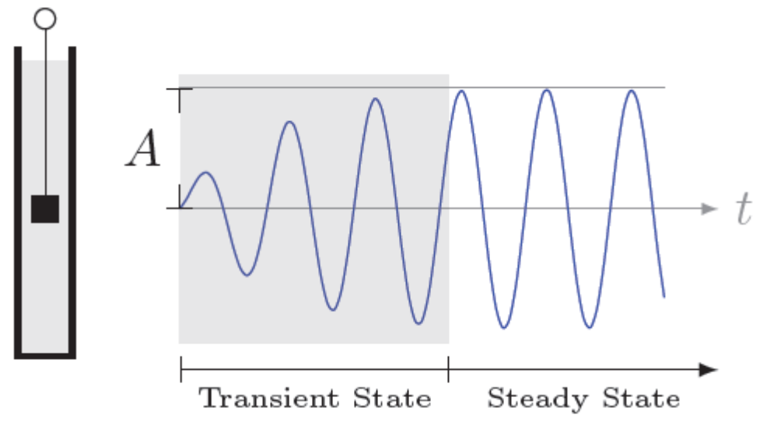
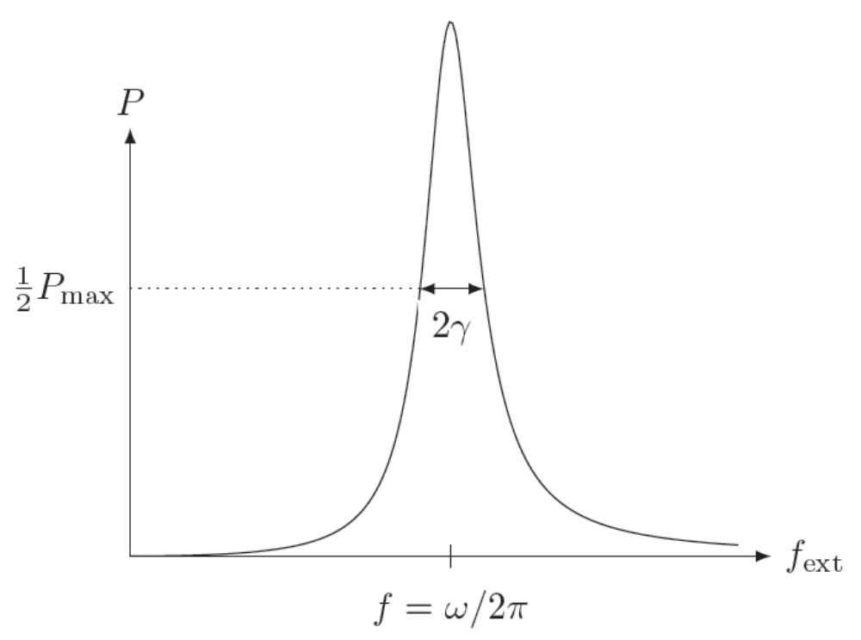
If energy is put into the system it is “driven”; some driving frequencies create resonance

