Slide 1
Elasticity
Physics 202 Lecture 2

Slide 2



The three phases of matter are characterized by how they respond to external force
Notes:
http://en.wikipedia.org/wiki/Kilogram
http://en.wikipedia.org/wiki/Liquid
http://www.popularmechanics.com/science/space/13-most-important-numbers-in-the-universe-ideal-gas-constant

Slide 3
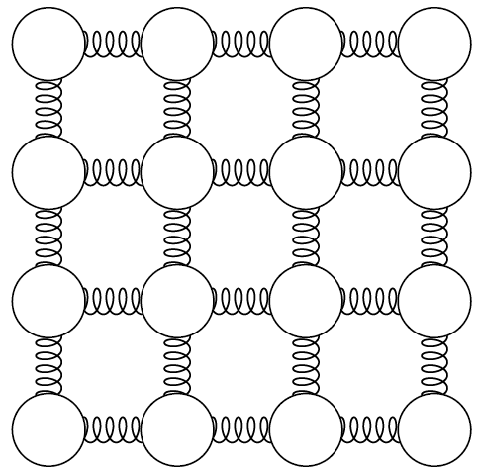
As solids deform, they “push back” – this elasticity is often shown with springs

Slide 4
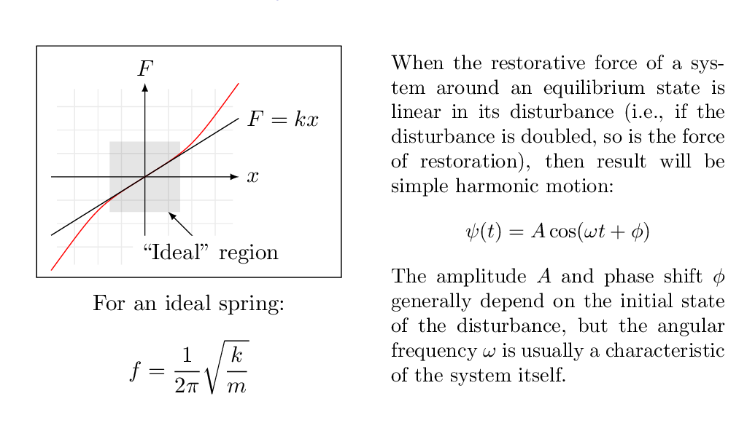

An ideal spring is the simplest elastic system and is defined by Hooke’s Law

Slide 5
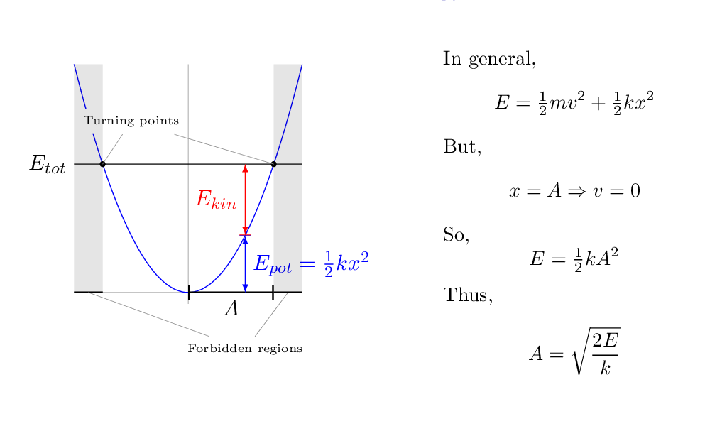
Energy in an ideal spring is parabolic; the amplitude is tied to the total energy

Slide 6
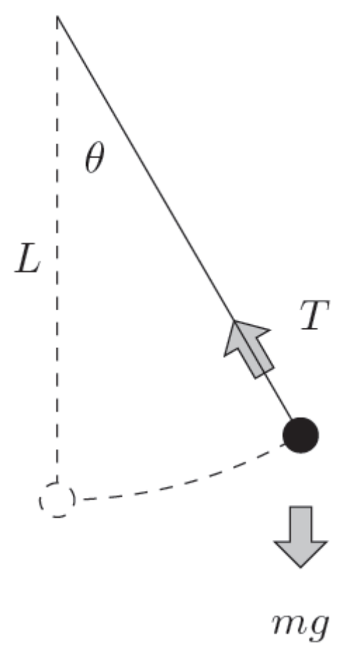


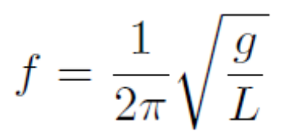
The forces need not be perfectly linear to apply these concepts: e.g., the pendulum

Slide 7
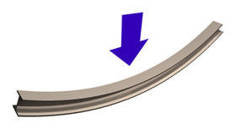
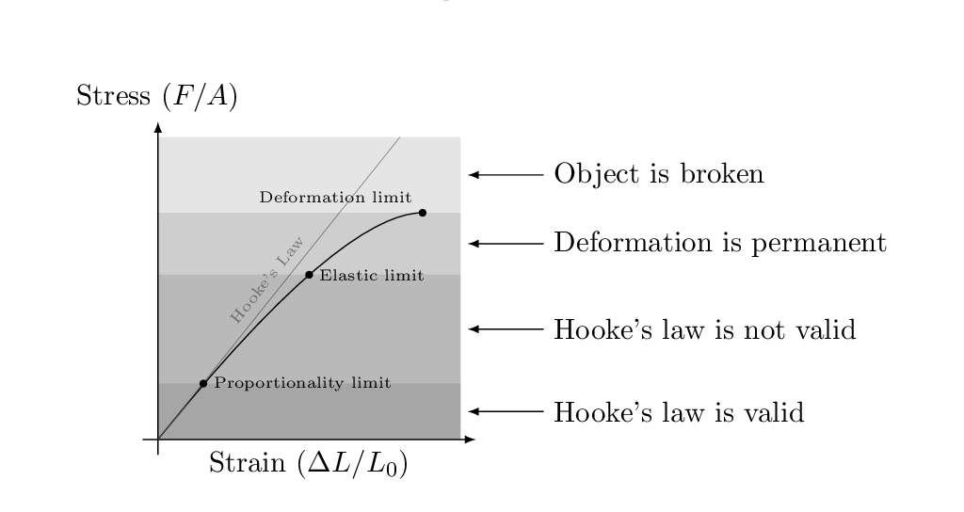
The deformation that results from small stress is linear (Hooke’s law again)
Notes:
http://en.wikipedia.org/wiki/Bending

Slide 8
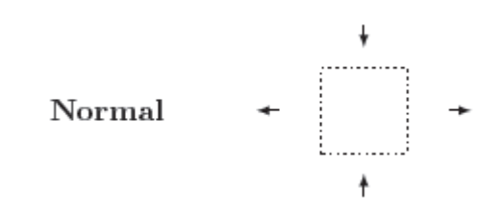

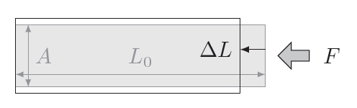
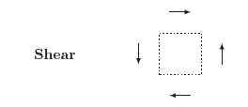

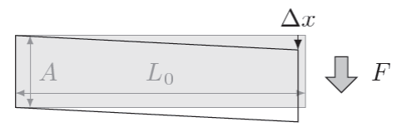
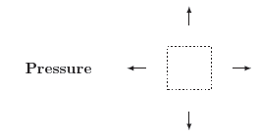
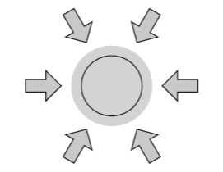

Stress is from multiple forces on an object – can be classified as three basic types
Normal
Shear
Pressure

Slide 9
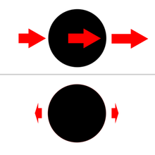
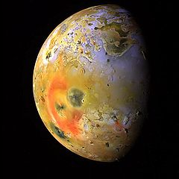
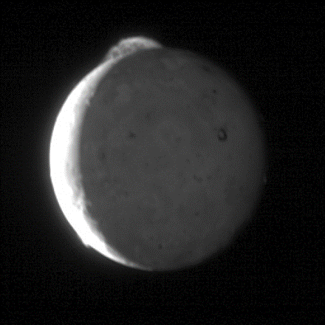
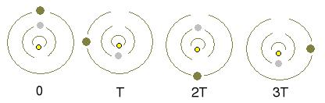

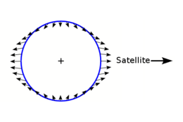
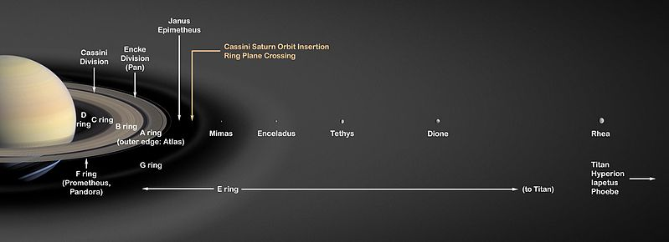
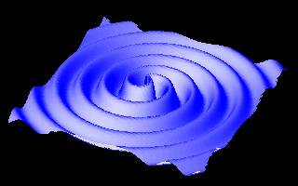
Newton’s law of gravity creates stress on an astronomic scale: tides and gravity waves
Ganymede, Europa and Io
Notes:
http://en.wikipedia.org/wiki/Tidal_bulge
http://en.wikipedia.org/wiki/File:Wavy.gif
http://en.wikipedia.org/wiki/File:Tvashtarvideo.gif
http://en.wikipedia.org/wiki/File:PIA01667-Io%27s_Pele_Hemisphere_After_Pillan_Changes.jpg
http://en.wikipedia.org/wiki/File:TheLaplaceResonance2.png
http://upload.wikimedia.org/wikipedia/commons/thumb/0/0e/Enceladus_geysers.jpg/320px-Enceladus_geysers.jpg
http://en.wikipedia.org/wiki/File:Saturn%27s_Rings_PIA03550.jpg

