Slide 1
Fluids
Physics 202 Lecture 3

Slide 2
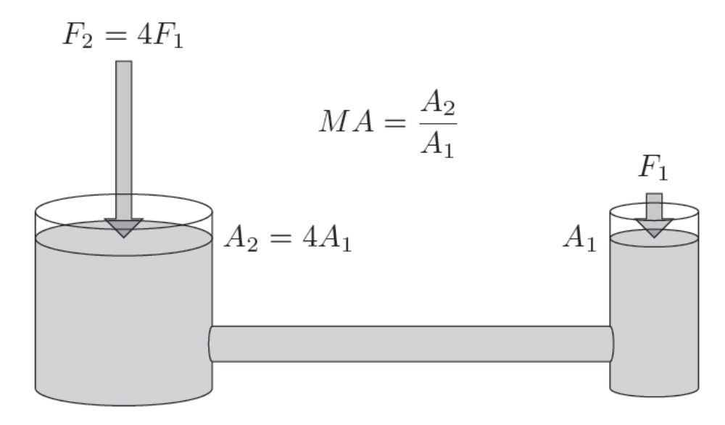
Pascal’s principle: any pressure change will flow through the entire fluid equally

Slide 3
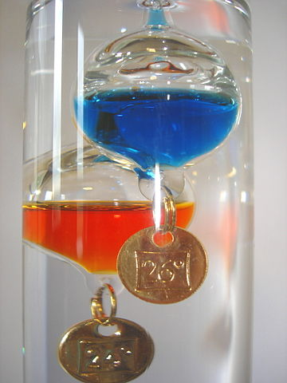
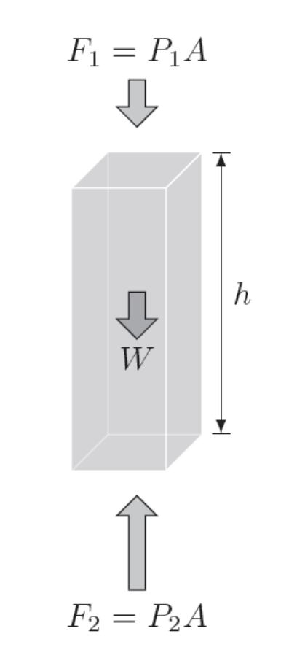


Archimedes’ principle: vertical pressure differentials provides the force of buoyancy
Notes:
http://en.wikipedia.org/wiki/Galileo_thermometer

Slide 4
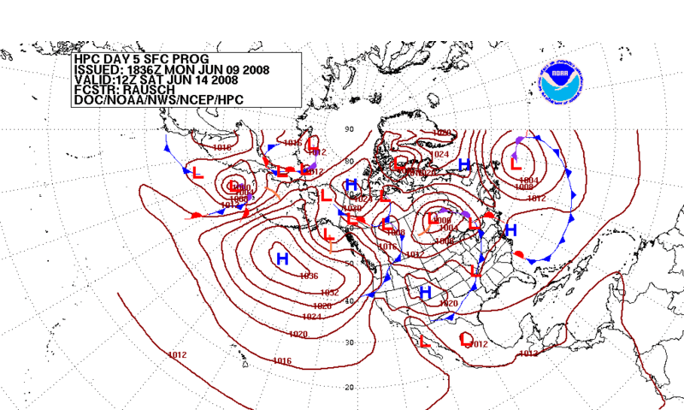
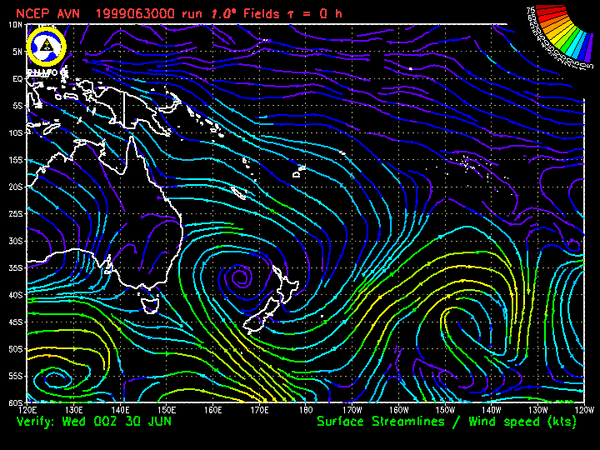
Pressure differentials cause flow; steady flow moves along streamlines of current
Notes:
http://en.wikipedia.org/wiki/Weather_forecasting
http://wx.gmu.edu/dev/clim301/AF-Trainee.pdf

Slide 5
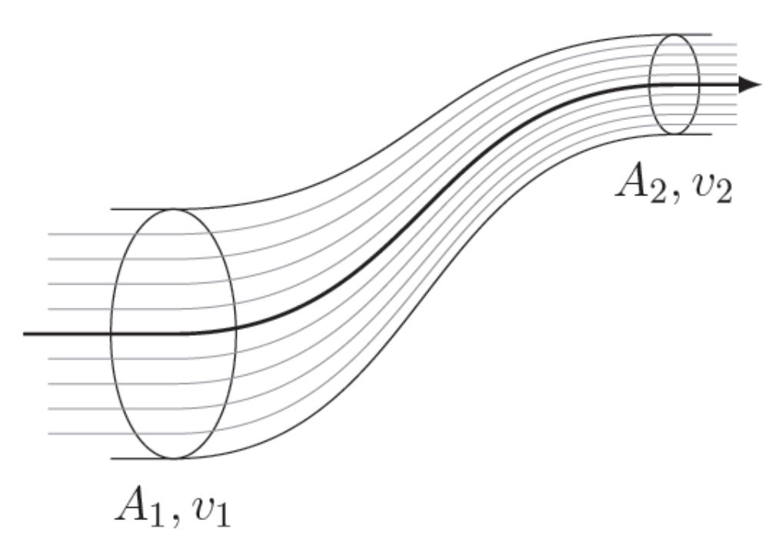



The steady flow of an ideal fluid is both incompressible and non-viscous

Slide 6
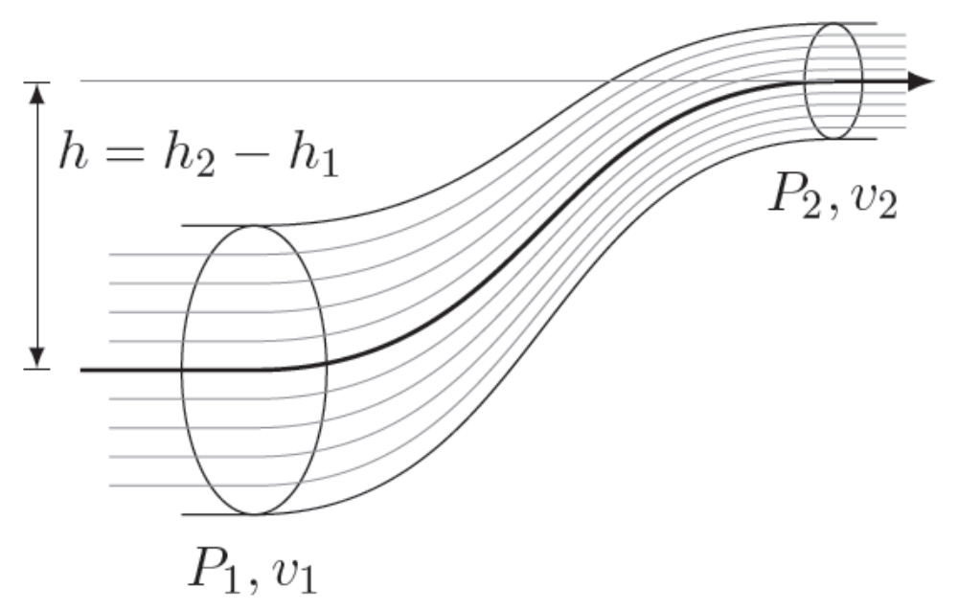

Bernoulli's equation describes the pressure differentials in a ideal fluid that is flowing

Slide 7
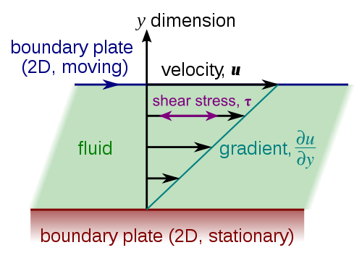




Viscosity is fluid friction; leads to air drag and requires extra pressure for flow
Notes:
http://en.wikipedia.org/wiki/Viscosity

Slide 8
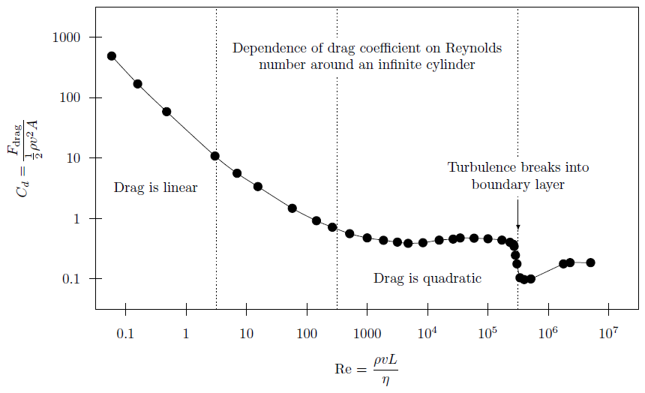
Turbulence driven by speed and size of the object, viscosity and density of the fluid
Notes:
Data from http://www.ma.iup.edu/projects/CalcDEMma/drag/drag7.html

Slide 9
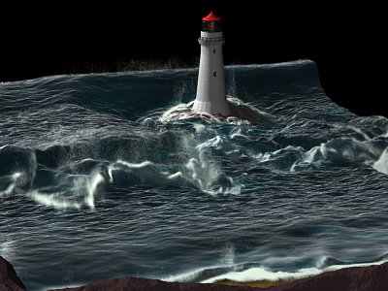
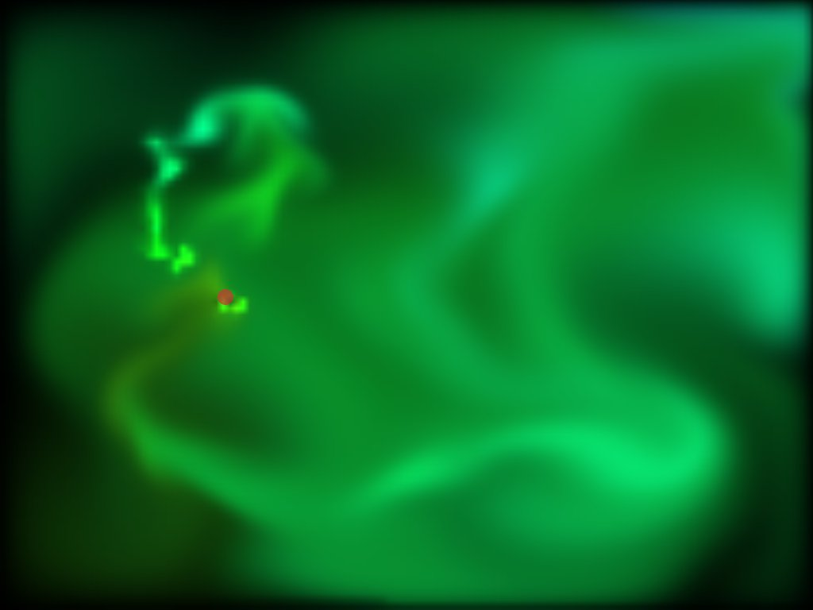

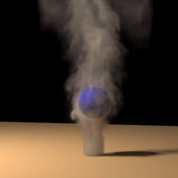
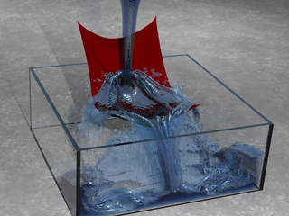
Navier-Stokes equations go beyond Bernoulli, but are very difficult to solve
Notes:
http://physbam.stanford.edu/~fedkiw/
http://www.planit3d.com/source/review_files/realflow/real_flow1.html

