Slide 1
Heat and Temperature
Physics 202 Lecture 4

Slide 2
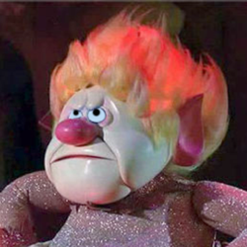

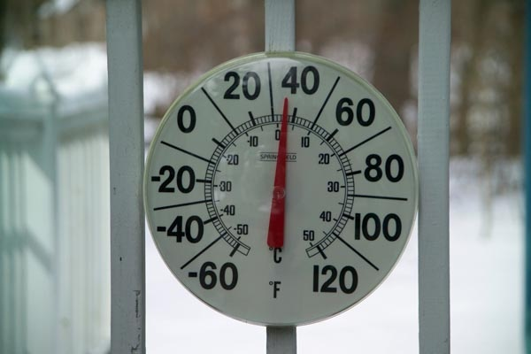




Of the many possible temperature scales, the Celsius and Kelvin scales are preferred
Notes:
http://en.wikipedia.org/wiki/Heat_Miser
http://en.wikipedia.org/wiki/Snow_Miser
http://www.freefoto.com/preview/16-11-1/Outdoor-Thermometer

Slide 3
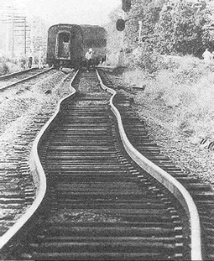
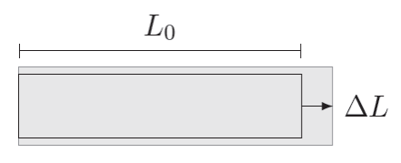
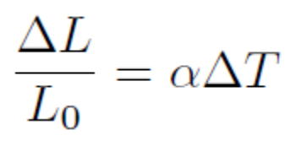
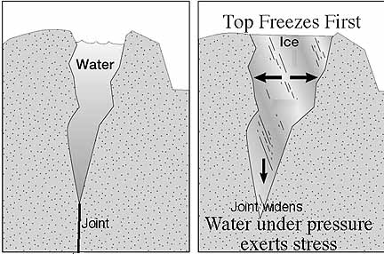
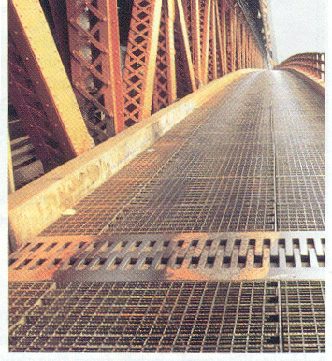
Thermometric properties are linear in small increments; simplest is thermal expansion
Notes:
http://www.schenectady.k12.ny.us/users/pattersont/IBDT%20Website/Page_Generators/ThermalExpansion.html
http://alliance.la.asu.edu/slides/stop02/2b/2b.html

Slide 4
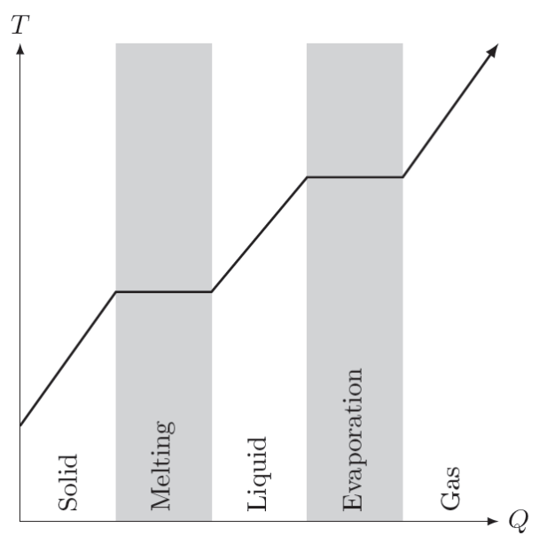



The difference between temperature and heat: heat capacity and internal energy
Hot
Fire
Air
Dry
Water
Earth
Wet
Cold

Slide 5
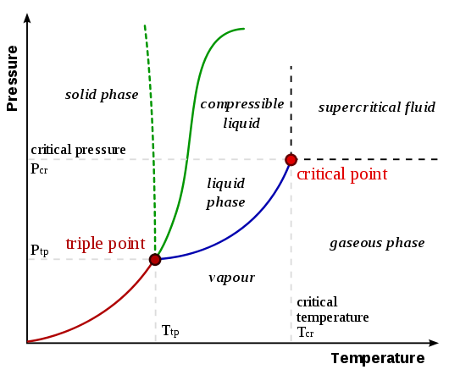

Phase changes also show the distinction between heat energy and temperature
Notes:
http://upload.wikimedia.org/wikipedia/commons/thumb/3/34/Phase-diag2.svg/530px-Phase-diag2.svg.png

Slide 6
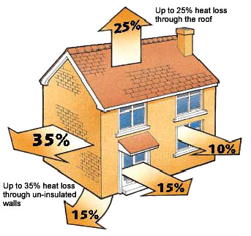
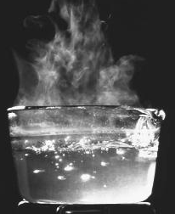

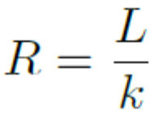
Heat energy is transported via conduction (solids) and convection (fluids)
Notes:
http://www.insulationcavity.com/tag/heat-insulation-2
http://whatscookingamerica.net/boilpoint.htm

Slide 7
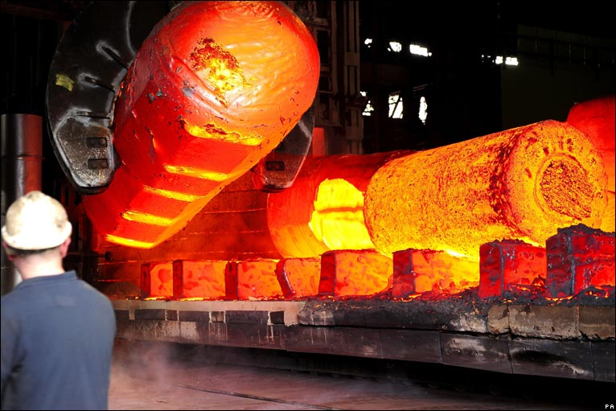
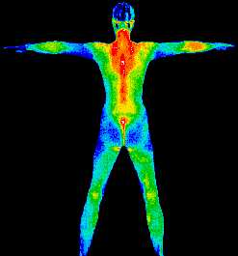
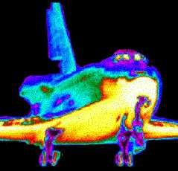
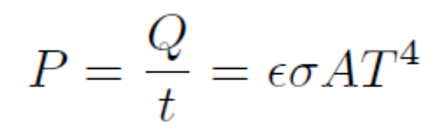

The electromagnetic field is also able to transport heat energy via radiation
Notes:
http://news.bbc.co.uk/media/images/45778000/jpg/_45778122_15_5_steel.jpg
http://coolcosmos.ipac.caltech.edu/cosmic_classroom/ir_tutorial/what_is_ir.html

Slide 8
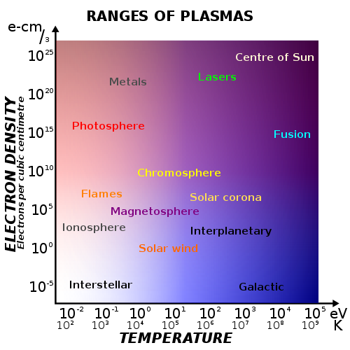
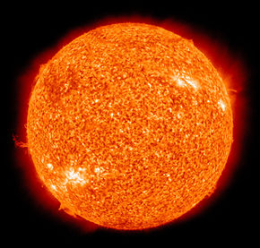
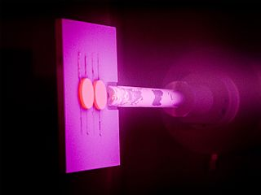
Very high temperatures can rip apart the atoms in a gas to create plasma
Notes:
http://en.wikipedia.org/wiki/Sun
http://en.wikipedia.org/wiki/Physical_vapor_deposition
http://en.wikipedia.org/wiki/Plasma_(physics)

Slide 9
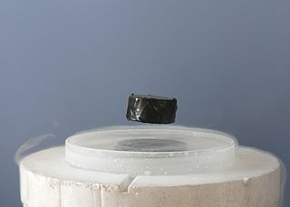
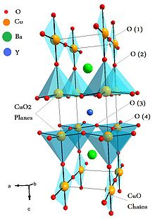
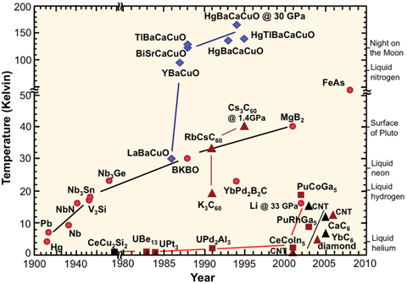
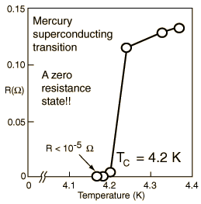
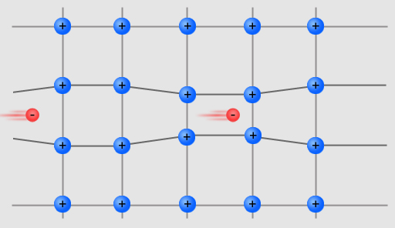
Very low temperatures reveal a new world of superconductivity and other effects
BCS
Notes:
http://en.wikipedia.org/wiki/Superconductivity
http://hyperphysics.phy-astr.gsu.edu/hbase/solids/scdis.html
http://www.abc.net.au/science/articles/2011/07/20/3273635.htm

