Slide 1
Kinetic Theory
Physics 202 Lecture 5

Slide 2
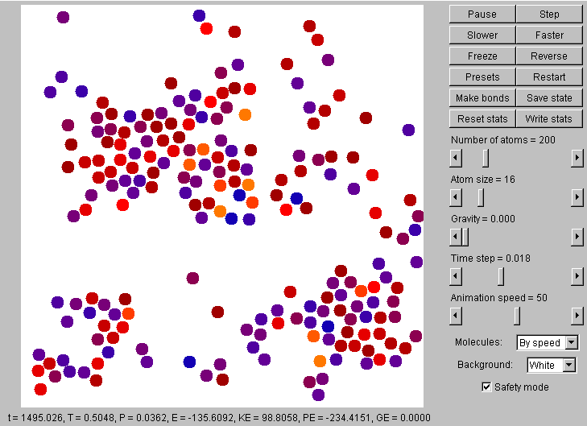
The kinetic hypothesis: heat energy is the random mechanical energy of molecules
http://physics.weber.edu/schroeder/software/MDApplet.html

Slide 3
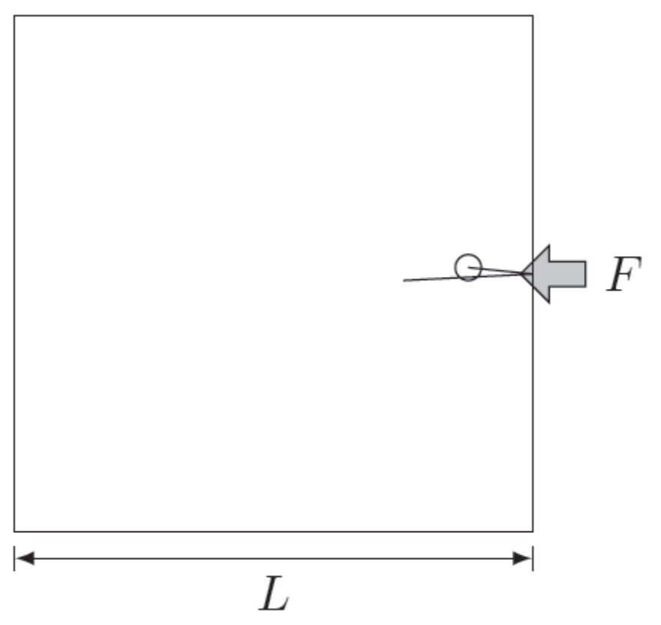

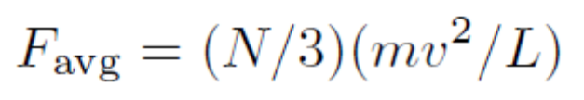
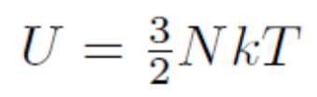
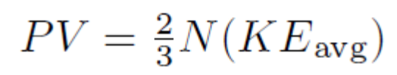


The simplest thermal system is one with no molecular interaction at all—an ideal gas

Slide 4


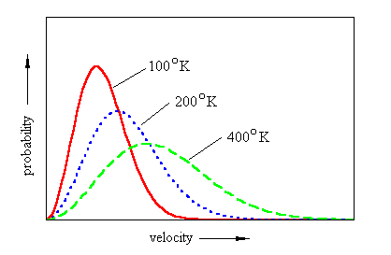
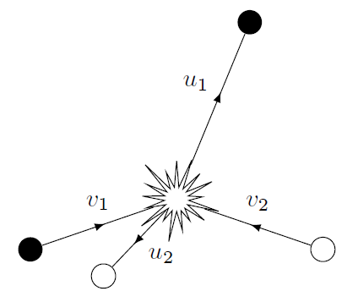
The Maxwell-Boltzman distribution depicts the molecular speeds in an ideal gas
Notes:
http://tannerm.com/maxwell_boltzmann.htm

Slide 5
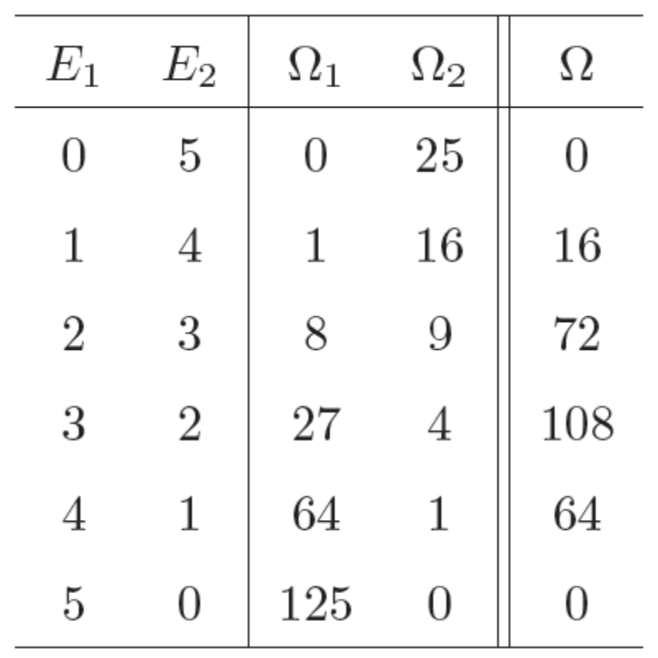


Entropy measures the distribution of internal energy in a system

Slide 6
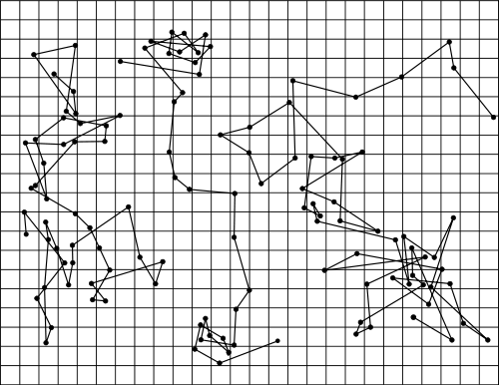
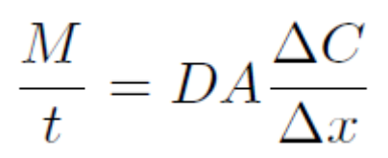

Fick's law of diffusion and Brownian motion also follows from the kinetic hypothesis
Notes:
http://en.wikipedia.org/wiki/Brownian_motion

Slide 7
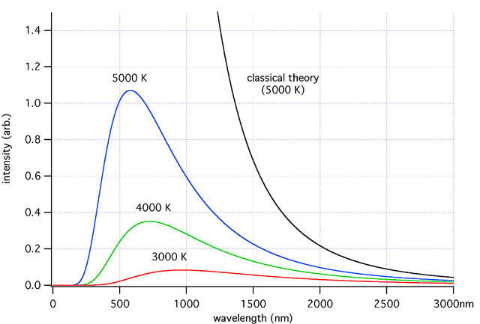

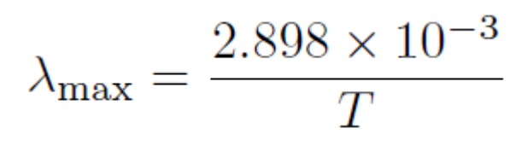
Statistical mechanics based on Newton's laws is not as successful as it should be
Notes:
http://en.wikipedia.org/wiki/Ultraviolet_catastrophe

Slide 8
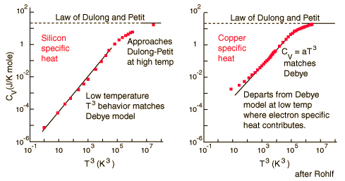

The root cause of this failure appears to be “frozen” degrees of freedom
Notes:
http://hyperphysics.phy-astr.gsu.edu/hbase/thermo/dulong.html

Slide 9
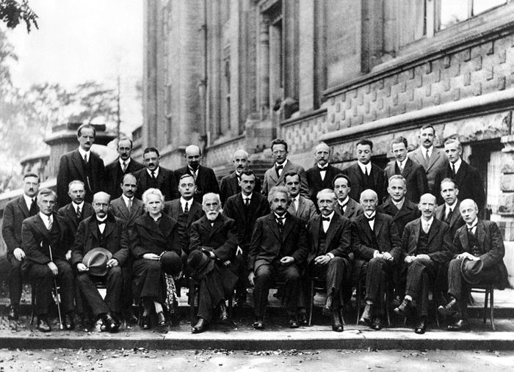
These considerations paved the way to a new theory of quantum mechanics
Notes:
http://en.wikipedia.org/wiki/Solvay_Conference

